Slide 1
Развитие умений чтения на разных этапах обучения английскому языку

Slide 2
МБОУ Большемокринская СШ
Урок английского языка в 3 классе
«Furry Friends!»
Учитель английского языка Южанинова Н.Г.
с. Большое мокрое , 2023

Slide 3
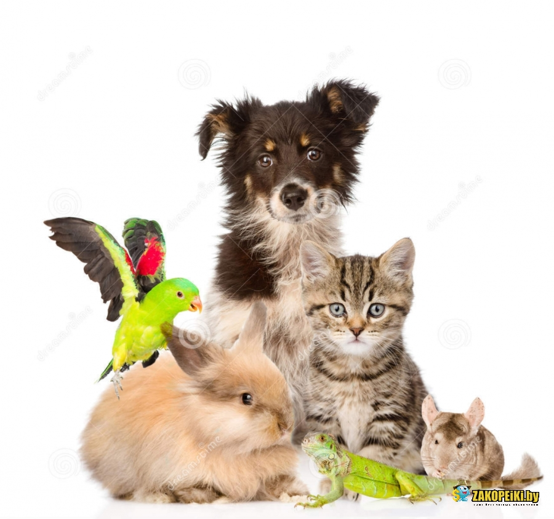
Answer the question:
What animals can be pets?

Slide 4
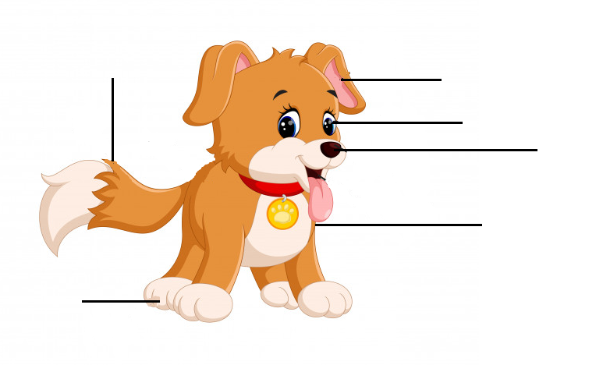
Look at the picture of the dog,name the pars of its body and describe the dog:
This is Spike. Spike has got…
a head
a tail
ears
eyes
a nose
a body
legs

Slide 5
What does a dog do?
wag - [wæg] – вилять хвостом
bark - [bɑːk] – лаять
roar - [rɔː] – рычать
bounce - [baʊns] – прыгать
sniff - [snɪf] – нюхать
whine - [waɪn] – скулить

Slide 6
always [ˈɔːlweɪz] - всегдa
comes [kʌmz] – приходить
around her [əˈraʊnd] - вокруг неё
kind [kaɪnd] – добрый
but [bʌt] – но
never [ˈnevə(r)] - никогда
it is alone [əˈləʊn] - один
it hates to be alone [heɪt]- ненавидеть

Slide 7
Complete the sentences.
wags
Spike is a very good dog. It always .…….its tail when it meets people. When Mum comes from the shop it…..…her bags and ………around her. It is very kind, it never..……and…….but……….when it is alone. It hates to be alone.
sniffs
bounces
barks
roars
whines

Slide 8
Agree or disagree.
a) Spike is a very good cat.
b) It always [ˈɔːlweɪz] wags its tail when it meets people.
c) When Mum comes from the shop it never sniffs her
bags and bounces around her.
d) It never roars and whines when it is alone.
e) It likes to be alone.

Slide 9
Put the sentences in a logical order.
a) When Mum comes from the shop it sniffs her bags and bounces around her.
b) It hates to be alone.
c) Spike is a very good dog.
d) Spike is very kind it never barks but roars when it is alone.
e) Spike always wags its tail when it meets people.

Slide 10
Retell (перескажи) the story as if you are Spike.
My name is Spike…

Slide 11
Thanks
for your attention!

