Slide 1
HOW TO LOOK AFTER PETS
КАК УХАЖИВАТЬ ЗА ПИТОМЦАМИ

Slide 2
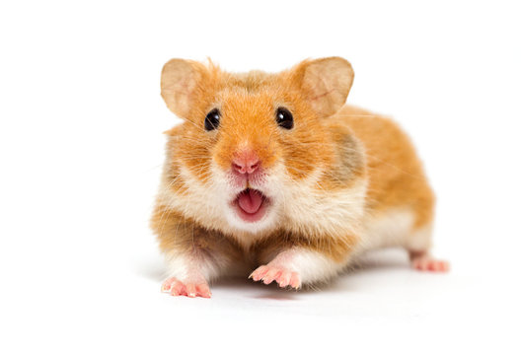
HAMSTER

Slide 3
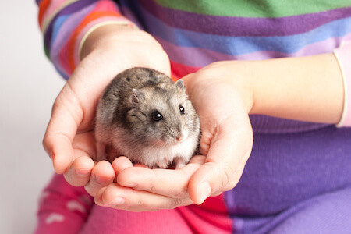
HOLD

Slide 4
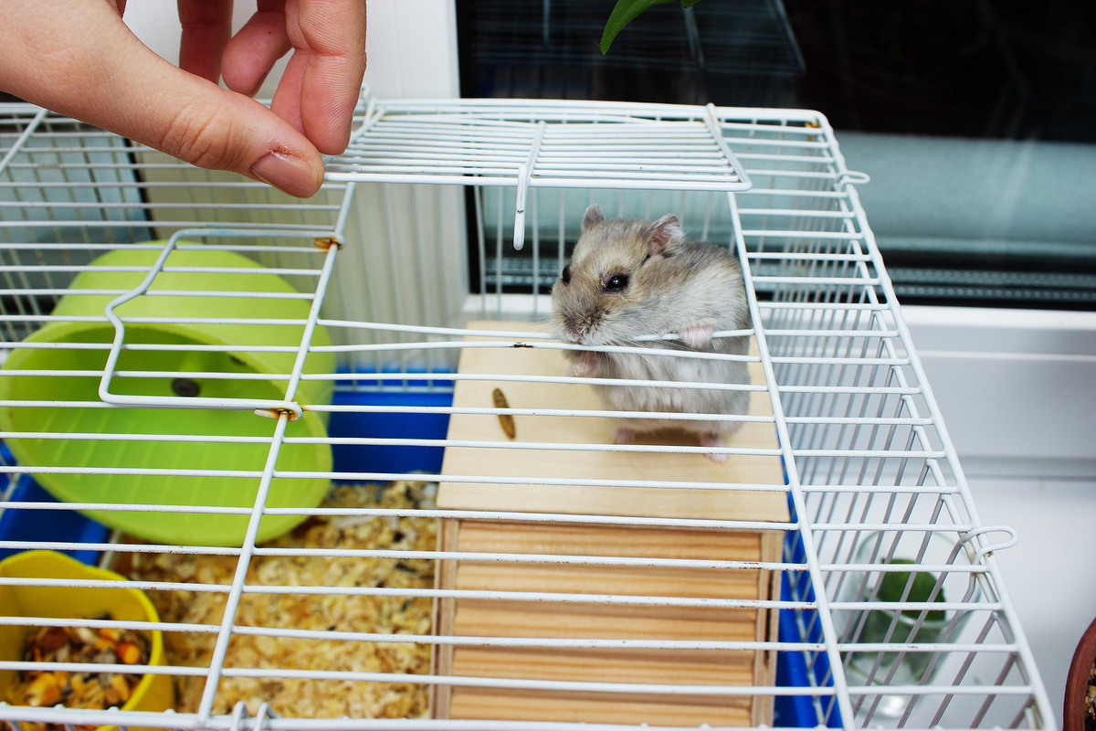
KEEP CLEAN

Slide 5
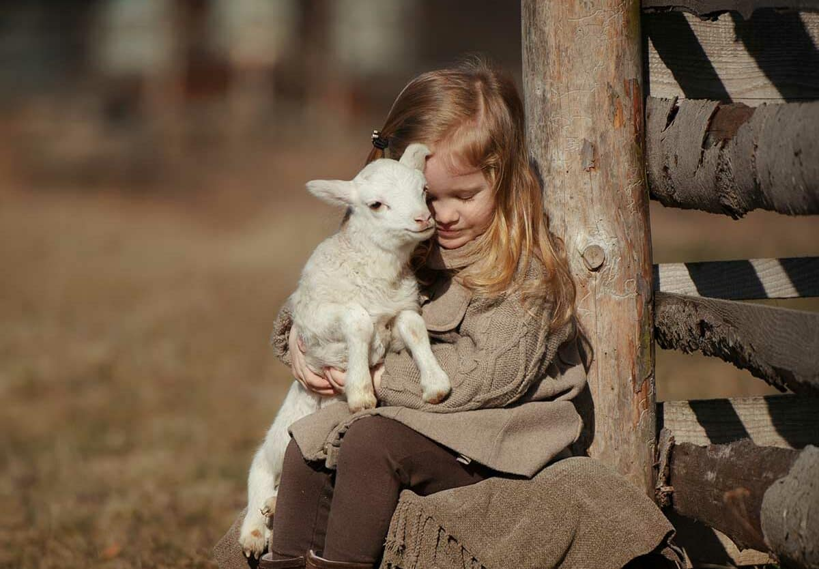
NOT HURT

Slide 6
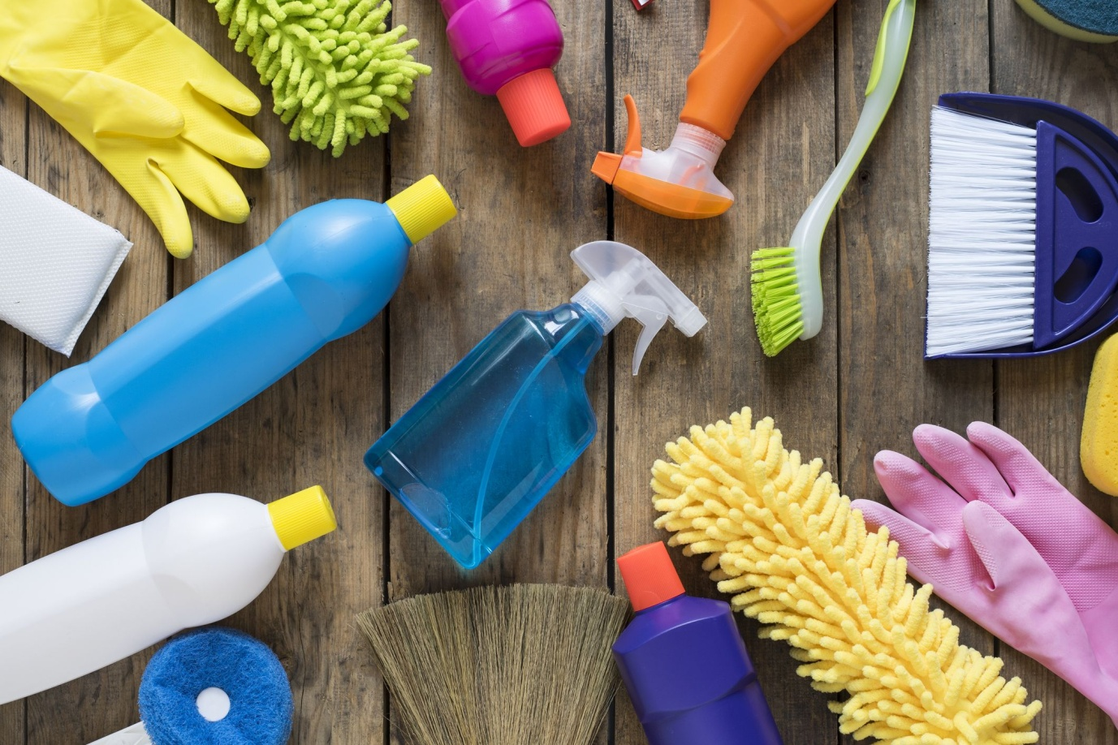
CLEAN

Slide 7
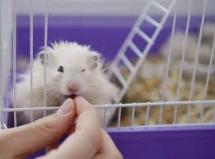
LOOK AFTER

Slide 8
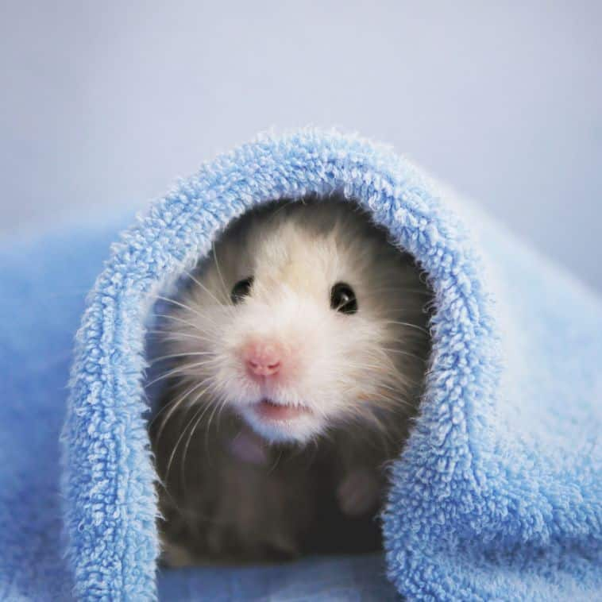
NOT GET COLD

Slide 9
MUST

