Slide 1



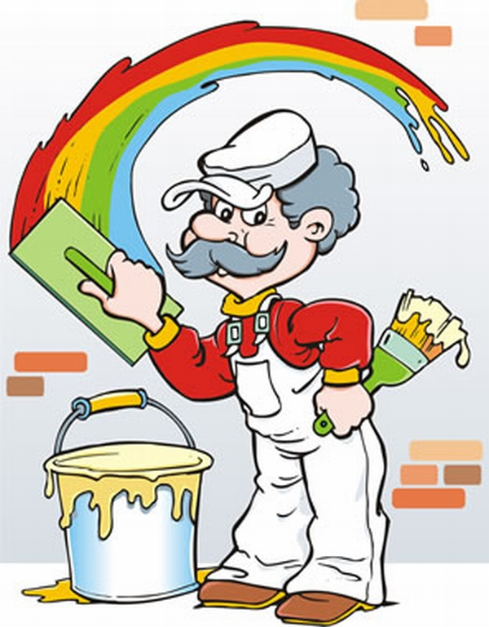


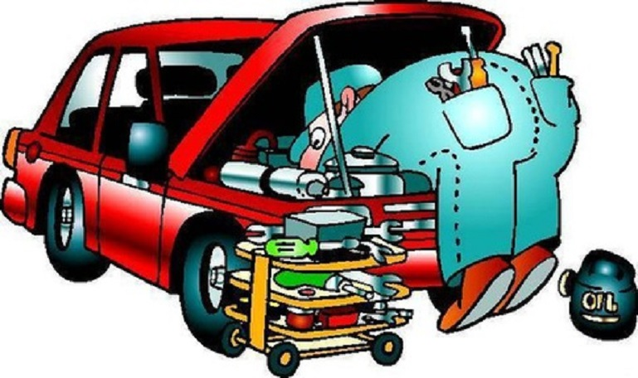

Slide 2


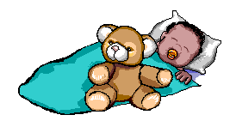


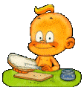



Slide 3
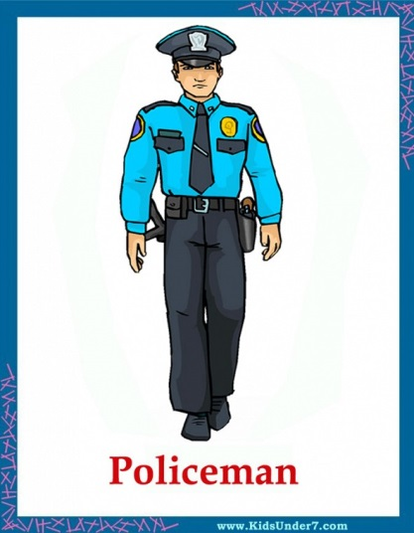
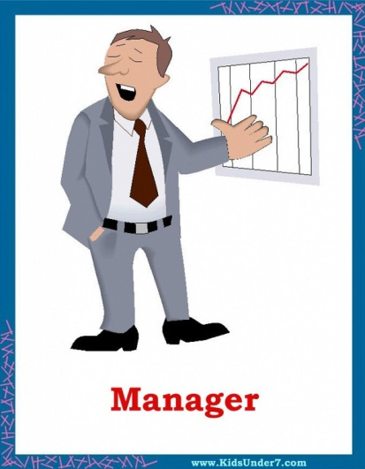


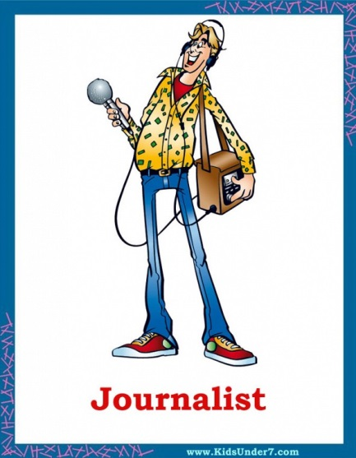
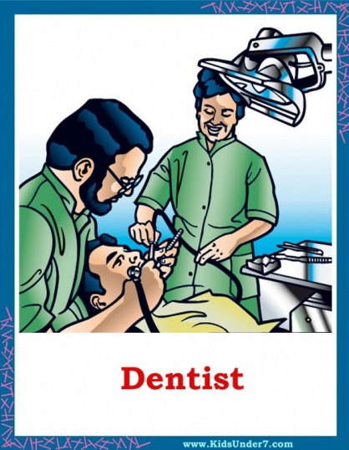


ф
Notes:
3

Slide 4
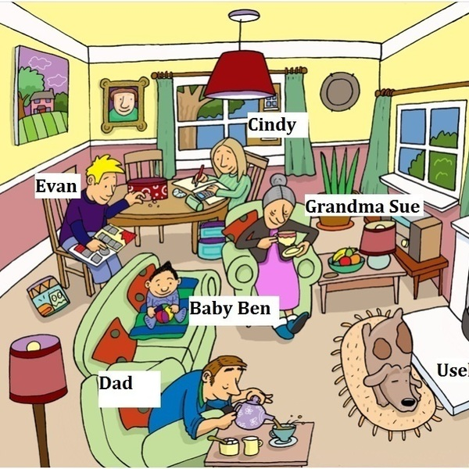
What are they doing now?
Use these verbs:
sleep
pour some tea
play with toys
have some tea
do homework
collect stamps

Slide 5
Present Continuous
Утвердительная форма
I | am | Ving
He She It | is
We You They | are

Slide 6
Put the words in the correct order
to make full sentences.
1. Dad/my/painting/is/today/house/the
2. Email/am/an/I/writing/my/to/friend
3. Are/the/TV/children/watching/now
4. Car/his/ Tom/repairing/is
5. Sleeping/the/by/fire/dog/the/is

Slide 7
Present Continuous
Отрицательное предложение
I | am | not | Ving
he she it | is
we you they | are

Slide 8
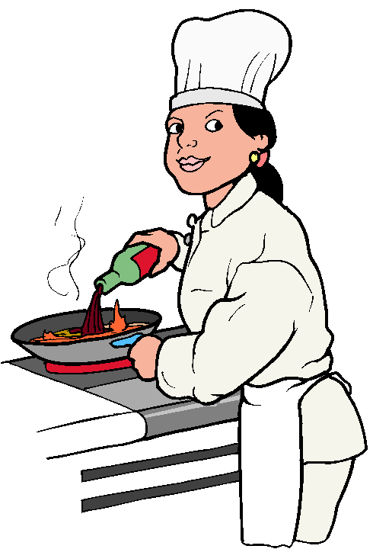
Put the words in the correct order
to make full sentences.
1. dad/my/not/painting/is/today/house/the
2. email/am/an/I/writing/not/my/to/friend
3. are/the/not/TV/children/watching/now
4. car/his/ Tom/repairing/is/not
5. sleeping/the/not/by/fire/dog/the/is

Slide 9
Present Continuous
Вопросительное предложение.
Am | I | Ving ?
Is | He She it
Are | We You they

Slide 10

Put the words in the correct order
to make full sentences.
1. dad/my/painting/is/today/house/the/?
2. email/am/an/I/writing/my/to/friend/?
3. are/the/TV/children/watching/now/?
4. car/his/ Tom/repairing/is/?
5. sleeping/the/by/fire/dog/the/is/?

Slide 11
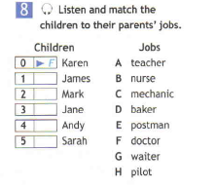
Listening!
A
H
G
C
D

Slide 12


Look left, right
Look up, look down
Look around.
Look at your nose
Look at that rose
Close your eyes
Open, wink and smile.
Your eyes are happy again.

Slide 13
1. Tony…(write) an email.
a) is writing b) are writing c) am writing
2. My sisters…(wash) the dog.
a) is washing b) are washing c) wash
3. She…(play) with a friend.
a) is playing b) are playing c) am playing
4. Look! Mom…(make) a phone call.
a) is making b) is make c) are making
5. Dad and Mike…(work) in the garden.
am working b) is working c) are working
6. He…(plant) flowers.
a) am planting b) is planting c) are planting
7. I … (write) a letter to my sister.
a) Write b) am writing c) am write
8. Grandmother…(drink) coffee now.
a) are drinking b) is drinking c) drinks
9. The students…(listen) to the teacher very attentively at the moment.
a) listening b) are listening c) listen
10. Tom…(have) a dinner now. You may talk to him.
a) Has b) have c) is having

Slide 14
correct answer | mark
9-10 | «5»
7-8 | «4»
5-6 | «3»
3-4 | «2»
Notes:
14

Slide 15
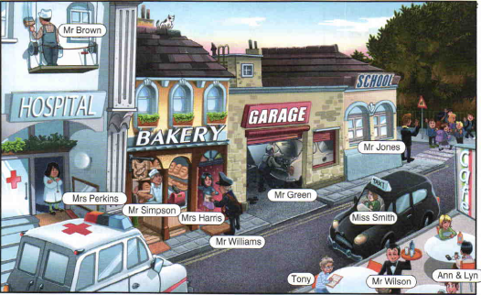

Slide 16
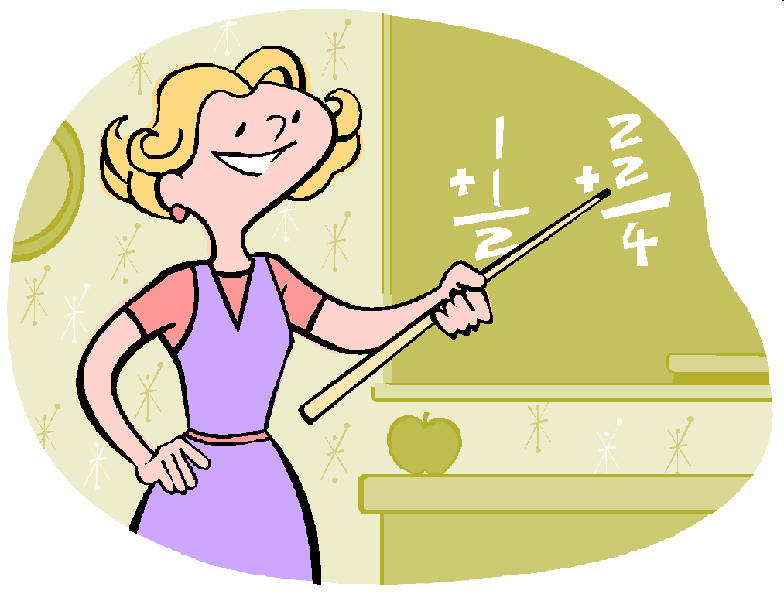



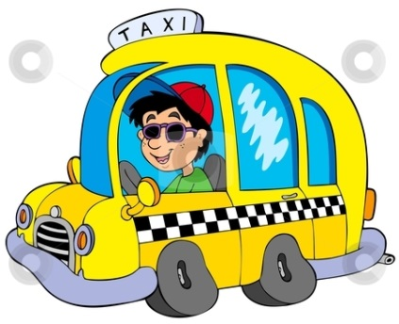
Q | E | J | Z | I | E | X | P | A | F | W | J | T | D
A | S | L | O | W | D | O | S | J | O | T | V | A | U
X | M | P | Q | O | D | O | G | K | O | E | N | X | S
E | M | V | A | D | U | S | I | D | G | A | F | I | L
P | D | E | B | A | K | E | R | U | Z | C | U | D | I
L | O | O | C | A | T | T | A | L | A | H | I | R | E
U | C | S | A | H | G | W | A | I | T | E | R | I | O
I | T | A | T | V | A | W | J | X | I | R | N | V | Q
F | O | Q | A | M | M | N | P | A | I | N | T | E | R
M | R | A | I | N | A | D | I | Z | V | M | E | R | A
I | V | U | X | W | J | N | O | C | E | P | F | O | Z

Slide 17
Q | E | J | Z | I | E | X | P | A | F | W | J | T | D
A | S | L | O | W | D | O | S | J | O | T | V | A | U
X | M | P | Q | O | D | O | G | K | O | E | N | X | S
E | M | V | A | D | U | S | I | D | G | A | F | I | L
P | D | E | B | A | K | E | R | U | Z | C | U | D | I
L | O | O | C | A | T | T | A | L | A | H | I | R | E
U | C | S | A | H | G | W | A | I | T | E | R | I | O
I | T | A | T | V | A | W | J | X | I | R | N | V | Q
F | O | Q | A | M | M | N | P | A | I | N | T | E | R
M | R | A | I | N | A | D | I | Z | V | M | E | R | A
I | V | U | X | W | J | N | O | C | E | P | F | O | Z

Slide 18
+ing | e+ing | Double consonant +ing
have swim go work meet eat do look paint
serve read come stop run put open relax visit
Notes:
18

Slide 19

Homework
WB. p.52 ex.7
Correct the sentences
Notes:
19

Slide 20

Thank you for the lesson!
Good-bye!
Notes:
20

