Slide 1
Friendship
In Our life

Slide 3
Ex 4 p 61
Read the text and say if you
agree with the conclusions psychologists make. Give examples from your own experience.
Friendship in Development

Slide 4
Ex 4 p 61
B. Find in the text English equivalents for the following.
1) performing activities together;
2) they are very self-oriented;
3) less individualized;
4) more aware of others;
5) experience peer rejection;
6) establishing good friendships;
7) become increasingly more complex;
8) loyalty and commitment;
9) similar attitudes.

Slide 6
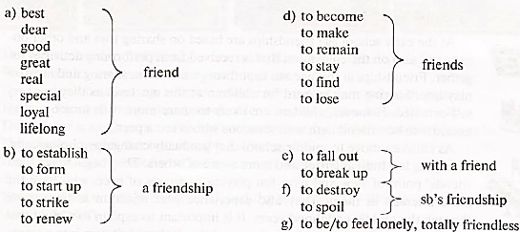
Ex 6 p 62
Tell the story of one of your friendships. You may use some of the word combinations below.

Slide 7
Ex 6 p 62
Tell the story of one of your friendships. You may use some of the word combinations below.

Slide 8
Рефлексия
I knew…
I remembered…
It was easy…
It was difficult…

Slide 9
Ex 10 p 64
Write your own sentences with these words and word combinations.
peer(s) (сверстник(и))
to establish good contacts (наладить хорошие контакты)
to affect one’ health (влиять на чьё-либо здоровье)
to be aware of something (быть в курсе чего-либо)
to reject one’s idea (отвергать чью-либо идею)
shops and other commercial establishments (магазины и другие коммерческие предприятия)
in my experience (по моему опыту)
to feel/have a strong affection for somebody (испытывать/иметь сильную привязанность к кому-либо)
to increase the risk (увеличивать риск)
my attitude to somebody/something (моё отношение к кому-либо/чему-либо)

