Slide 1
Cinema & Theatre in London
8th GRADE

Slide 2
Answer the questions:
Устно ответить на вопросы.
1) Do you like going to the cinema?
2) How often do you go to the cinema?
3) When did you go to the cinema last time?
4) Do you like going to the cinema alone or with your friends?
5) What kinds of films do you like to watch?
6) Do many people go to the cinema nowadays?
Why or Why not?

Slide 3
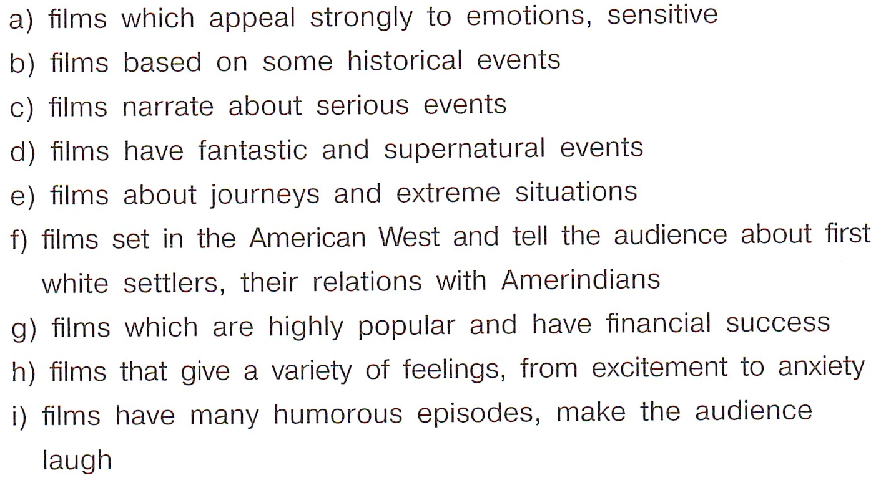
Name the Genres.
adventure | thriller | comedy
melodrama | tragedy | historical
fantasy | western | blockbuster

Slide 4
Name the Genres.
adventure | thriller | comedy
melodrama | tragedy | historical
fantasy | western | blockbuster

Slide 5
Name the Genres.
adventure | thriller | comedy
melodrama | tragedy | historical
fantasy | western | blockbuster

Slide 6
Name the Genres.
adventure | thriller | comedy
melodrama | tragedy | historical
fantasy | western | blockbuster

Slide 7
Name the Genres.
adventure | thriller | comedy
melodrama | tragedy | historical
fantasy | western | blockbuster

Slide 8
Name the Genres.
adventure | thriller | comedy
melodrama | tragedy | historical
fantasy | western | blockbuster

Slide 9
Name the Genres.
adventure | thriller | comedy
melodrama | tragedy | historical
fantasy | western | blockbuster

Slide 10
Name the Genres.
adventure | thriller | comedy
melodrama | tragedy | historical
fantasy | western | blockbuster

Slide 11
Name the Genres.
adventure | thriller | comedy
melodrama | tragedy | historical
fantasy | western | blockbuster

Slide 12
Name the Genres.
adventure | thriller | comedy
melodrama | tragedy | historical
fantasy | western | blockbuster

Slide 13
New Words (Ex.3 p.83)
Слова выписать в тетрадь (словарь), прочитать определения к словам
WORD | DEFINITION | TRANSLATION
stunt | an exciting action, usually in a film, that is dangerous or appears dangerous and usually needs to be done by someone skilled | трюк
stunt man/woman | a man or woman who performs stunts, especially instead of an actor in a film or television programme | каскадер
flashback | a short part of a film, story or play that goes back to events in the past | воспоминание
close-up shot | a camera shot taken at a very short distance from the subject, to get a close and detailed view of an object or action | снимок вблизи
row | a line of things, people, animals, etc. arranged next to each other in the theatre | ряд

Slide 14
New Words (Ex.3 p.83)
Слова выписать в тетрадь (словарь), прочитать определения к словам
WORD | DEFINITION | TRANSLATION
special effect | an unusual piece of action in a film, or an entertainment on a stage, created by using particular equipment | спецэффекты
outstanding | excellent; clearly very much better than what is usual | выдающийся
breathtaking | extremely exciting, beautiful or surprising | захватывающий
setting | the time and the place in which the action of a book, film, play, etc. happens | место действия

Slide 15
New Words (Ex.3 p.83)
Устно перевести примеры с новыми словами:
It’s a typical action film with plenty of spectacular stunts.
I admire film stars who do their own stunts instead of getting stunt men perform for them.
The novel began with a flashback to the hero’s experiences in the war.
I prefer films to plays because you can have close-up shots of the actors.
We had seats in the front row of the theatre.
The film’s special effects are amazing.
It's an area of outstanding natural beauty.
The view from the top of the mountain is breathtaking.
The play has its setting in a wartime prison camp.

Slide 16
Watch the Video and Answer the Questions.
1) Where can you buy tickets for London’s theatres?
2) How many big cinemas are there in Leicester Square?
3) Who often comes to the cinemas in Leicester Square for the first screening?
4) How many theatres are in one square kilometre in London’s West End?
5) When are cinemas and theatres cheaper?
Пройти по ссылке и посмотреть видео на YouTube. Устно ответить на вопросы.
https://www.youtube.com/watch?v=en2_IR2aR7g&list=PL59GcrPDHI8KRjnxslMF13wbOQ8Uyb5Oh&index=16

Slide 17
Watch the Video and Answer the Questions.
1) Where can you buy tickets for London’s theatres?
In lots of kiosks and booths.
2) How many big cinemas are there in Leicester Square?
5 cinemas.
3) Who often comes to the cinemas in Leicester Square for the first screening?
The actors and plenty of their fans.
4) How many theatres are in one square kilometre in London’s West End?
More then 40.
5) When are cinemas and theatres cheaper?
At 3 or 4 in the afternoon.

Slide 18
Watch the Video and Match the Columns.
Пройти по ссылке и посмотреть видео на YouTube. Соотнести названия постановок и театров с их описанием.
PLAYS | DESCRIPTIONS
1) 39 Steps | a) is based on Agatha Christie novel.
2) The Mousetrap | b) is a successful show about the group Queen and Freddy Mercury.
3) The Royal Haymarket | c) is a very popular musical set in Australia.
4) We Will Rock You | d) a comedy based on a Hitchcock film.
5) Priscilla | e) is nearly 300 years old. It’s London’s oldest theatre.
1 – d, 2 – a, 3 – e, 4 – b, 5 - c
https://www.youtube.com/watch?v=en2_IR2aR7g&list=PL59GcrPDHI8KRjnxslMF13wbOQ8Uyb5Oh&index=16

Slide 19
Going to the cinema and visiting theatres.
Устно ответить на вопрос:
What play would you like to visit? Why?
I would like to visit | 39 Steps | because | I’m fond of comedies.
 | The Mousetrap |  | I like detective stories.
 | The Royal Haymarket |  | I’d like to see the oldest theatre in London.
 | We Will Rock You |  | I’m keen on music.
 | Priscilla |  | I’m interested in Australia.

