Slide 1
Places of interest in Arkhangelsk devoted to Stepan Pisakhov and his fairy tale heroes

Slide 2
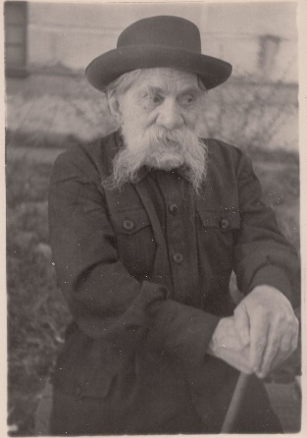
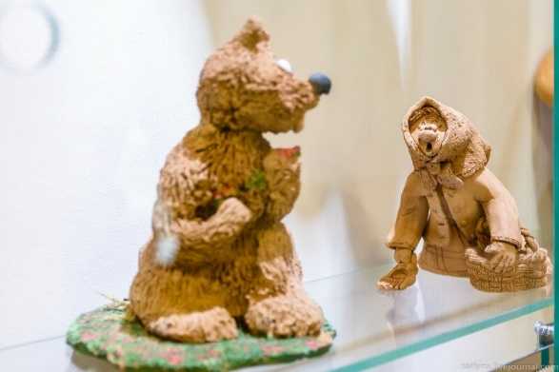
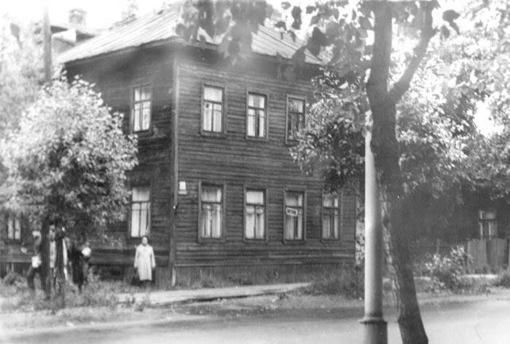
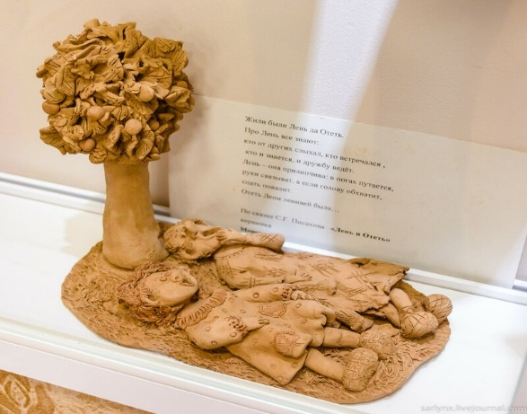
Stepan Grigorievich Pisakhov is the famous Northern writer of fairy-tales.

Slide 3
The Museum of Folk Arts and Crafts of Primorye in Uyma

Slide 4
A monument to Stepan Pisakhov in Chumbarov-Luchinsky Street opened in September 2008

Slide 5
A monument to Senya Malina, a favourite character of famous Northern fairy-tales by Stepan Pisakhov

Slide 6
In October 2019 an exhibition in Plotnikova’s Estate Museum was opened on the occasion of the 140-th anniversary of Pisakhov.

Slide 7
For years Pisakhov performed his fairy-tales orally. The first one appeared in print in 1924.

Slide 8
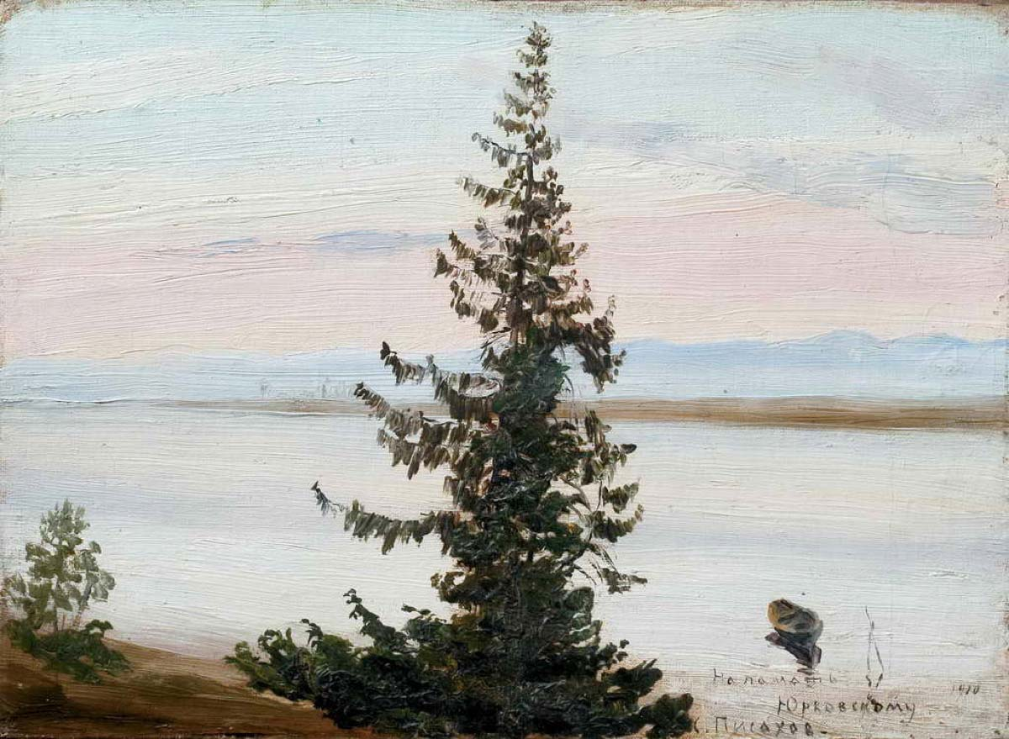
This exhibition shows us Pisakhov as a painter.

Slide 9
Thank you for your attention!

