Slide 2
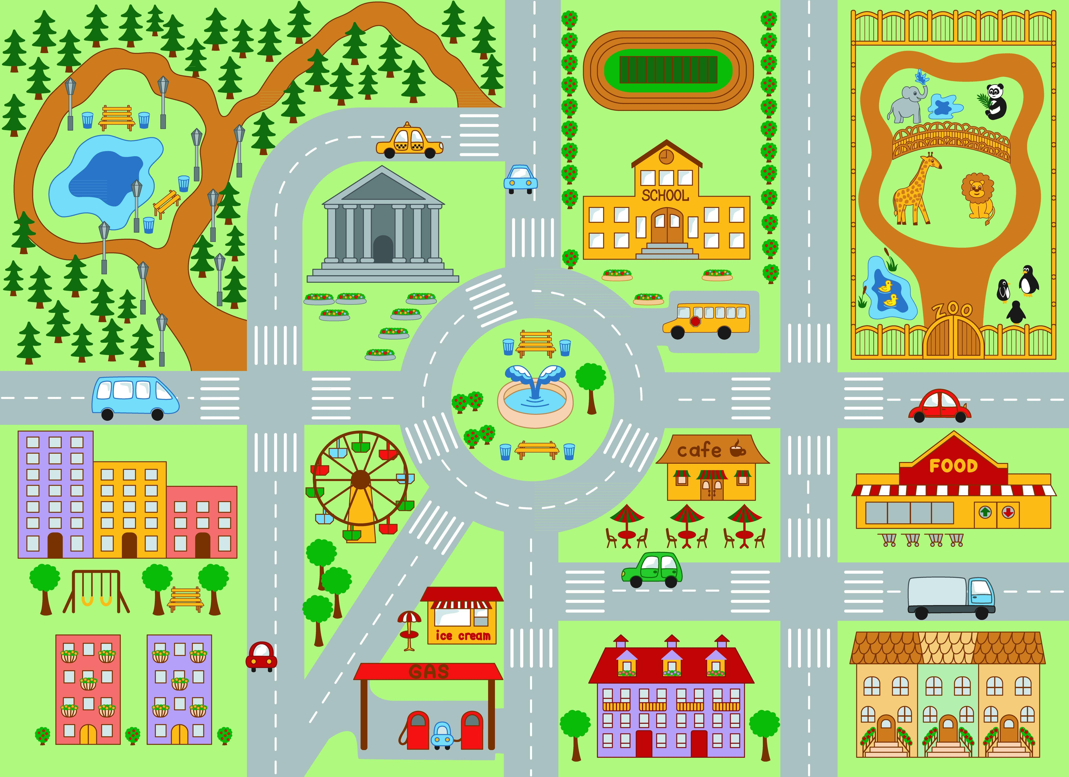
The Present Continuous Town
Finish
Start

Slide 4
Значение

Slide 5
I am running now.
You are running at the moment.
He is running right now.
Listen! A dog is running.
Mary and John are running.
Я бегу сейчас.
Ты бежишь в данный момент.
Он бежит прямо сейчас.
Послушай! Собака бежит.
Посмотри! Мэри и Джон бегут.

Slide 6
Present Continuous Tense
настоящее длительное время
В английском языке для того, чтобы описать действие, которое происходит прямо сейчас, мы используем Present Continuous.

Slide 7
Present Continuous Tense
Наречия времени
now [naʊ] - сейчас
still [stɪl] - еще, все еще
right now [raɪt naʊ] - прямо сейчас
at the moment [ˈməʊmənt] - в данный момент Look! [lʊk] - Посмотри!
Listen! [ˈlɪsn] - Послушай!

Slide 9
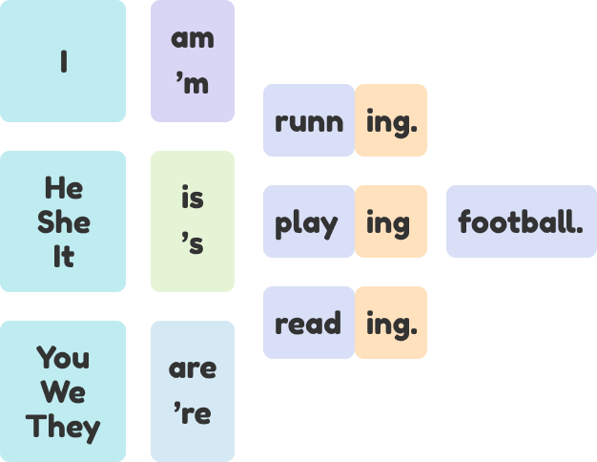
to be + V-ing

Slide 10
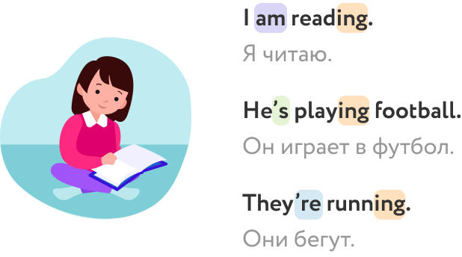

Slide 11
Now I … playing basketball.
Nick … writing a letter to Santa Claus.
My cat … sitting on the chair.
We … learning English.
My parents … sleeping now.

Slide 12
am
Now I … playing basketball.

Slide 13
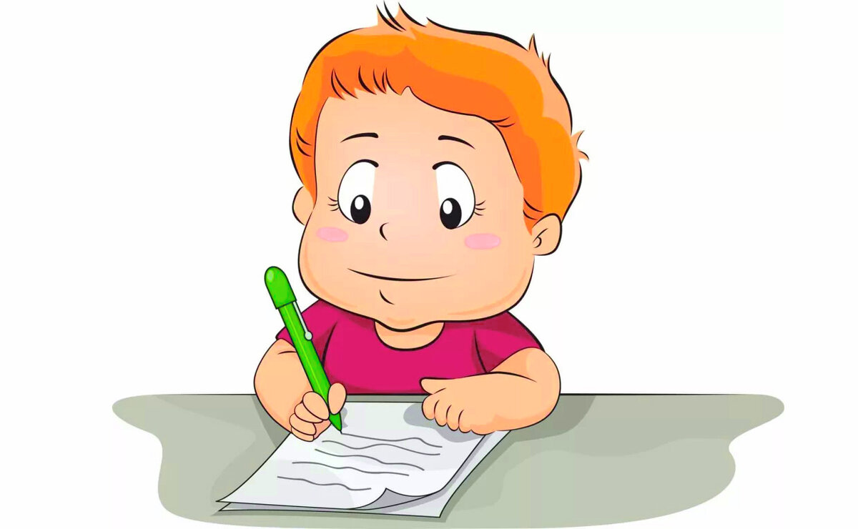
is
2. Nick … writing a letter to Santa Claus.

Slide 14
is
3. My cat … sitting on the chair.

Slide 15
are
4. We … learning English.

Slide 16
are
5. My parents … watching TV now.

Slide 17
Правило добавления -ing

Slide 18
Правило добавления -ing
1. Большинство глаголов:
Окончание -ing добавляется без изменений:
go – going
play – playing
speak - speaking

Slide 19
Правило добавления -ing
2. Глаголы с окончанием -e:
Буква -e опускается и добавляется -ing:
write - writing
live – living
come - coming

Slide 20
Правило добавления -ing
3. Глаголы, оканчивающиеся на ударный слог с кратким гласным звуком:
Последняя буква удваивается и добавляется -ing:
swim - swimming
sit – sitting
hop - hopping

Slide 21
Jump
Give
Help
Wash
Open
Sleep
Make
Sit
Stop

Slide 22
giving
1. Give –

Slide 23
swimming
2. Swim –

Slide 24
helping
3. Help –

Slide 25
washing
4. Wash –

Slide 26
opening
5. Open –

Slide 27
sleeping
6. Sleep –

Slide 28
making
7. Make –

Slide 29
sitting
8. Sit –

Slide 30
stopping
7. Stop –

Slide 31
Утвердительные предложения

Slide 32
To be + V-ing

Slide 33
Mary (play) the piano now.
He (swim) in the pool.
We (walk) in the park now.
Look! My mother (cook).
I (talk) on the phone.

Slide 34
1. Mary (play) the piano now.
Mary is playing the piano now.

Slide 35
2. He (swim) in the pool.
He is swimming in the pool.

Slide 36
3. We (walk) in the park now.
We are walking in the park now.

Slide 37
4. Look! My mother (cook).
Look! My mother is cooking.

Slide 38
5. I (talk) on the phone.
I am talking on the phone.

Slide 39
Отрицательные предложения (Negative)

Slide 40
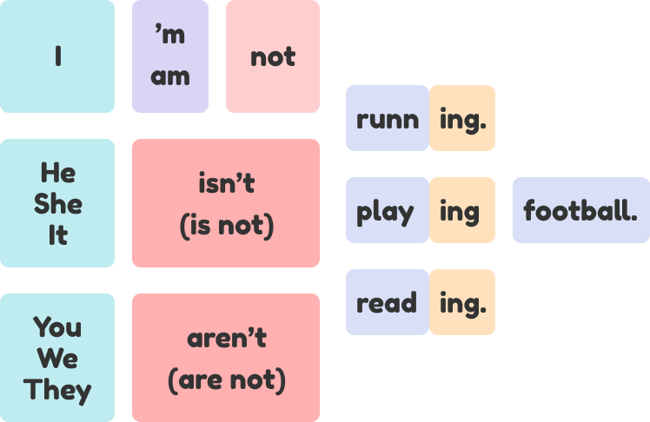

Slide 42
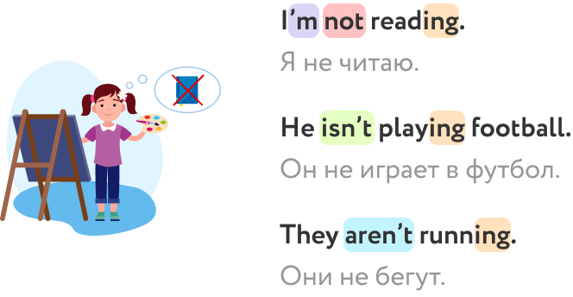

Slide 43
1. Mary (play) the piano now.
Mary isn’t playing the piano now.

Slide 44
2. He (swim) in the pool.
He isn’t swimming in the pool.

Slide 45
3. We (walk) in the park now.
We aren’t walking
in the park now.

Slide 46
4. Look! My mother (cook).
Look! My mother isn’t cooking.

Slide 47
5. I (talk) on the phone.
I am not talking on the phone.

Slide 48
Вопросительные предложения и ответы (Yes / No questions and answers)

Slide 50
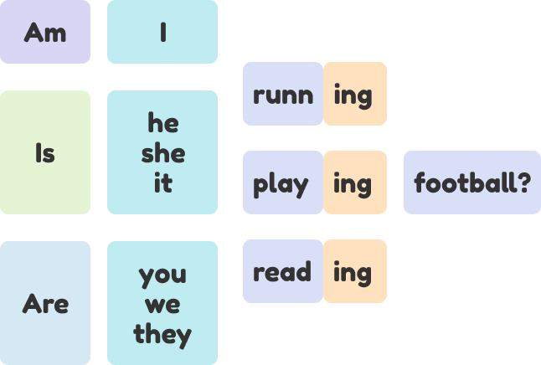

Slide 51
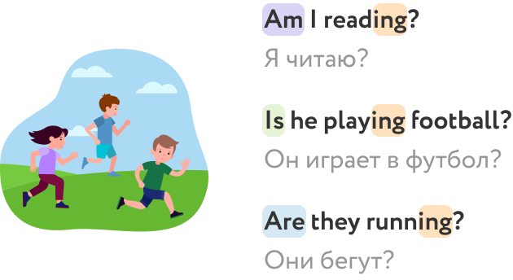

Slide 52
1. Mary (play) the piano now.
Is Mary playing the piano now?

Slide 53
2. He (swim) in the pool.
Is he swimming in the pool?

Slide 54
3. They (walk) in the park now.
Are they walking
in the park now?

Slide 55
4. Look! My mother (cook).
Is My mother cooking?

Slide 56
5. I (talk) on the phone.
Are you talking on the phone?

Slide 57
Ответы (Yes / No questions and answers)

Slide 58
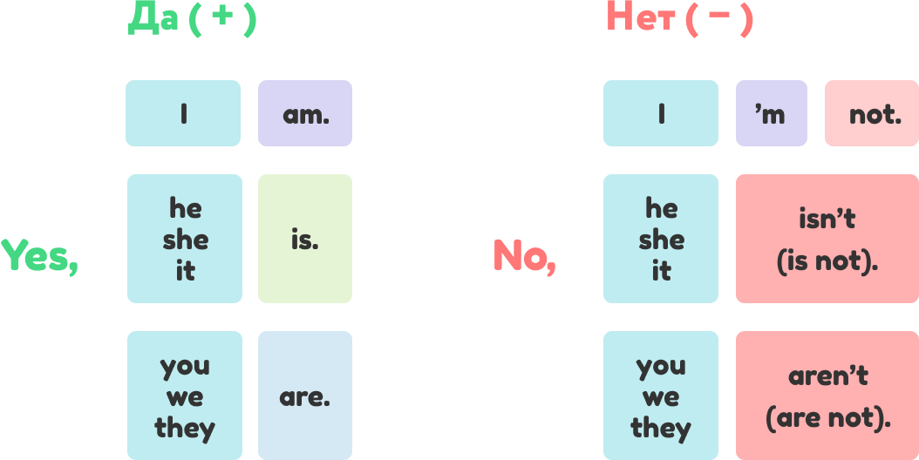

Slide 59
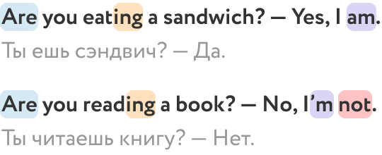

Slide 60
1. Is Mary playing the piano now?
Yes, she is.
No, she isn’t.

Slide 61
2. Is he swimming in the pool?
Yes, he is.
No, he isn’t.

Slide 62
3. Are they walking in the park now?
Yes, they are.
No, they aren’t.

Slide 63
4. Is my mother cooking?
Yes, she is.
No, she isn’t.

Slide 64
5. Are you talking on the phone?
Yes, I am.
No, I’m not.

Slide 66
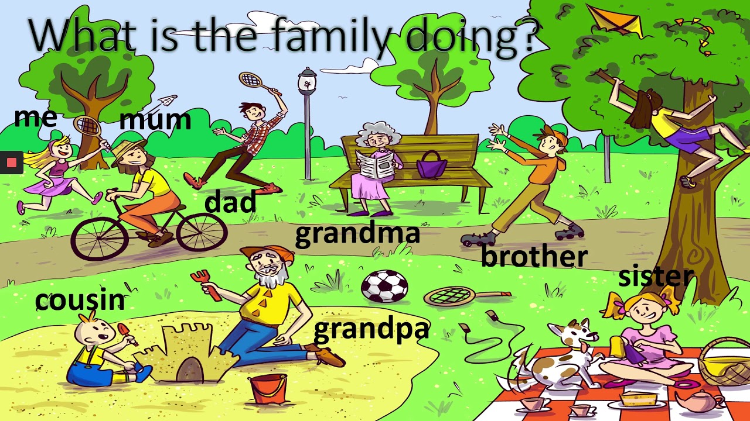
Meet my family!
I am playing badminton. My dad is playing badminton, too. Look! My grandma is sitting and is reading a newspaper.
My mum is not playing, she is riding a bike,
What is my sister doing?
She is playing with a dog
What is my grandpa doing? He is making a sandcastle!
(play)
(play)
(sit)
(read)
(not/play)
(ride)
(do)
(play)
(do)
(make)

Slide 68
Электронные ресурсы:
1. https://foxford.ru/wiki/angliyskiy-yazyk/the-present-continuous-primary

