Slide 1
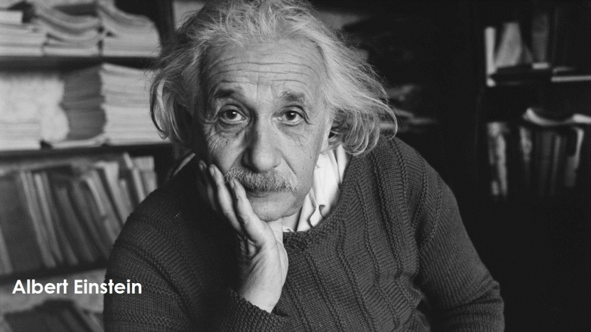
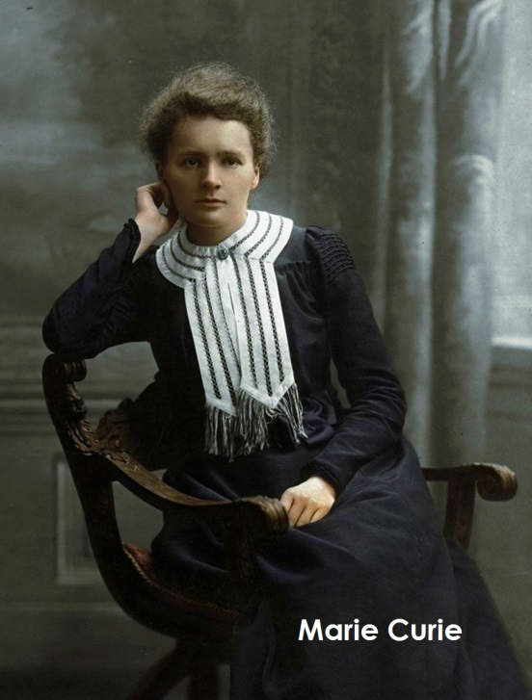
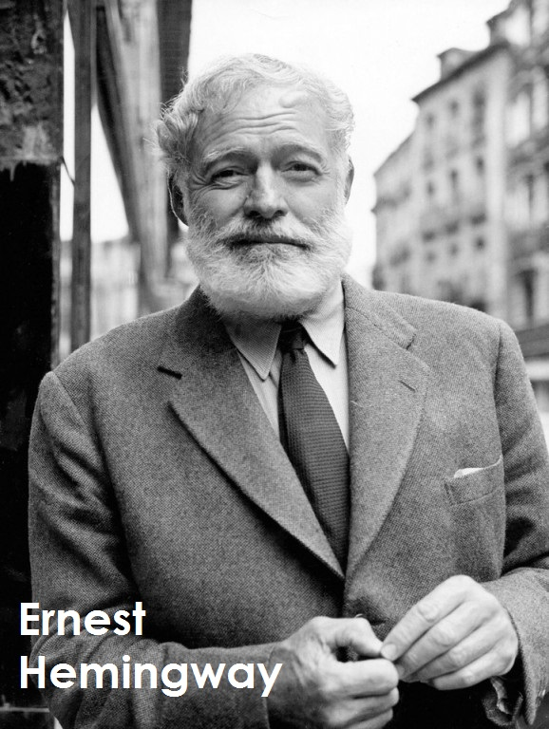
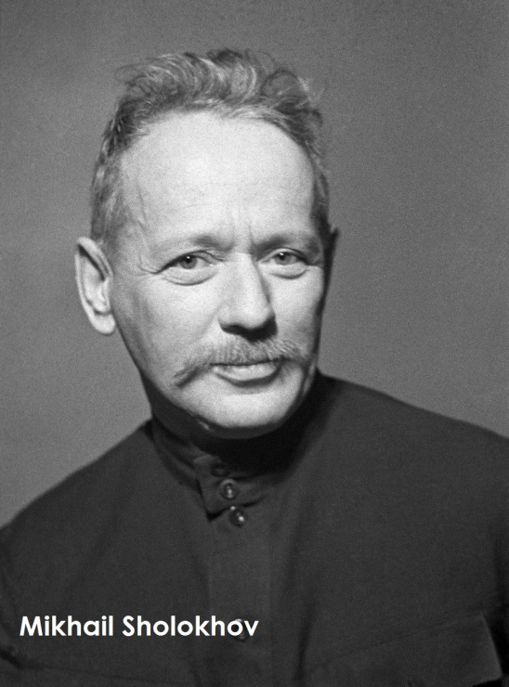

Slide 2
Famous
people

Slide 3
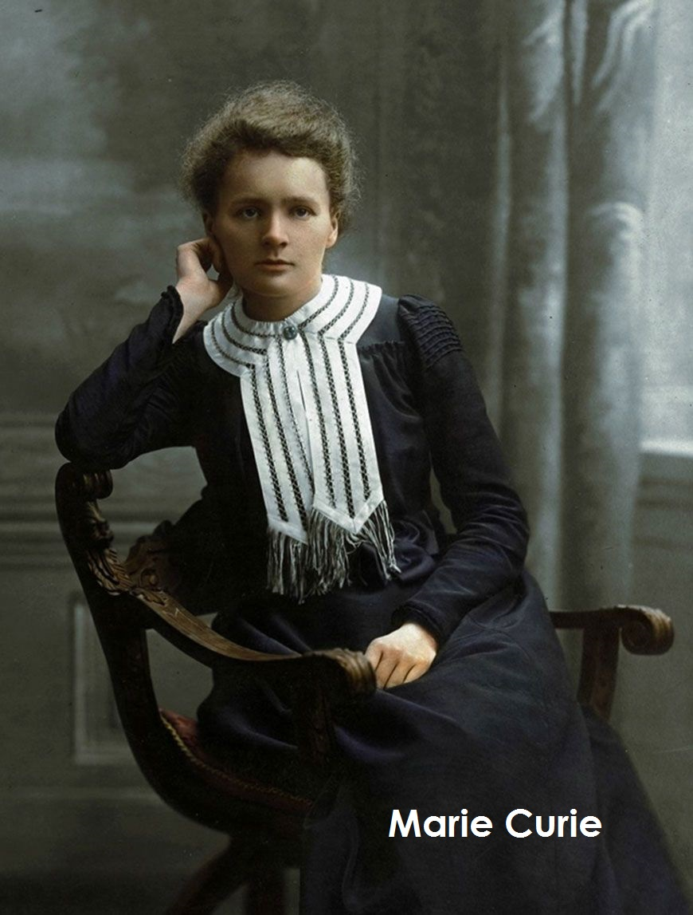
She was the first woman to win a Nobel Prize, is the first person and the only woman to win the Nobel Prize twice, and is the only person to win the Nobel Prize in two different scientific fields.

Slide 4
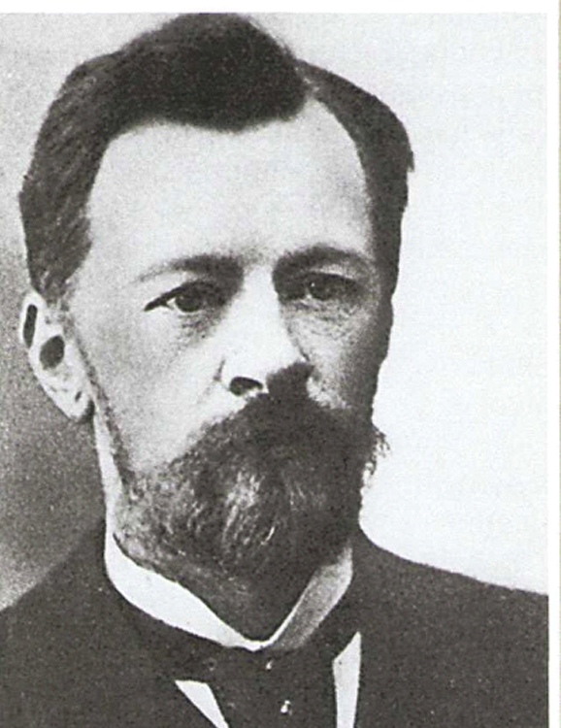
Do you know this person?

Slide 5
Vladimir Shukhov was a great Russian engineer, scientist and architect.

Slide 6
Vladimir Shukhov
It is not easy to become famous.
We love and respect people who did a lot for nation.
One of them is Vladimir Shukhov.
Vladimir Grigoryevich Shukhov (1853— 1939) was a great Russian engineer, scientist and architect.
In 1864 Vladimir entered Saint Petersburg gymnasium.
During his high school years he loved learning Maths.
In 1876 Shukhov graduated from the Imperial Moscow Technical school with distinction and a Gold Medal.
Shukhov made important contributions to the chemical industry.
Shukhov worked hard all his life and succeed.
He invented many useful things.
He built bridges, factories, special towers, ships, railways and railway stations.
Vladimir Shukhov invented the first pipeline in Russia in the nineteenth century.
His ideas changed the world because he is a person who kept his goals.
He is an example to follow.

