Slide 1
Онлайн-урок-лекция по английскому языку в 10 классе на тему:
« COVID-19. Let’s talk…»
Разработала учитель английского языка
МОУ Малеевской СОШ
Смирнова Людмила Леонидовна
г.о.Клин - 2020

Slide 2

COVID-19
/

Slide 3

COVID-19. Let’s talk…
COVID-19. Let’s talk…

Slide 4

He has a cough.
I have a cold.
He is sneezing.
She has a fever.
He’s running a temperature.
What’s her temperature?
His temperature is 39 degrees. body ache / боль в теле/ fatique /усталость/ difficulty breathing /затрудненное дыхание/
My body aches and feels fatique. It’s hard for me to breathe.
Symptoms

Slide 5
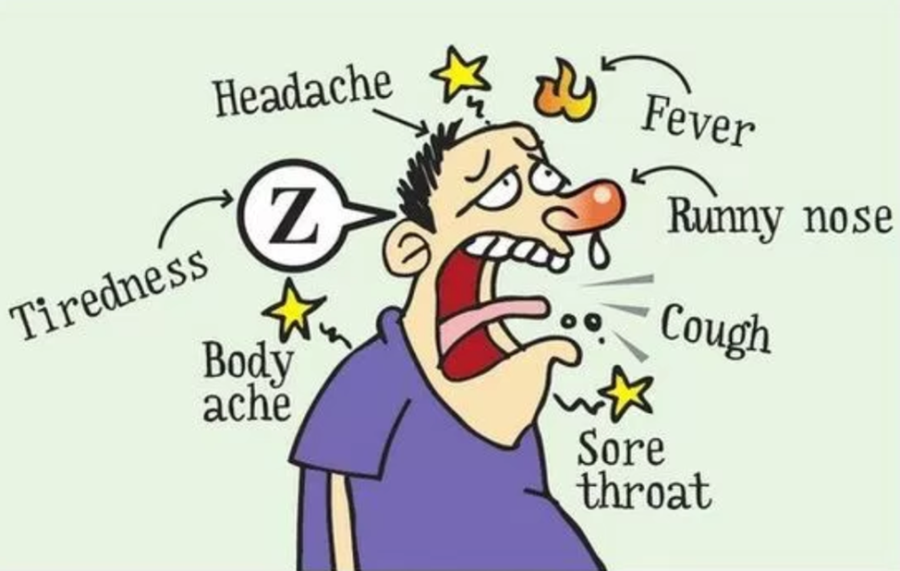
Symptoms

Slide 6
Nouns.
There was an outbreak in Wuhan, China. - *
When the outbreak spread, it became an epidemic. - **
The WHO declared COVID – 19 a pandemic. - *** (WHO is World Health Organization)
The Health Authorities took various measures.
They wanted to limit the transmission of the virus.
People who have the coronavirus must be in isolation.
People who might have the coronavirus are asked to be in quarantine.
Self-isolation, self-quarantine
The city is under lockdown.
They are concerned about community spread.
Many people are wearing face masks.

Slide 7
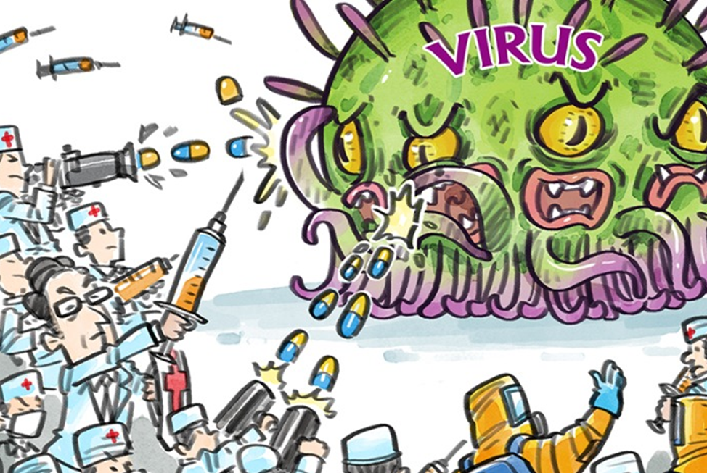
Virus

Slide 8

to declare a pandemic to hunker down at home to ban large gatherings to livesrtream a press conference to restrict travel to seal borders to avoid contact with others to stock up on groceries to hoard goods to shut non-essential businesses to cancel school to postpone events to control the spread to develop symptoms to test patients to protect the vulnerable
Verbs

Slide 9

A Picture Is Worth a Thousand Words

Slide 10
Adjectives
The virus is contagious. It can pass easily to others.
She tested positive. It’s a confirmed case.
People who show signs of illness are symptomatic.
People who don’t have signs of an illness are asymptomatic.
It’s mandatory for him to be in isolation.
It’s voluntary to work from home.
COVID – 19 can be fatal.

Slide 11
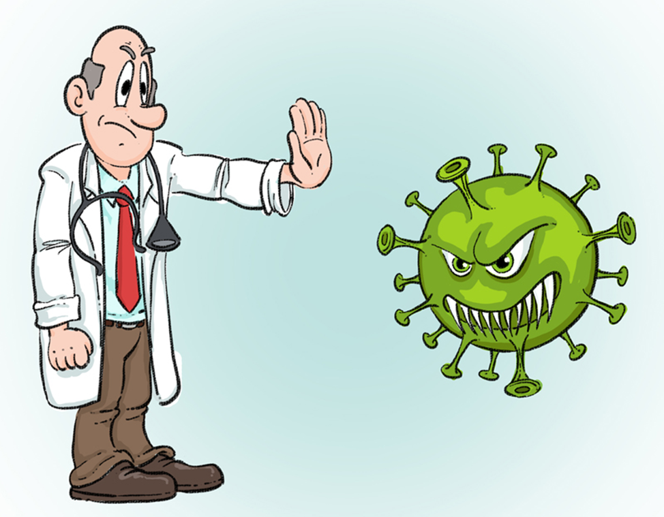
/

Slide 12
Recommendations
*Maintain social distance
*Avoid contact with sick people
*Wash your hands frequently with soap
*Use hand sanitizer (a special liquid to clean hands)
*Avoid touching face, mouth, nose, eyes to prevent yourself from getting sick
*Cough/sneeze into a tissue
*Cough/sneeze into a bend of your elbow
*Do not visit vulnerable people (elderly, unwell, weak)
*Work from home

Slide 13
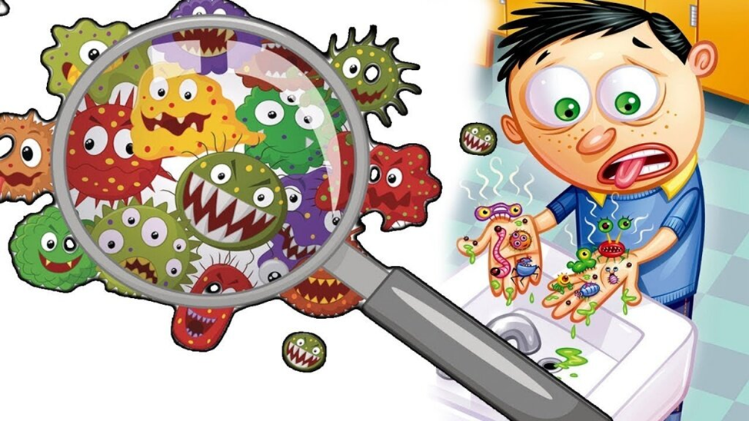
/

Slide 14
Social distancing
Do Not: Avoid:
*get close to others *large groups/crowds
*touch others *public transportation
*visit others
*invite others
*go out socially
*travelling
Do:
*stay home
*work/study from home
*keep in touch (by phone, by video)
Why:
*to reduce chances of catching the virus
*to reduce chances of passing it to others

Slide 15
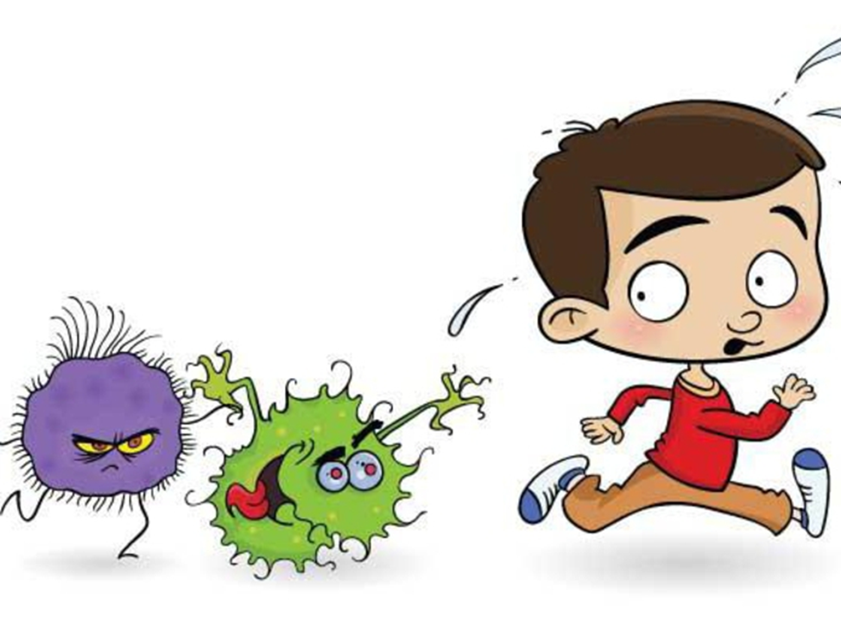
.
/

Slide 16
What you might hear or say?
• I hope the situation improves soon.
• I hope and pray that everything will be alright.
What can we do? Let’s…
• stay calm
• stay positive
• follow the advice of experts and local authorities
• make the most of our time
• take care of ourselves
• be kind to each other
What can you say to others?
• be well
• stay healthy
• stay strong
• may you and your family stay safe, healthy and strong
Thank you so much for your attention!
Be healthy!!!

Slide 17

.

