Slide 1
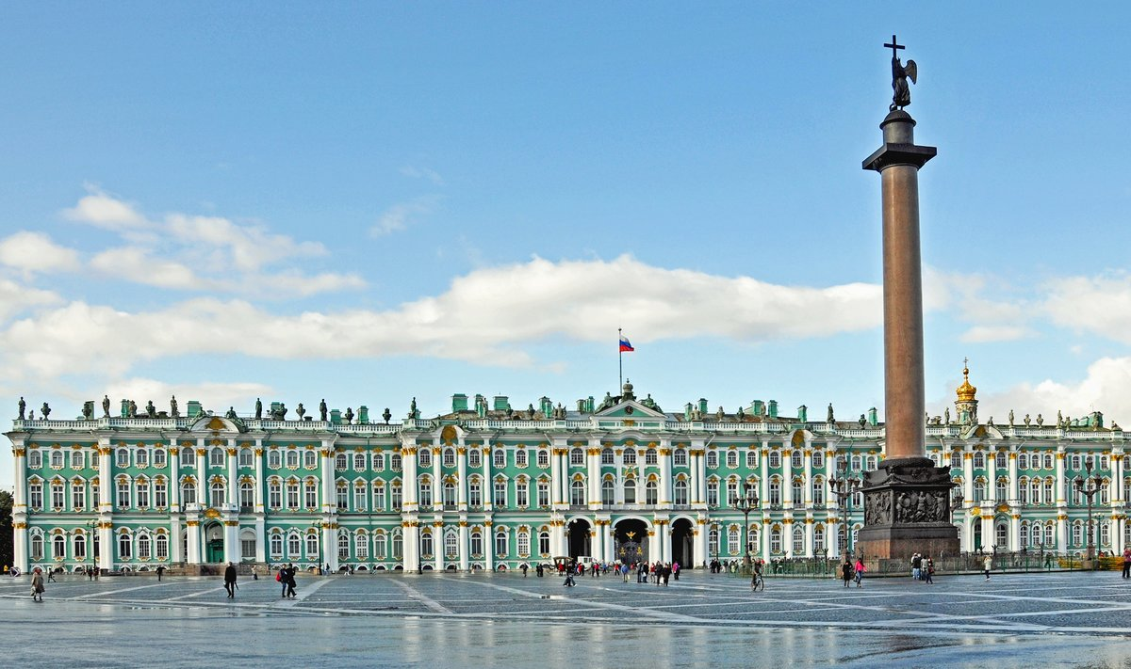
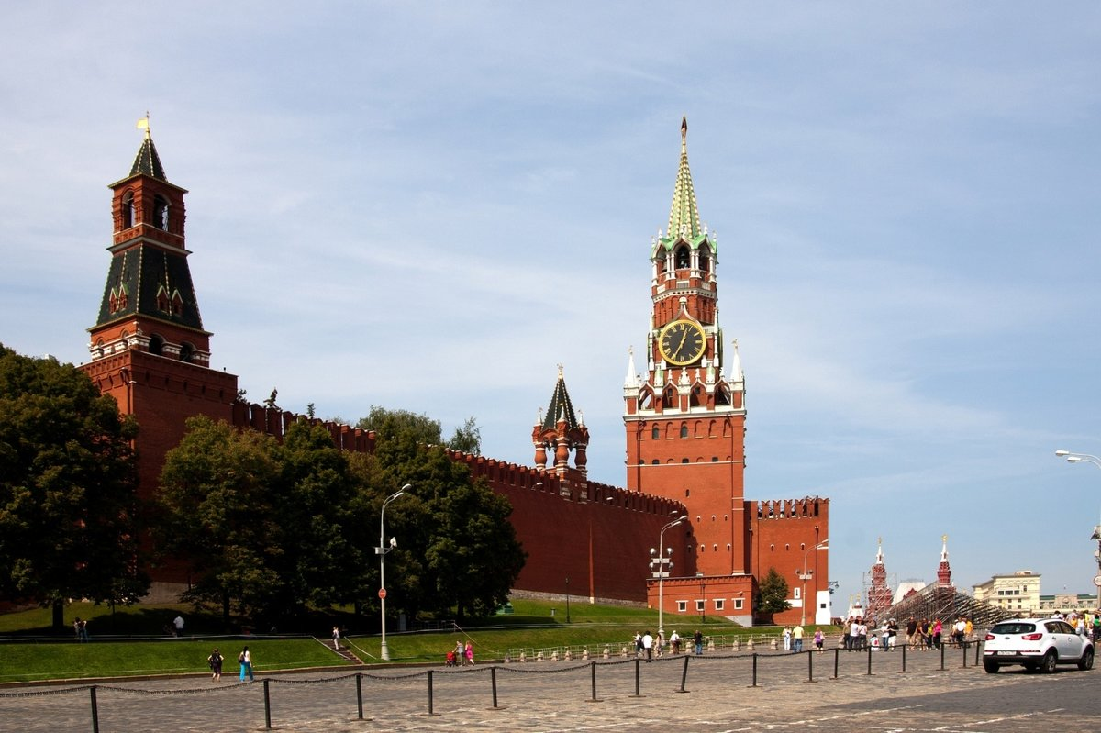
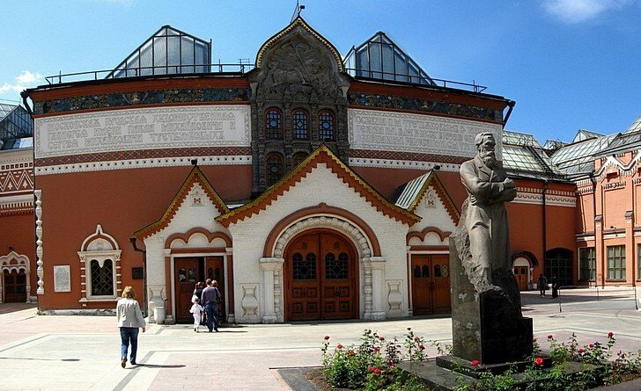
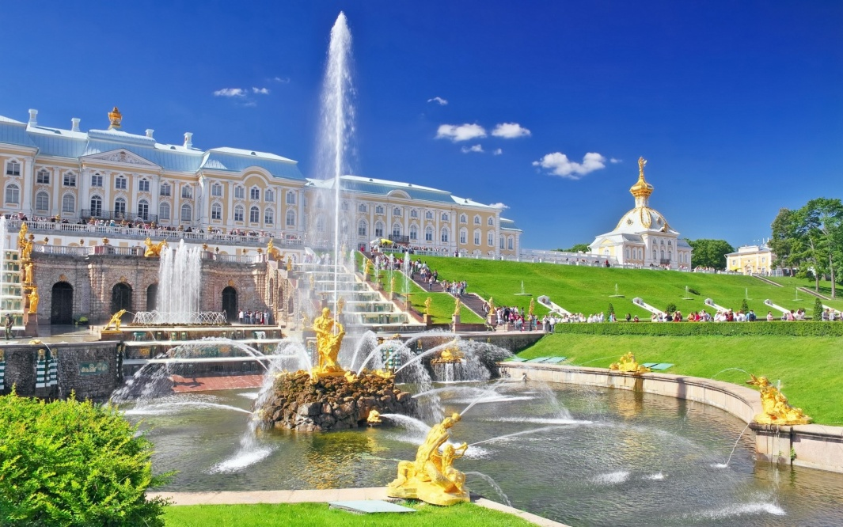
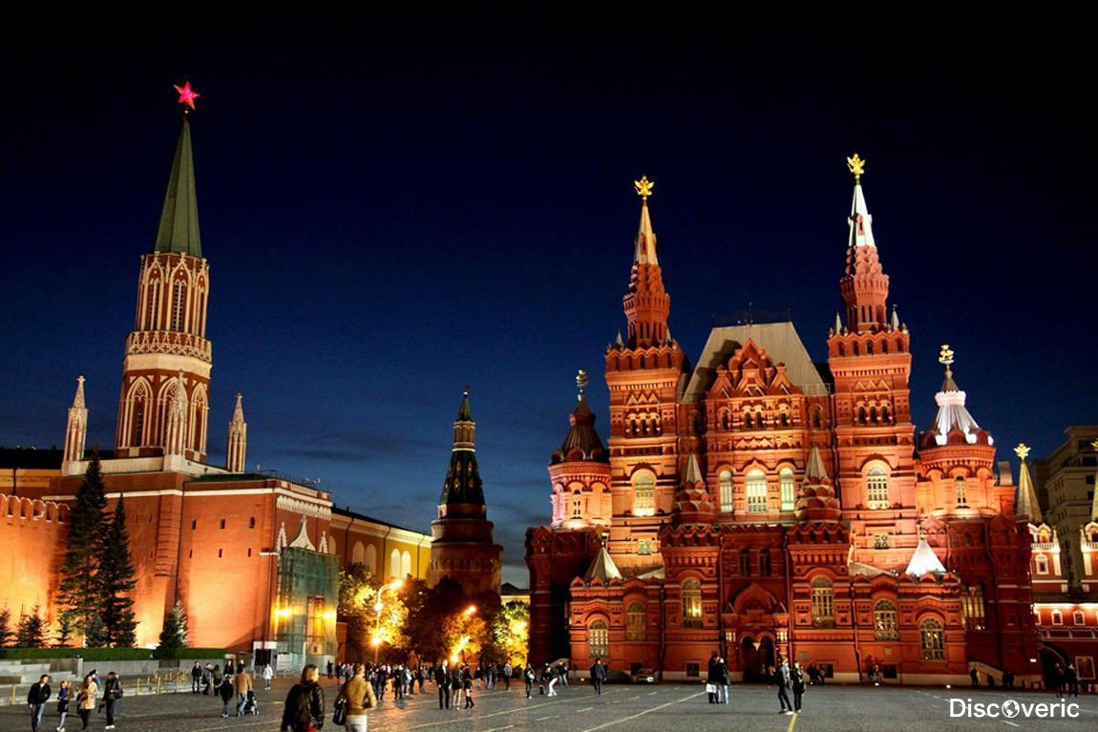

Slide 2
You are going to watch a video about sights of Russia. Complete the sentences
Russia is large, endless and _________
It is a home for _______nationalities.
It is a country where religions have coexisted _____ .
The country is a combination of _______

Slide 3
Keys
1. amazing
2. about 100
3. peacefully
4. picturesque nature

Slide 4
Answer the questions
What is the official name of our country?
What is the capital of the Russian Federation?
Why do we call the Russian Federation a multinational country?
Russia is the largest country in the world, isn’t it?

Slide 5
Match the words
1. see
2. try
3. go on
4. practice
5. buy
6. visit
7. explore
A. the local cuisine
B. famous landmarks
C. museums
D. souvenirs
E. the language
F. nature
G. guided tours

Slide 6
New words
the foreigners - иностранцы

Slide 7
Match the headings to the text «RUSSIA»
Politics
Nationalities
Attractions
Nature
Climate
Location

Slide 8
Keys
1 – f
2 – d
3 – e
4 – b
5 - a

Slide 9
Mark the sentences TRUE or FALSE
The level of population is high in Russia.
Lake Baikal is the deepest lake in the world.
On the Russian territory there are 19 time zones
Our country is one of the poorest in natural resources countries in the world:
The national symbols of the Russian Federation are the state white blue-red flag and 2-headed Eagle.

Slide 10
Keys
1. TRUE
2. TRUE
3. FALSE
4. FALSE
5. TRUE

Slide 11
Dialogue
- Hi, Tom. How are you? Glad to see you in Russia.
- Hello, Sasha. Thanks, I'm well. I'm glad too. At least we've met in real life.
- Yes, you're right. Have you ever been to Russia?
- No. It's my first time. And I'd like to visit many sights. What can you advise me?
- Oh, there are so many interesting places in the Russian Federation. Here, in Moscow, you can visit Red Square, Tretyakov Art Gallery, St. Basil’s Cathedral
- Great. Unfortunately, I have no much time. So I'll go to Saint Petersburg in two days. What can I see there?
- Of course, Hermitage. It's very interesting and exciting. I'm sure, you'll like it.
- By the way, I have a great chance to come to Russia in winter too. Will you show me Russian nature, forest, villages soon?
- Really? I'll be waiting for you. My grandparents live in the country, near the forest and river. We can go there.
- Wonderful! Sorry, I should go now. I'll write you e-mail. Thanks a lot, Sasha.
- You're welcome.

Slide 12
What information was interesting and new for you? Fill in the table
+ | I know that
- | I did not know that
! | I have learnt that
? | I would like to know

Slide 13
Cinquain
1 noun
2 adjectives
3 verbs
1 sentence
1 key word

Slide 14
After this lesson I am…
1. great!
4. discontented…
2. puzzled
3. inspired!
5. enthusiastic
7. in love with English
6. tired
9. interested
8. frustrated
10. thankful

