Slide 1
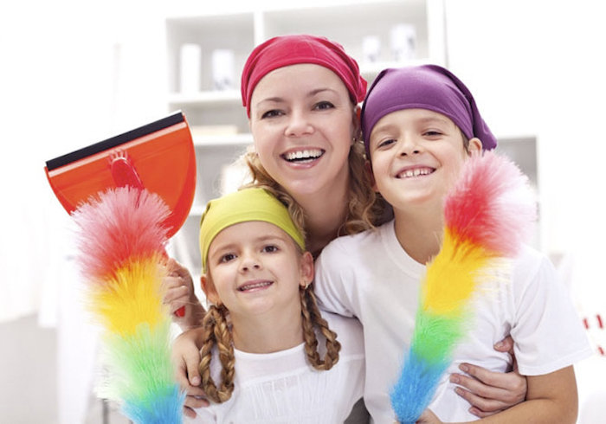
The__of February
???
Учитель английского языка МБОУ СОШ с. Богородское:
Пассар Ксения Ивановна

Slide 2
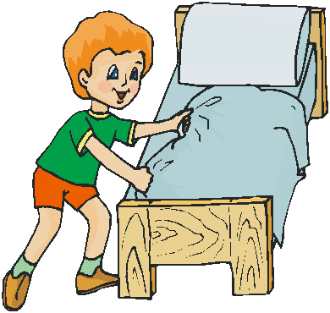
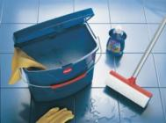
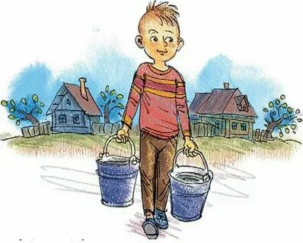
Do you____________?
No, I don’t
Yes?, I do

Slide 3
Listen and repeat
[ð] Mother,father
[z]lazy
[b] Buy-bought
[w] Want-went, work

Slide 4
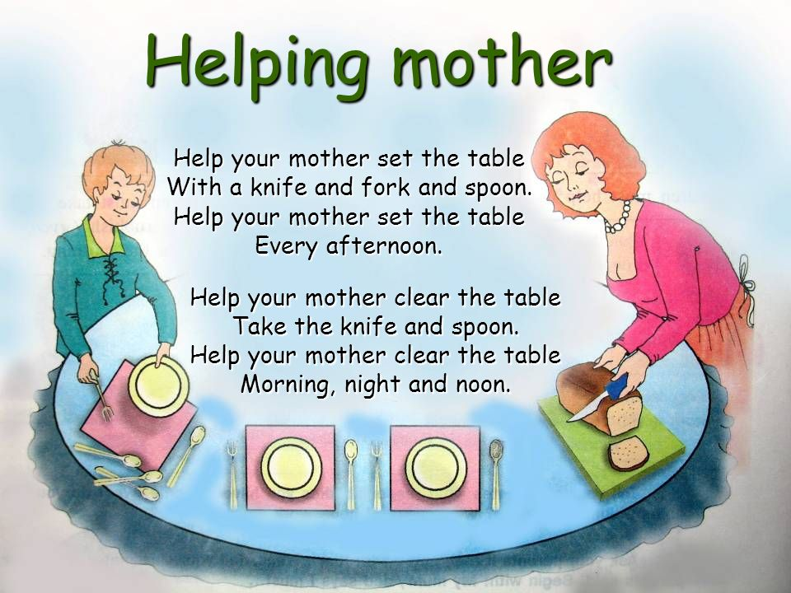
Listen to the song

Slide 5
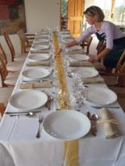
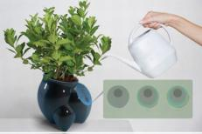
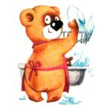
What do you do to help your family?
At home I usually_____

Slide 6
New words
Tribe-стойбище, племя
Neighbour-соседский
Bring- brought –принести
Hurt-поранить
Spoil beauty-испортить красоту
Wave-махать
Turn into-превратиться
Wings-крылья
Goose-гусь
Forget-forgot-забыть
Language-язык

Slide 7
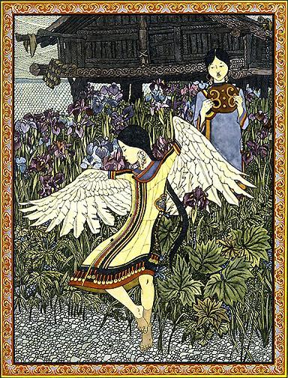
Once upon a time a Nanai called La lived. He had a beautiful daughter Ayoga. Everybody loved her. She was the most beautiful girl in the tribe. She just looked at her reflection in the water.
Ayoga bacame so lazy, that she didn’t want to do anything.
Once her mother asked the girl to bring water. Ayoga didn’t want to help her mother.
The neighbour girl helped Ayoga’s mother. She went to the river and brought the water.
The mother made a cake. Ayoga saw the cake and shouted loudly
“Give me a cake, mother!”
“Your hands may hurt” said the mother. “You needn’t work, you may spoil your beauty! I’ll better give the cake to the girl who is not afraid to spoil her hands!”
Ayoga was angry.. She waved her hands and suddenly they turned into wings. She fell into the river and became a goose.
The goose swam and shouted “Ah, how beautiful I am! Ha, ha, ha!.. How beautiful I am!
She was swimmimg and swimming until she forgot the Nanai language. She forgot all the words except her name.
When she saw people she cried “Aioga – ga – ga – ga! Aioga – ga – ga – ga!”
.
Why didn’t Ayoga help her mother ?

Slide 9
You can see the Tree of knowledge.
Оранжевый- урок очень интересный. Мне понравилось всё.
Жёлтый- мне понравился урок но я не совсем справился.
Зелёный- было скучно и я ничего не выполнил.

Slide 10
Homework: draw a picture
YOU ARE PERFECT!

