Slide 2
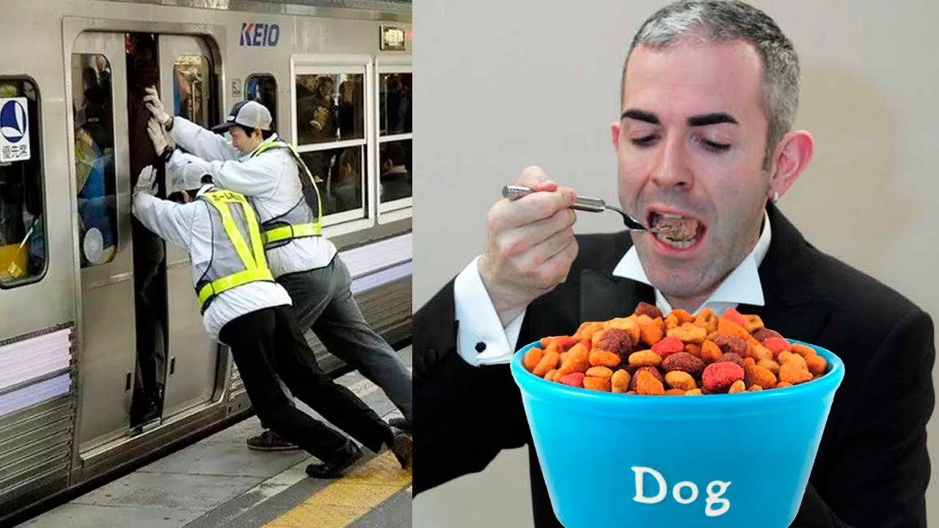
WEIRD JOBS

Slide 3
Speculate on the following points
How do you understand the phrase «weird job»?
What jobs do you consider to be weird?
Would you like to perform an extraordinary job?Why?

Slide 4
Passive voice

Slide 5
Change from active into passive
Scuba diving delivery man brings pizza to people in a hotel in Florida

Slide 6
Present simple
Pizza is brought to people in a hotel in Florida by scuba diving delivery man

Slide 7
Change from active into passive
Duck master marched the ducks at festive occasions only

Slide 8
Past Simple
The ducks were marched by duck master at festive occasions only

Slide 9
Ash portrait artist can use ash of a person who has passed away in a proper way

Slide 10
Change from active into passive
Modal verb
Ash of a person who has passed away can be used by ash portrait artist in a proper way

Slide 11
Change from active into passive
People in Japan are using underground because they try to save money for petrol

Slide 12
Present Continious
Underground is being used by people in Japan because they try to save money for petrol

Slide 13
Home task for the next lesson.
Write down an e-mail to your friend “There is nothing weird about weird jobs”
OR
Make a presentation describing another new weird job (qualities that person needs, responsibilities)

