Slide 1
The 15th of March

Slide 2
Vocabulary
the growth of pollution;
(air pollution, water pollution, land pollution);
shortage of natural resources;
destruction of wildlife;
the growth of population;
traffic noise;
acid rains;
the greenhouse effect (global warming);
depletion of the ozone layer;
radiation;
deforestation and desertification;
health and chemical safety;
extinct animals;
car exhaust fumes;
dumping domestic and industrial waste in seas and rivers .

Slide 3
Put the missing words to complete the text.
1.The word “e………………” means what is around us. It is all things we need to be able to live – clean w ……….. to drink, fresh a…………. to breathe and healthy f……… to eat. We can’t live without p………… s and a……….s .
2.The world is our h………… and we want to see it clean and b ……………… . But we cut d……... forests, b…………factories on the land, make a lot of h…………. . We dump domestic and i…….. waste in the country and pour toxic waste into our rivers, seas and oceans. Cars and factories, plants and power stations pollute the a….. and make it d………… to breathe.

Slide 4
Put the missing words to complete the text.
3.All these are serious e………… problems. People should think about it. We should s………….. all living things around us and our B……. Planet.

Slide 5
Think about your own ecological group
The name of a group:
The motto:
The logo:

Slide 6
ECOLOGY OF KADOM

Slide 7
Kadom

Slide 8
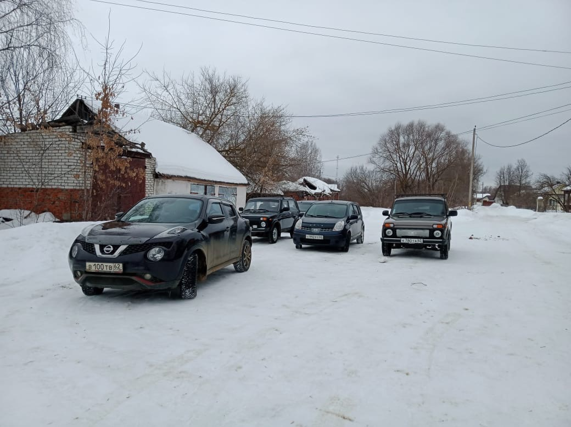

Slide 9
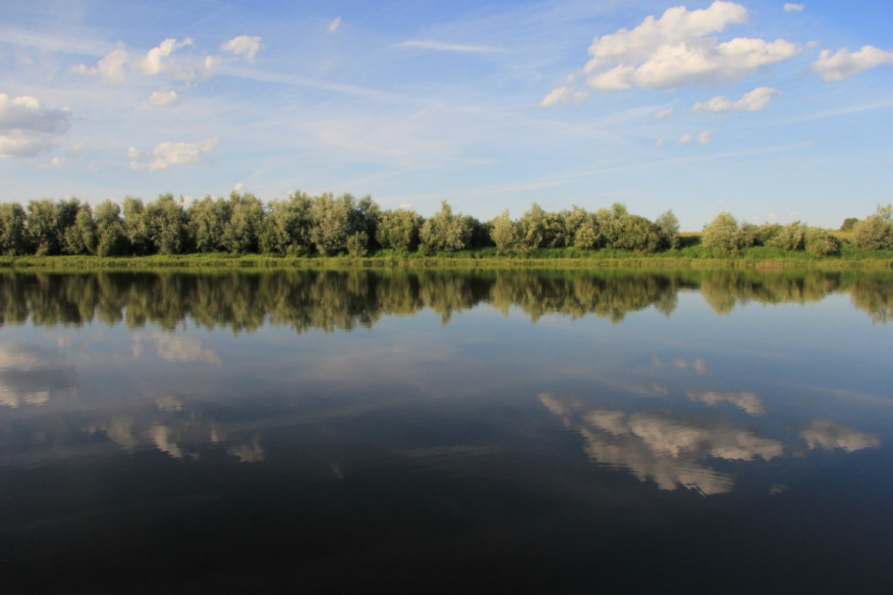
The Moksha river

Slide 10
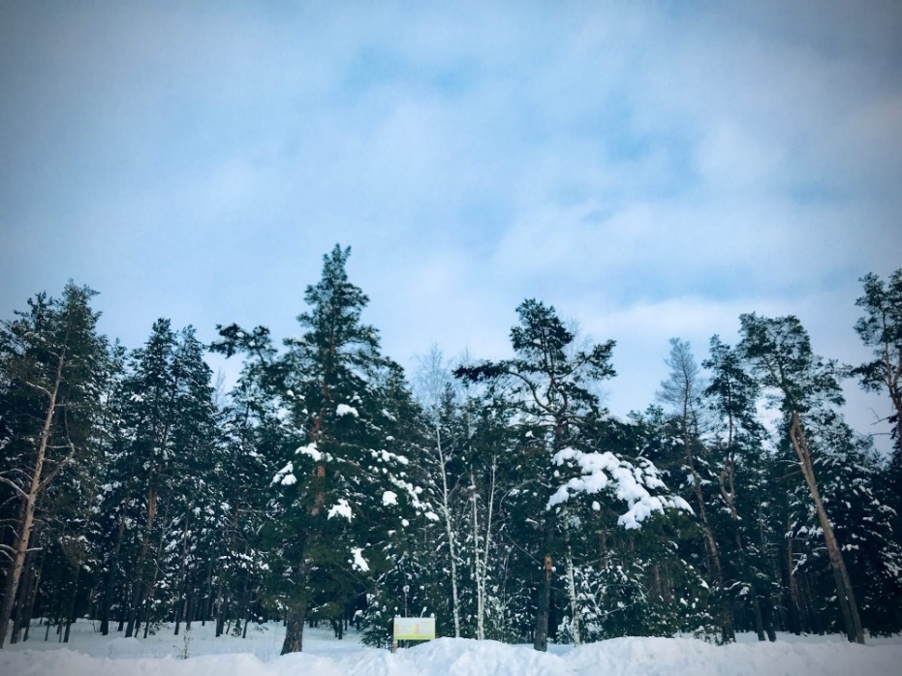
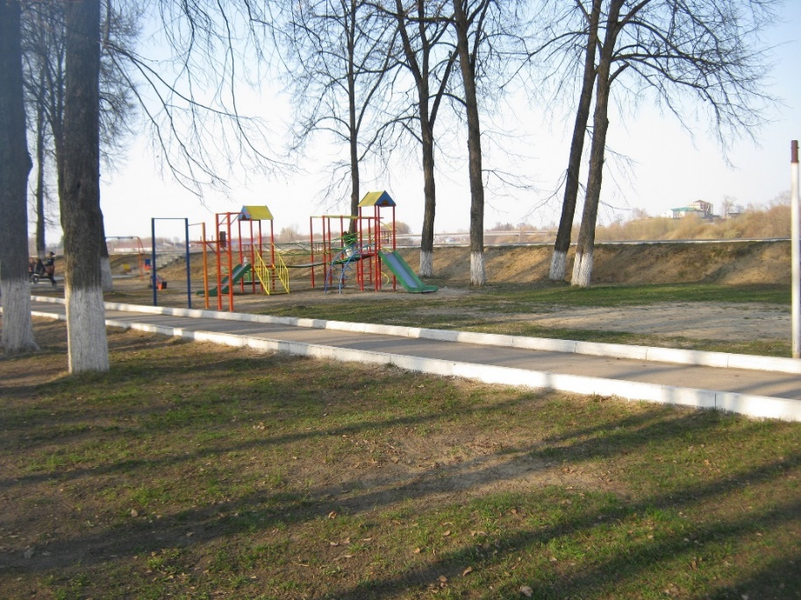
Streets, a forest and a park

Slide 11
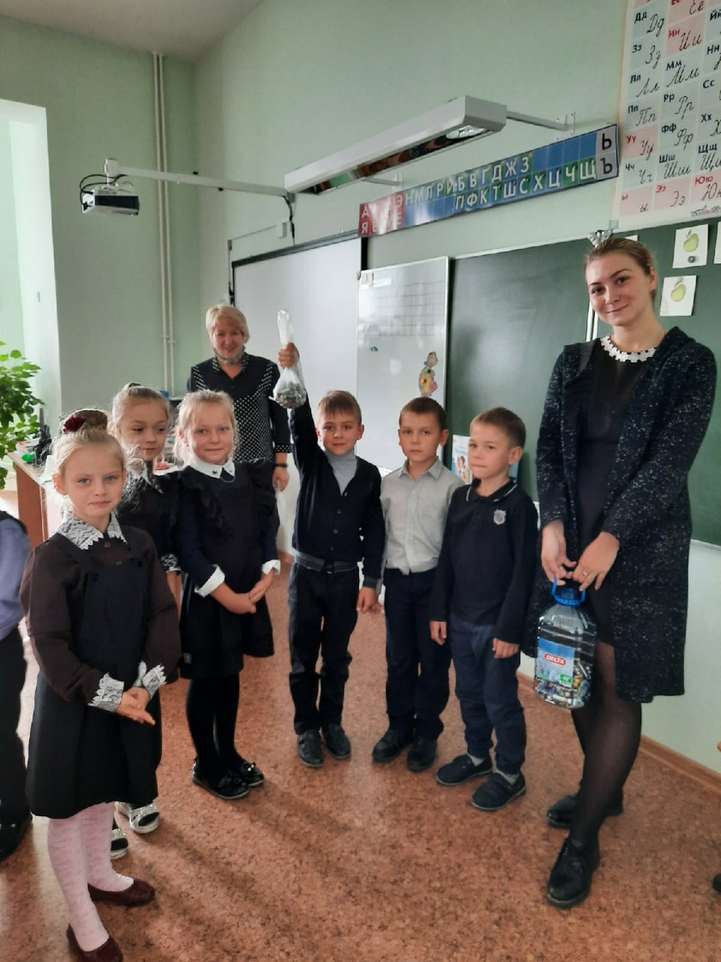
Action «batteries»

Slide 12
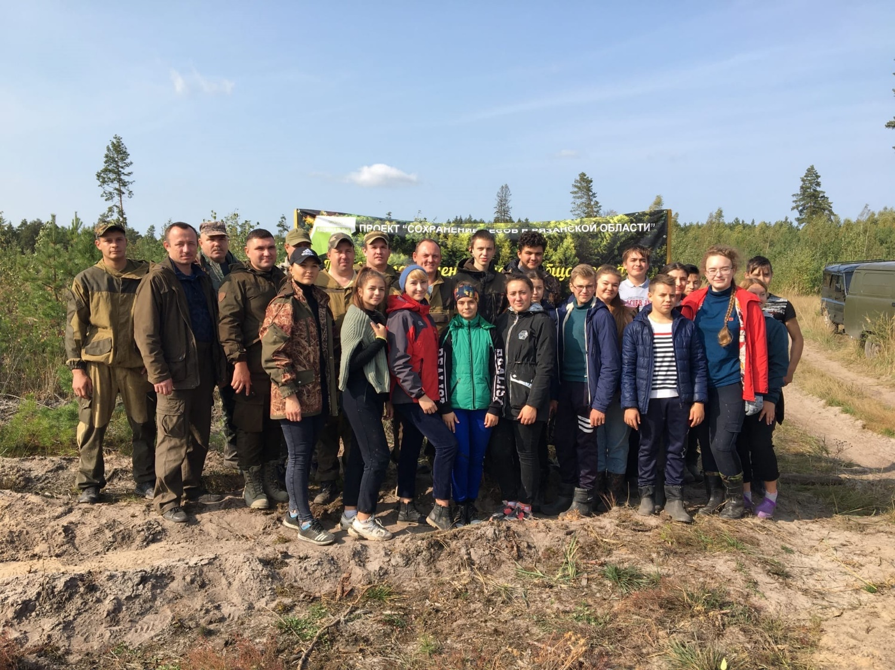

Slide 13
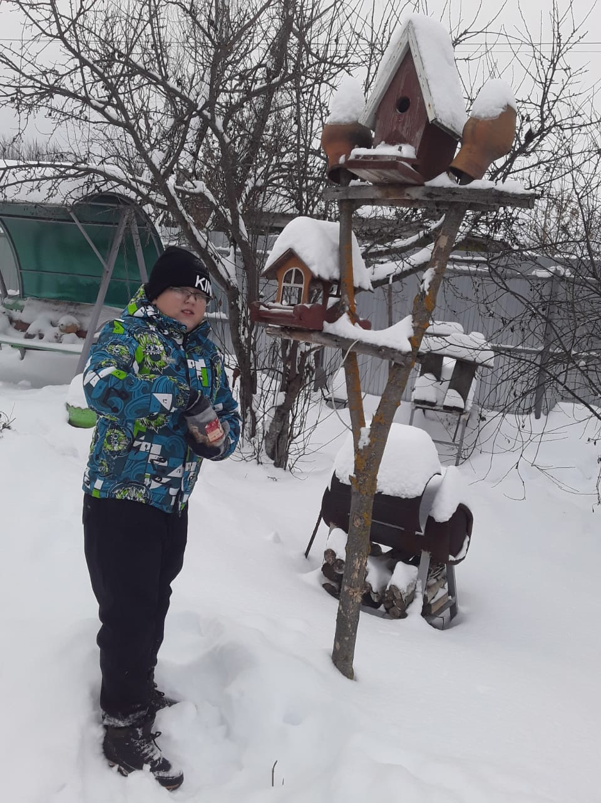
Birdhouses for birds

Slide 15
Homework
To make a report about environmental problems in Russia (7-10 sentences)

Slide 16
Сonclusion
1) What have you known today?
2) What have you done in English lesson?
3) What was the most interesting?
4) Who deserves ‘5’, ’4’, ‘3’ ?

Slide 17
What was the English lesson like?
A spring tree
interesting
boring
fascinating
disappointing
funny
dynamic
unusual
entertaining
perfect
useful
slow
terrible
bright
violent
moving
gripping

