Slide 1
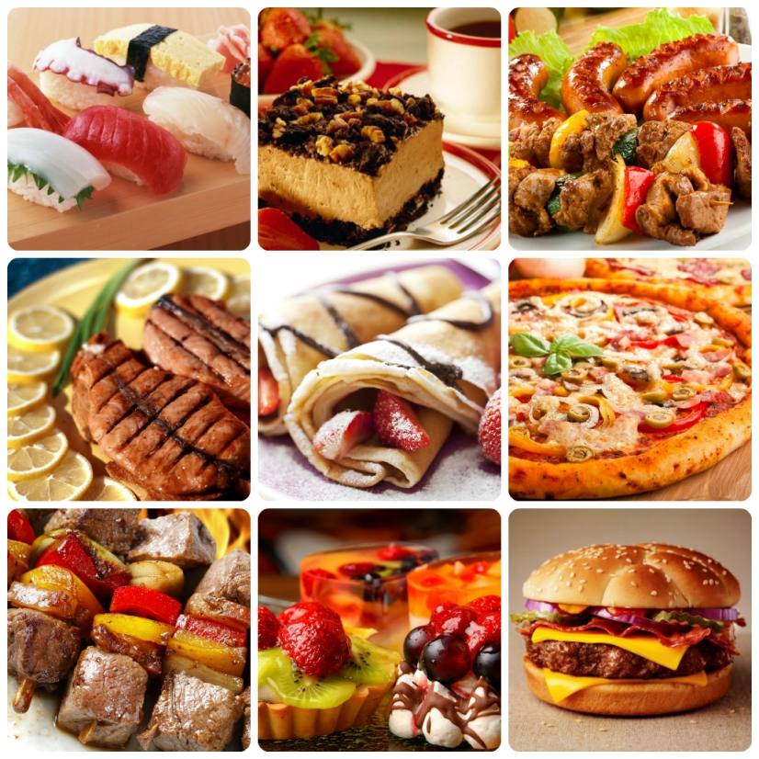

My favourite food

Slide 2
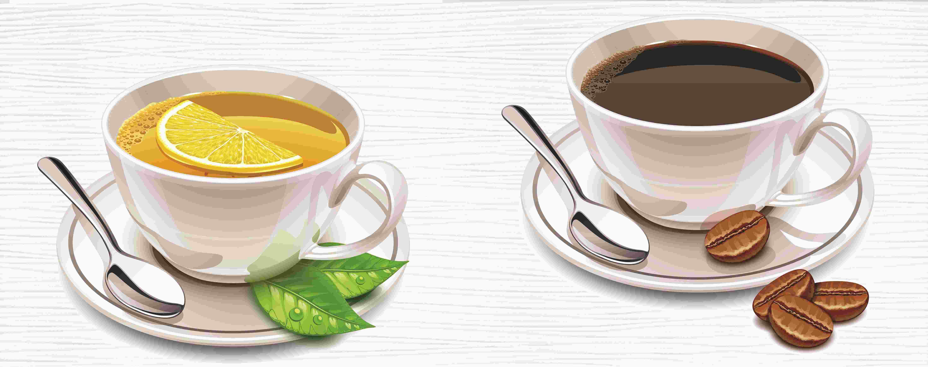
One, Two, Three
One, two, three.
Let me see –
Who likes coffee
And who likes tea?

Slide 3
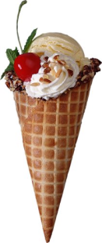
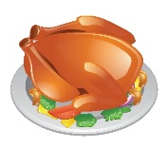
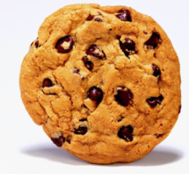
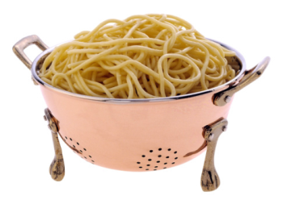
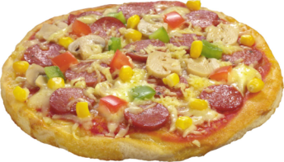
ch_cken
p_zza
bi_cuit
spag_etti
ice _ream

Slide 4
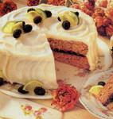
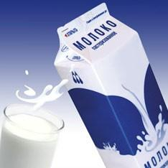
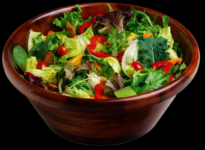
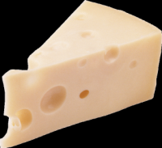
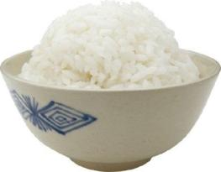
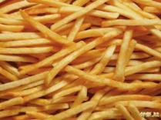
mil_
ch__se
s_lad
_ake
ch_ps
ric_

Slide 5

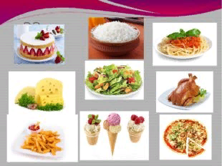
I LIKE

Slide 6

I DON’T LIKE

Slide 7
PRESENT SIMPLE
утвердительная форма
like
likes
отрицательная форма
don’t like
doesn’t like
вопросительная форма
Do/Does … like…?

Slide 8
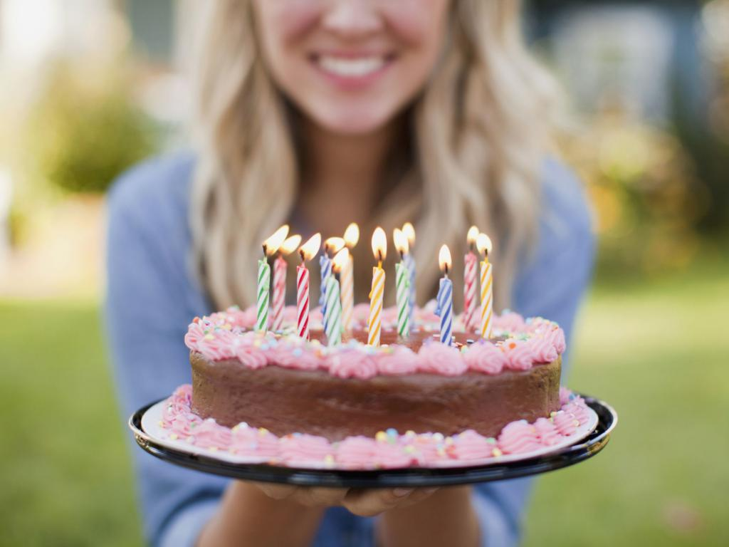
Hi, I’m Mary. It’s my birthday today! There are lots of friends at my party! I like cakes and biscuits! My friends like rice, salad, cheese and water. They don’t like water and milk. They like birthday cake.
Do you like birthday cake?

Slide 9
Hi, I’m Mary. It’s my birthday today! There are lots of friends at my party! I like cakes and biscuits! My friends likes rice, salad, cheese. They doesn’t like water and milk. They likes birthday cake.

Slide 10
biscuit
rice
salad
cake
cheese
water
rice
spaghetti
chips
ice cream
milk
water
cheese
cake
chips

Slide 11

Dear …!
Happy birthday to you!
Have a nice day!
…

Slide 12
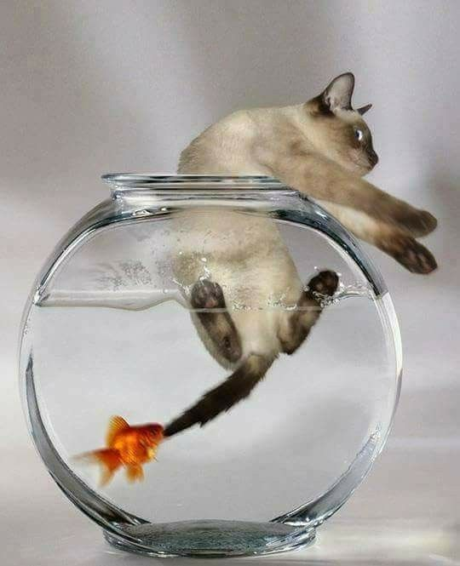
«Я съел бы еще…»
I would eat more…

Slide 13
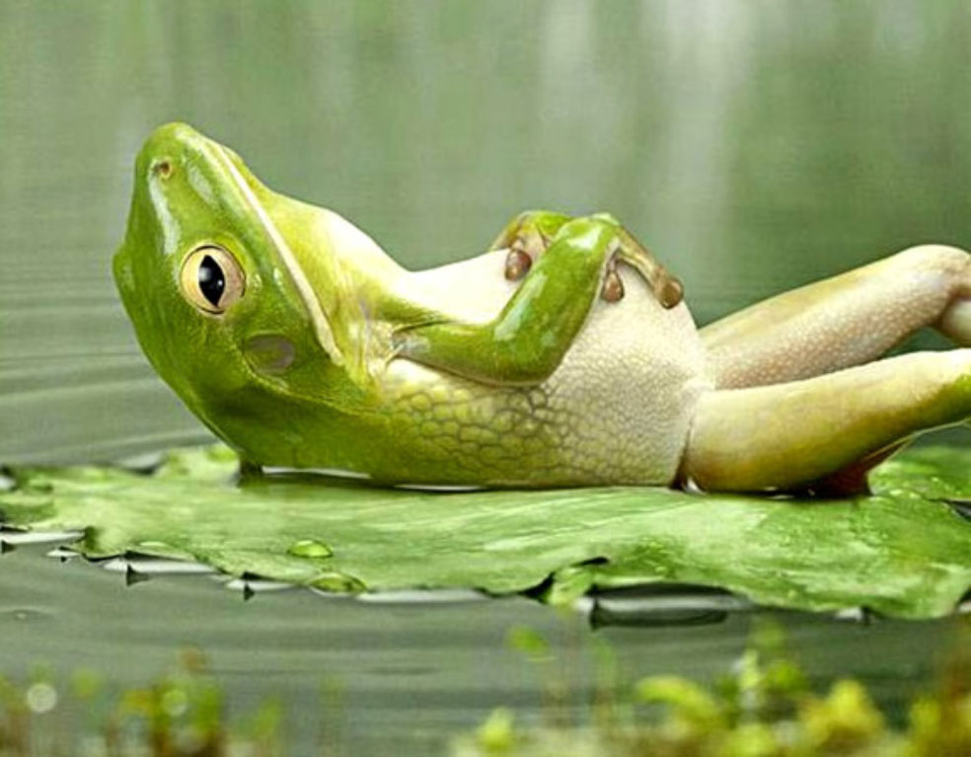
«Я почти переварил…»
I almost digested…

Slide 14
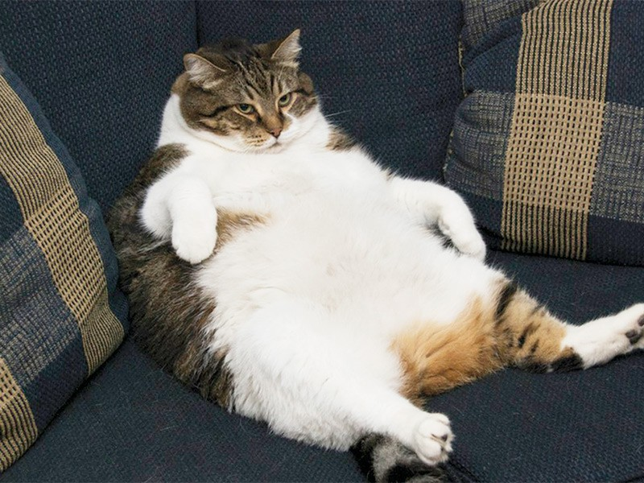
«Я переел…»
I ate too much…»

Slide 15
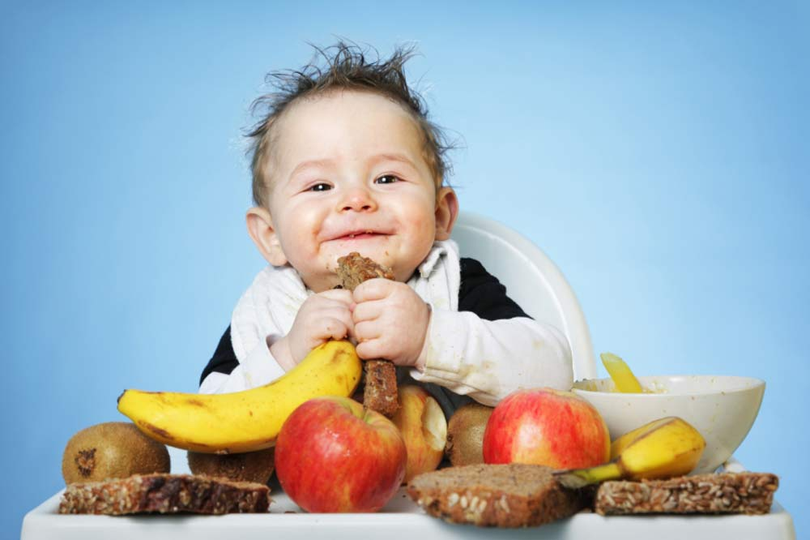
«Больше всего мне понравилось…»
Most of all I liked…»

Slide 16
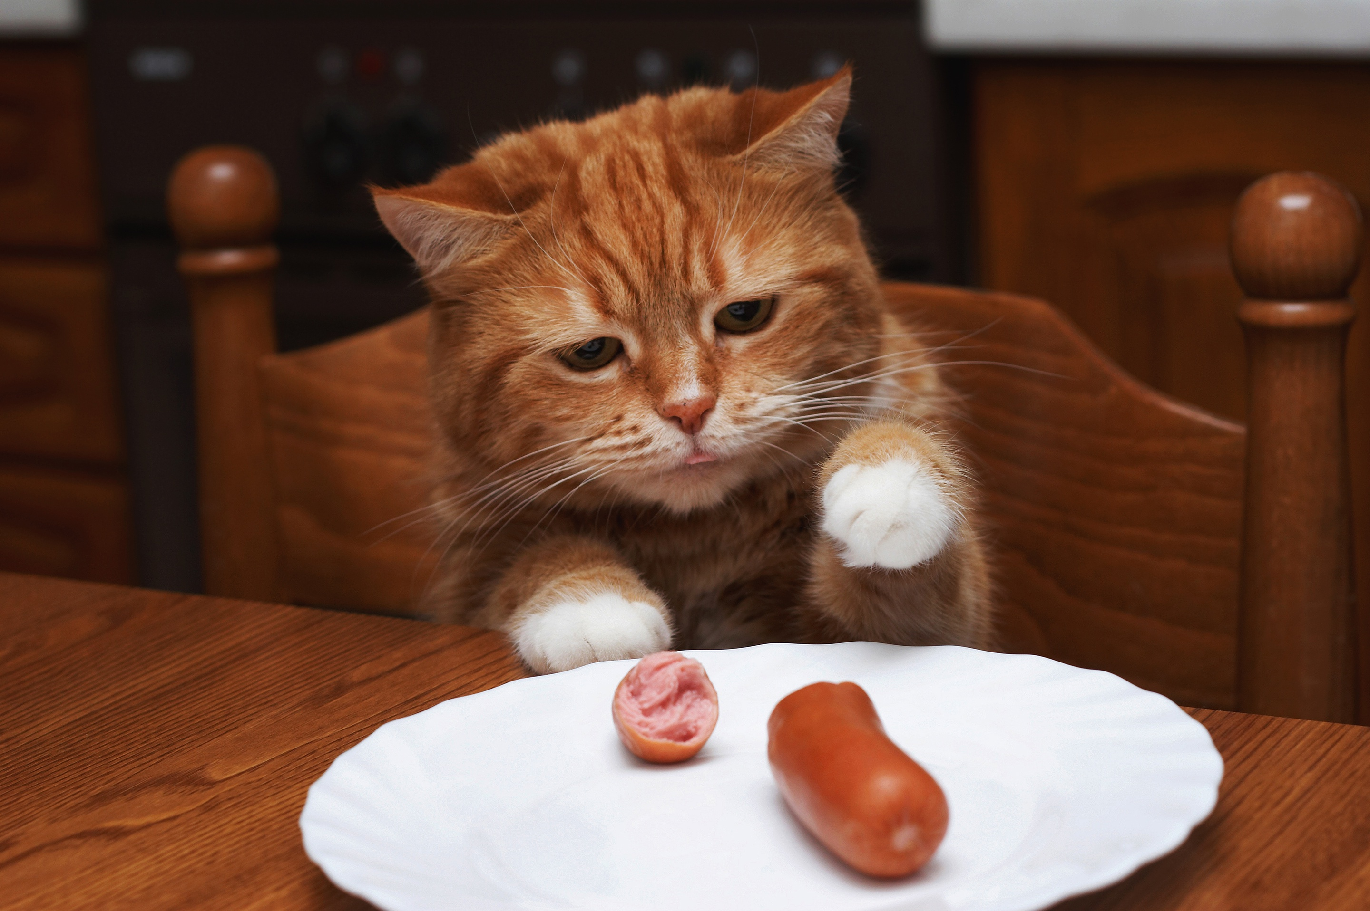
Пожалуйста, добавьте еще…»
Please add more…»"

Slide 17
