Slide 1
warming up
Do you like shopping? For what kinds of things?
How often do you go shopping?
Do you prefer to go shopping alone or with your friends and family?
4.What was the best thing you ever bought?
5.Do you often regret having bought something?
6. Have you ever returned something to the shop you bought it from?
7.Are you a bargain hunter?
8.Do you shop online?
9.What kinds of things do you buy online?

Slide 2
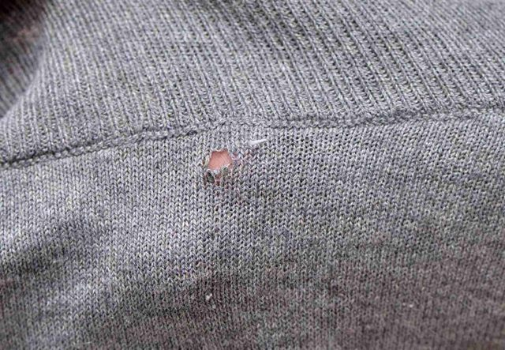
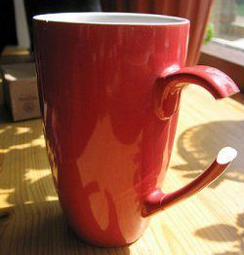
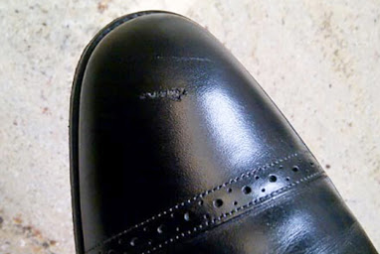
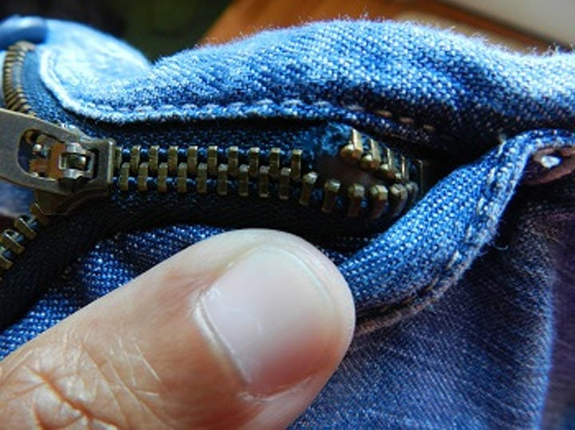

Slide 4
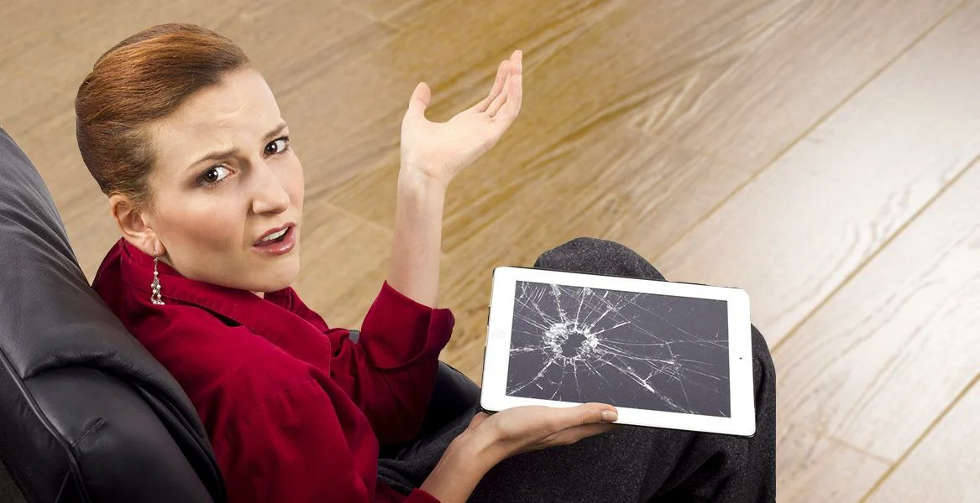
Emails of complaint
Returning faulty items

