Slide 1
Watch the video and guess the theme
https://learnenglishkids.britishcouncil.org/short-stories/dark-dark-wood

Slide 2
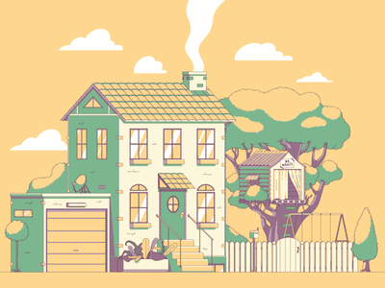
My House.

Slide 3
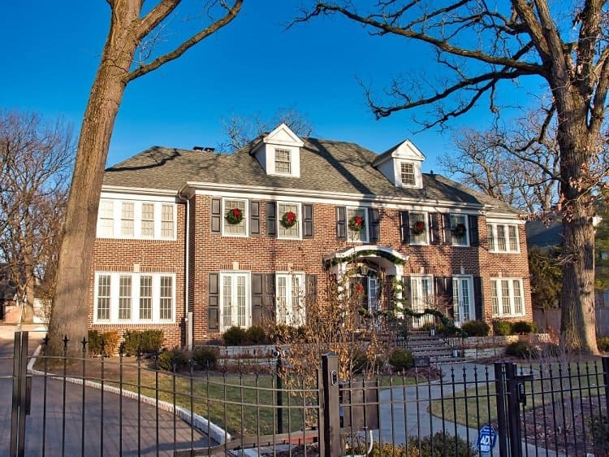
Do you know this house?Describe it

Slide 4
Learn the new words
https://wordwall.net/ru/resource/23956672/starlight-5-unit-2-2a

Slide 5
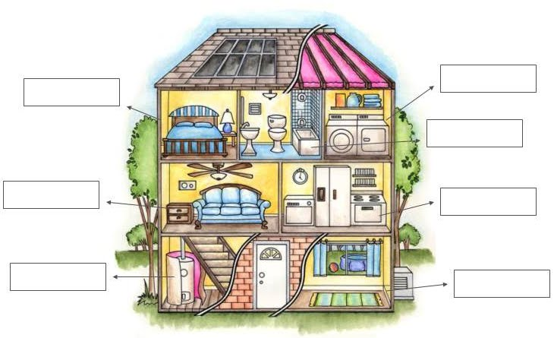
PARTS OF THE HOUSE
ATTIC
UTILITY ROOM/
LAUNDRY
BEDROOM
BATHROOM
LIVING ROOM
KITCHEN
CELLAR
DINING
ROOM

Slide 6
Practice the new words
https://wordwall.net/ru/resource/25000056/english/dining-room
https://wordwall.net/ru/resource/25000315/english/bedroom

Slide 7
New Grammar
There is
There are

Slide 8
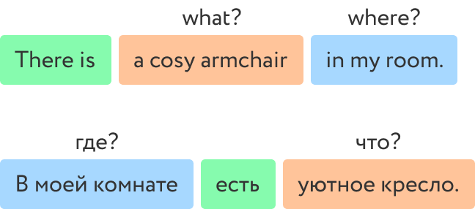

Slide 9
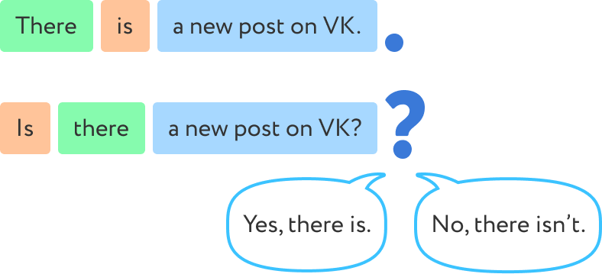

Slide 10
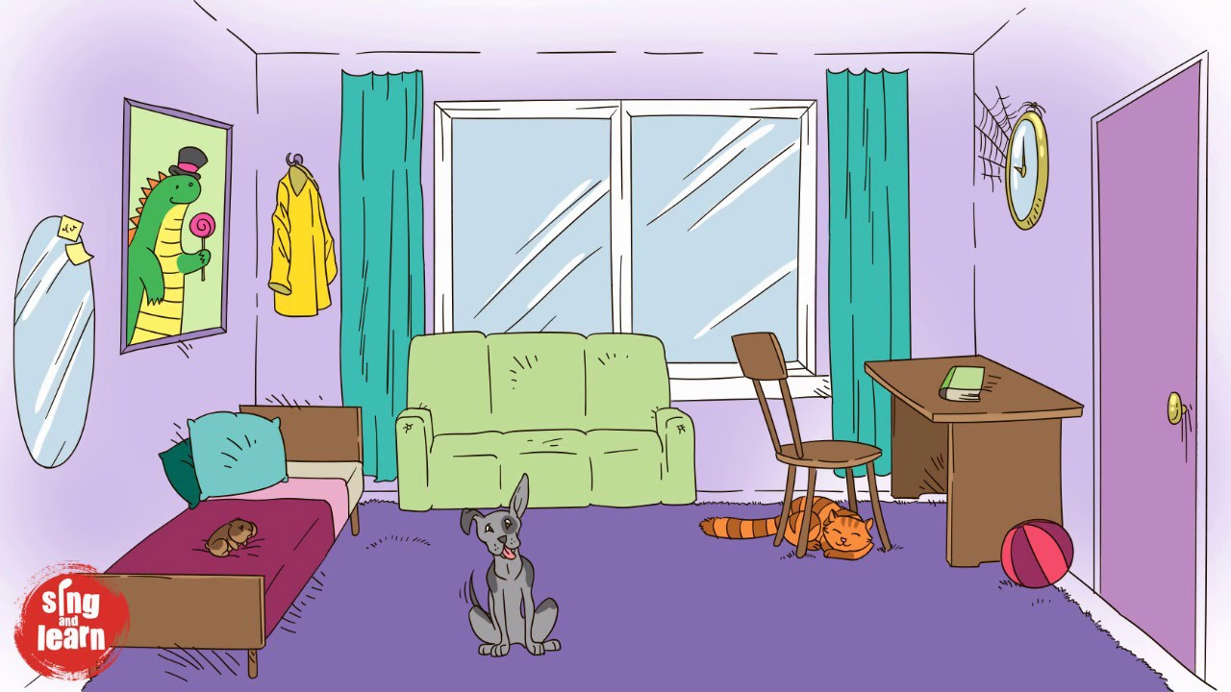
Practice online
https://www.liveworksheets.com/worksheets/en/English_as_a_Second_Language_(ESL)/There_is_-_there_are/THERE_IS_-_THERE_ARE_cq2158446eo

Slide 11
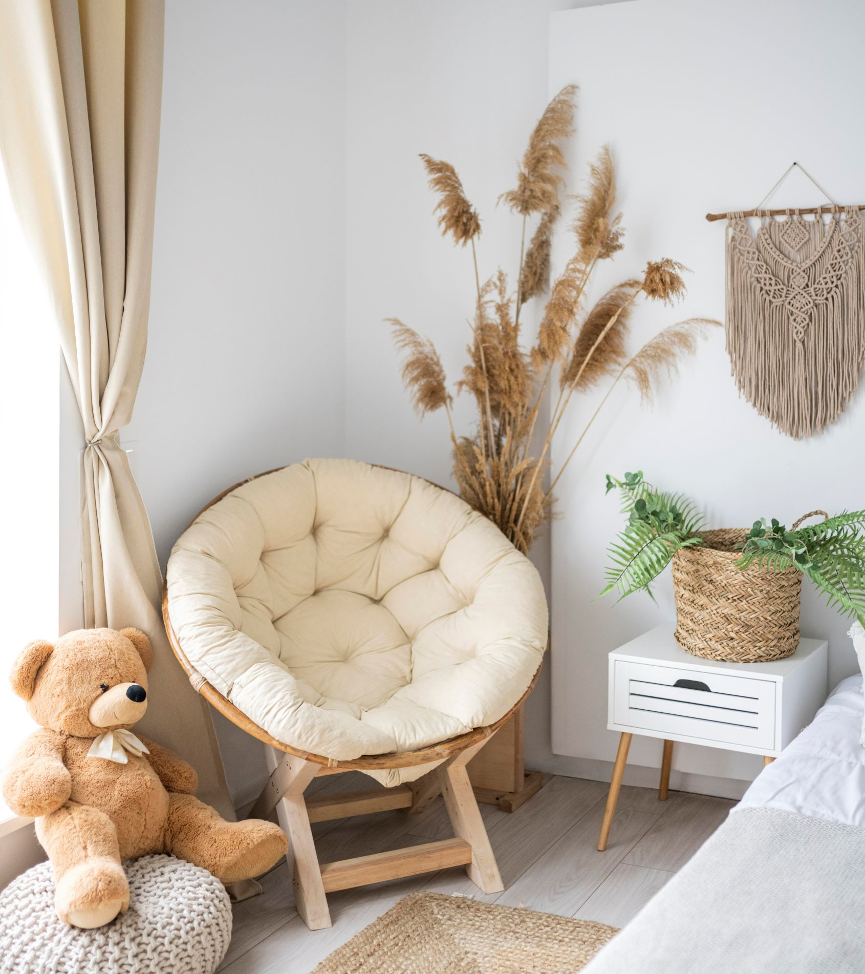
Room tour
https://my.matterport.com/show/?m=mdRPbQunhq7&play=1

Slide 12
Hometask
Record a video of your room tour.

