Slide 1
ХАБИБУЛЛИНА ГУЗЕЛЬ РУСТАМОВНА
СОШ №4

Slide 2
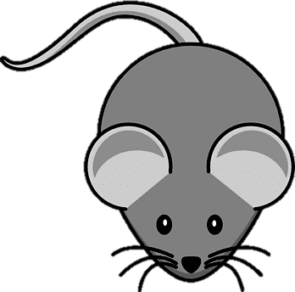
A black cat sat on a mat and rapidly ate a fat rat

Slide 3
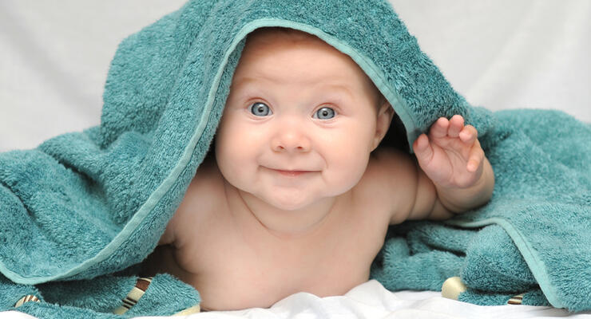
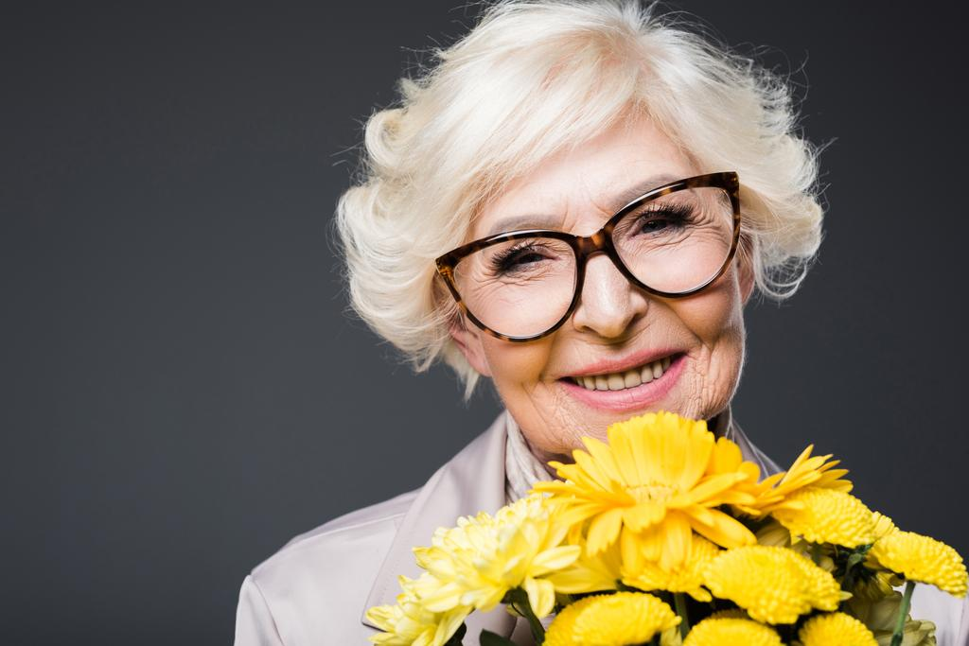
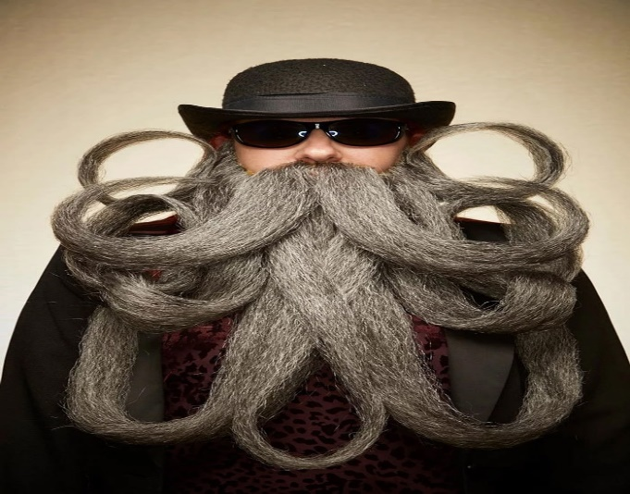
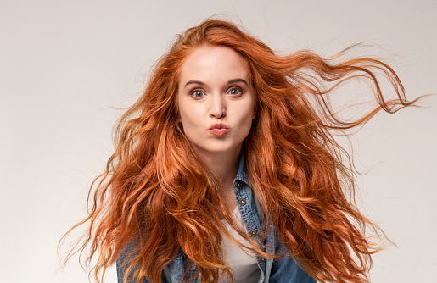
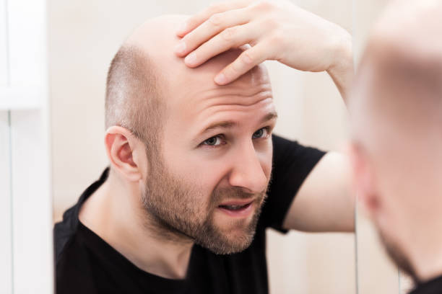
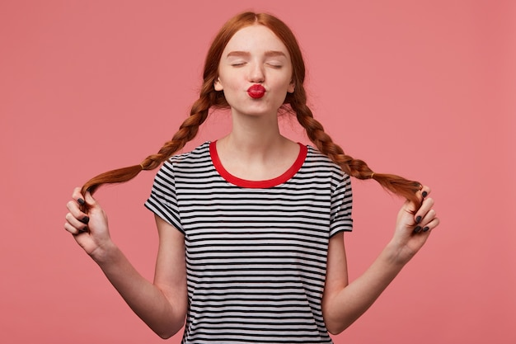
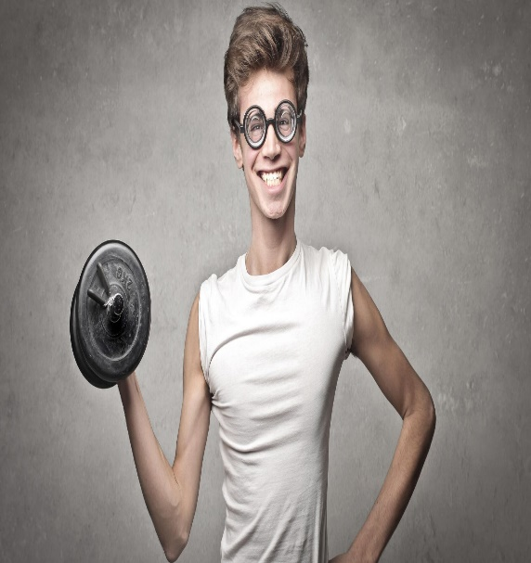
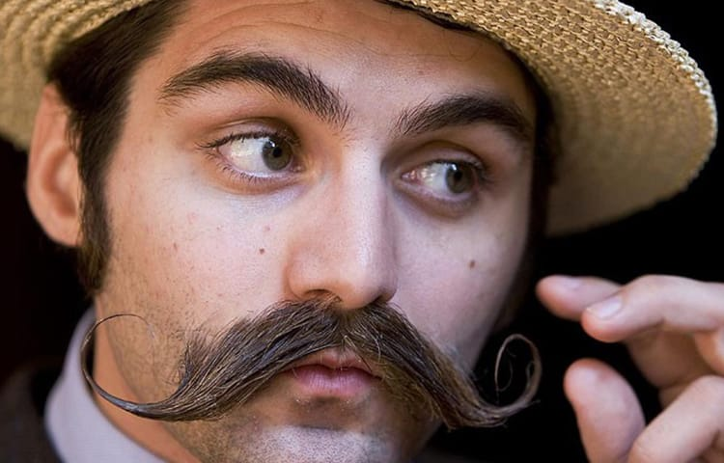
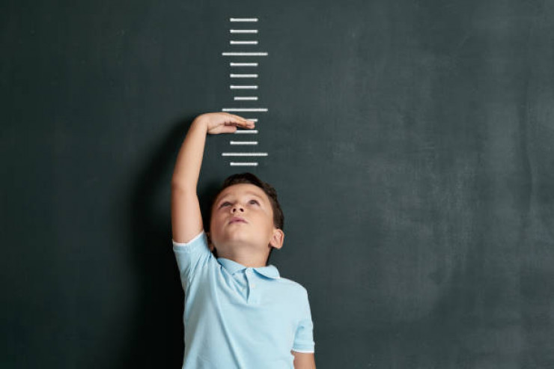
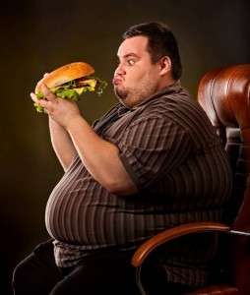

Slide 4
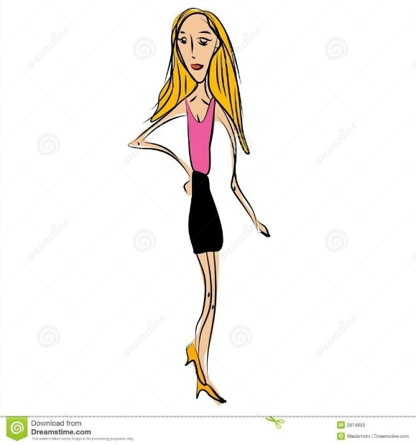
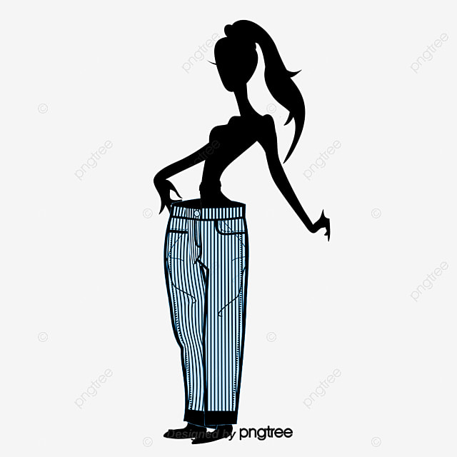
BUILD
skinny
Slim
стройный
thin

Slide 5
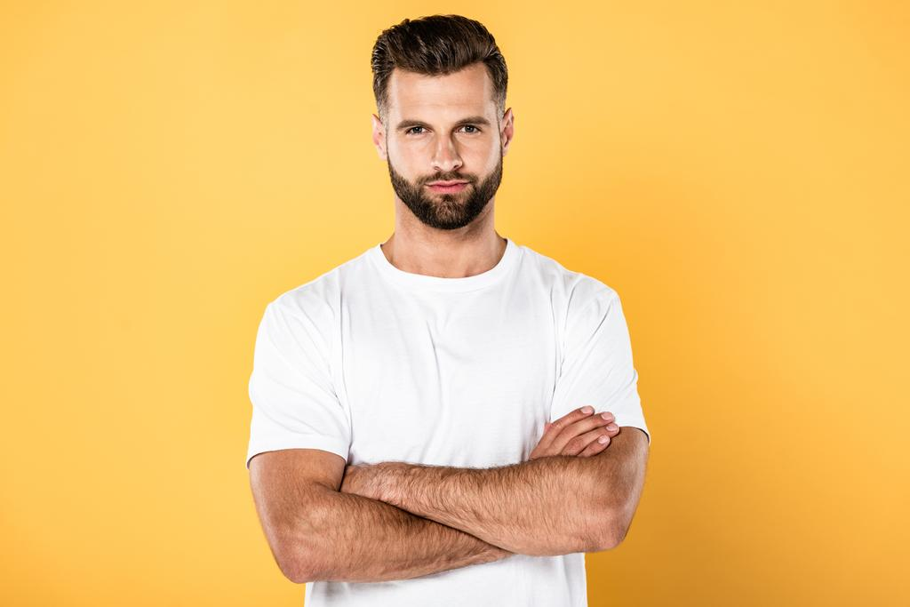
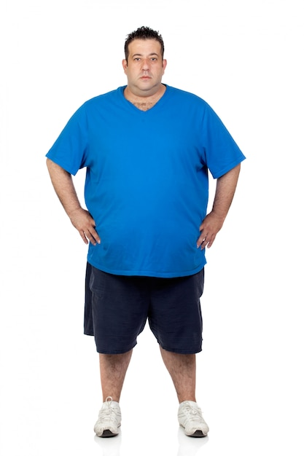
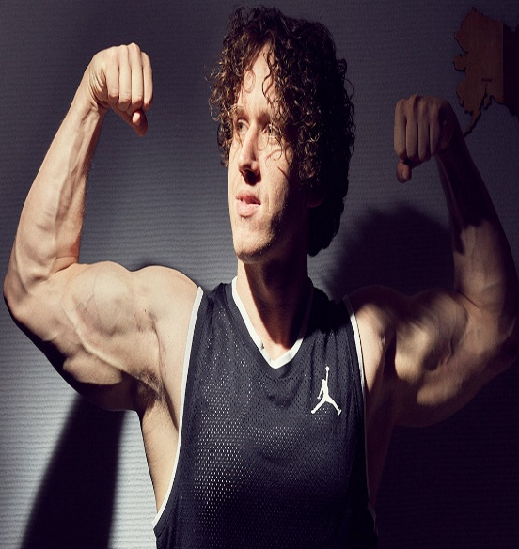
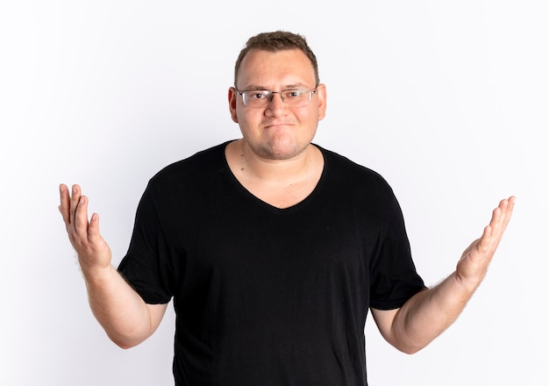
BUILD
well-built
fat
plump
полный
heavily built

Slide 6
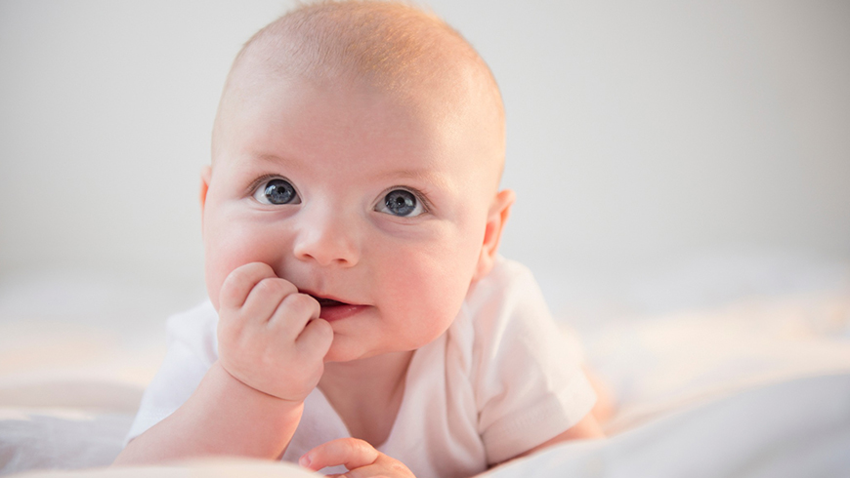
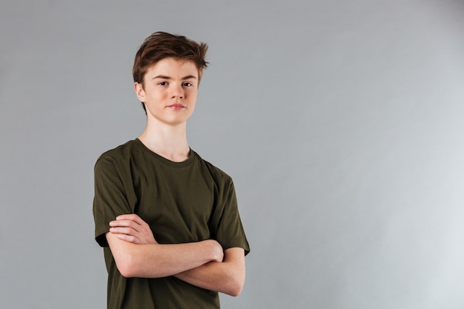
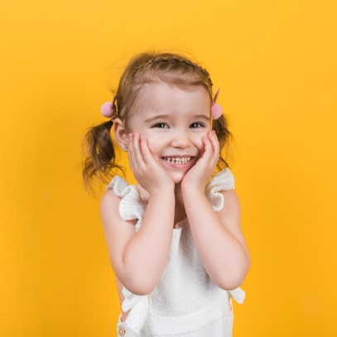
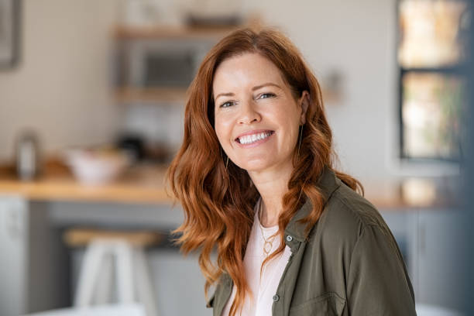
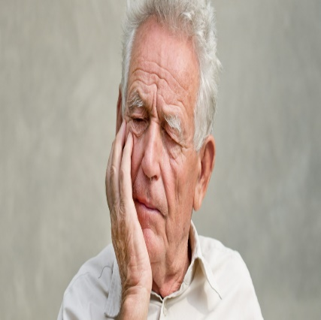
AGE
AGE
AGE
baby
Child
child
teenager
young
middle-aged
old
в возрасте между 20
и 29; за 20
in his/her twenties

Slide 7
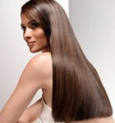
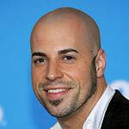
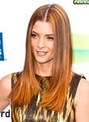
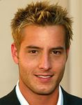
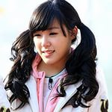
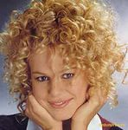
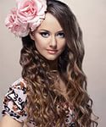
short
long
shoulder-length
bald
HAIR
spiky
straight
pigtails
curly
wavy

Slide 8
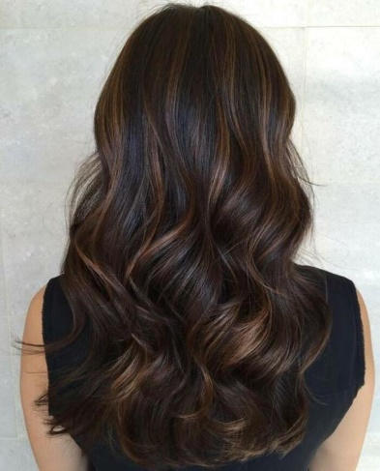
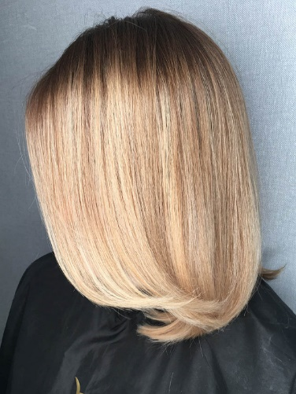
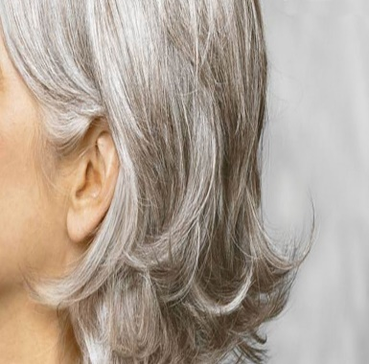
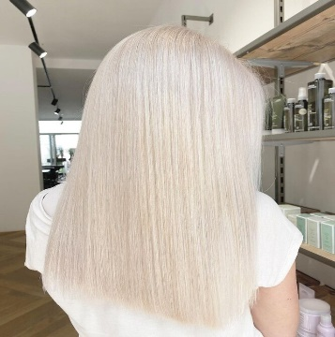
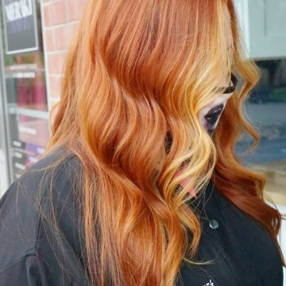
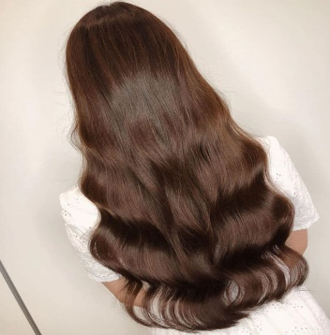
HAIR
Hair
Hair
COLOUR
dark
fair
grey
blond(e)
brown
red

Slide 9
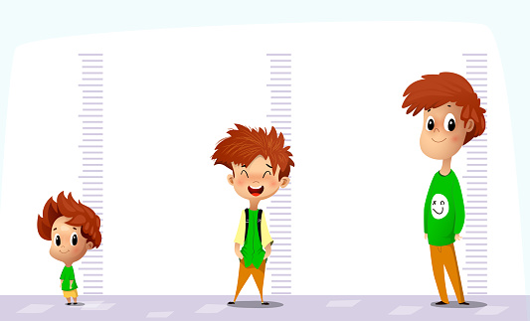
HEIGHT
of medium
height
tall
short

Slide 10
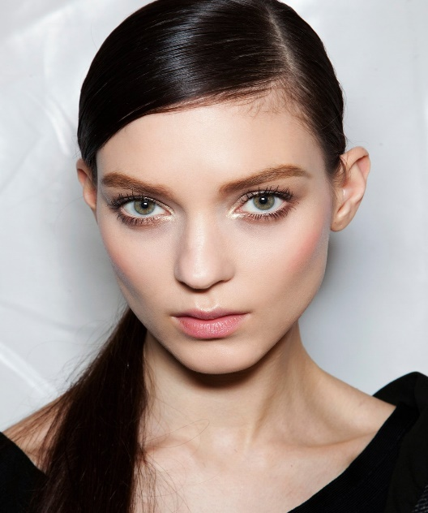
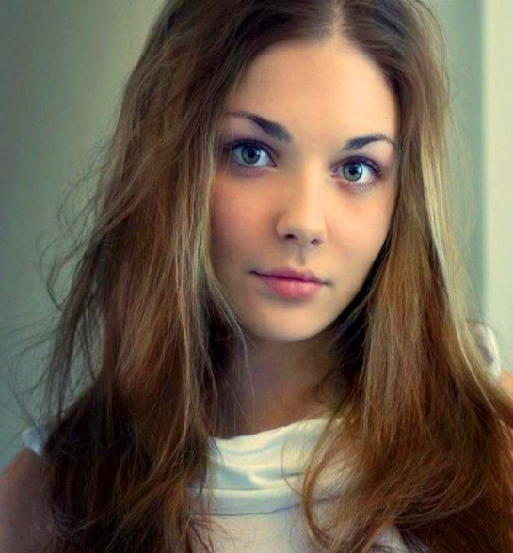
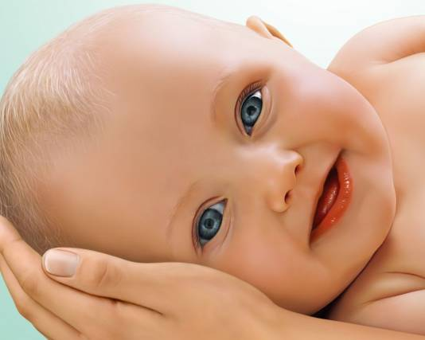
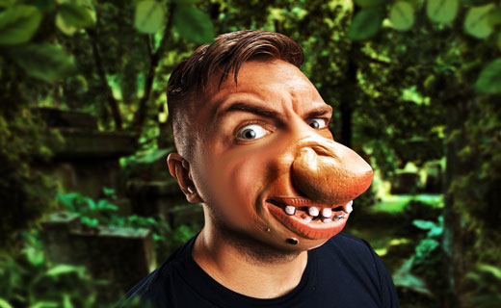
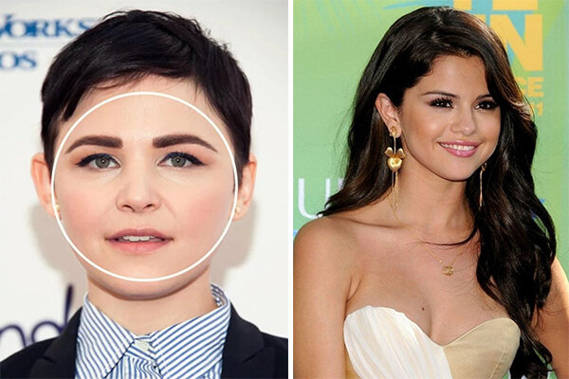
сute
pretty
thin
ugly
FACE
round

Slide 11
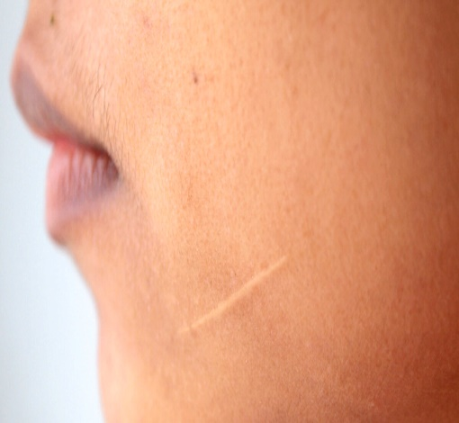
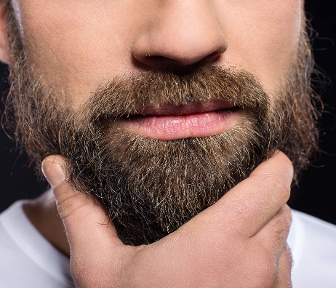
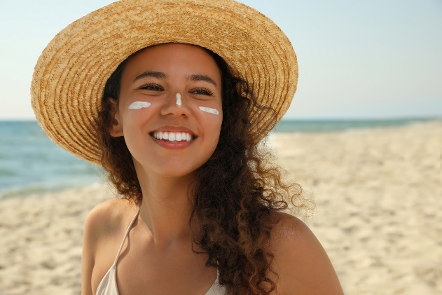
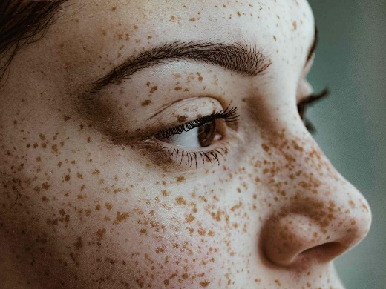
beard
scar
moustache
FACIAL FEATURES
dark tan
freckles

Slide 12
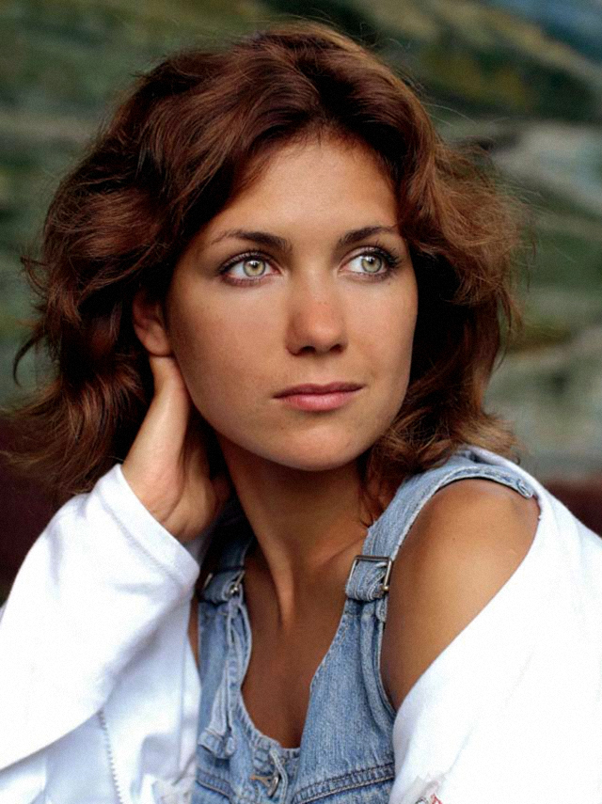
Choose the correct word to describe the picture
She is old/middle-aged.
She has short/long hair.
Her hair is straight/wavy and blonde/brown.
Her face is ugly/pretty.
She has short/long hair.

Slide 13
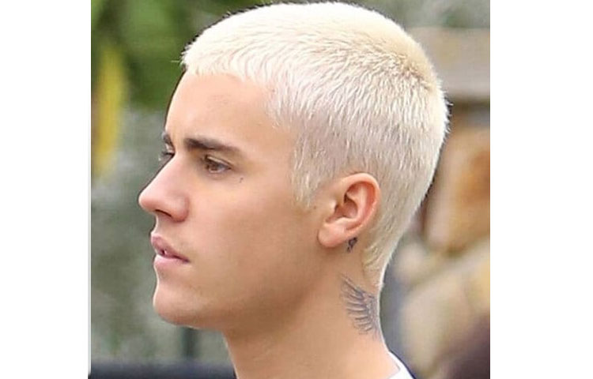
Choose the correct word to describe the picture
He is a teenager/middle-aged man with grey/dark short/shoulder-length curly/spiky hair.
He is skinny/well-built.

Slide 14
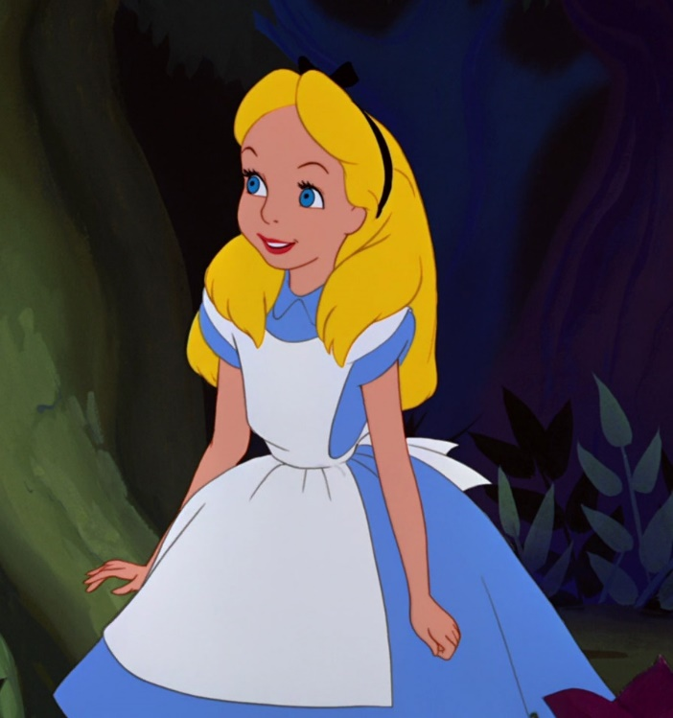
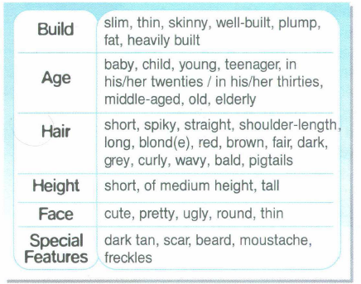
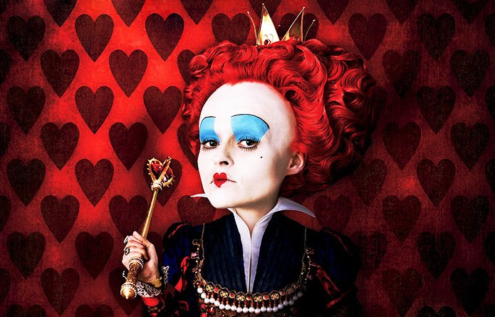
Choose a character. Use the adjectives to describe the people.
Alice
The Duchess

Slide 15
Choose a character. Use the adjectives to describe the people.
Dorothy
The Wicked Witch

Slide 16
Choose a character. Use the adjectives to describe the people.
Peter Pan
Captain Hook

Slide 17
Choose a character. Use the adjectives to describe the people.
1
2
1.Scrooge. 2.Bob Cratchit

Slide 18
Order of adjectives
Study the theory box. Then make your own sentences.
When describing people, mind the order of adjectives. Do not use more than three adjectives before a noun.
Bob is an excellent, young, American athlete.
Opinion | Height/Age | Origin | Noun
excellent | tall/young | American | athlete

Slide 19
Thank you for your attention!

