Slide 2
Self- assessment sheet
№ | Names of tasks | Your mark
1 | Scheme “Jobs”
2 | Board game “What do these people do at their jobs?”
3 | “What job is good for you?”
4 | “What are you doing on…?”
5 | Linda is talking about her intentions for the next year
6 | Rachel`s quastions
7. | Total mark
Rating scale
0-1 mistakes | 2-3 mistakes | More than 3 mistakes
“5” | “4” | “3”

Slide 3
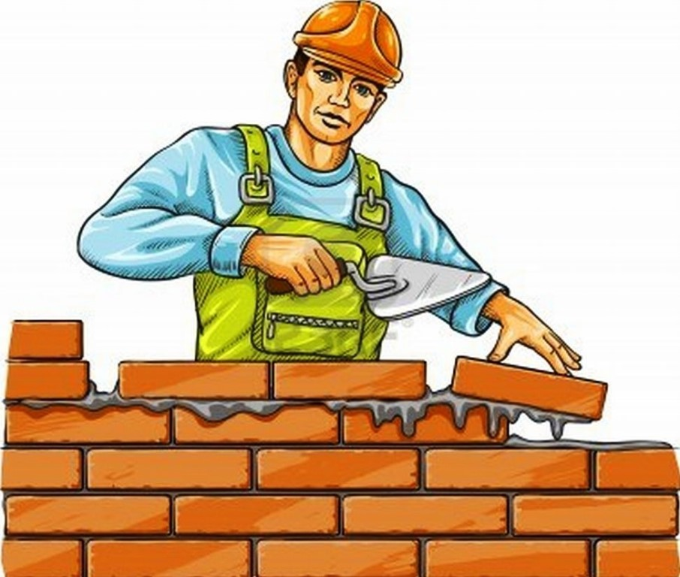
What are we going to talk about?
We are going to talk
about
_____________________.

Slide 4
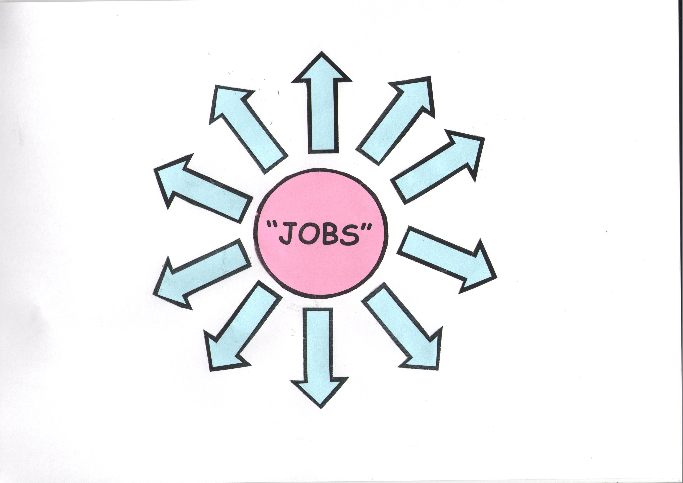
spidergram “jOBS”

Slide 5
spidergram “jOBS”
a hairdresser
a factory worker
a secretary
a builder
a doctor
a bank clerk
a writer
a baby-sitter
a teacher
a computer programmer

Slide 6
BOARD GAME
“Who does it?”

Slide 7
I am going to be ____because
it`s ____.
I am not going
to be ____
because
it`s ____
Which job is good for you?
Why?

Slide 8
Saturday
morning
afternoon
evening
Sunday
morning
afternoon
evening
-What are you doing on…?
-I am going to …

Slide 9
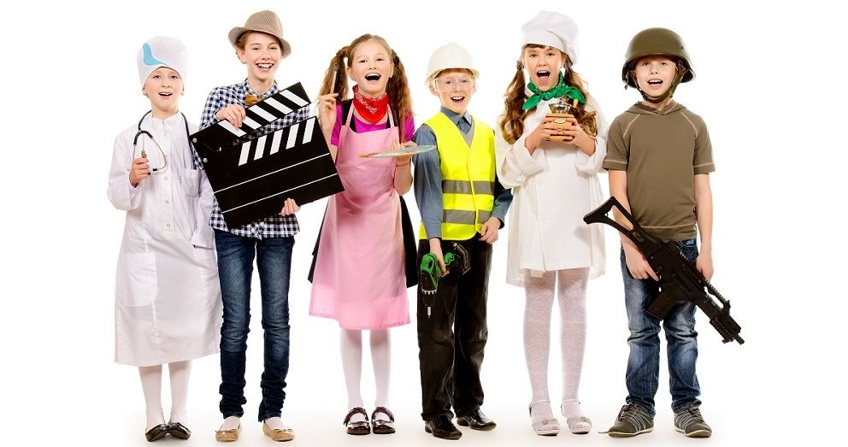
Let’s have a rest

Slide 11
Prediction – Future Simple
People will live under the sea it the next century
Plans – to be going to
He is going to be a doctor
Arrangements – Present Continuous
I am meeting the editor

Slide 12
homework
Ex.19p.79 W. B.
complete the dialogue using the verbs from the box in the right form

Slide 13
Self- assessment sheet
№ | Names of tasks | Your mark
1 | Scheme “Jobs”
2 | Board game “What do these people do at their jobs?”
3 | “What job is good for you?”
4 | “What are you doing on…?”
5 | Linda is talking about her intentions for the next year
6 | Rachel`s quastions
7. | Total mark
Rating scale
0-1 mistakes | 2-3 mistakes | More than 3 mistakes
“5” | “4” | “3”

