Slide 2
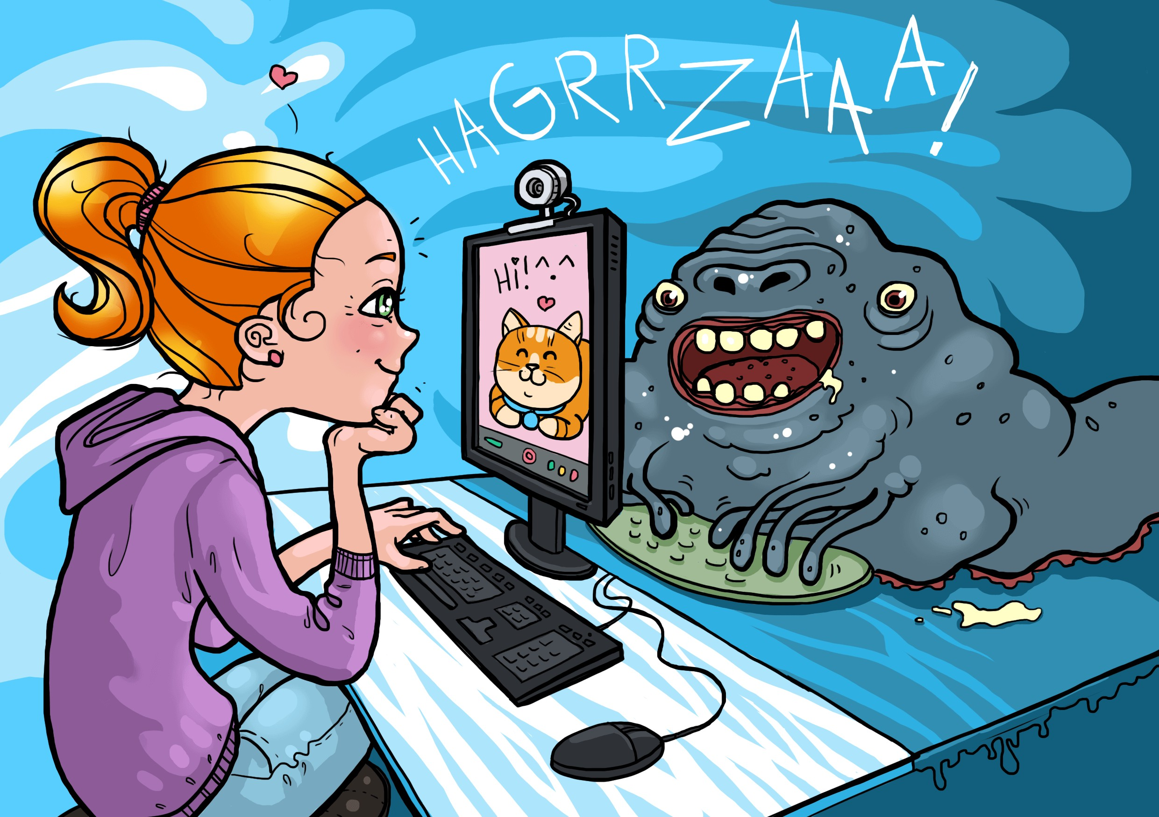

Slide 3
Тема урока:
Social Media Safety (Медиабезопасность.
Правила поведения в социальных сетях).

Slide 4
Цель урока:
Познакомить с правилами общения в социальных сетях.

Slide 5
План урока:
Познакомимся к новой лексикой по теме Интернет, Социальные сети
Решим кейсы
Составим плакат на тему: «Медиабезопасноть. Правила поведения в социальных сетях».
Подведем итоги.

Slide 6
Интернет – «слэнг», который мы знаем:
Login -
Password –
Browser –
Settings –
User –
What else do you know?

Slide 7
Safety -
Network –
Accept –
Attached file –
Password –
Fraud –
Browser –
Settings –
Awareness -

Slide 8
Safety - безопасность
Network – социальная сеть
Accept – принимать
Attached file – прикрепленный файл
Password – пароль
Fraud – мошенничество
Browser – браузер
Settings – настройки
Awareness - осведомленность

Slide 9
Internet safety or social media safety is trying to be safe on the internet and is the act of maximizing a user's awareness of personal safety and security risks to private information.

Slide 11
Case #1
Tom accepted a message on Facebook from a person he didn’t know. There was an information that he was selected and he can get a price. To get the price he should open attached file and give his personal information.
What advice would you give to Tom?

Slide 12
Case #2
Kate met a boy on a social network. They sent messages to each other. He was smart and had a great sense of humor. One day they decided to meet in a park in the evening. When Kate came she saw a grown up man and he didn’t look like a boy from the network.
What advice would you give to Kate?

Slide 13
Case #3
John has read an information on a Social Network that their school starts to study online from the next week because a lot of pupils get sick. John didn’t like to go to school so he was glad and he sent this information to all his classmates. Next Monday everybody went to school except John and his friends.
What kind of information was it? And what advice can you give to John.

Slide 14
Fake news is false information presented as news.
Online fraud is a type of cybercrime fraud.
Personal data is any information related to a person.
Digital footprint - digital activities, actions on the Internet or digital devices.
Cyberbulling - is a form of harassment using electronic means.

Slide 15
Fake news – фальшивые новости
Online fraud – мошенничество в сети
Personal data – персональные данные
Digital footprint – цифровой след
Cyberbulling - кибербуллинг

Slide 16
Делаем плакат
6 tips to stay safe online:
1
2
3
4
5
6

Slide 17
Ответьте на вопросы:
Что понял?
Что хочу узнать?
Что осталось непонятным?

