Slide 1
[ɑɪ] I like white mice.
[eɪ] Say, what date it is today.
[ŋ] Fishing is boring, singing is interesting.

Slide 2
Like
Love
Hate
Enjoy
Don`t like
+ глагол + ing
I like cooking.

Slide 3
I like playing the piano.
You hate riding a bike.
We like feeding our cat.
They don`t like singing.
He enjoys driving his car.
She loves reading books.
It likes sleeping.

Slide 4
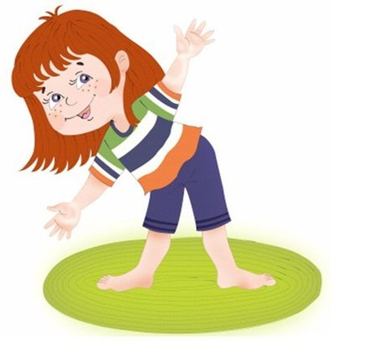
I like watching.
I like swimming.
I love walking.
I love jumping.
I enjoy sleeping.
I enjoy sitting.

