Slide 1
Урок английского языка на тему:
«The Medical Profession»

Slide 2
1. Стадия вызова (EVOCATION)
Речевая разминка. Введение в тему урока. As you know there are a lot of interesting and useful jobs in the world. Now I’d like you to listen to a poem about a job which is difficult but noble and rewarding.
Фонетическая зарядка. We’ll start the lesson with a tongue twister. Nine nice night nurses nursing nicely.

Slide 3
Match the parts of different proverbs
The doctor is often more to be feared | than the disease.
An ignorant doctor is no better | than a murderer.
A young doctor makes | a full graveyard.
Don’t live in a town where | there are no doctors.
An apple a day | keeps the doctor away.
The presence of the doctor | is the beginning of the cure.
Pay the doctor | praise the Lord.
Mother Nature, time and patience | are the three best doctors.
Every doctor thinks | his pills are the best.
God heals | but the doctor gets paid.
The best doctor gives | the least medicines.
Only a doctor can teach | how to love life
“Dr.” is not just a prefix | it’s a super power.
Medicine cures diseases | but only doctors can cure patients.
A doctor is always | someone’s HERO and someone’s HOPE.
The presence of the doctor | is the beginning of the cure.
No doctor is better | than three.

Slide 4
Pre- reading
What is the goal of a doctor?
What makes a doctor a good doctor?
What skills should a doctor have?

Slide 5
2. Этап осмысления
(REALIZATION OF MEANING)

Slide 6
The White Hat: calls for information, known or needed. “The facts, just the facts.”
The Red Hat: signifies feelings, hunches and intuition - the place where emotions are placed without explanation.
The Black Hat: signifies caution and critical thinking - do not overuse! Why something may not work.
“Six Thinking Hats”
The Yellow Hat: symbolizes brightness and optimism. You can explore the positives and probe for value and benefit.
The Green Hat: focuses on creativity, possibilities, alternatives and new ideas. It is an opportunity to express new concepts and new perceptions .
The Blue Hat: is used to manage the thinking process. It ensures that the “Six Thinking Hats” guidelines are observed.

Slide 7
TEXT. What is a doctor?
Advantages of the medical profession
Disadvantages of the medical profession
Vocational medical education
What qualities does a doctor need?
Where do doctors work?

Slide 8
Doctor's salary in different countries
Country | Min. doctor's salary/year | Avg. doctor salary/year | Nurse | Dentist | Veterinarian | Surgeon
USA | 68,922 | 105,968 | 73,550 | 133,941 | 95,000 | 395,350
UK | 36,792 | 76,056 | 29,652 | 94,947 | 40,832 | 85,967
Australia | 44,805 | 78,566 | 49,352 | 66,234 | 44,112 | 102,043
Canada | 52,541 | 110,396 | 58,955 | 205,660 | 58,653 | 145,248
Germany | 40,933 | 110,939 | 30,513 | 55,988 | 52,629 | 66,222
France | 44,376 | 127,528 | 33,697 | 121,307 | 71,512 | 215,843
Russia | 496 month | 662 month | 496 month | 1,089 month | 662 month | 889 month
China | 42,429 | 115,548 | 38,572 | 117,057 | 56,852 | 141,206

Slide 9
University | Bachelor’s / year | Country
Harvard University | 64,984 | USA
University of Oxford | 40,382 | UK
University of Cambridge | 68,881 | UK
Stanford University | 80,312 | USA
Johns Hopkins University | 56,500 | USA
Karolinska Medical Institute | 24,536 | Sweden
University of California at Los Angeles | 23,687 | USA
University College London | 44,020 | UK
Yale University | 42,120 | USA
Imperial College London | 52,221 | UK

Slide 10
Advantages of Being a Doctor
Doctors can earn good salaries
Doctors have a high reputation in society
You can help other people
Doctors can save lives
Being a doctor is more than a profession
You learn to become responsible
Being a doctor can give you a purpose in life
Doctors learn how to become leaders
Every day looks different
You learn how to deal with death
Doctors can work indoors
You can help out your family and friends
Many different fields you can work in
Doctors will always be needed
You can open your own doctor’s office
Gives you the opportunity to retire early
Many doctors are happy with their job

Slide 11
Disadvantages of the medical profession
Being a doctor implies high levels of pressure
Mistakes can cost lives
Doctors often have plenty of stress
It takes quite long to finish medical school and subsequent training
High tuition fees
Doctors often work long hours
You may have to work at nighttime
You may get sued
Many doctors are not able to unplug from their job
Some patients are rather difficult
Doctors may become infected with diseases
You will not know what’s happening
Even your best performance will sometimes not be enough
Sleeping problems are quite common among doctors
You have to rely on your staff

Slide 12
Let’s compare and analyze the facts thinking of pros & cons of being a doctor.
Being a Doctor Pros | Being a Doctor Cons
Doctors have a good salary | Being a doctor can be mentally challenging
Being a doctor can give you meaning | High costs for medical school
You can save lives | Student loan debt is a problem
Doctors have a high reputation in society | Your mistakes can cost lives
You can help your family and friends | Some patients will not appreciate your work
Various different fields you can work in | You may get sued
Doctors have good chances in the dating market | Doctors have to work long shifts
Being a doctor is more than a profession | Mental issues are rather common
You can learn how to become a leader | Sleeping problems
You learn how to deal with adversity | Doctors may have to work at nighttime

Slide 13
3. Рефлексия (REFLECTION)
Cinquains
Doctor
Helpful, strong-willed
To examine, to cure, to prescribe
An apple a day keeps the doctor away.
Physician
Doctor
Sensible, well-organized, disciplined
To protect, to heal, to diagnose
No doctor is better than three.
5.Specialist

Slide 14
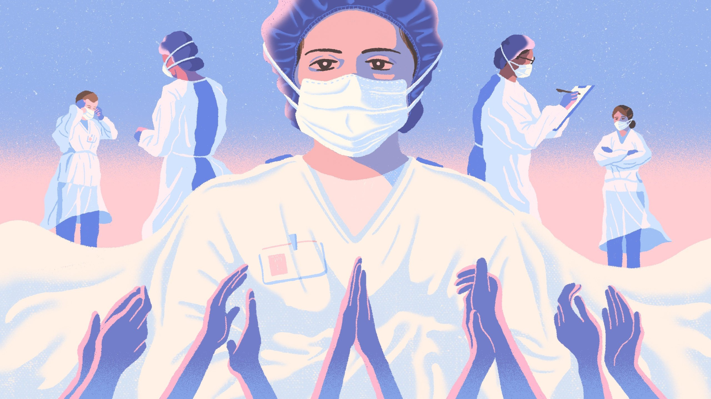
Conclusion
http://www.drivemusic.club/medicine/50542-a.parkhomenko-net-professii-blizhe-k-bogu.html

