Slide 1
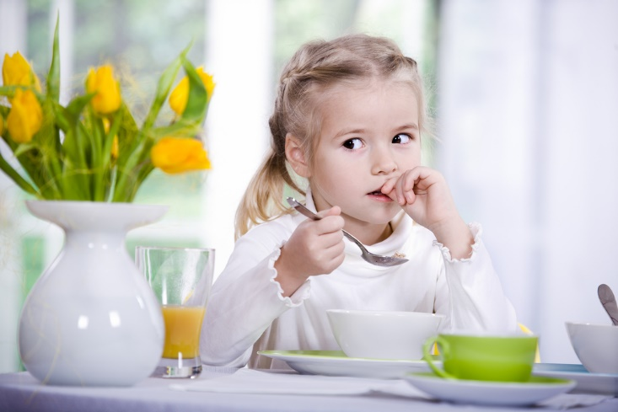
Здоровье близко – ищи его в миске
Презентация выполнена Синицыной Т.В., педагогом дополнительного образования ГБДОУ №34 Красногвардейского района города Санкт-Петербурга

Slide 2
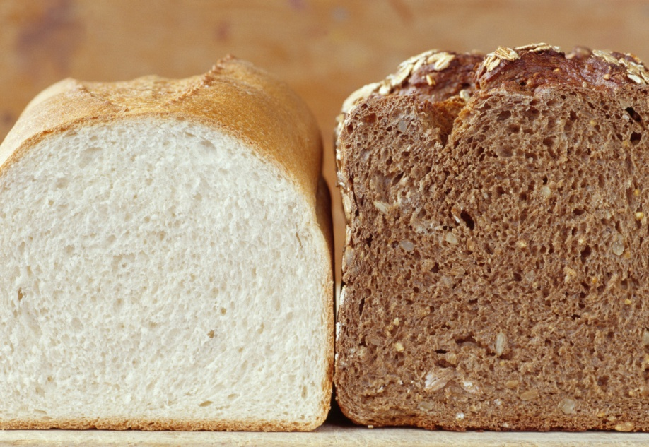
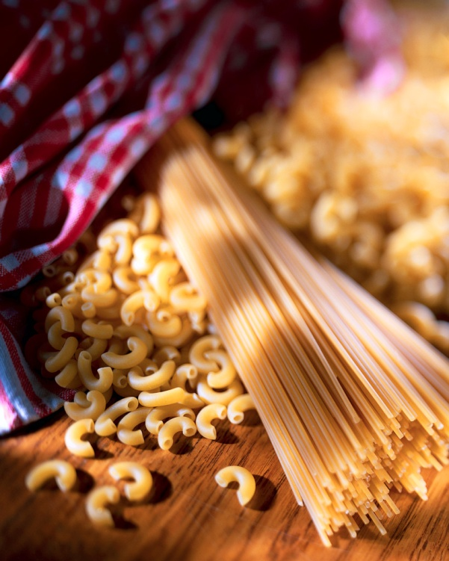
Do you like…? – Yes, I do/No, I don’t.
porridge
bread
rice
pasta

Slide 3
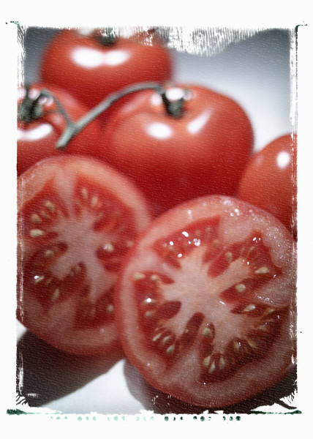
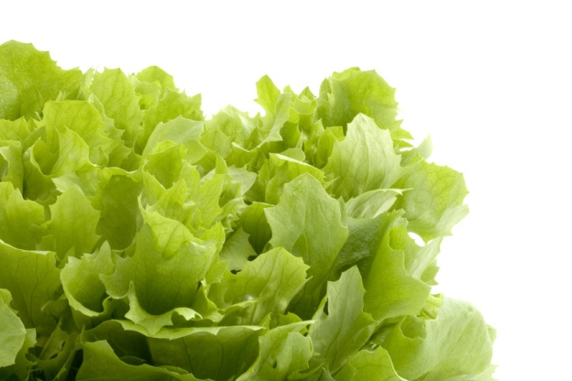
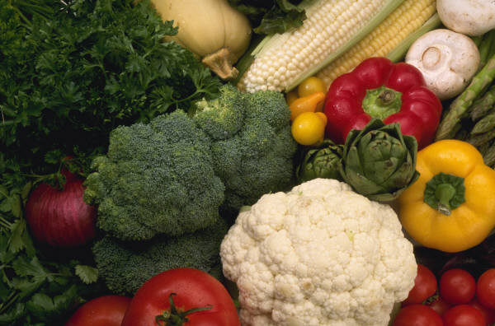
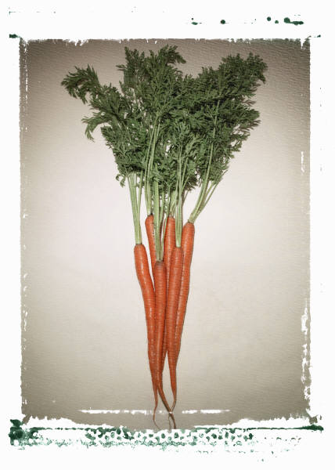
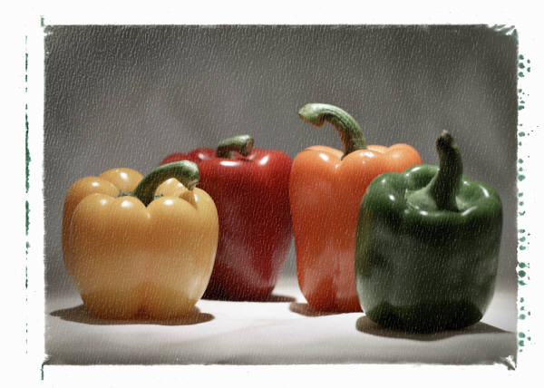
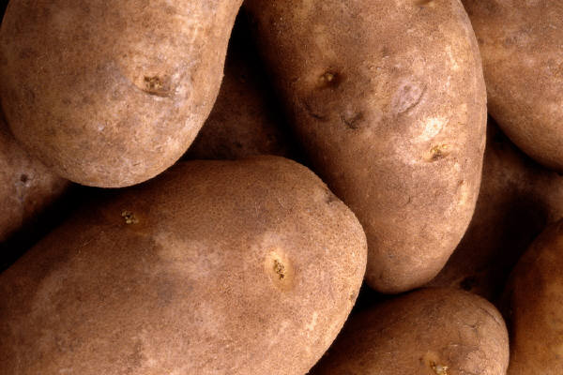
Do you like…?
Yes, I do/No, I don’t.
salad
tomatoes
vegetables
carrots
peppers
potatoes

Slide 4
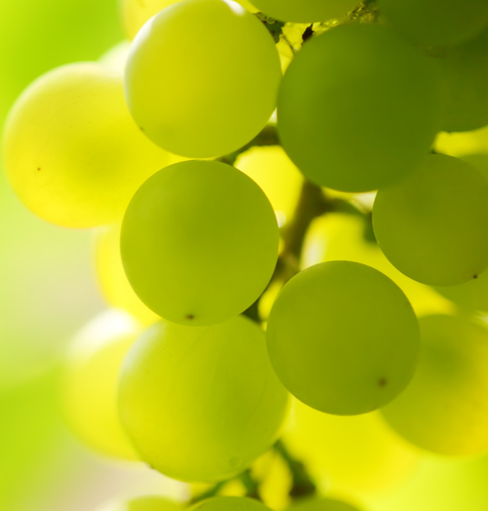
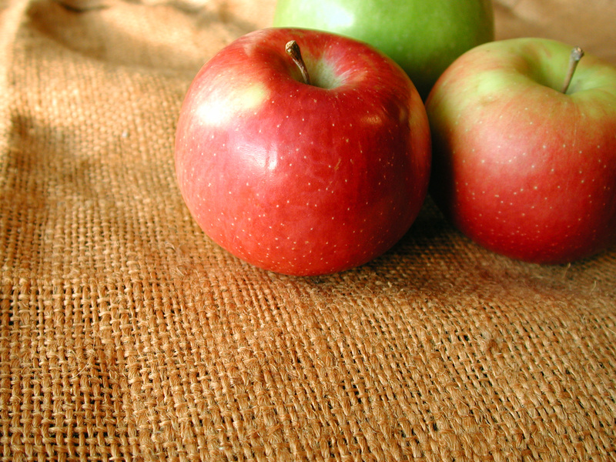
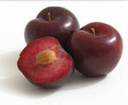
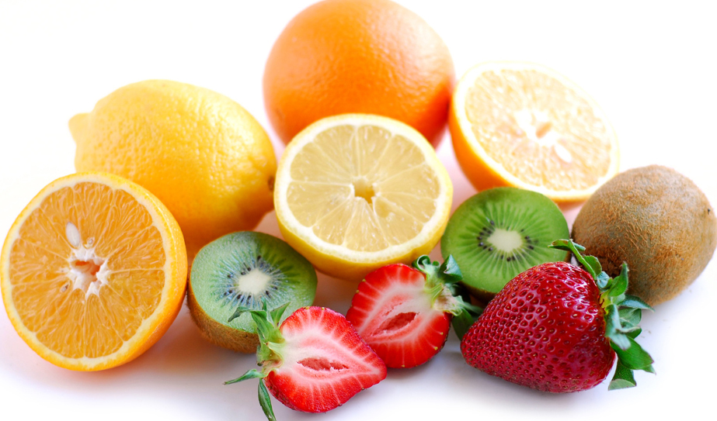
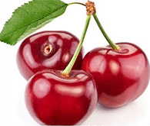
Do you like…?
Yes, I do/No, I don’t.
plums
apples
grapes
fruit
cherries

Slide 5
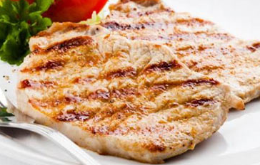
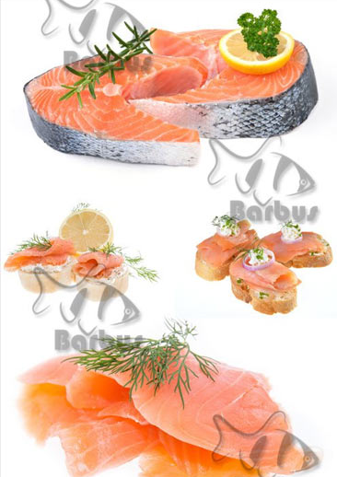
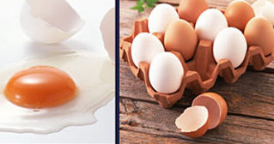
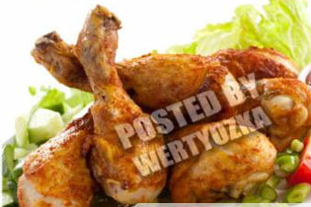
Do you like…? – Yes, I do/No, I don’t.
meat
eggs
fish
chicken

Slide 6
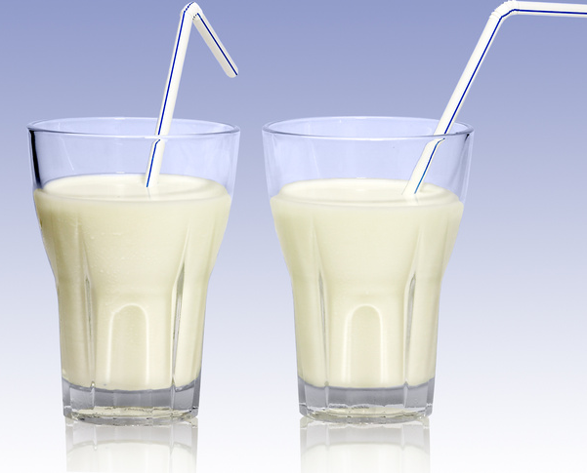
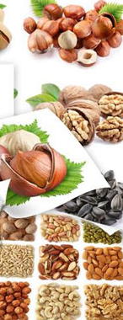
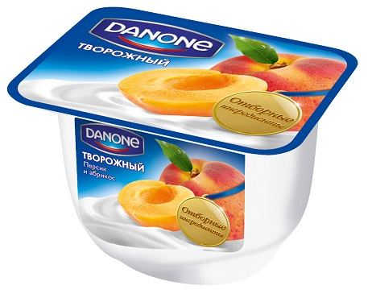
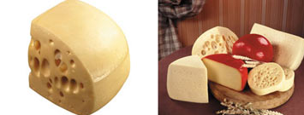
Do you like…? – Yes, I do/No, I don’t.
milk
yoghurt
nuts
cheese

Slide 7
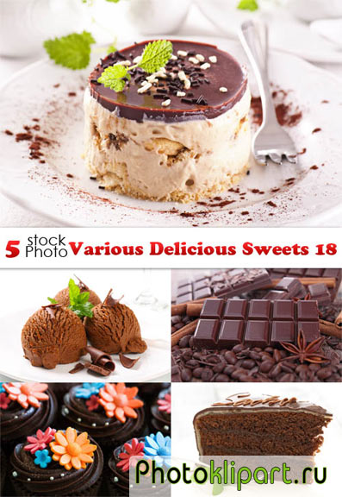
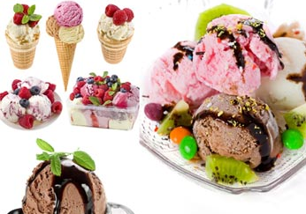
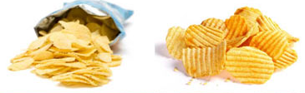
Do you like…? – Yes, I do/No, I don’t.
chocolate
cake
chips
ice-cream

Slide 8
Always
bread rice pasta vegetables fruit

Slide 9
Often
meat fish eggs chicken nuts
cheese milk yoghurt

Slide 10
Sometimes
cake
chocolate
ice-cream chips

Slide 11
It’s good for me!
Sometimes
Often
Always

