Slide 2
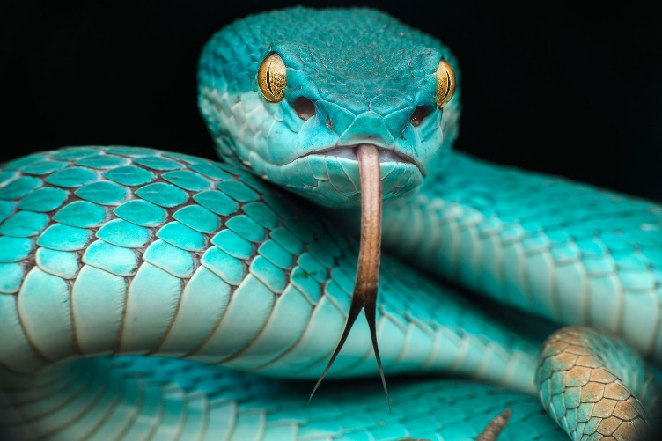
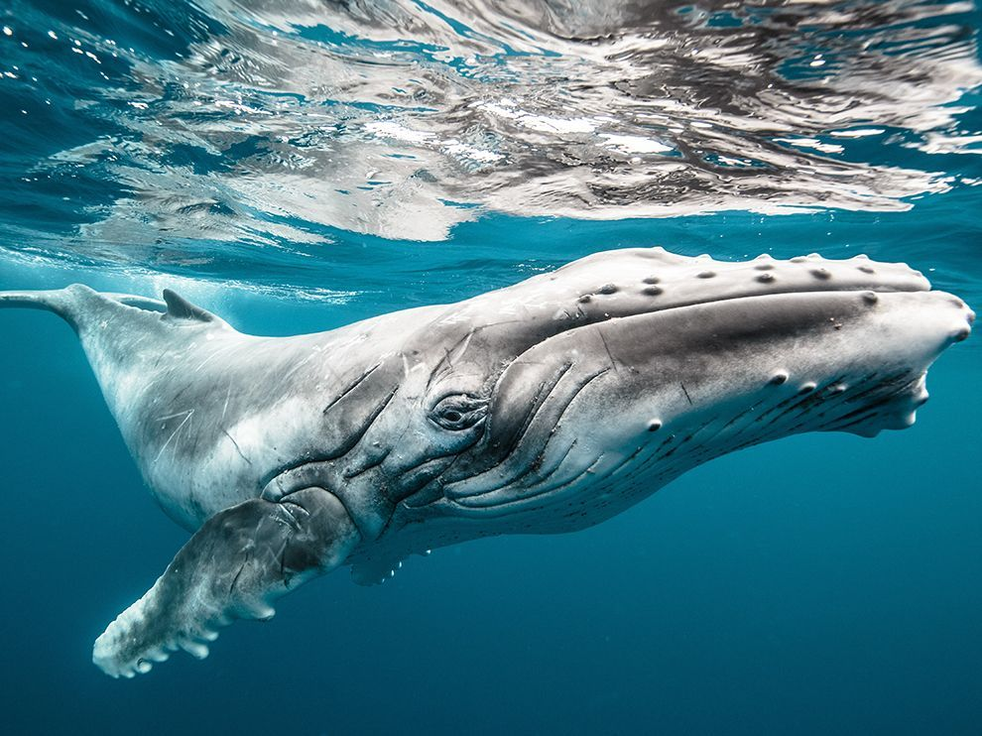
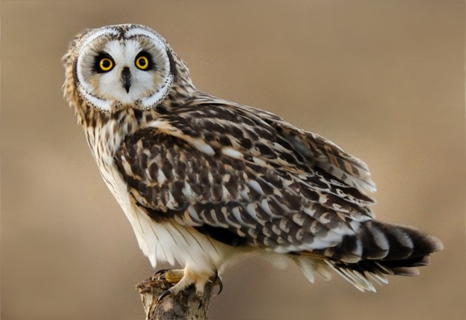
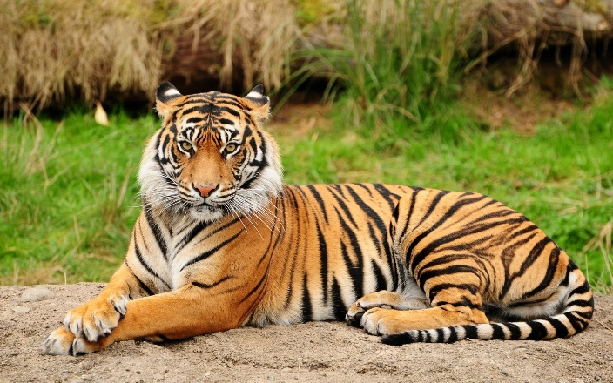
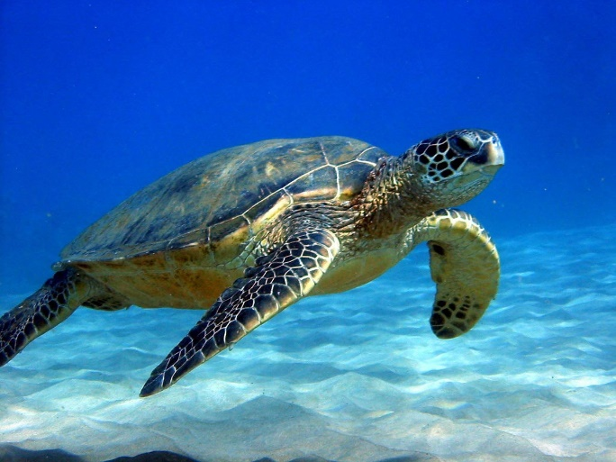
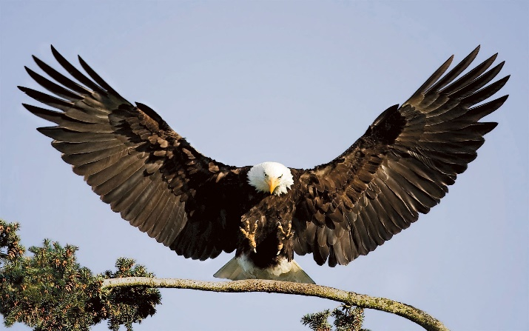
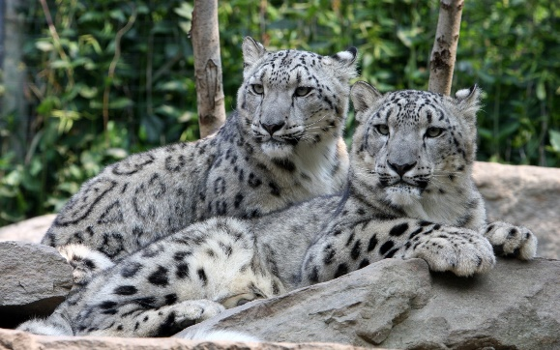
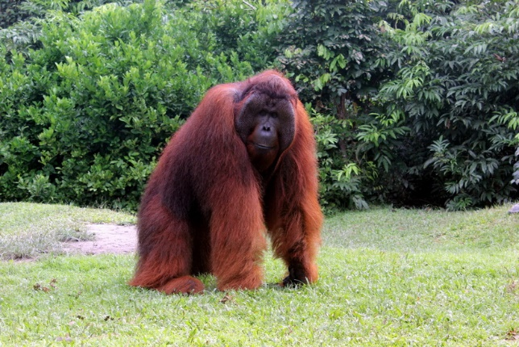
Look at the pictures!!!
We are going to talk about
ANIMALS!
Can you guess?
What are we going to talk?

Slide 3
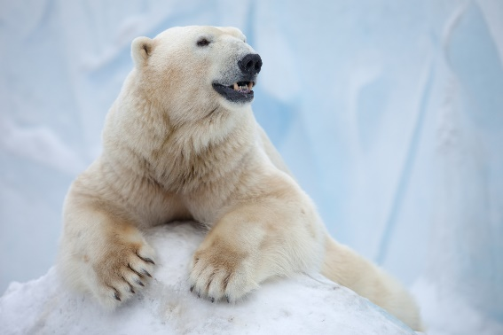
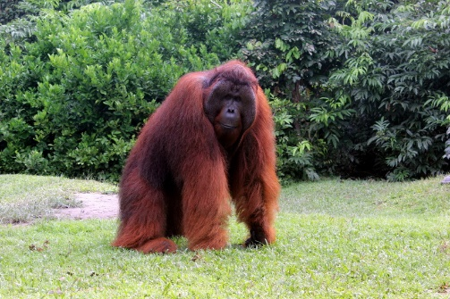
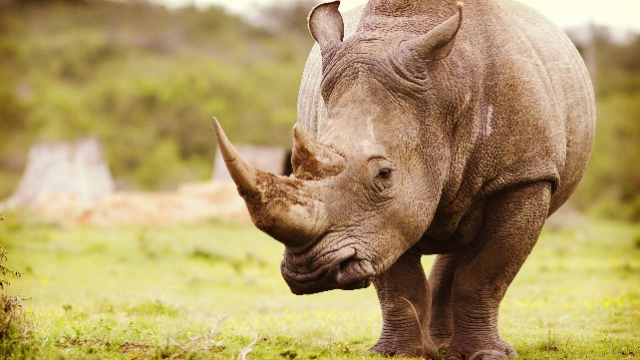
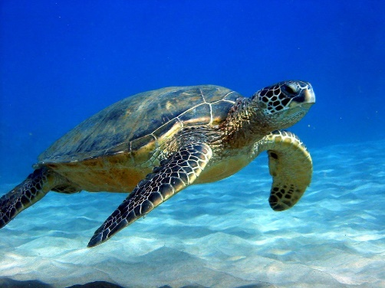
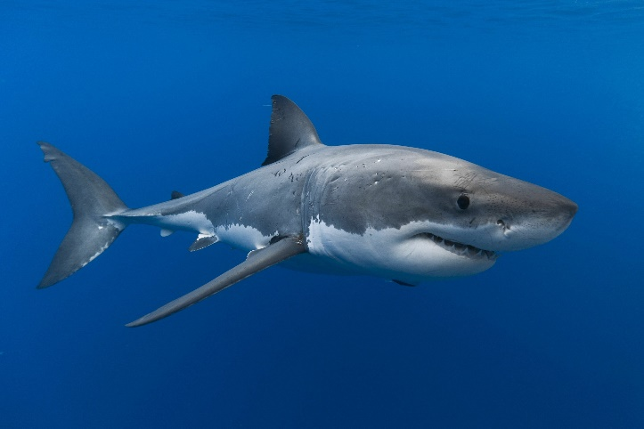
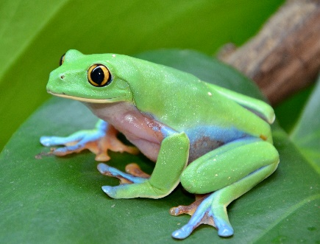
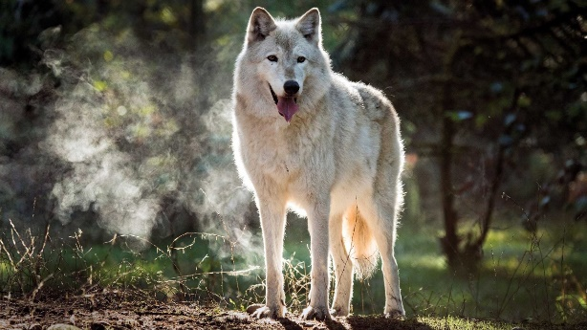
ANIMALS
2
3
OWL
RATTLESNAKE
1.A.Put down the words into you vocabulary book.
TURTLE
ORANG-UTAN
1
4
5
EAGLE
RATTLESNAKE
POLAR BEAR
GORILLA
ELEPHANT
TIGER
ORANG-UTAN
WHALE
SNOW LEOPARD
6
7
8
RHINO
SHARK
RHINO
WHALE
TURTLE
WOLF
1.B.Translate these words into russian.
POLAR BEAR
9
10
11
TIGER
2.Listen and repeat.
FROG
EAGLE
SNOW LEOPARD
OWL
SHARK
12
13
PANDA
3.Match the words with the pictures.
FROG
WOLF

Slide 4
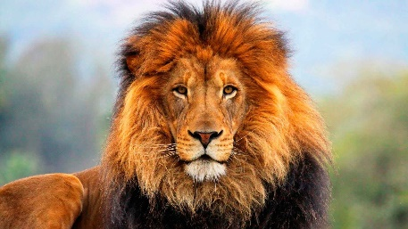
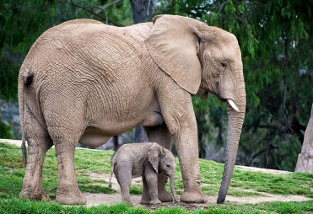
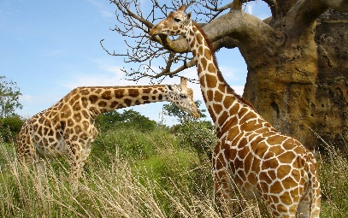
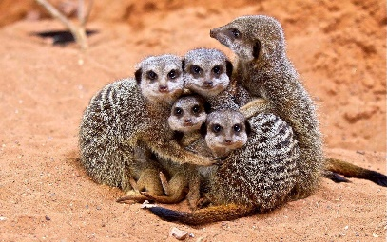
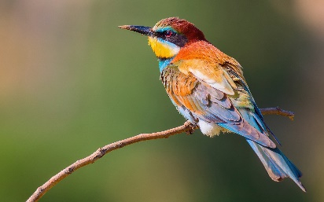
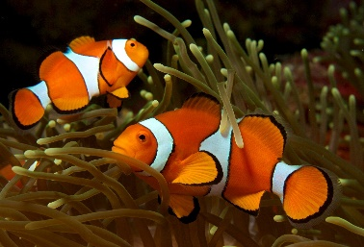
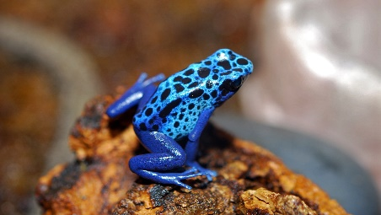
ANIMALS
FROG
4.Listen to the ringtones. Can you identify the six animals
WOLF
1
4
FROG
WHALE
WHALE
2
5
OWL
WOLF
POLAR BEAR
POLAR BEAR
3
6
RATTLESNAKE
OWL
RATTLESNAKE

Slide 5
ANIMALS
6. Try to guess and tell if it is right or wrong.
Example:
IS IT A WHALE?
IS IT A TIGER?
YES, IT IS.
NO, IT ISN’T.
IT’S A WHALE.
IT’S A POLAR BEAR

Slide 6
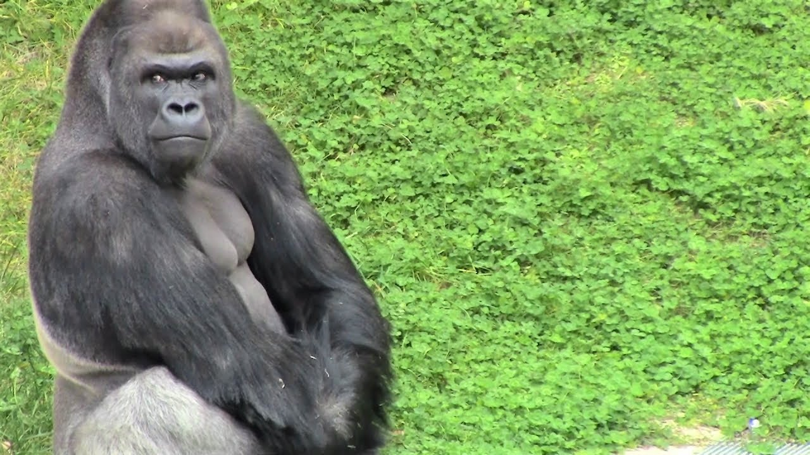
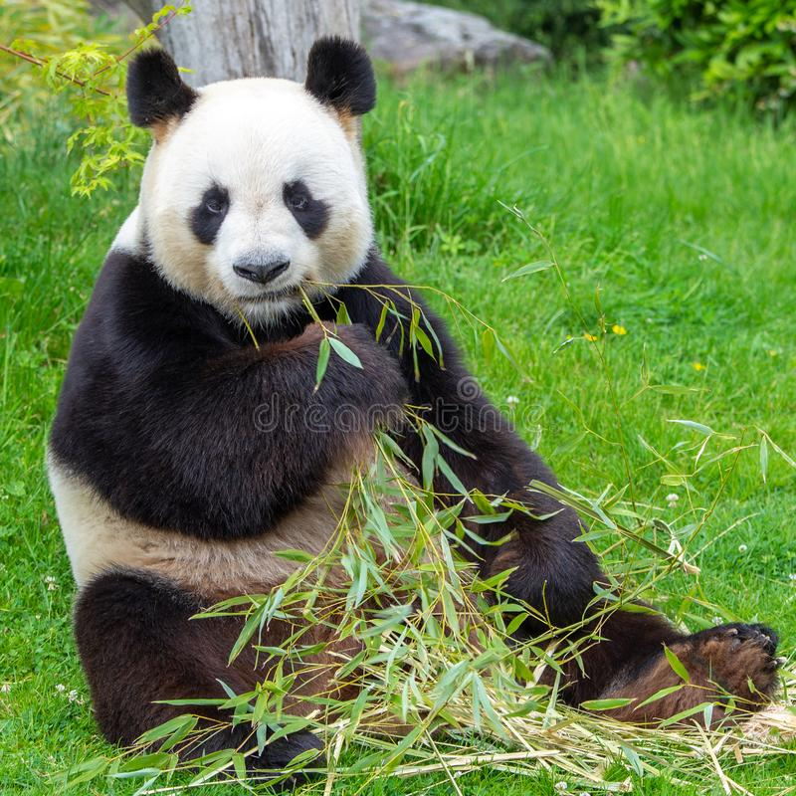
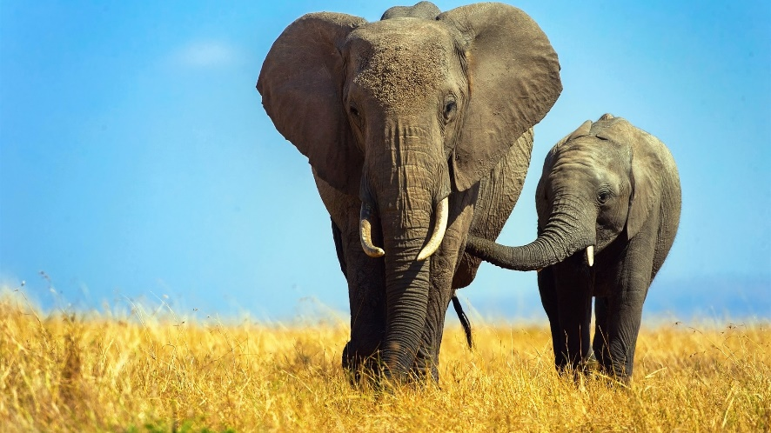
ANIMALS
IS IT A POLAR BEAR?
IS IT A PARROT?
IS IT A SHARK?
YES, IT IS.
IS IT A POLAR BEAR?
NO, IT ISN’T.
NO, IT ISN’T.
IT’S A POLAR BEAR.
NO,IT ISN’T
IT’S AN EAGLE.
IT’S A GORILLA
IT’S A TURTLE
IS IT A DOG?
IS IT A PANDA?
IS IT AN ELEPHANT?
IS IT A FROG?
YES, IT IS.
NO, IT ISN’T.
YES, IT IS.
YES, IT IS.
IT’S A TIGER.
IT’S A PANDA.
IT’S AN ELEPHANT.
IT’S A FROG.
IS IT A SHARK?
IS IT A WOLF?
YES, IT IS.
YES, IT IS.
IT’S A SHARK?.
IT’S A WOLF.

Slide 7
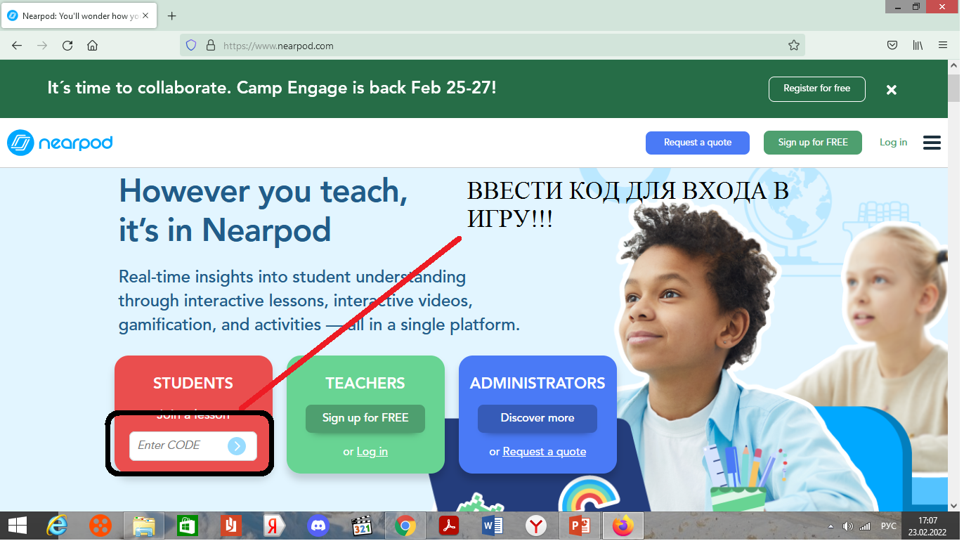
ANIMALS
GAME
1. Введите сайт: www.nearpod.com
2. Введите код для игры:

