Slide 2
Why do I always
start our lesson
asking “How are you?”

Slide 4
Do you agree that
emotions influence your
working efficiency?

Slide 5
+ I absolutely agree with that. I am of this opinion because… I can also prove it from my personal experience. For example, …
- I totally disagree with that. I am of this opinion because… I can also prove it from my personal experience. For example, …

Slide 6
Emotional intelligence
Emotional quotient
EQ

Slide 7
I suppose, emotional intelligence is …
I guess, emotional intelligence is …
It seems to me that emotional intelligence is …

Slide 8
Emotional intelligence (EI) or emotional quotient (EQ) is the ability of individuals to recognize their own and other people's emotions, to discriminate between different feelings and label them appropriately, and to use emotional information to guide thinking and behavior

Slide 9
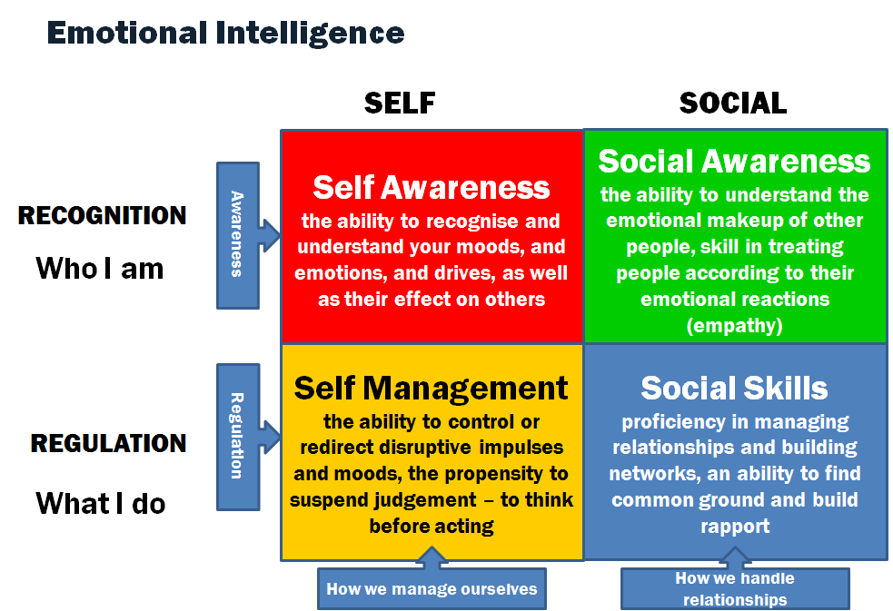

Slide 10
What do you feel now
and why?
Talking about myself, …
I believe, I feel that because …

Slide 11
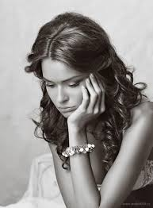
Sad, depressed, upset

Slide 12
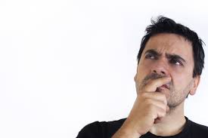
thoughtful

Slide 13
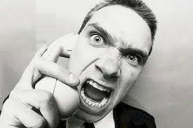
Angry, furious

Slide 14
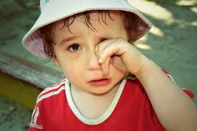
Unhappy, miserable

Slide 15
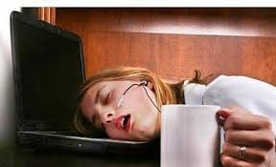
Tired, exhausted

Slide 16
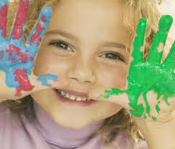
Happy, cheerful

Slide 17
Relaxed, relieved

Slide 18
What can we do in such
situations?
I didn’t sleep enough and feel tired
The teacher was unfair and I feel angry
It seems that nobody understands me and I feel lonely
Exams are coming and I feel nervous and worried

Slide 19
A | B
So, what would you do if you …? | You know, I would probably … And you?
As for me, I would … | I see.

Slide 20
Read the boy’s story.
What is his problem?

Slide 21
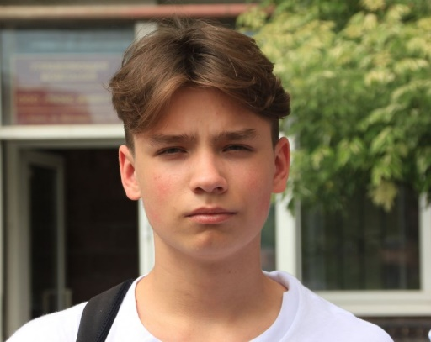
- Hello, my name is Kirill and next year I’m going to enter the university. So, as you may guess, my life is really stressful now. Quite often I feel annoyed with my parents because it seems they can only talk about my coming exams. Sometimes I feel angry with my teachers cause I think they aren’t fair. I also feel sad when I get bad marks at school. Besides I feel disappointed when my girlfriend doesn’t appreciate my attempts to make her happy or just to cheer her up.
To be honest, all these negative emotions dominate my life and spoil it. Can I improve the situation somehow?

Slide 22
Write down some advice
for him

Slide 23
What do you feel now
and why?
At the end of the lesson I feel …
I feel that because …

