Slide 1
Brainstorm game for students 7 classes
by
Kunitsyna A.M.

Slide 2
Content
Hot potato
Tongue-twister
Question words
Abbreviation «Internet Slang»
Make a pizza (Past Simple)
Speaking

Slide 3
Hot potato

Slide 4
Tongue-twister
Peter Piper picked a peck of pickled peppers.
A peck of pickled peppers Peter Piper picked.
If Peter Piper picked a peck of pickled peppers,
Where is the peck of pickled peppers
Peter Piper picked?

Slide 5
Question words
https://wordwall.net/ru/resource/28110542
https://wordwall.net/ru/resource/15102956
https://wordwall.net/resource/10124020
https://wordwall.net/resource/291143

Slide 6
Abbreviation
«Internet Slang»
BBL
FAQs
IMHO
LOL
TTYL
TYVM
MSG
ROFL
Laughs Out Loud
Rolling Of The Floor Laughing
In My Humble Opinion
Message
Talk To You Later
Thank You Very Much
Frequently Asked Questions
To Be Back Later

Slide 7
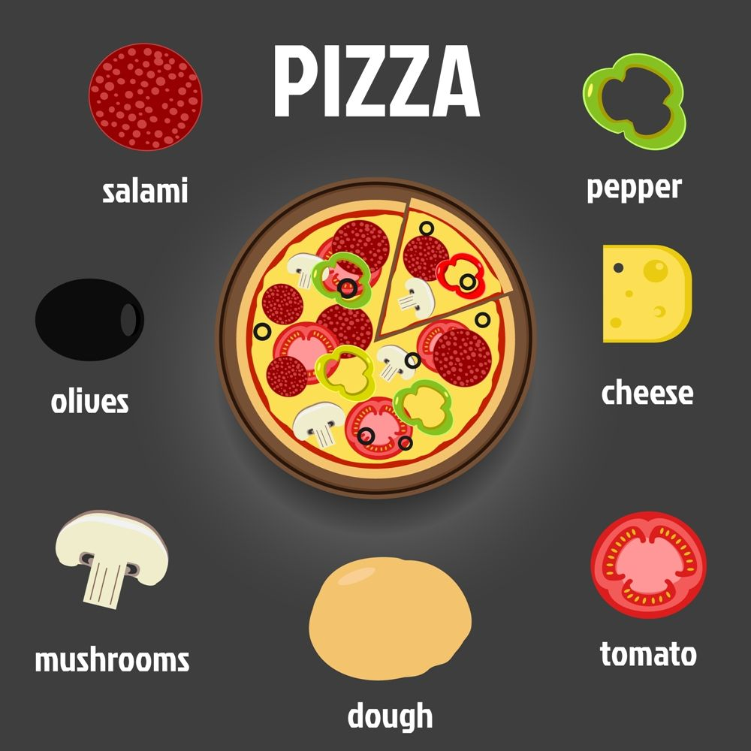
Make a pizza (Past Simple)

Slide 8
Speaking
What colour…?
What is he/she doing?
It’s…
Who is it?
Where is he/ she?

