Slide 1
«My favorite season”

Slide 2
Snowy fine sunny rainy cloudy sky jump
In winter its cold and _______
In summer its____ and_______
In autumn its____ and_______
In spring I can ______
up into the_______

Slide 3
In winter its cold and snowy
In summer its sunny and fine
In autumn its cloudy and rainy
In spring I can jump up into the sky

Slide 5
Are these pictures correct with their descriptions or not?
1. To fly a kite 2. play in the fallen leaves
4. build sand castles
3. To play snowballs

Slide 6
What do you like to do when the weather is.. As for me when the weather is… I like …
To ski
To skate
To sledge
To play snowballs
To make a snowman
To walk in the forest
To play hockey
To play tennis
To play football
To swim in the river
To play with toys
To ride a bike
To read books
To walk with friends
To sing and dance
To stay at home and …
To play computer games
To watch TV
To play volleyball
To fly a kite

Slide 7
What do you do in winter?
In winter we can ... As for me in winter I like to …but when it is …I stay at …and …

Slide 8
What do you do in summer ?
In summer we can … As for me in summer I like to … but when it is … I stay at … and ….

Slide 9
What do you do in autumn ?
In autumn we can … . As for me in autumn I like to …but when it is …I stay at …and … .

Slide 10
What do you do in spring?
In spring we can … As for me in spring I like to …but when it is ... I stay at … and …

Slide 11
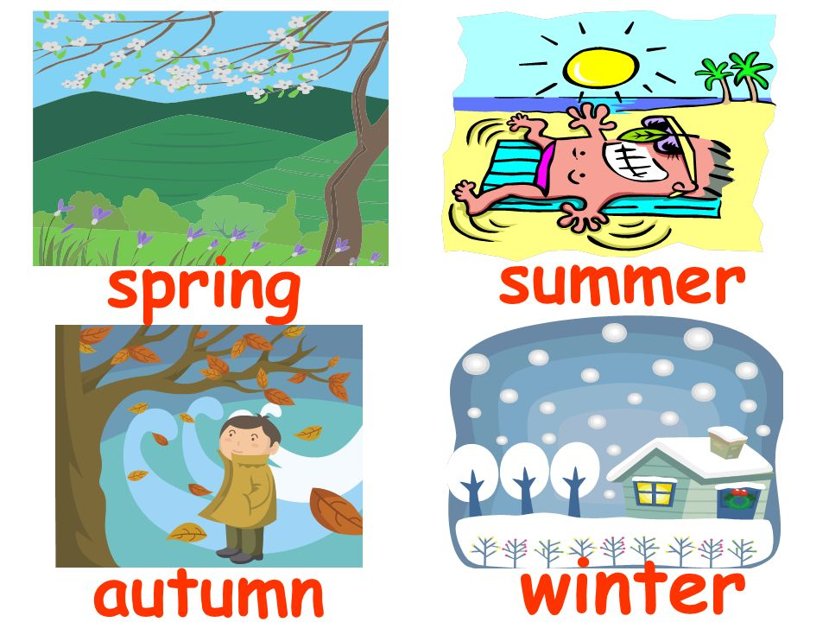

Slide 12
What is your favourite season?
There are four seasons in a … Winter has 3 months .They are … The winter days are … , the nights are ... The trees and streets are white. The winter is the coldest season … The weather in winter is …. When it is windy and cold I stay at.. But winter is my favourite … because I can …… But best of all I like to…..

Slide 13
Thanks for your attention!!!!

