Slide 1
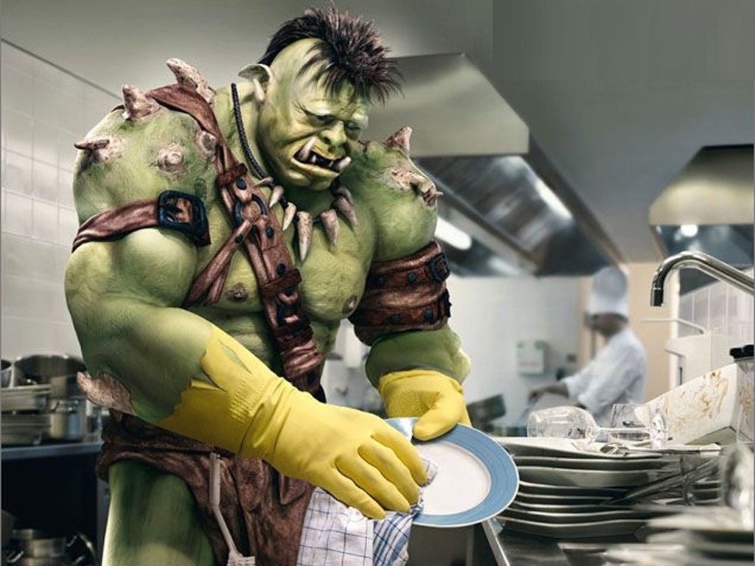
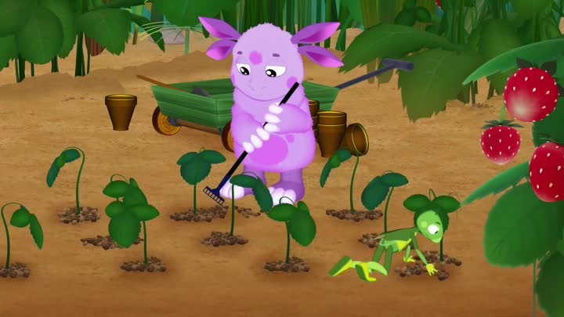
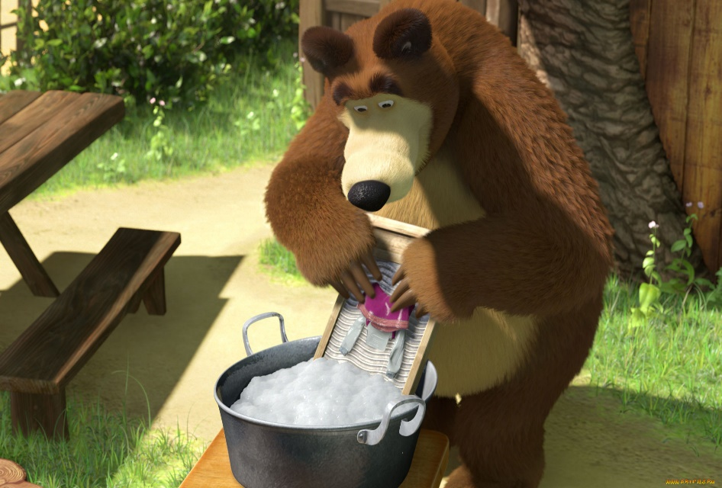
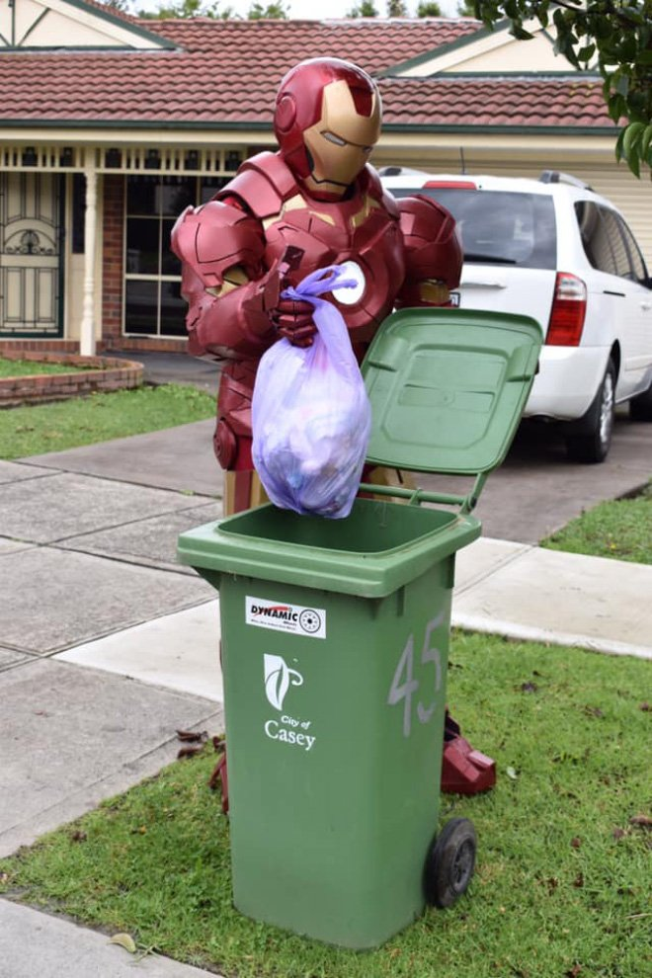
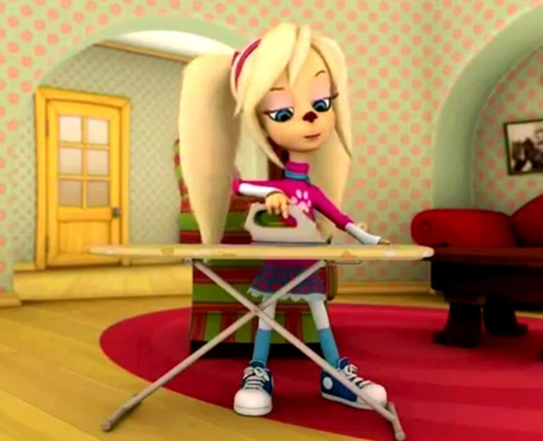
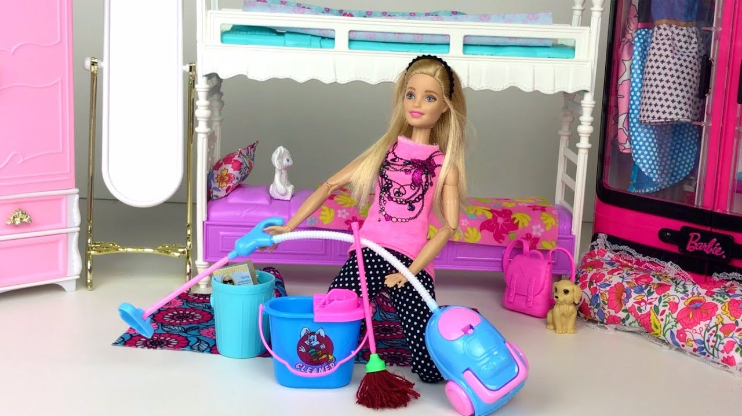
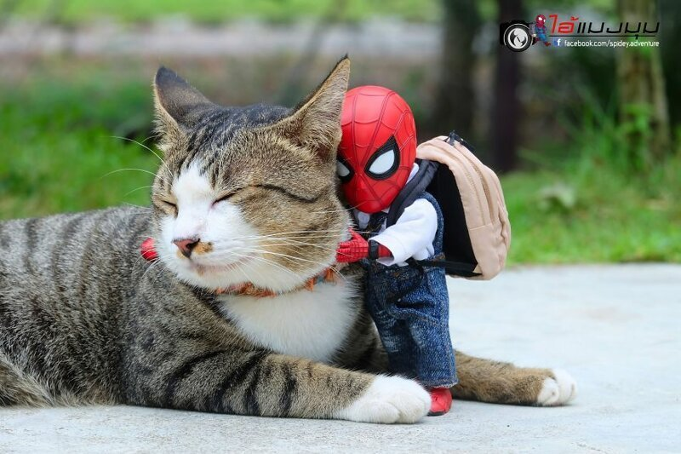
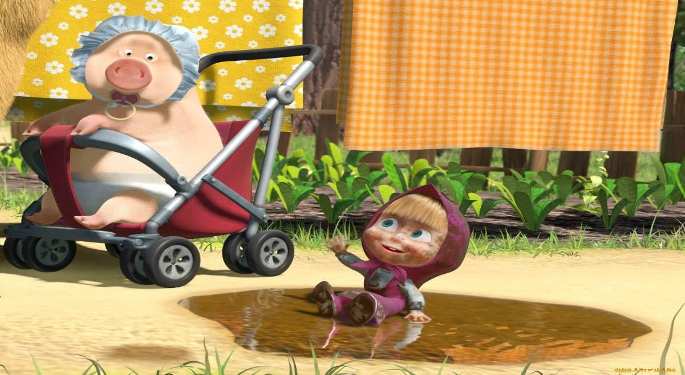
What are we going to talk about?
Household chores

Slide 2
Match
Make the bed
Выгуливать собаку
Tidy the room
Помогать с покупками
Wash the car
Накрывать стол
Do the washing
Мыть посуду
Do the vacuuming
Выносить мусор
lay the table
Полоть сад / огород
Sweep the floor
Гладить
Walk the dog
Выносить мусор
Wash the dishes
Убирать в комнате
Dry the dishes
Заправлять кровать

Slide 3
I have to go to the supermarket
You have to go to the supermarket
We have to go to the supermarket
They have to go to the supermarket
She has to go to the supermarket
He has to go to the supermarket

Slide 4
I have to go to the supermarket
You have to go to the supermarket
We have to go to the supermarket
They have to go to the supermarket
She has to go to the supermarket
He has to go to the supermarket
I don’t have to go to the supermarket
You don’t have to go to
the supermarket
We don’t have to go to the
supermarket
They don’t have to go to
the supermarket
She doesn’t have to go to the supermarket
He doesn’t have to go to the supermarket

Slide 5
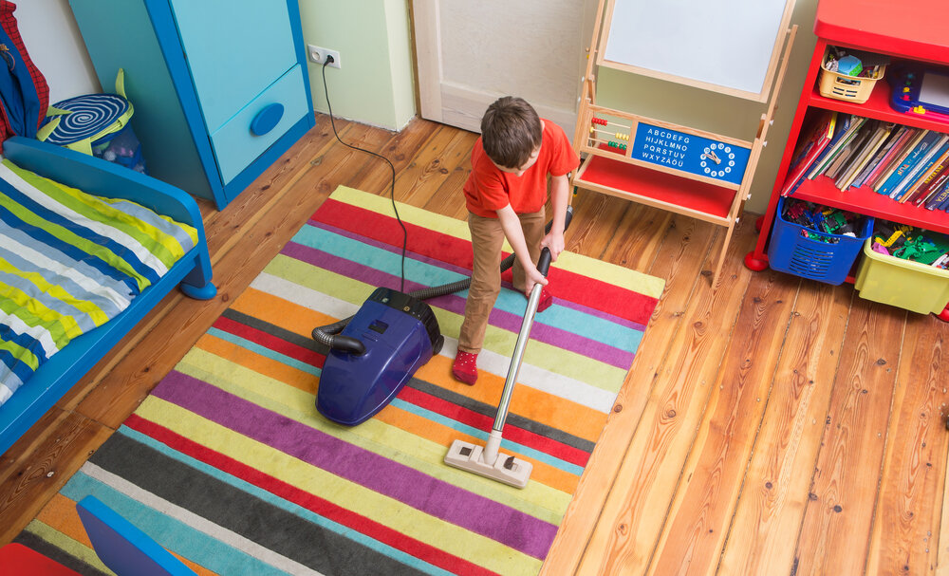
What does he / she have to do?
Mary
Ben
Make the bed
Tidy the room

Slide 6
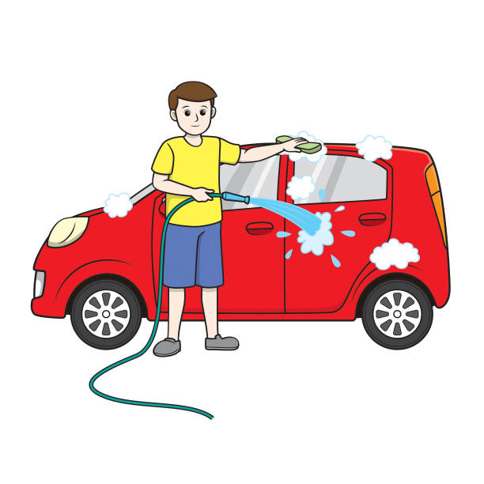
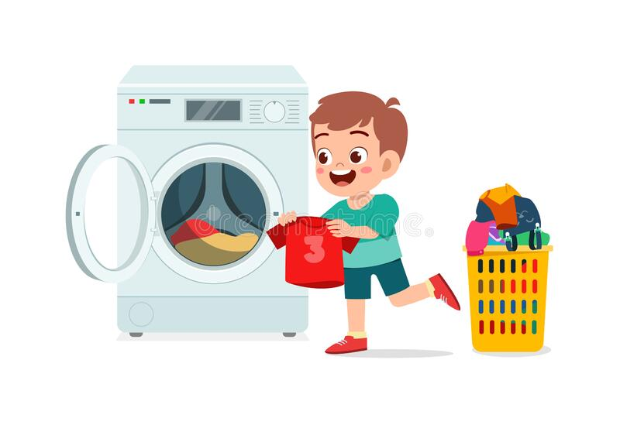
Ted
Tony
Wash the car
Do the washing

Slide 7
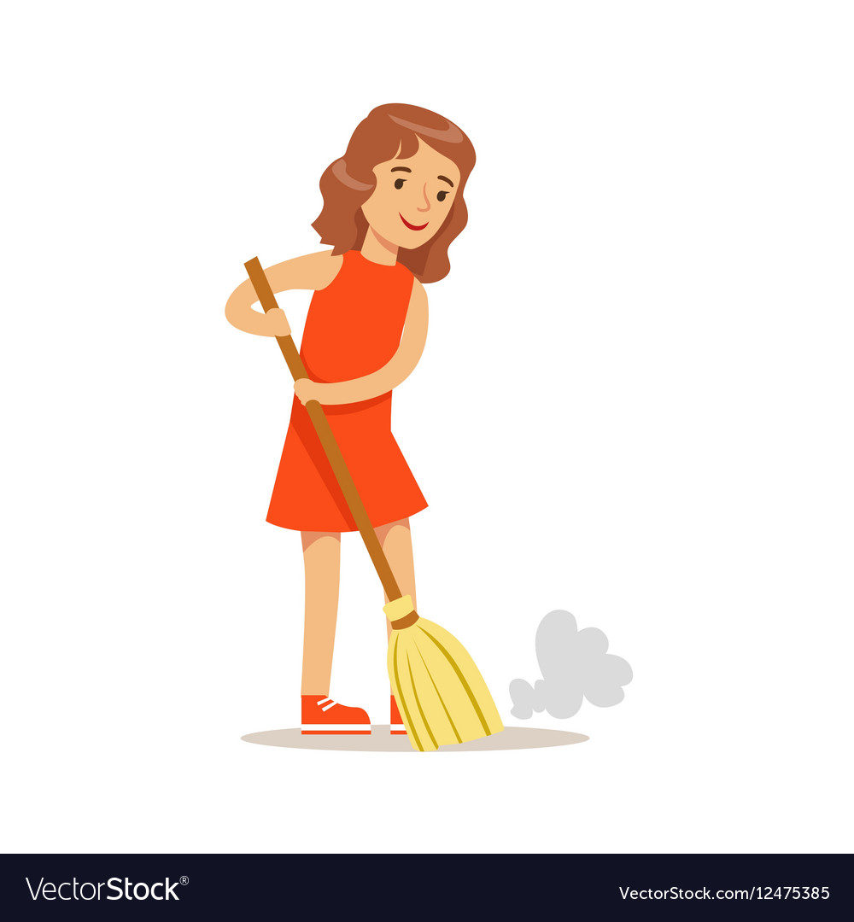
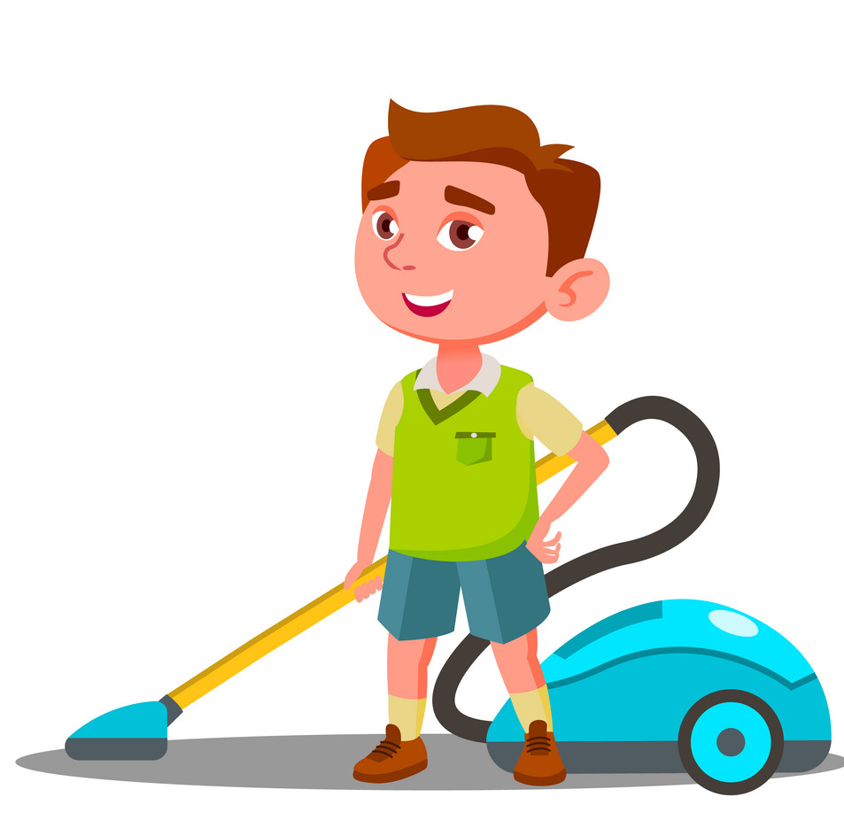
Tiffany
Freddy
Do the vacuuming
Sweep the floor

Slide 8
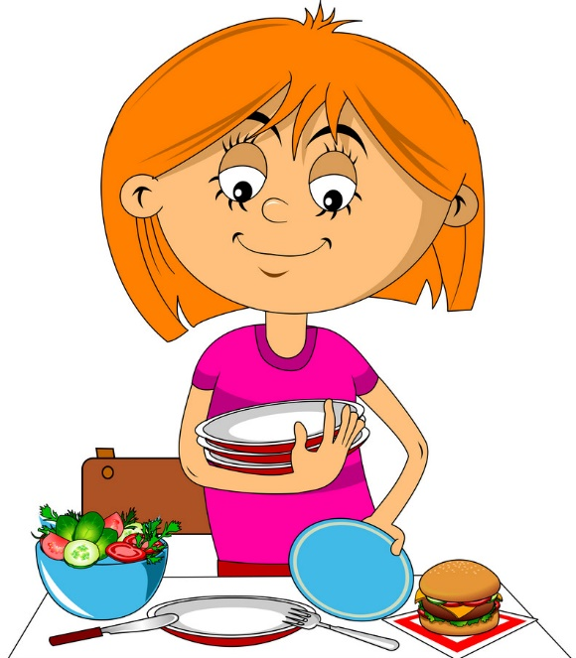
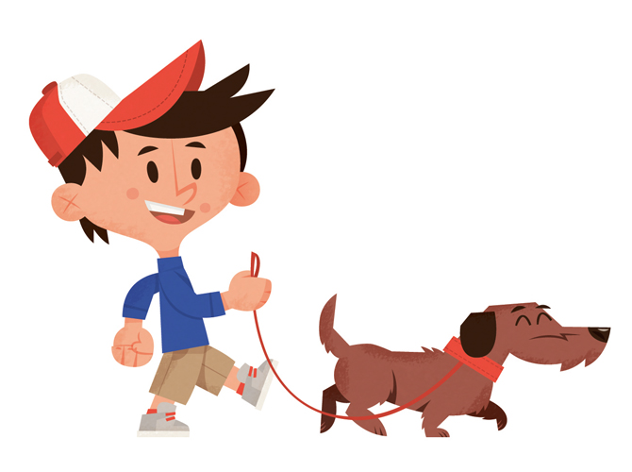
Peter
Ann
Lay the table
Walk the dog

Slide 9
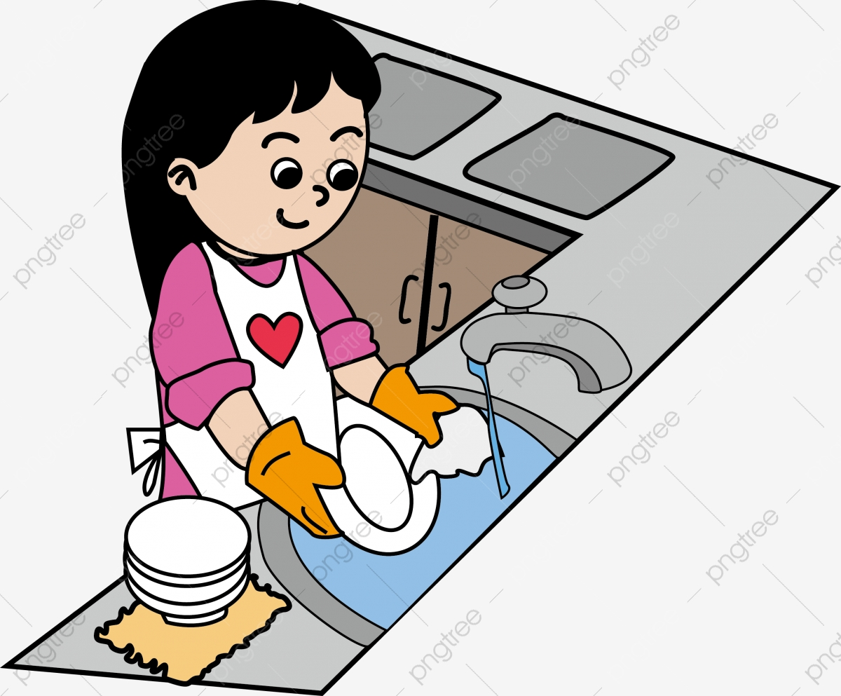
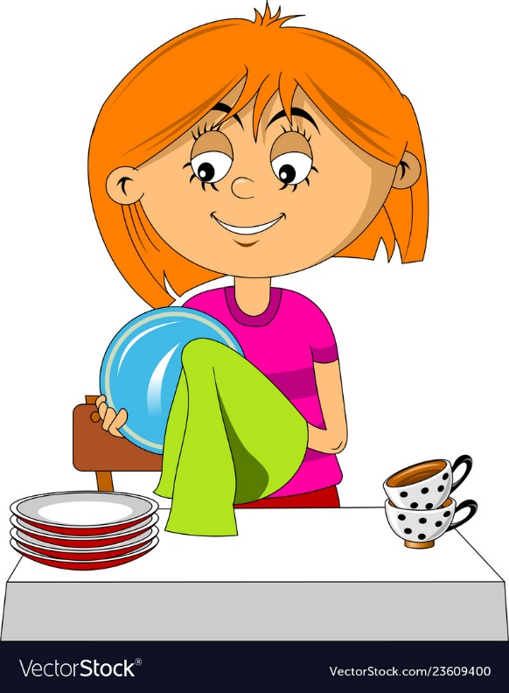
Ann
Monica
Do the washing up /
Wash the dishes
Dry the dishes

Slide 10
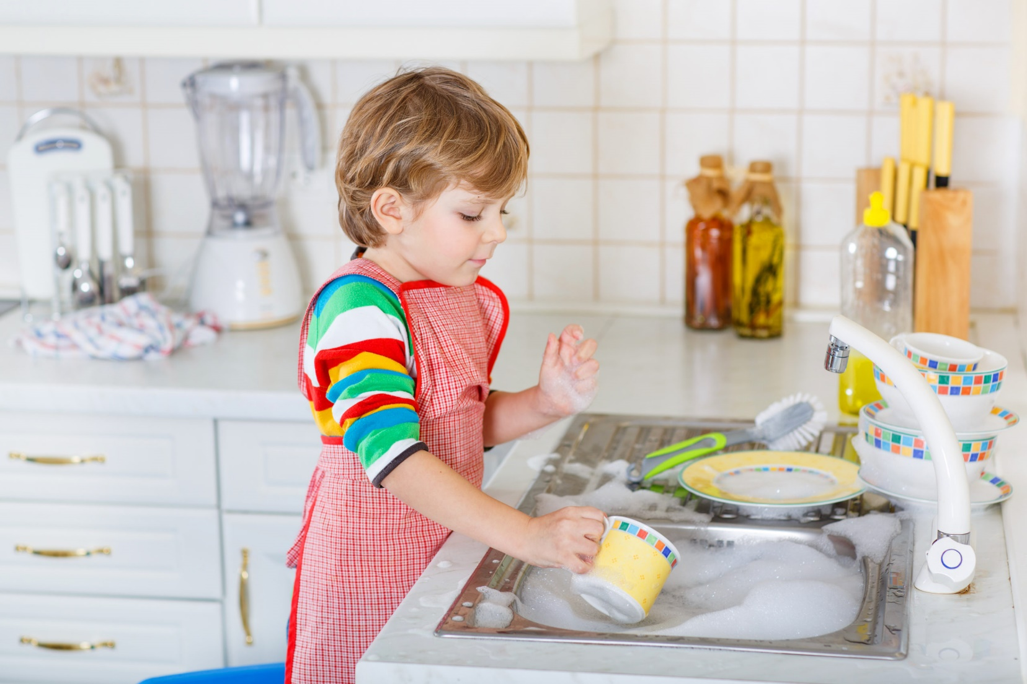
Mark
Jill
Wash the dishes
Help with the shopping

Slide 11
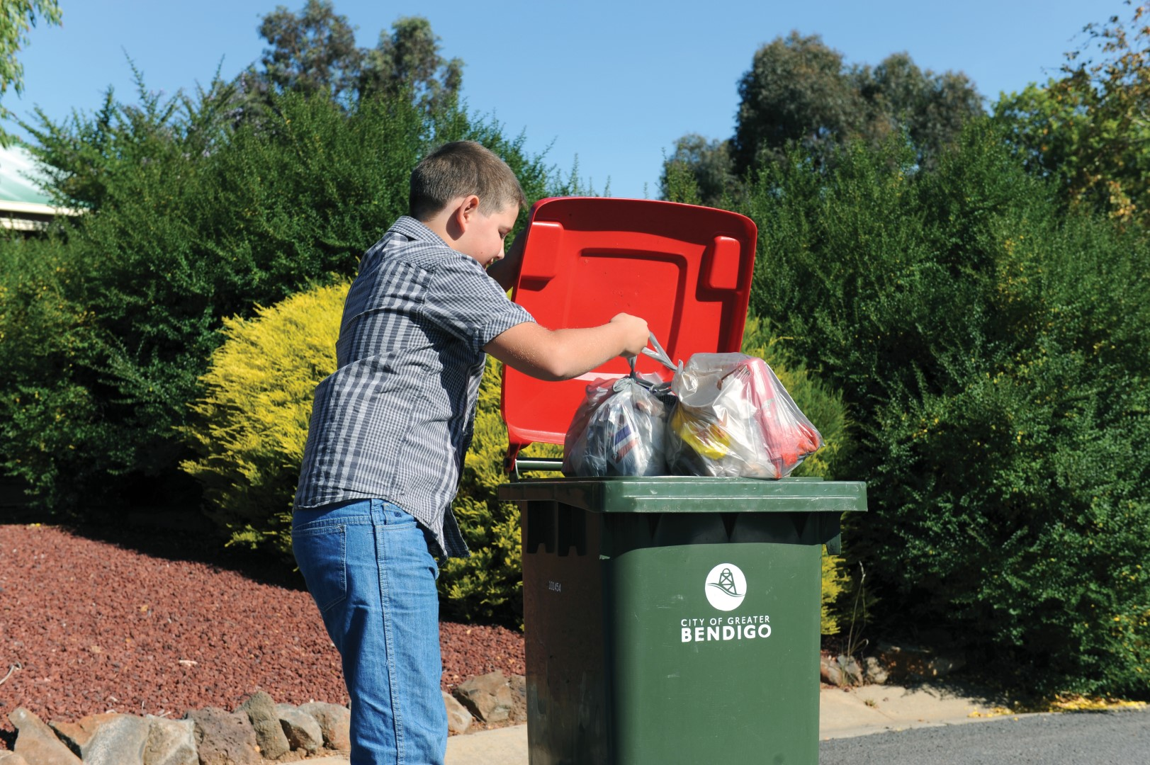
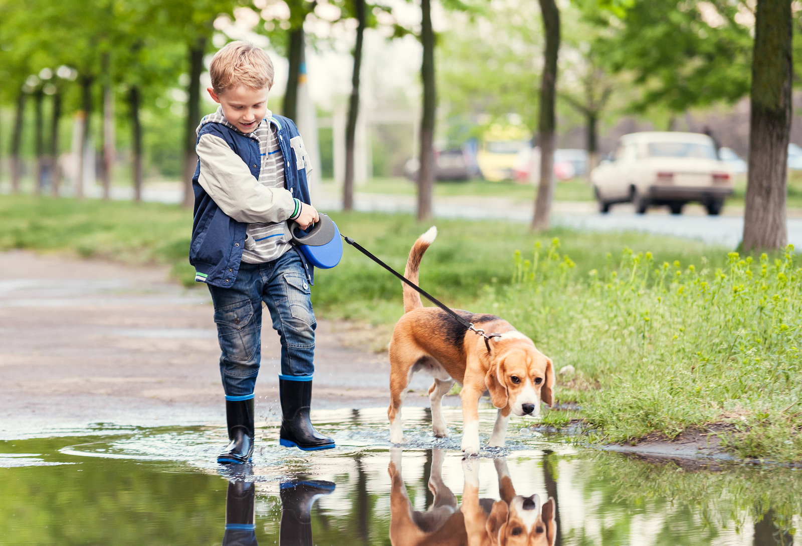
Tom
Billy
Take the rubbish out
Walk the dog

Slide 12
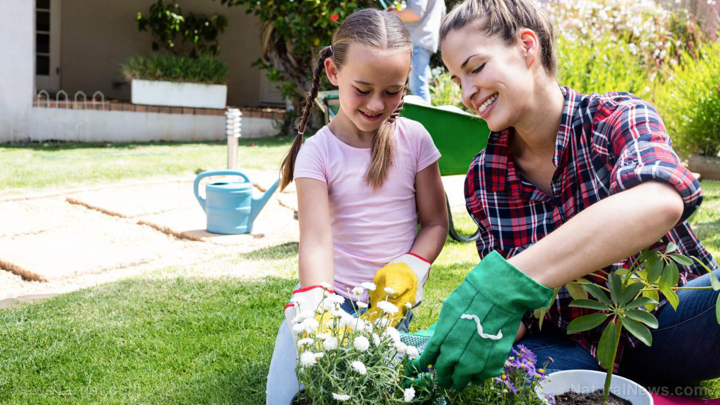
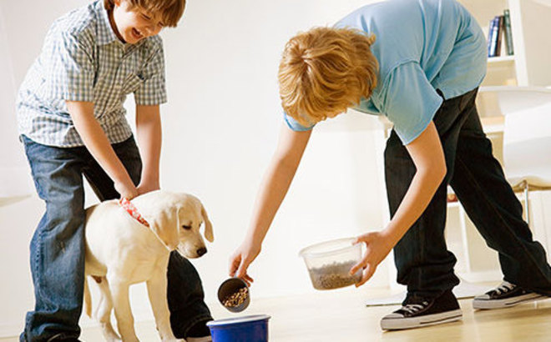
Sam
Anna
Weed the garden
Feed the pet

Slide 13
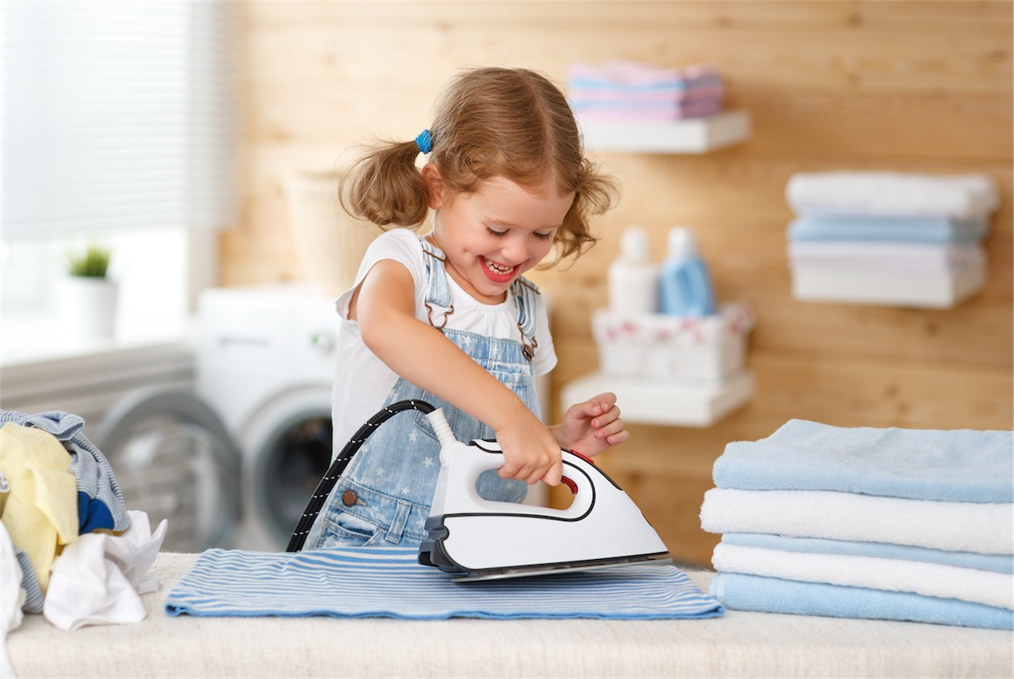
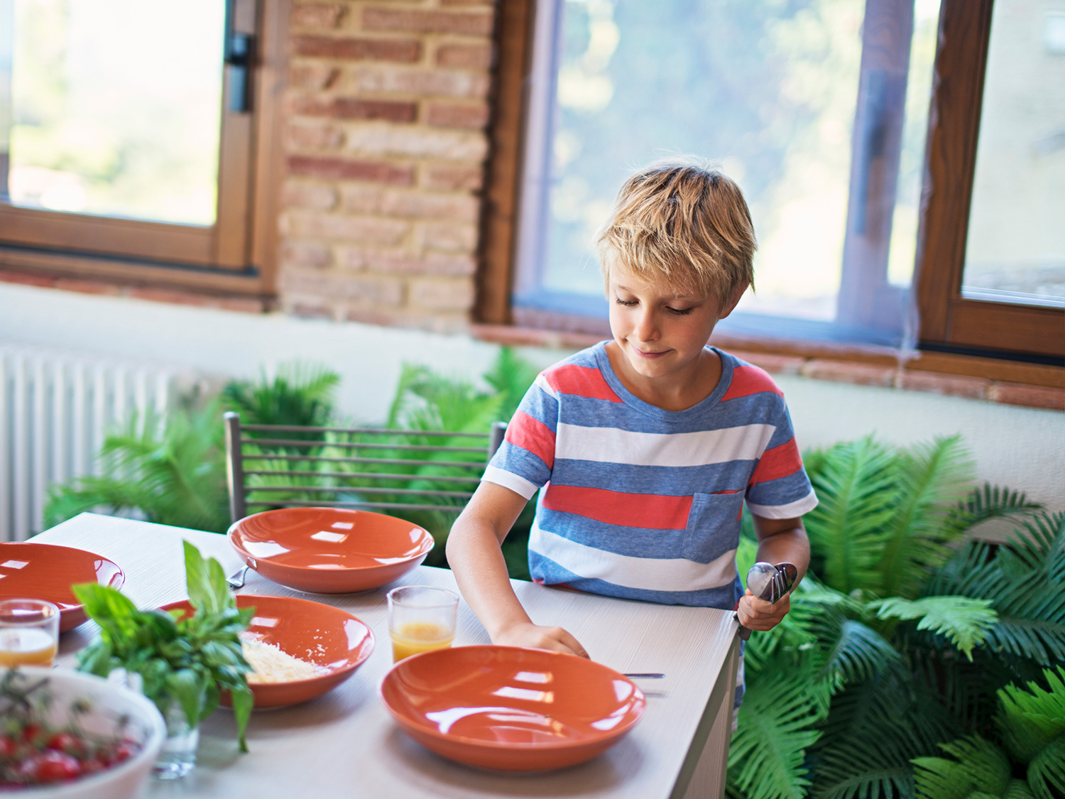
Sarah
Philip
Do the ironing
set the table

Slide 14
Sarah
Do the ironing
Help with the shopping

Slide 15
Sam
Anna
Weed the garden
Feed the pet

Slide 16
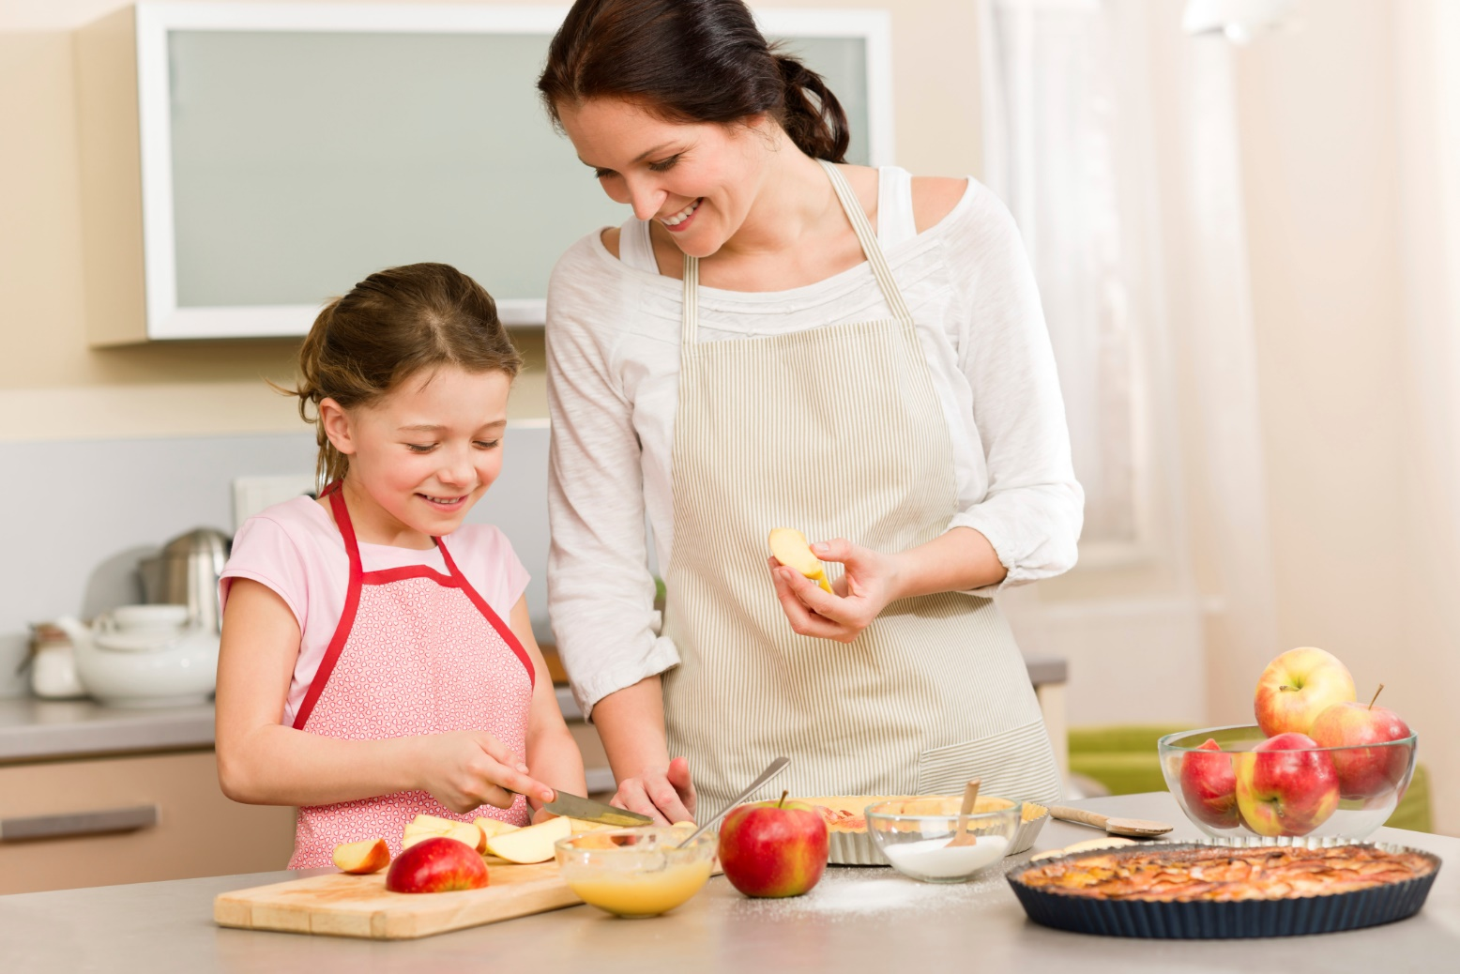
Tom
Amy
Take the rubbish out
Help with cooking

Slide 17
Make the bed
Выгуливать собаку
Walk the dog
Помогать с покупками
Tidy the room
Накрывать стол
Help with the shopping
Мыть посуду
подметать
Take the rubbish out
Выносить мусор
пылесосить
lay the table
Wash the dishes
Полоть сад / огород
Weed the garden
Гладить
Do the ironing
Убирать в комнате
Feed the pet
Do the vacuuming
Sweep the floor
Заправлять кровать
Кормить питомца

Slide 18
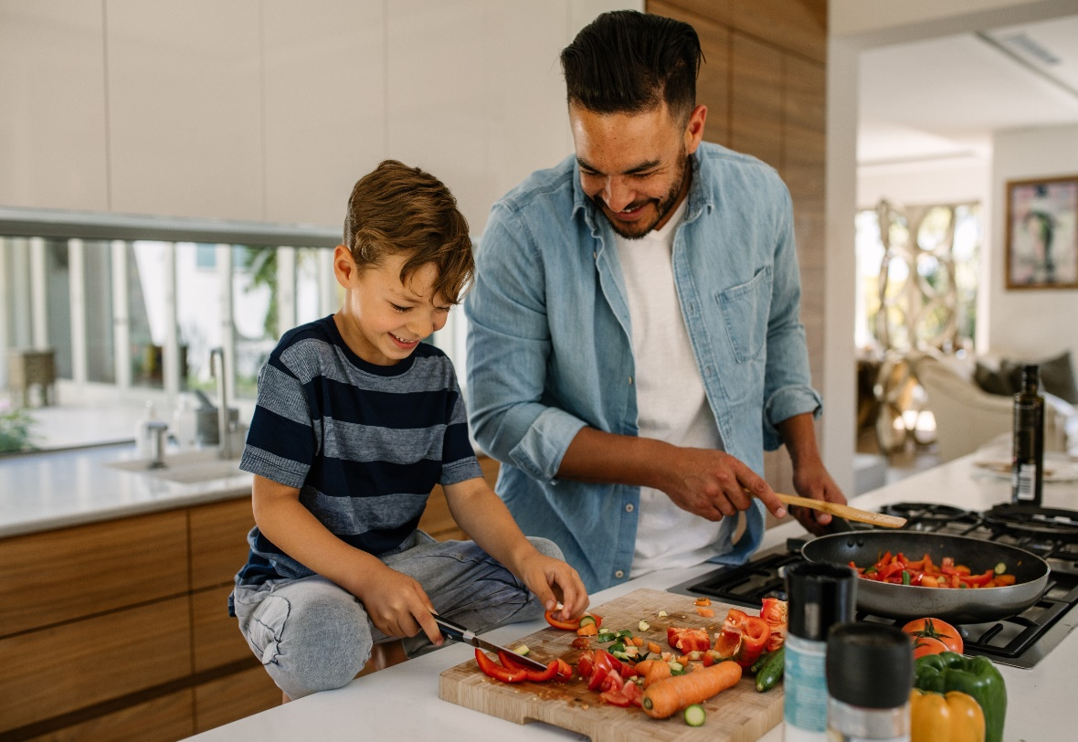
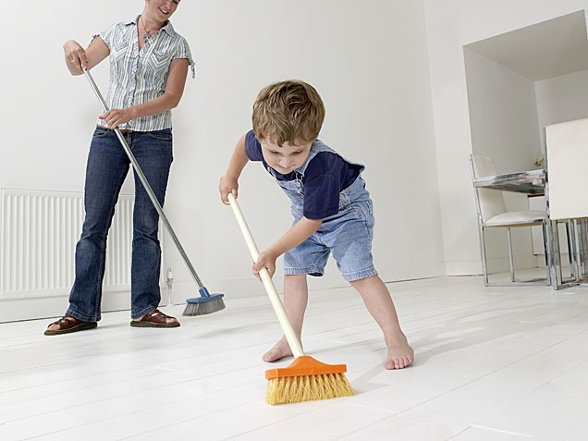
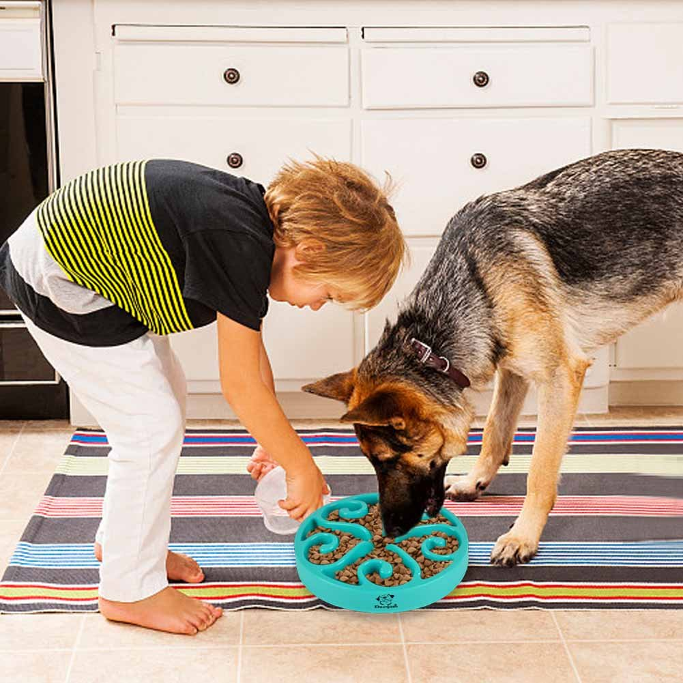
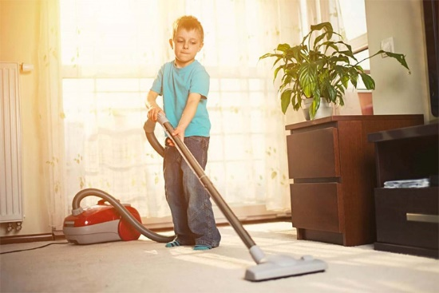
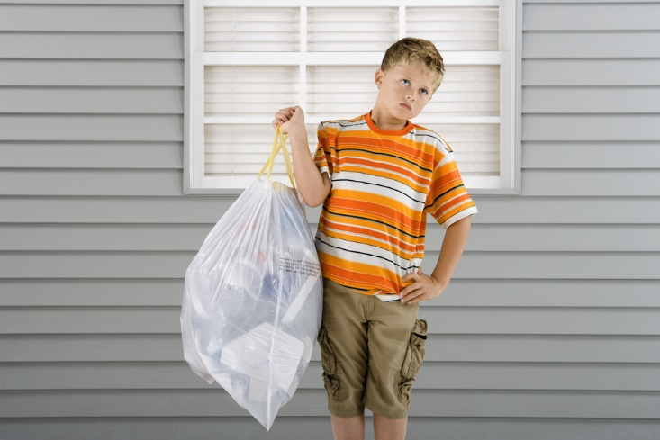
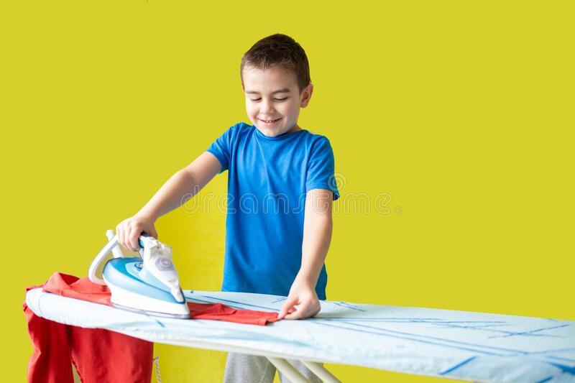

Slide 19
-yes, I do
Do you have to….?
-no, I don’t
Make the bed
Sweep the floor
Help with the shopping
Tidy the room
Take the rubbish out
Wash the dishes
Walk the dog
Weed the garden
Feed the pet
Do the ironing
lay the table
Do the vacuuming

Slide 20
Write have to / has to
I ____________ get up early every day because I ____________ make breakfast.
She____________ take the rubbish out in the morning.
They ____________ wash the dishes before they leave the kitchen.
He _____________ weed the garden.
My sister ___________ lay the table before lunch.
You ______________ feed your hamster. It looks very hungry.
My uncle _____________ wash his car when it’s dirty.
My mum ____________ do the ironing at the weekends.

Slide 21
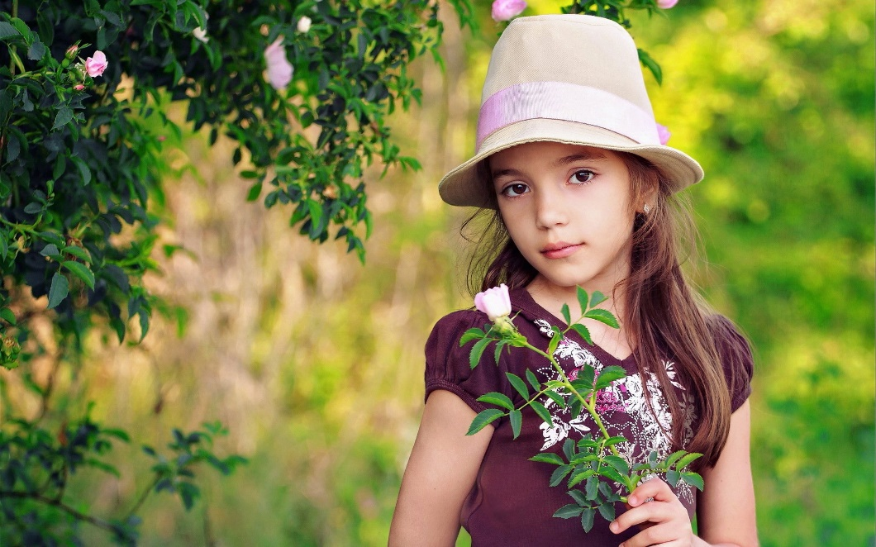
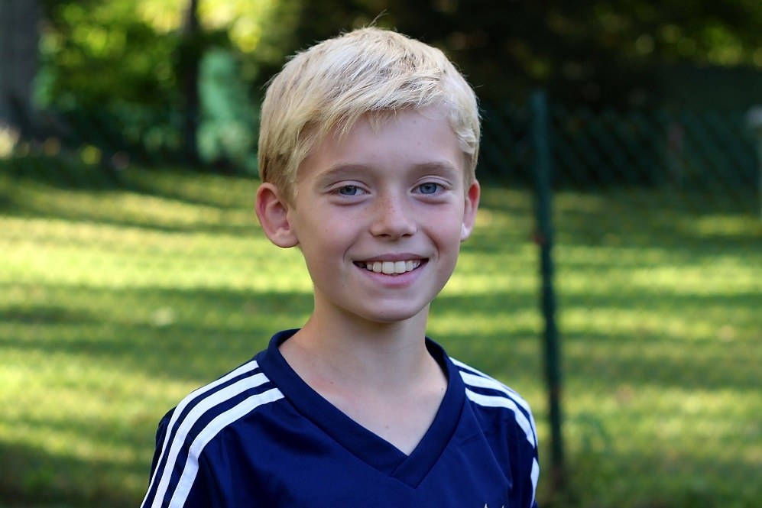
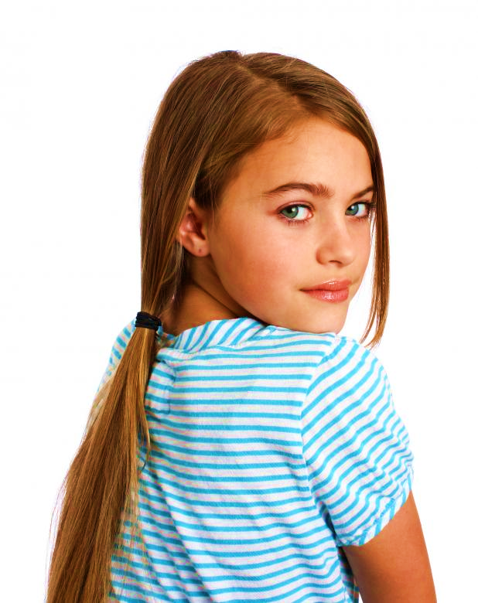
My name’s Sally. I’m eleven years old.
I have to help my parents. At the weekends I have to wash the dishes. I have to set the table and take the rubbish out. My sister sometimes has to do the ironing.
My name’s Philip. I’m eleven years old.
I have to help me parents too. I have to weed the garden at the weekends and water the plants. I have to feed my puppy everyday. My parents have to go to the supermarket and I sometimes help them.
My name’s Melissa. I’m twelve years old. I don’t have to help
much at home. I don’t have to do the vacuuming or sweep the floor. I
don’t have to help with cooking too. We don’t have any pets so
I don’t have to walk the dog or feed a cat. My sister has to tidy our room
and my brother has to take the rubbish out. I have a lot of free time!

Slide 22
 | Ammy | Shon | Steve & Pete
Make the bed | + | +
Walk the dog |  | +
Tidy the room | + | +
Help with the shopping |  | + | +
Take the rubbish out |  |  | +
lay the table | +
Wash the dishes |  |  | +
Weed the garden |  |  | +
Do the ironing | +
Feed the pet |  | +
Do the vacuuming | + |  | +
Sweep the floor | +

Slide 23
Let’s play together. Tic-tac-toe
+ Walk the dog
- Tidy the room
? Do the vacuuming
? Make the bed
+ Help with the shopping
- Sweep the floor
- Do the ironing
? Take the rubbish out
+ Weed the garden

Slide 24
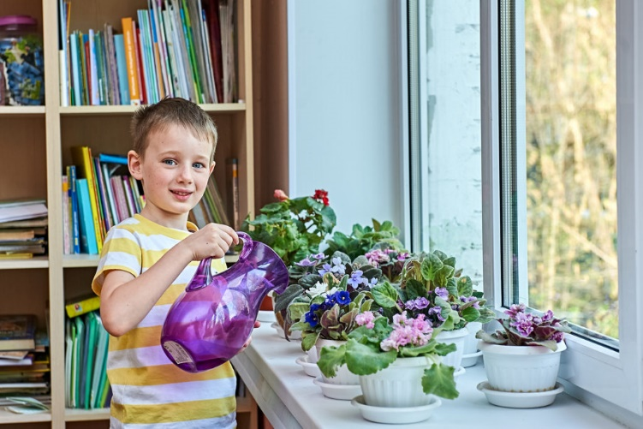
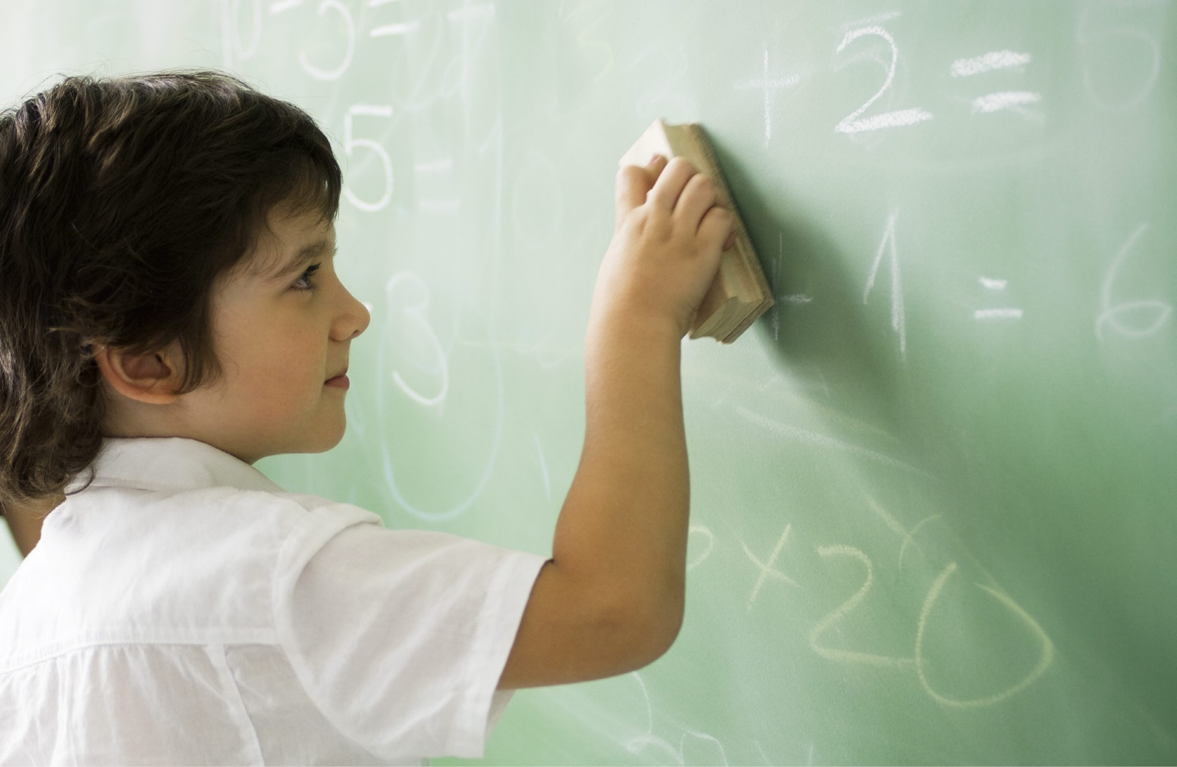
Water the plants
Clean the board

Slide 25
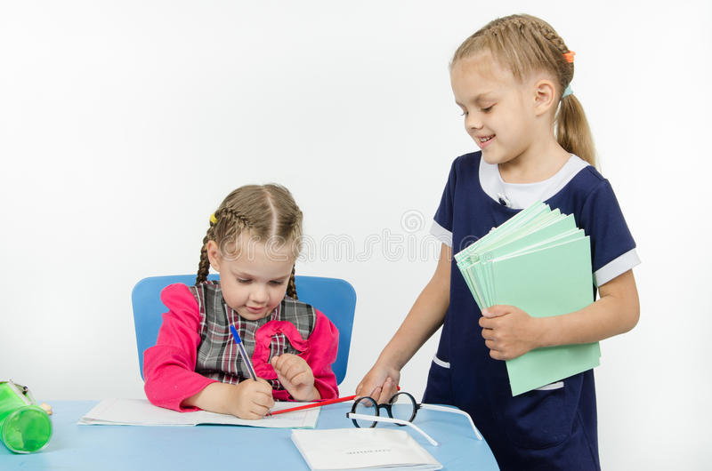
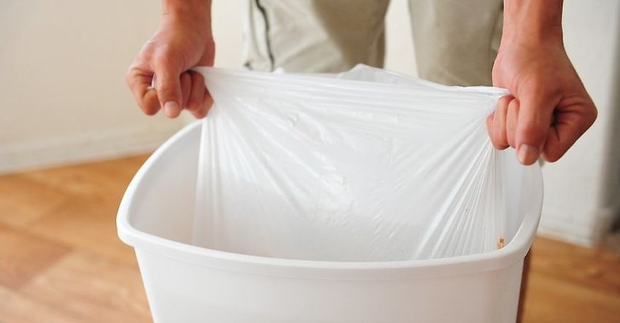
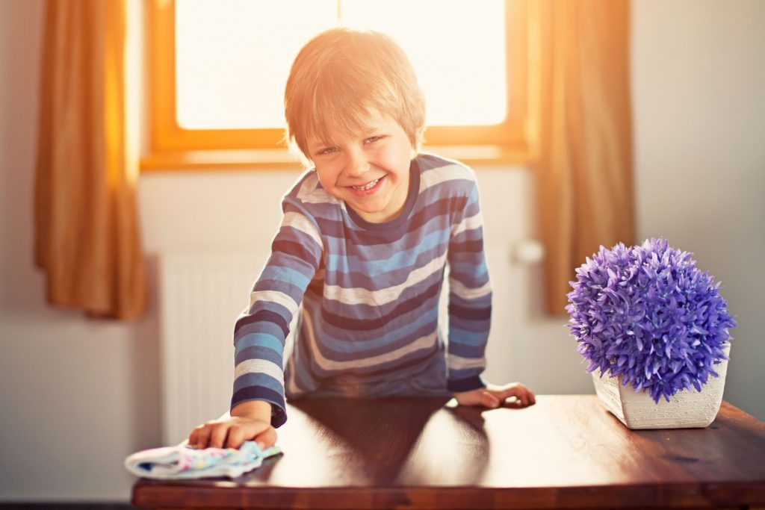
Collect the homework
Empty the wastepaper bin
Dust the furniture

Slide 26
Who has to do these things?
 | Dan | Emily | Sam & Kate
Collect the homework | + | +
Water the plants |  | +
Clean the board | + | + | +
Empty the wastepaper bin |  | + | +
Dust the furniture |  |  | +
Sweep the floor | + |  | +

Slide 27
Let’s talk
Let’s talk
How often do you do the vacuuming?
Who takes the rubbish out in your family?
Do you do the ironing?
Who lays the table when the guests come?
Do you help your mum with cooking?
How often do you weed the garden?
Do you like making your bed every morning?

