Slide 1
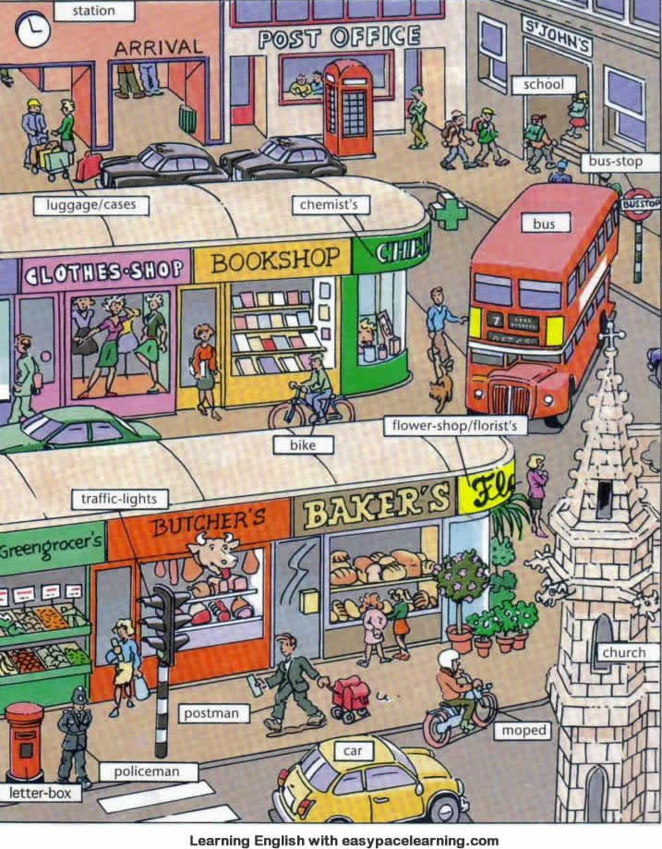

Slide 2
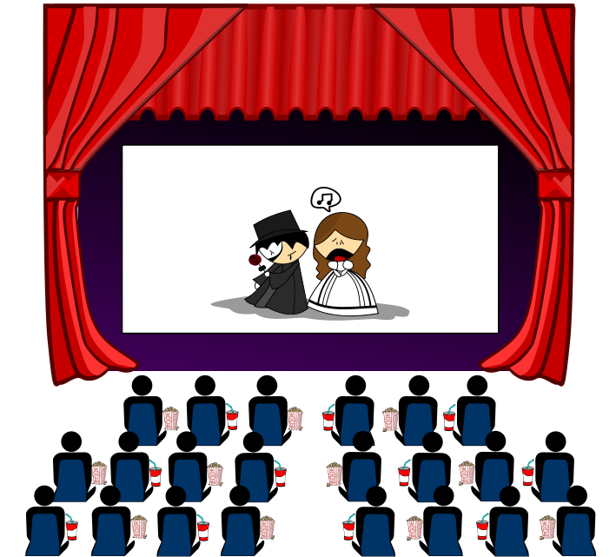
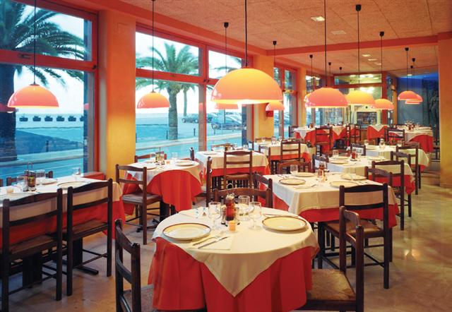
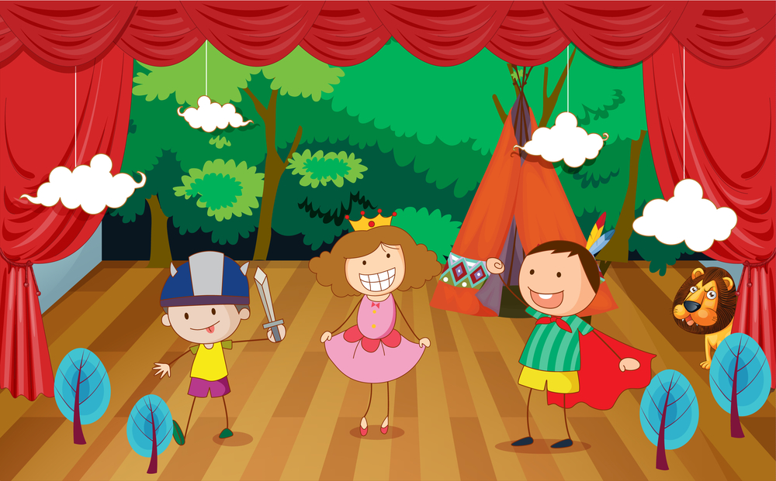
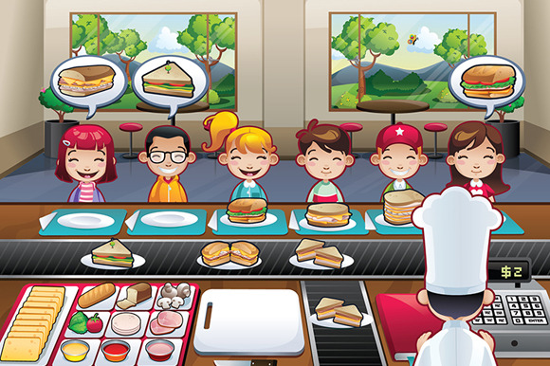
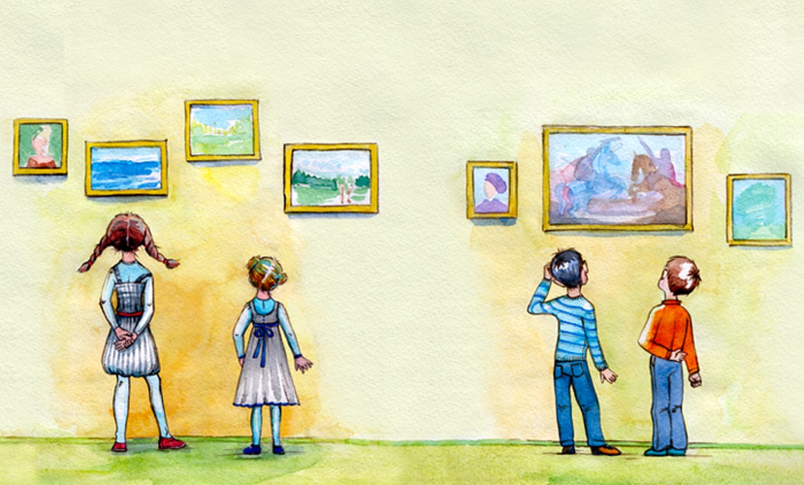
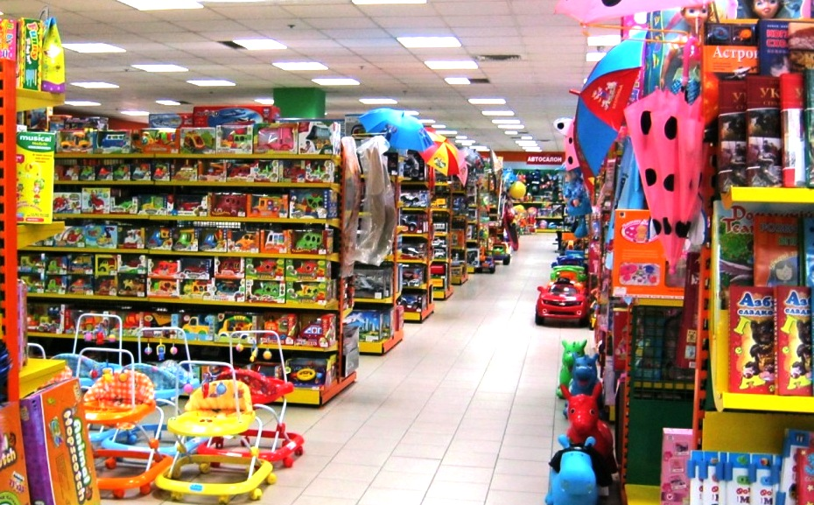
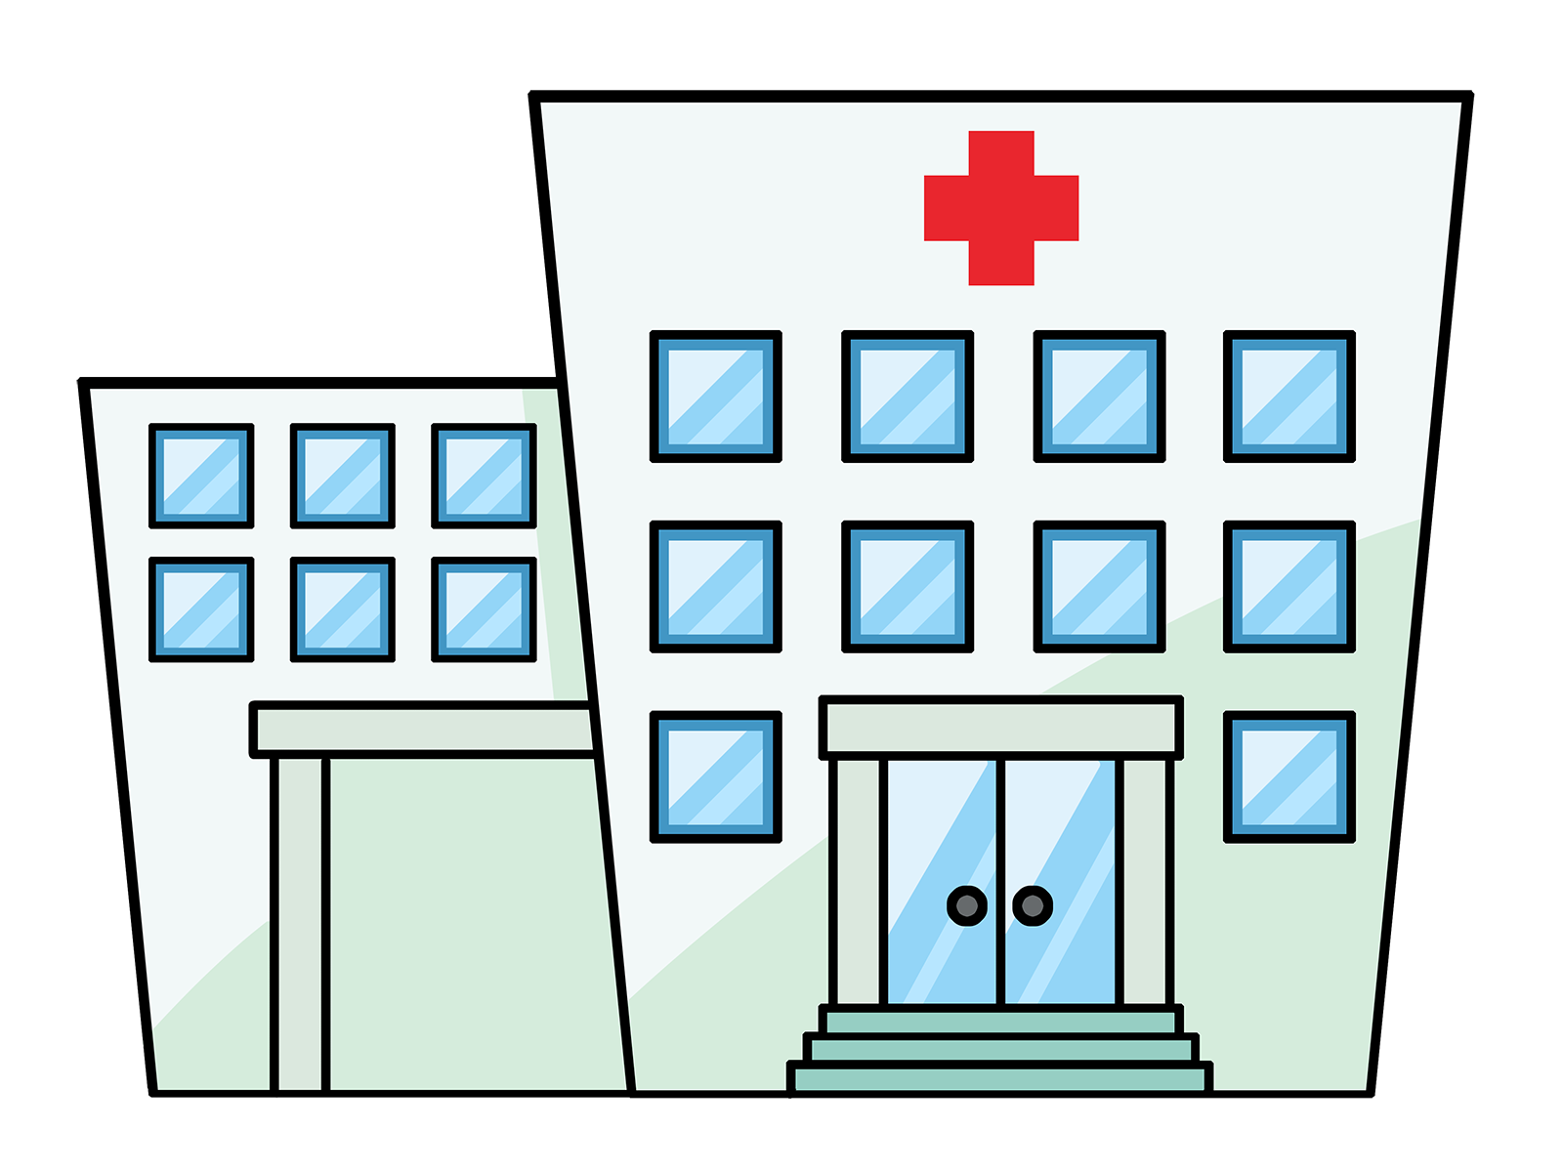

Slide 3
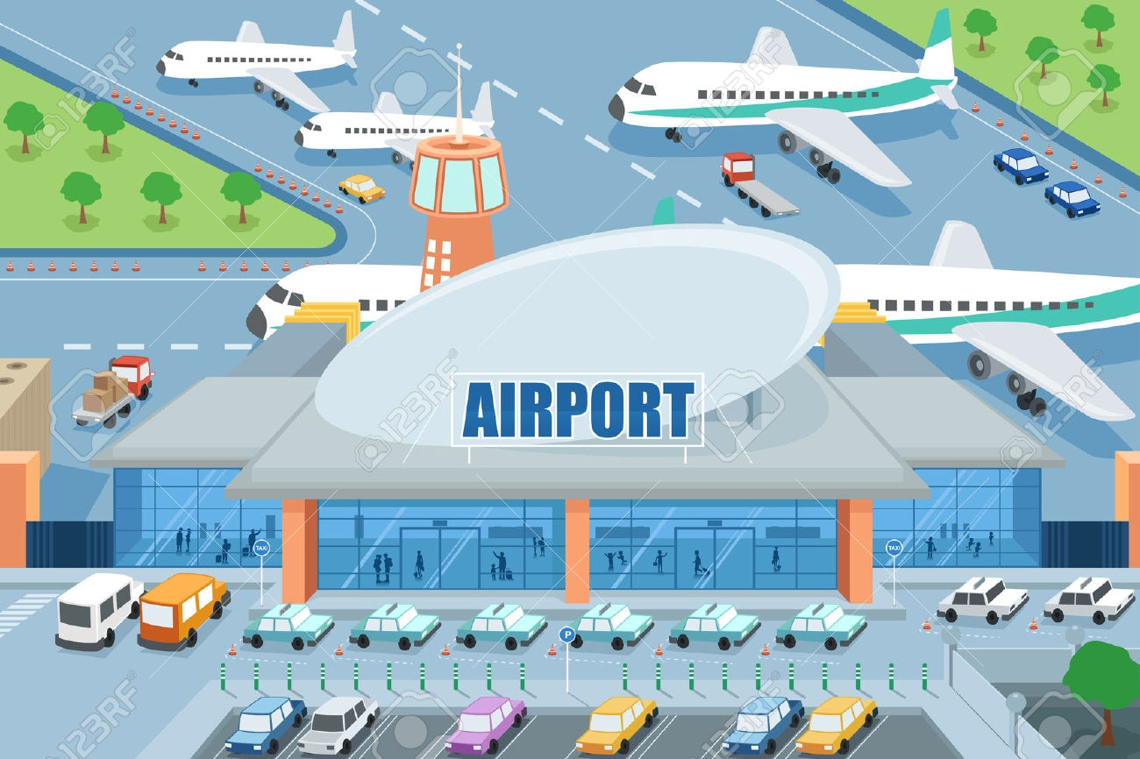
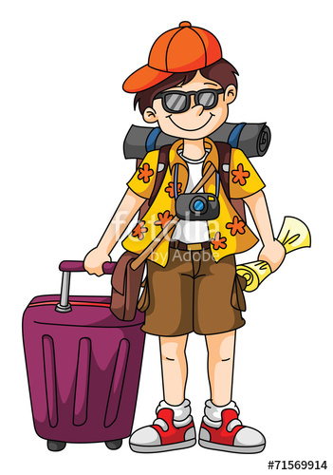
a map

Slide 4
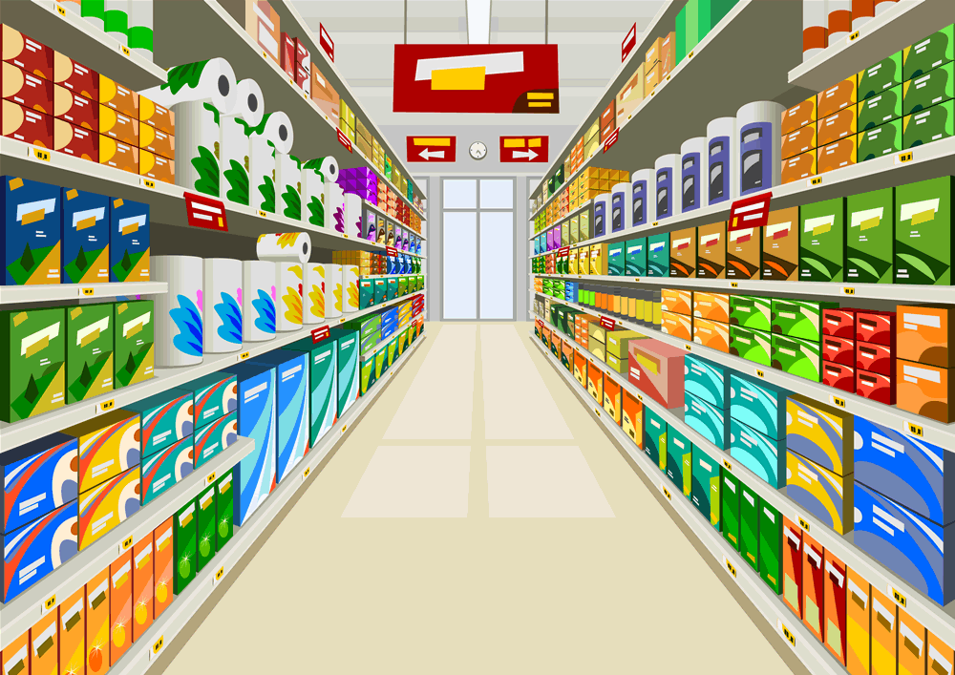
It’s a place where people can ….
You can … there.

Slide 5
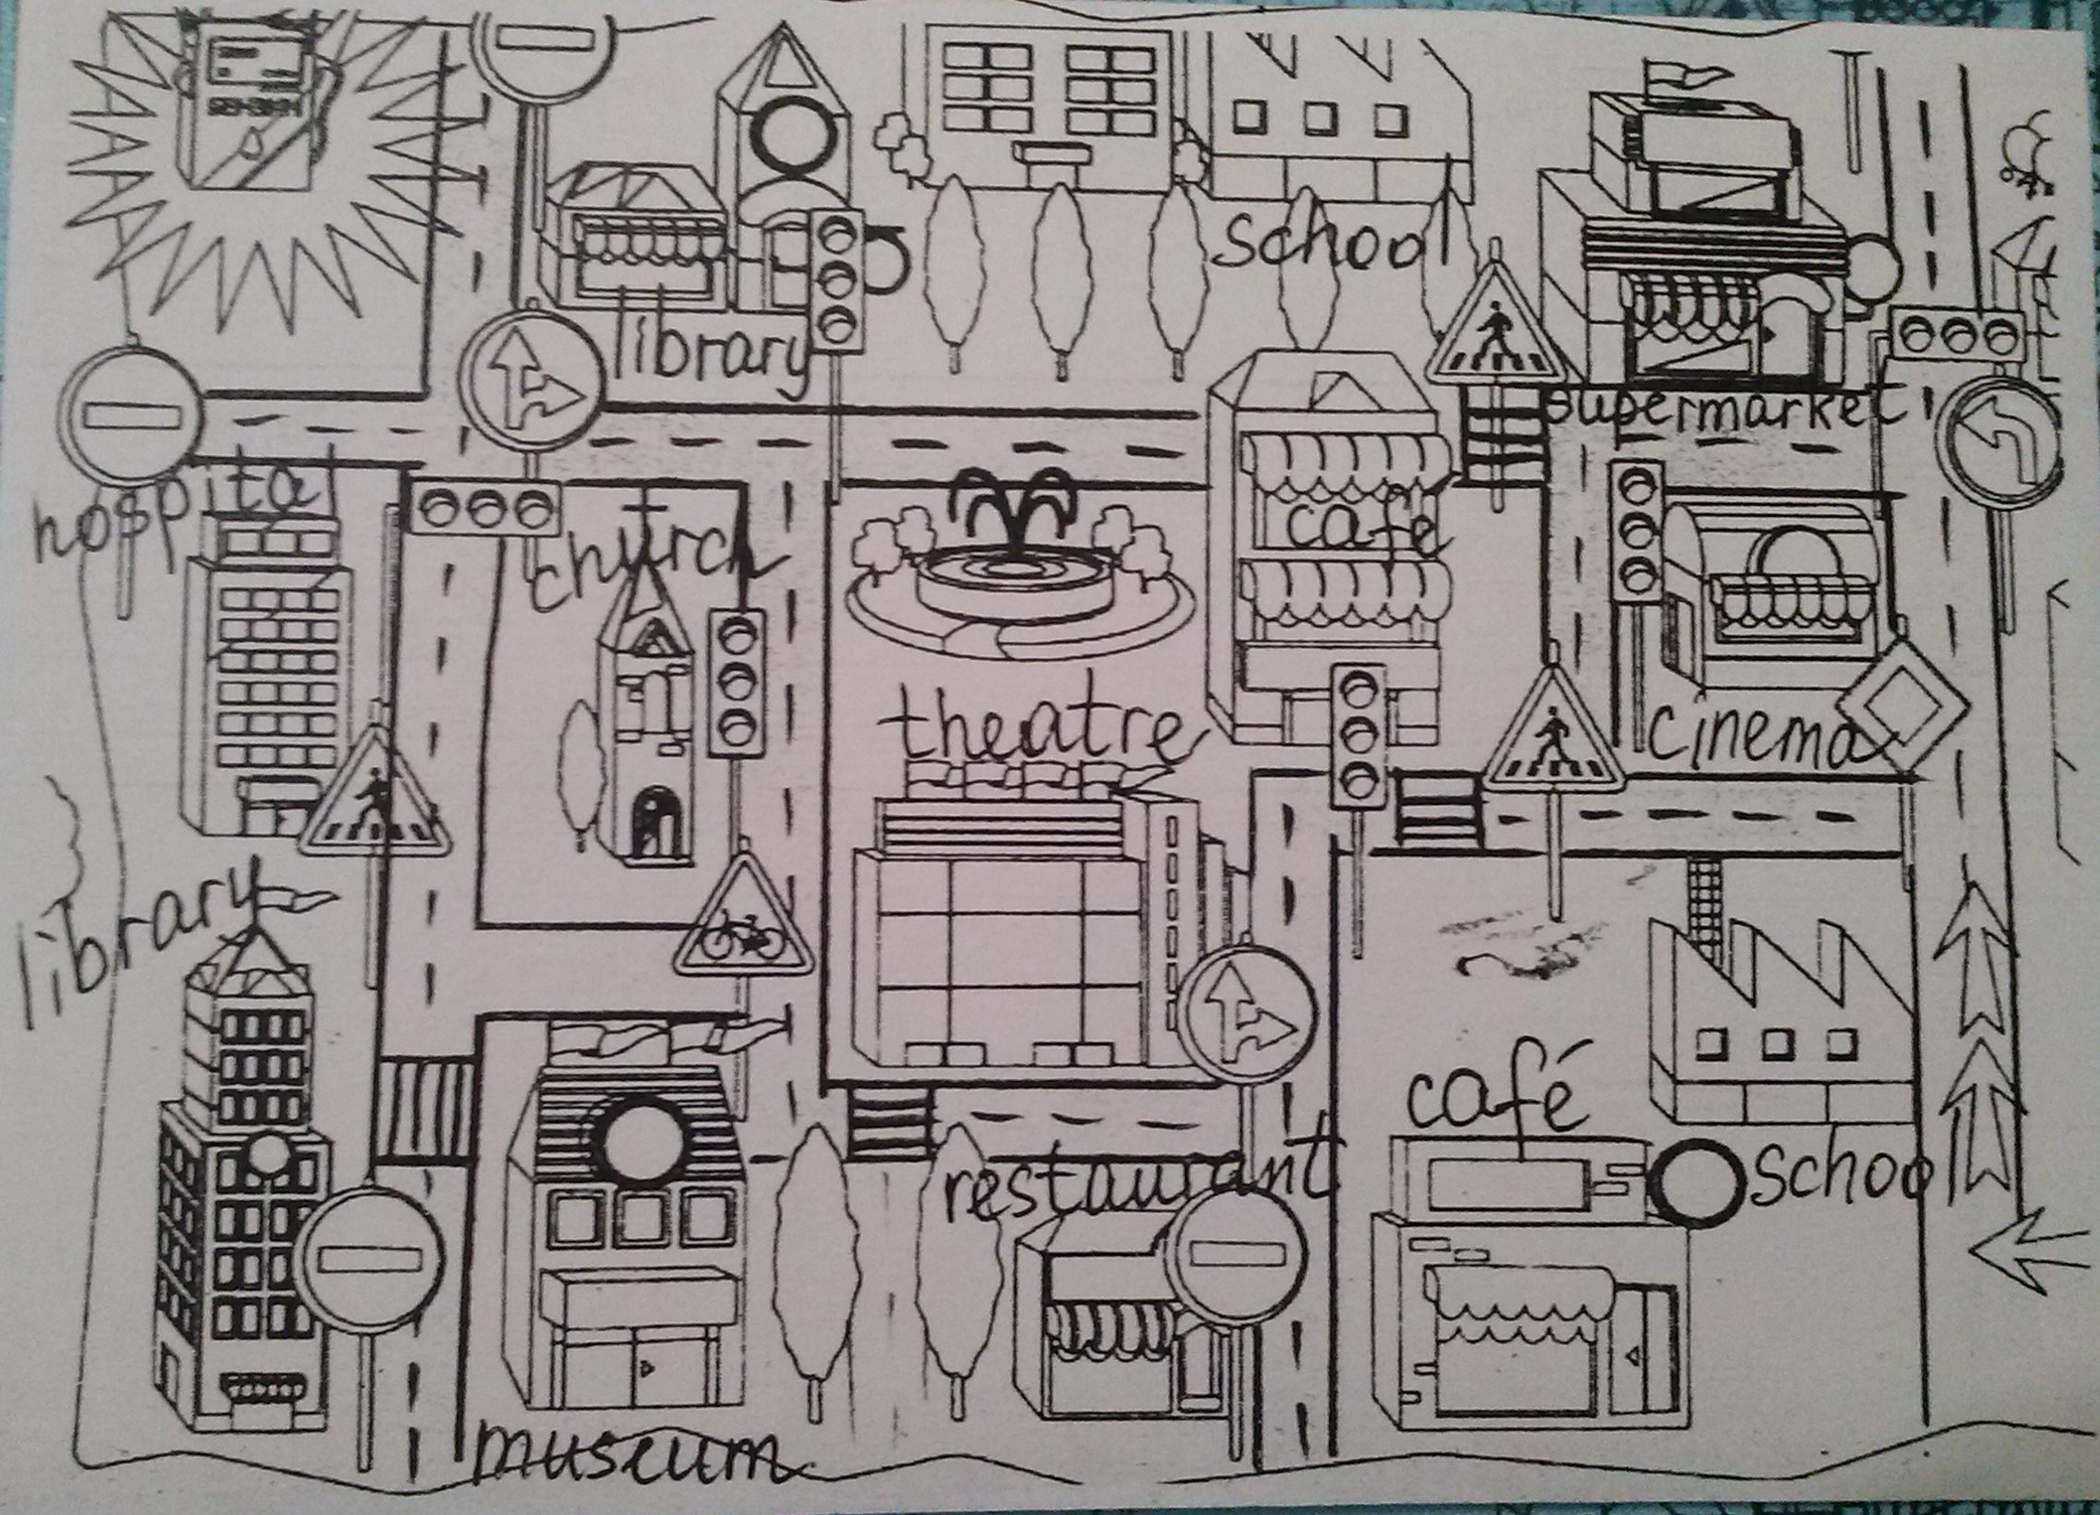

Slide 10
OUR TASKS
DEFINITIONS
WORD ORDER
MATCHING
QUESTIONS ON THE MAP
GIVING DIRECTIONS
DIALOGUES

Slide 11
Say what you have done at the lesson
Today I have …
acted out the dialogue;
practiced grammar;
asked and answered different questions;
played a game;
written a test;
reviewed the words.

Slide 12
Finish the sentences:
Now I know how to…
make up all types of sentences, using there is/there are;
give directions;
describe places;
express my opinion;
speak about places in town.

Slide 14
Home task
2. ex.1, 3(a), 4, p. 33 (copybook)
1. ex.1,3(a), p. 33 (copybook)

