Slide 1
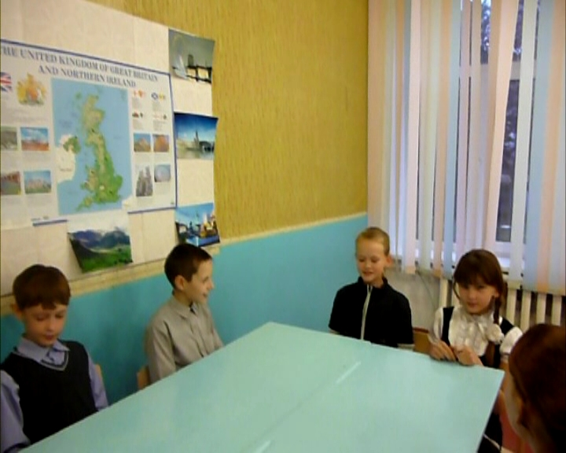
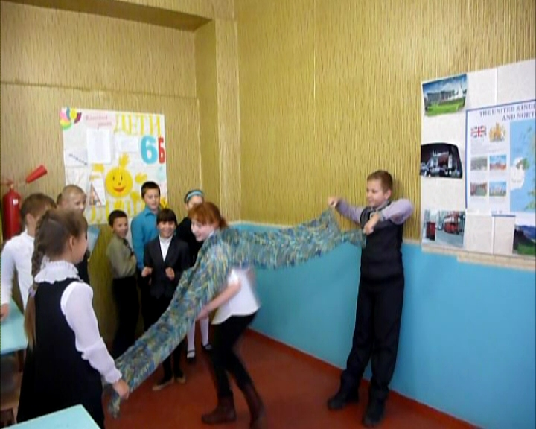
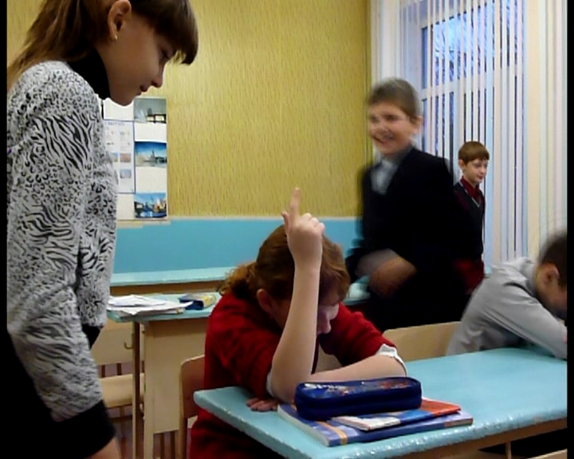
Игра
"I spy with my
little eye"
Игра "Fishing"
Игра
"Heads up
seven up"

Slide 2
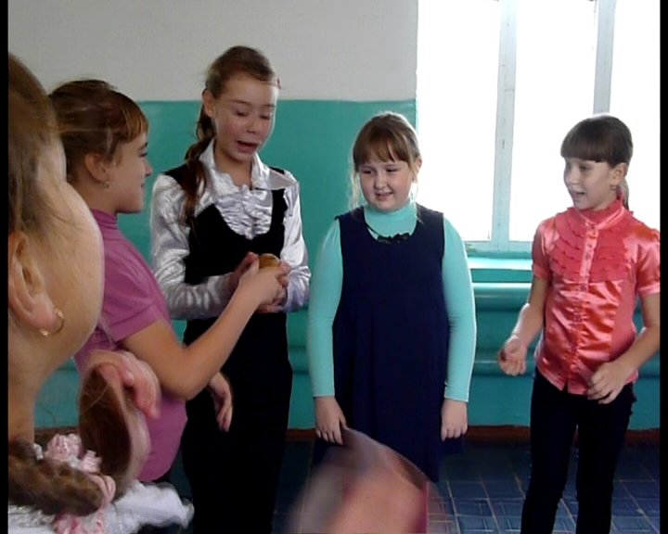
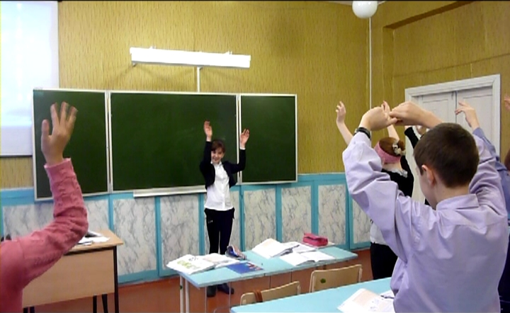
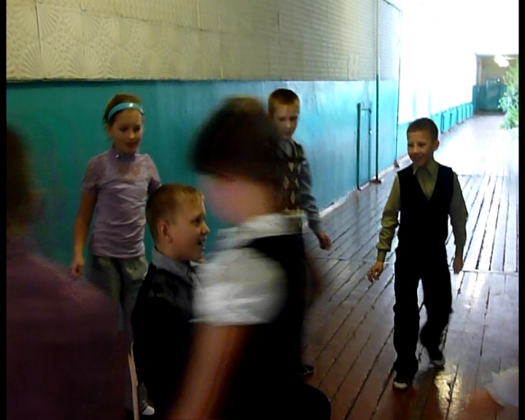
Игра
"Hot potato"
Игра
"Simon
Says"
Игра
"Foxy, Foxy"

