Slide 1
Harry Potter and Past Tenses
Past Simple vs Past Continuous

Slide 2
Past Simple
Past Continuous
Используется для последовательности событий в прошлом, когда нам важно показать, какое событие произошло первым.
The party started and then my friends came.
Выражает процесс в определенный момент в прошлом/ процесс, который прервали.
We were having dinner when my friends came.
Ved / V₂
was /
were
V ing
+
+
.
+
+
+
.
V₁
was /
were
V ing
+
didn’t
+
.
+
+
not
+
.
V₁
?
V ing
?
?
Did
Was /
Were
+
+
+
?
+
yesterday; last week/ month/ year; … ago; in 1991
all day long; the whole morning/ day/ evening/ night; at 5 o’clock yesterday; from 2 till 3, at that time

Slide 3
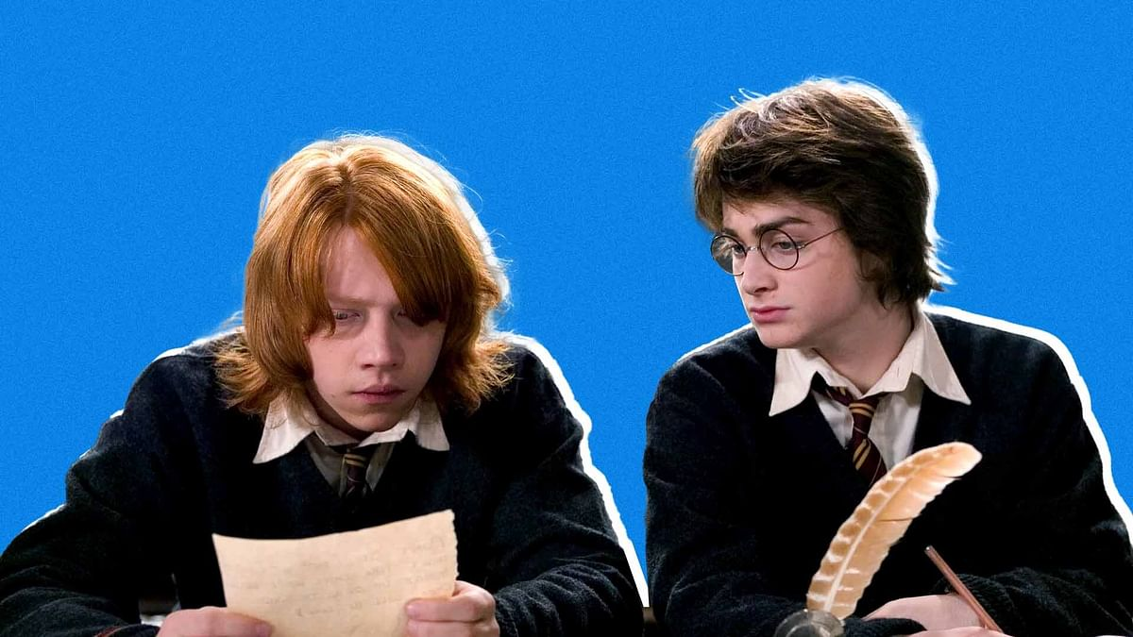
What ____ (happen) to Molly yesterday?
She ____ (walk) home when a man ___ (steal) her bag.

Slide 4
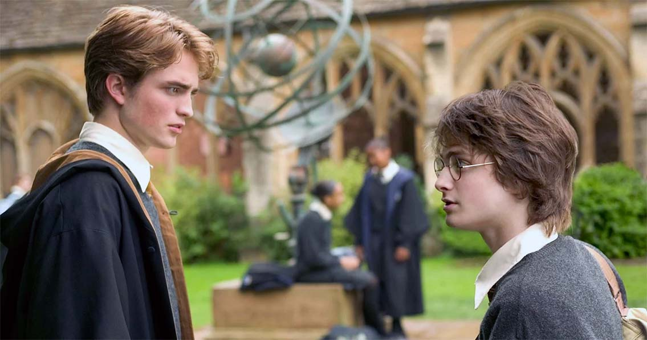
When I __ (see) Harry, I ___ (stop) and we ___ (have) a chat for a while

Slide 5
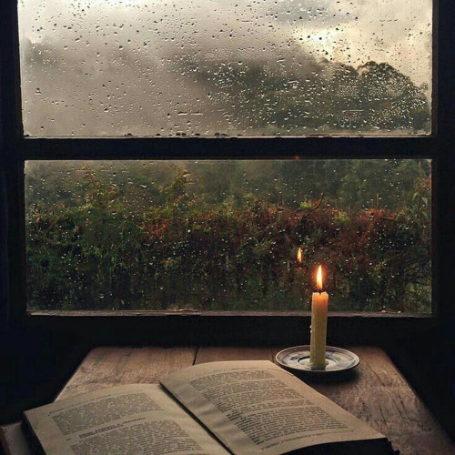
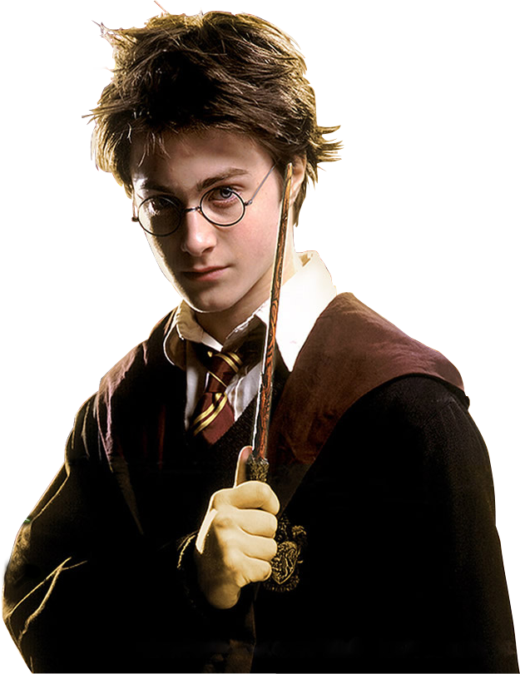
When I ___ (wake) up this morning it ___ (rain).

Slide 6
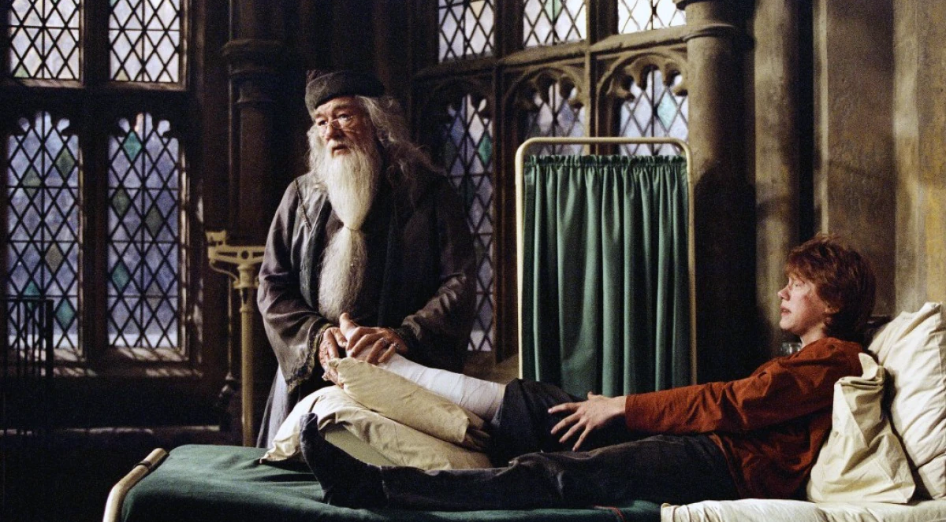
I ___(brake) my leg
when I ___ (ski)

Slide 7
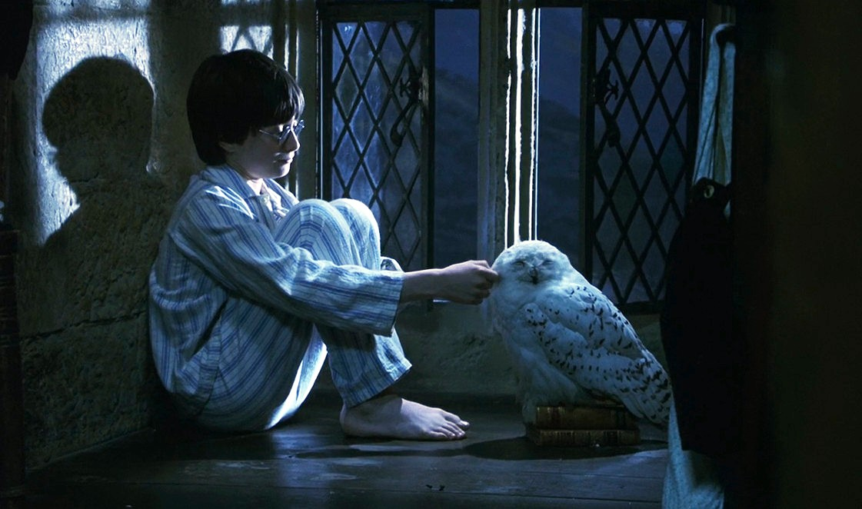
I ___ (sleep) happily when a loud noise ___ (wake up) me.

Slide 8
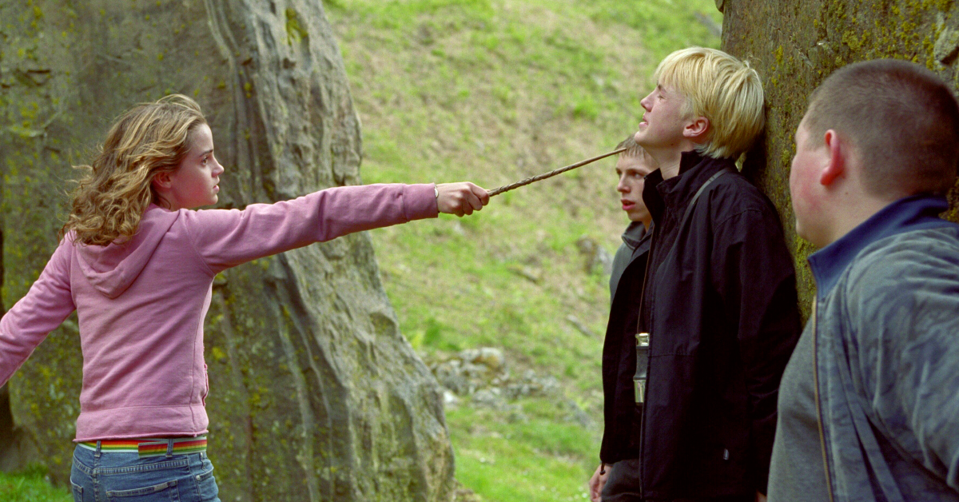
I ___ (call) you at 10 o’clock yesterday morning.
Oh, we probably ___ (not/hear) the phone.

Slide 9
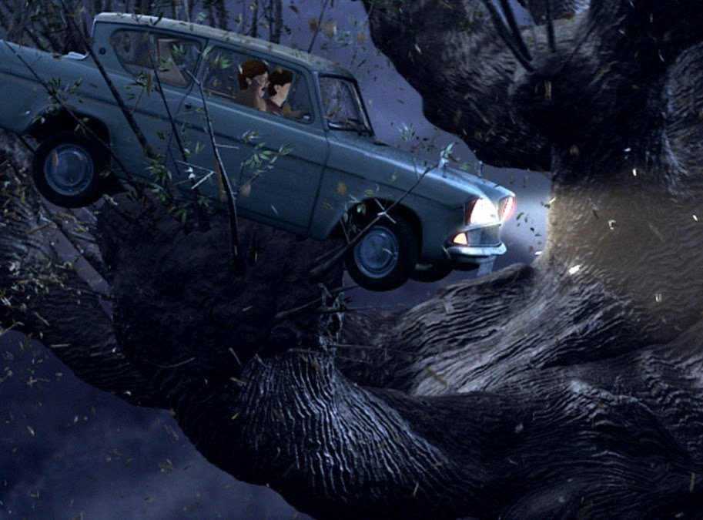
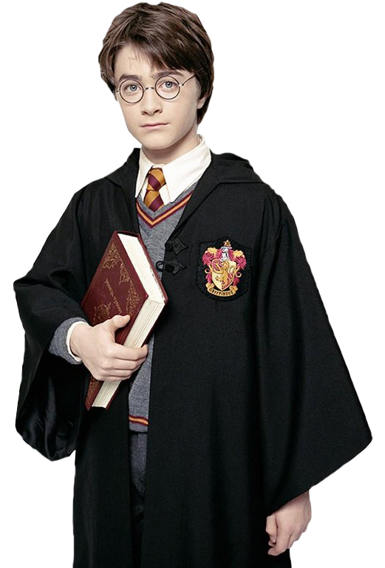
He ___ (drive) very fast when we ___ (have) the accident.

Slide 10
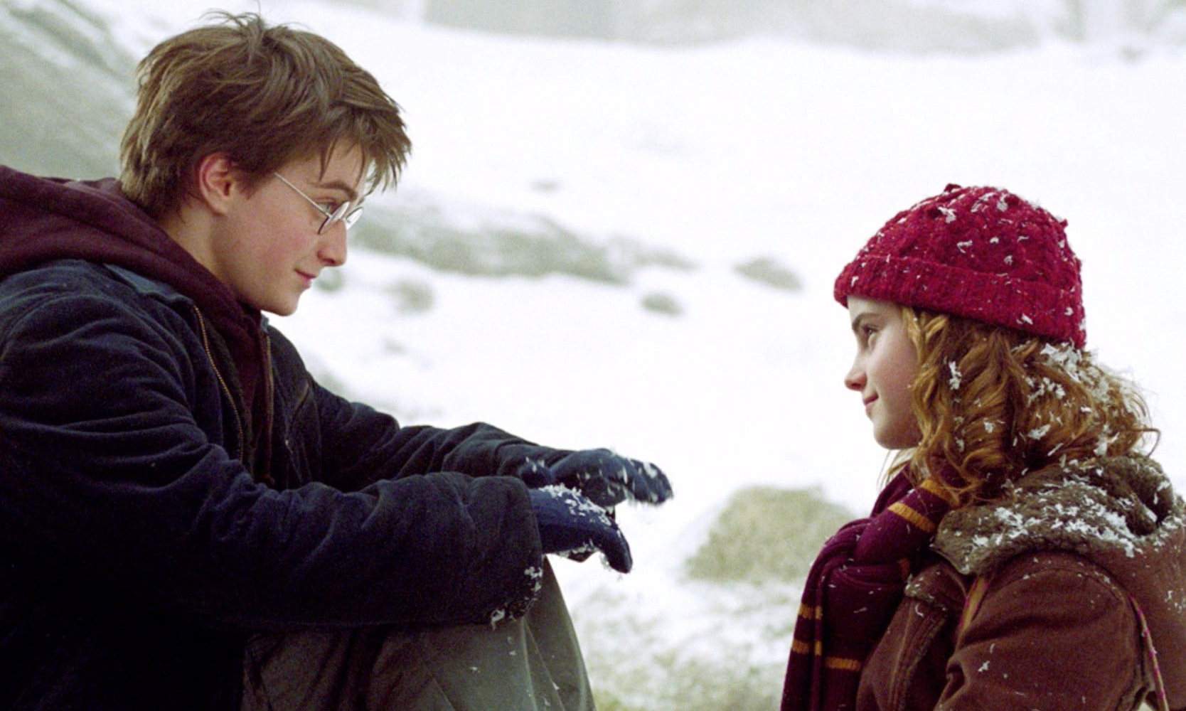
We ___ (talk) the whole morning.

Slide 11
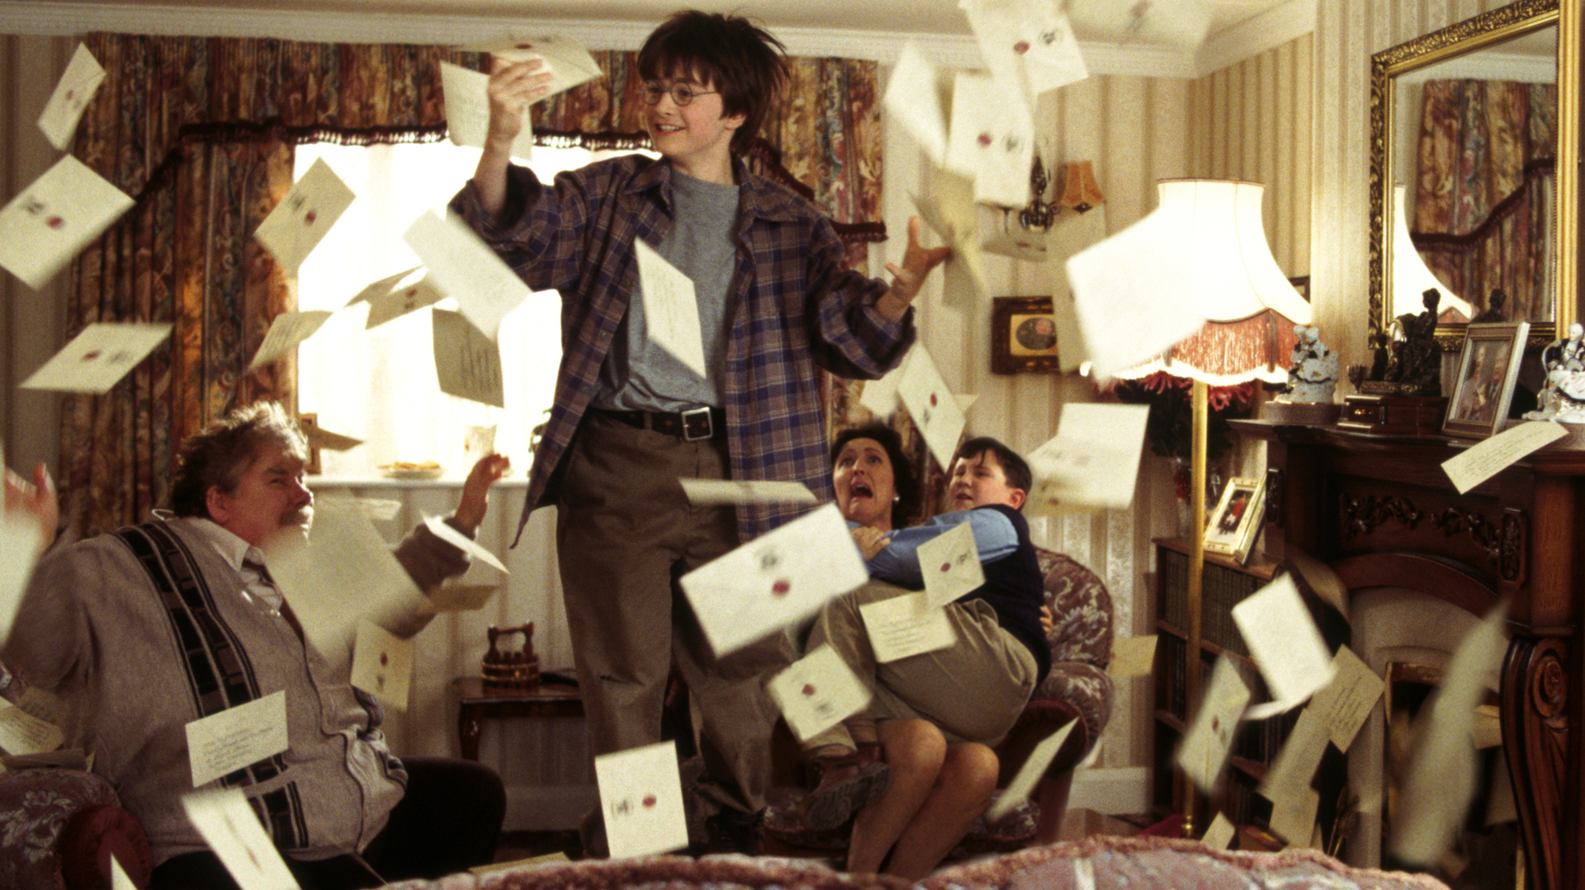
Letters ___ (come) all day long.

Slide 12
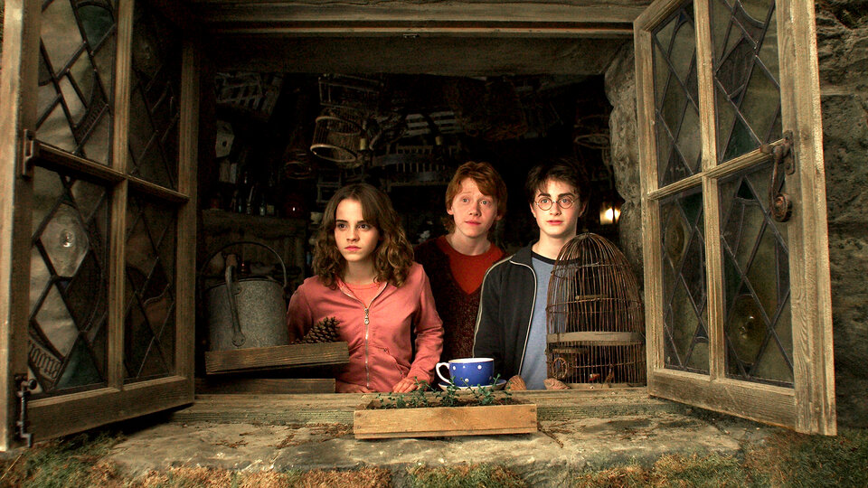
What ___ (do) you when we ___ (call) you last night?

Slide 13
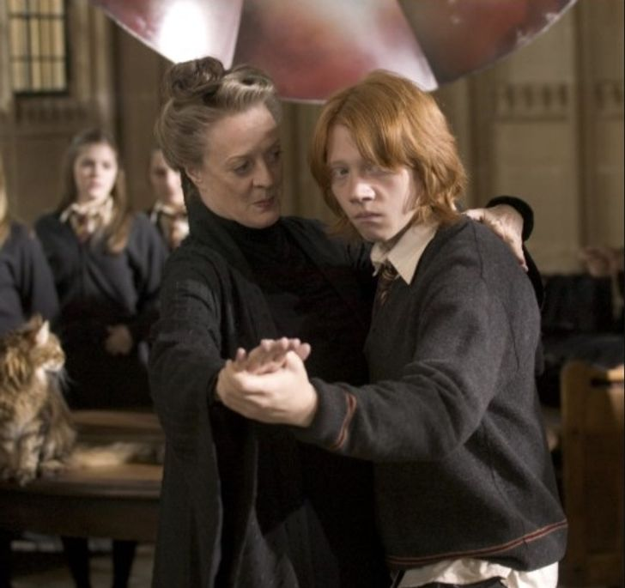
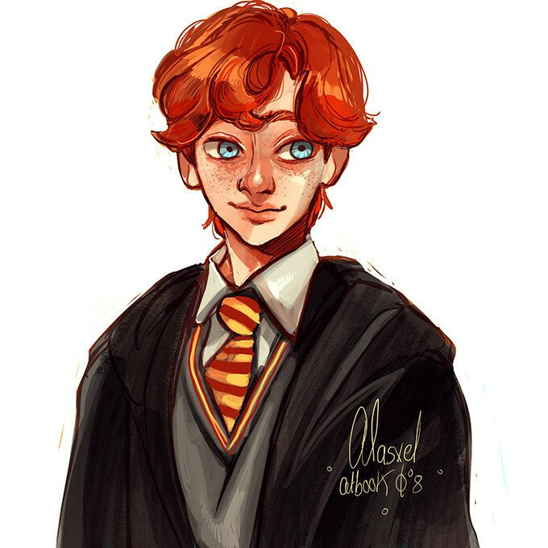
At 4 pm last Tuesday, I ____ (dance) with Professor McGonagl in the big hall..

