Slide 2
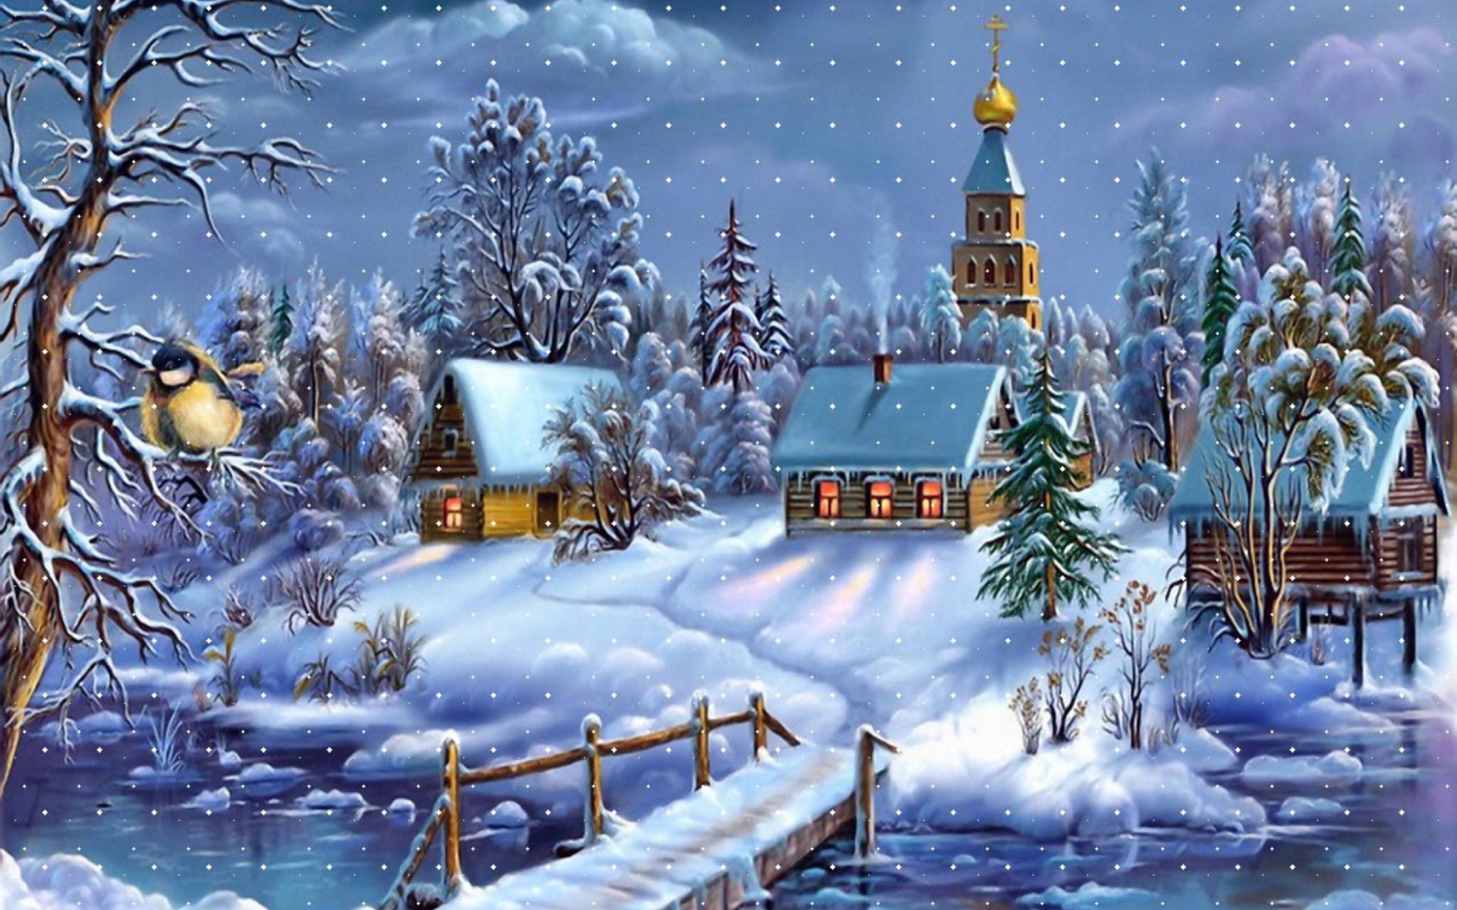
Dashing through the snow On a one horse open sleigh O’er the fields we go, Laughing all the way Bells on bob tail ring, making spirits bright What fun it is to laugh and sing A sleighing song tonight Oh, jingle bells, jingle bells Jingle all the way Oh, what fun it is to ride In a one horse open sleigh Jingle bells, jingle bells Jingle all the way Oh, what fun it is to ride In a one horse open sleigh.

Slide 3
Грамматический
конкурс

Slide 4
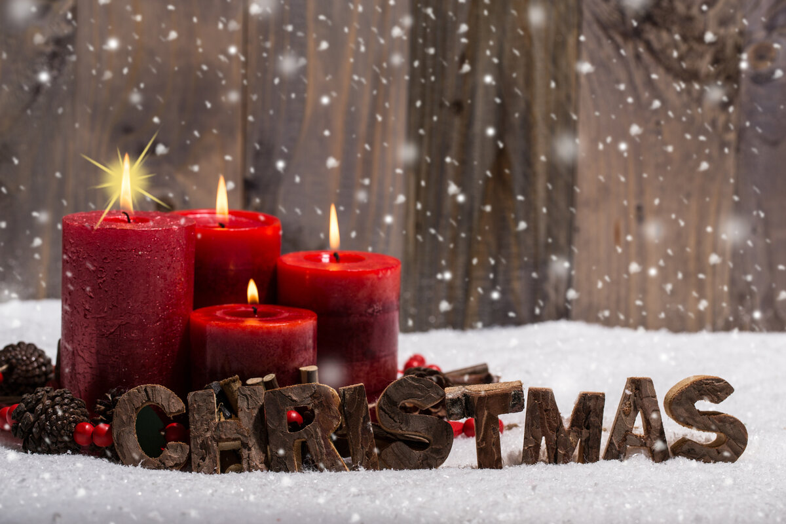
Логический конкурс

Slide 5
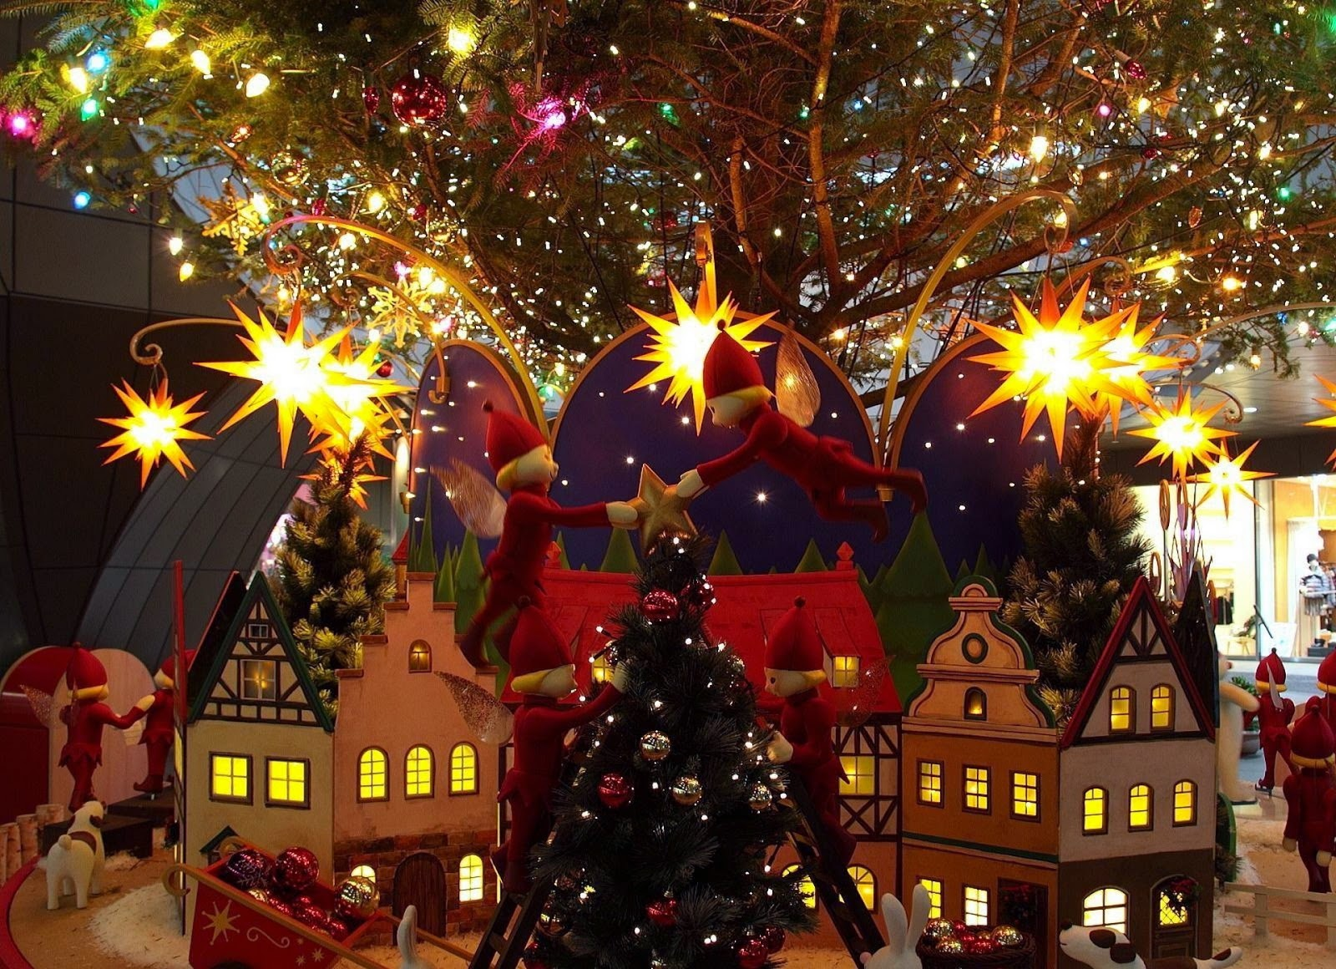
Буквенный конкурс

Slide 6
We wish you a Merry Christmas
We wish you a Merry Christmas We wish you a Merry Christmas We wish you a Merry Christmas And a Happy New Year.
Good tidings we bring To you and your kin Good tidings for Christmas And a happy new year.

Slide 7
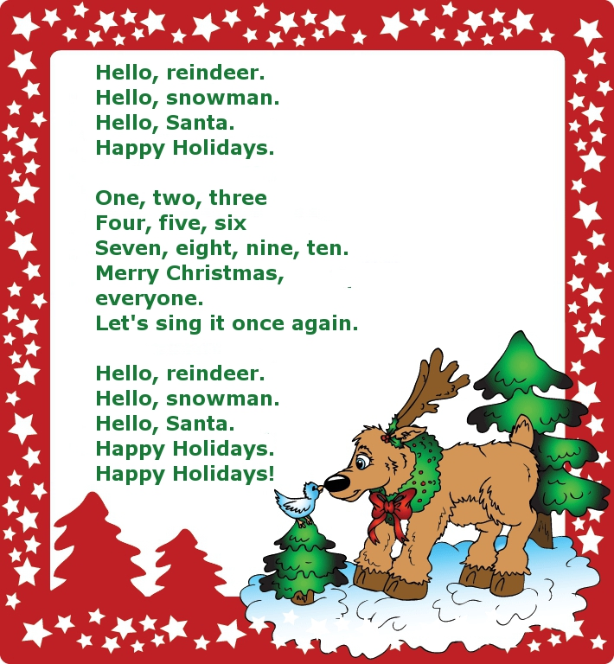

Slide 8
