Slide 1
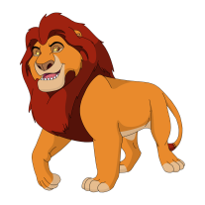
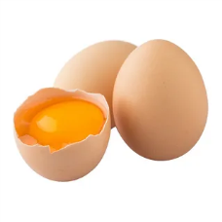
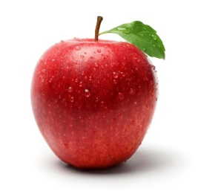
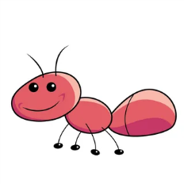

Slide 2
KLYUCHEVAYA

Slide 3
The topic of our lesson is … Today we will talk about … We will…
Read
Write
Watch a video
Have fun
Play a game

Slide 5
SPRING

Slide 6
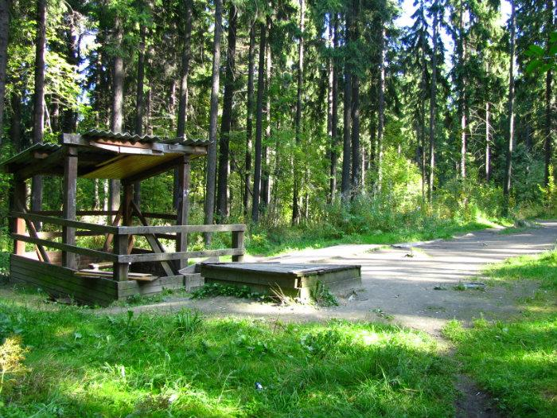

Slide 8
At the lesson …
I’ve learnt new words/facts.
I’ve practiced phonetics/reading.
I’ve read the text about …
Now I can/know … The lesson was interesting/boring. I liked/didn’t like/enjoyed …

