Slide 1
[u:] food [ɪ] fish, chips, milk, biscuits [ɪ:] pizza, cheese, cream, tea [e] egg, lemon [æ] jam, salad, apple [aɪ] ice, like [ɜ:] burger [dƷ] sausage, sandwich [ʌ] nut, but

Slide 3
Food

Slide 4
[ᶦpi:tsə] [ᶦfɪʃ ən ᶦtʃɪps]
[ᶦbɜ:gə] [ᶦtʃɒklət ᶦbɪskɪts]
[ᶦsᴂləd] [fu:d]
[ᶦsᴂnwɪdʒ]
[ᶦmɪlk ˌʃeɪk]
[ᶦsɒsɪdʒɪz]
[tʃɪ:z]

Slide 5
food [fu:d]
salad [ᶦsᴂləd]
burger [ᶦbɜ:gə]
sandwich [ᶦsᴂnwɪʤ]
pizza [ᶦpɪ:tsə]
cheese [tʃɪ:z]
sausages [ᶦsɒsɪʤɪz]
fish and chips [ᶦfɪʃ ən ᶦtʃɪps]
chocolate biscuits [ᶦtʃɒklət ᶦbɪskɪts]
milk shake [ᶦmɪlk ᶦʃeɪk]

Slide 6
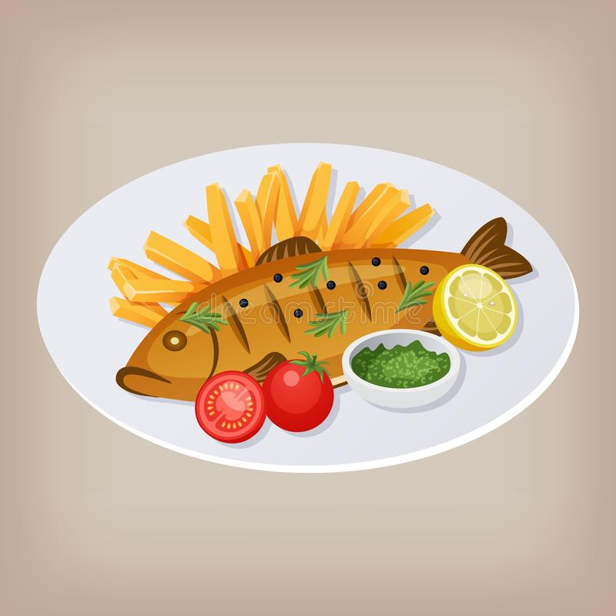
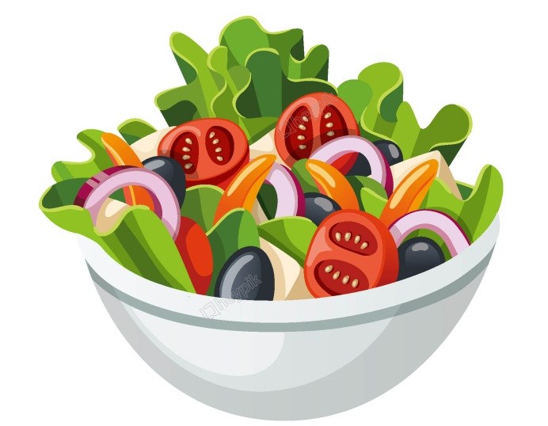
Alice

Slide 7
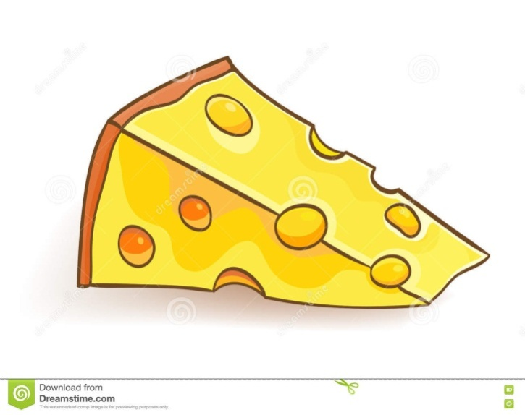
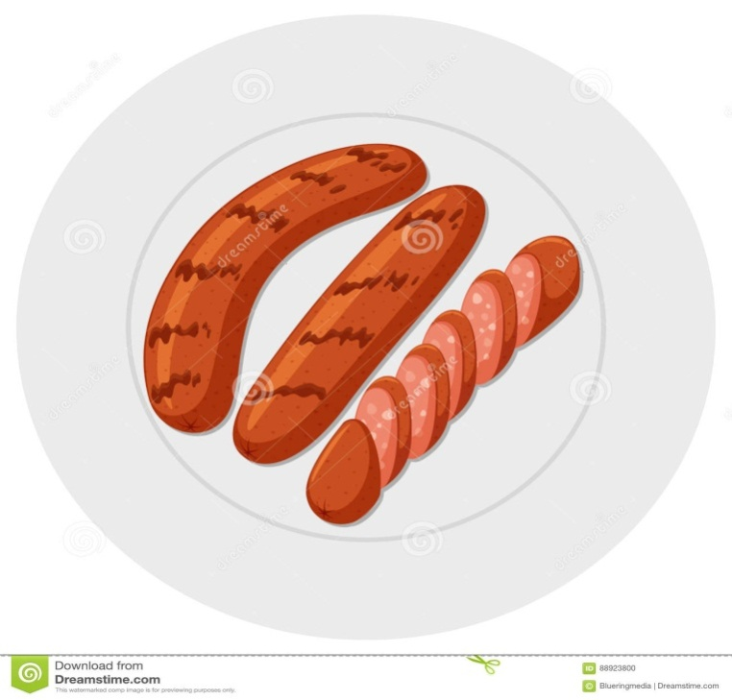
Roy

Slide 8
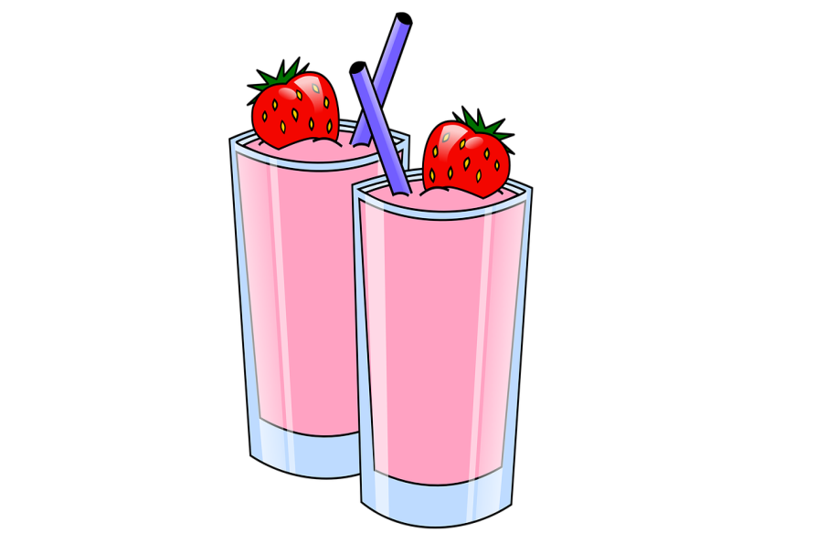
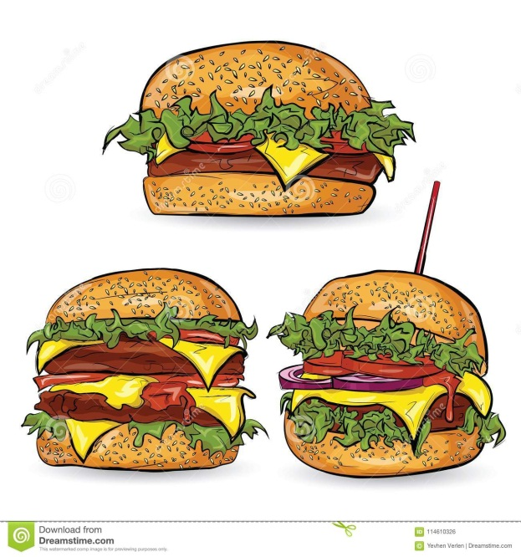
Mr. Wilson

Slide 9
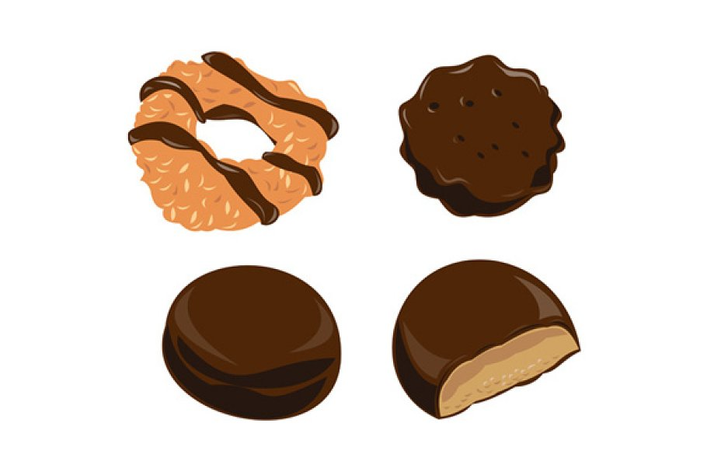
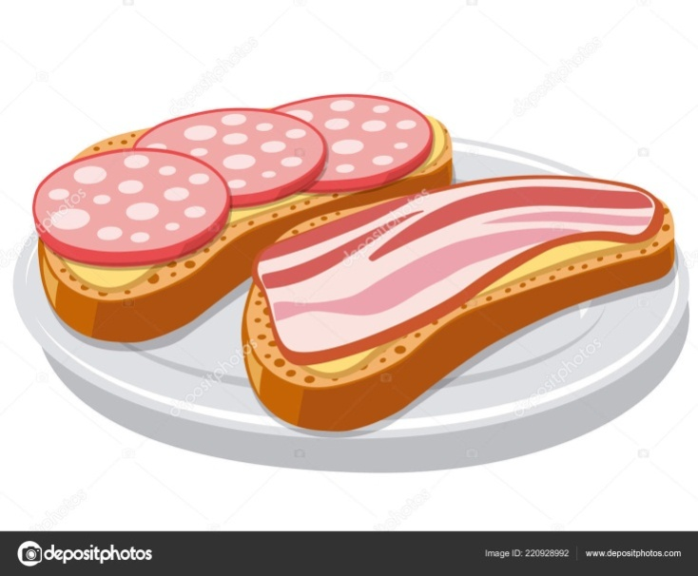
Lucy

Slide 10
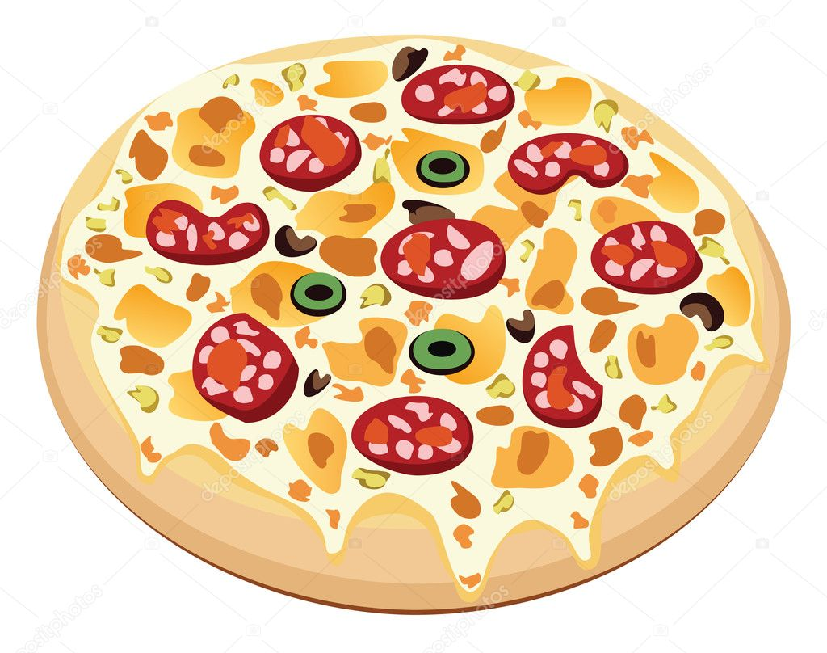
Bob

Slide 11
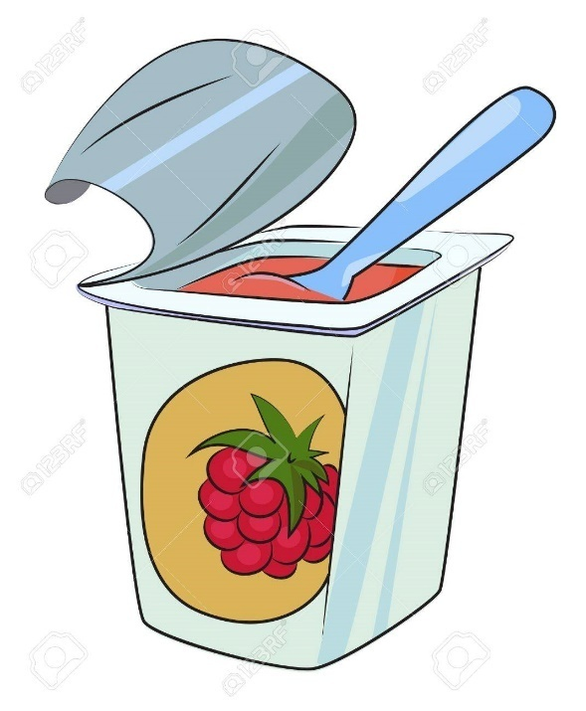
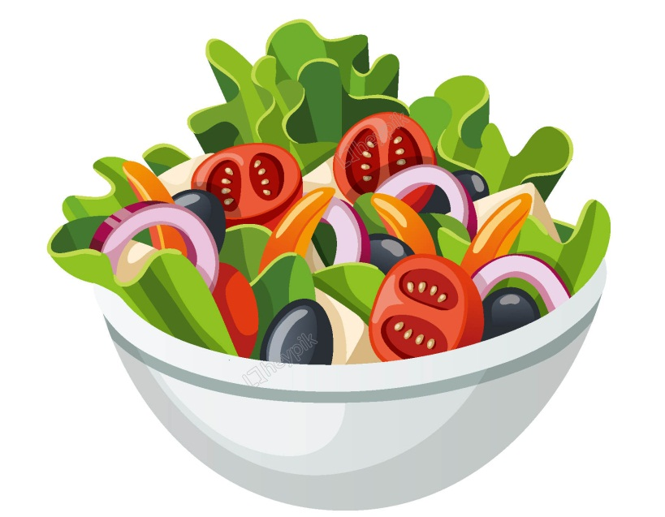
Miss Green

