Slide 1
The ecological contest
“ Keep our environment clean”
Оширова Виктория Анатольевна
учитель английского языка
МБОУ Новонукутская СОШ
Иркутская область

Slide 2
1. Warming up
Litter is
a) rubbish which people drop in the streets.
b) a place.
c) a measurement for water.
Recycling is
a) going on a bicycle again.
b) using litter again
c) a computer game.
A fine is
a) something nice.
b) the money you pay if you do something bad.
c) a present.
Air pollution is dangerous because
a) you can’t see.
b) you can’t hear.
c) you can’t breathe.
Pollution
a) is good for cars.
b) is good for tourists.
c) can kill people.
There will be no air without
a) animals.
b) icebergs.
c) forests.

Slide 3
Warming up
Litter is
a) rubbish which people drop in the streets.
b) a place.
c) a measurement for water.
Recycling is
a) going on a bicycle again.
b) using litter again
c) a computer game.
A fine is
a) something nice.
b) the money you pay if you do something bad.
c) a present.
Air pollution is dangerous because
a) you can’t see.
b) you can’t hear.
c) you can’t breathe.
Pollution
a) is good for cars.
b) is good for tourists.
c) can kill people.
There will be no air without
a) animals.
b) icebergs.
c) forests.

Slide 4
2. AN ECOLOGY QUIZ
This is the third planet from the Sun. It is about 12.750 km across its middle and is approximately 4.600 million years old. 71% of the surface is water and 5 billion people live on it. (the _________)
40% of all the world’s plants and animals live here. Every year an area the size of England disappears. Half of this in the tropical areas of the world has already gone, and the other half might disappear by 2050. (F________)
Every year about 6 hectares of land becomes this. The cause might be global warming – five of the world hottest years were in 1980-s and 1990-s. –but may be the way we use the land. One – third of the world’s land area is at risk from this increasing problem. (D_________)
This is a problem in all the big countries. It comes from factories, power stations and cars. It kills forests and lakes, and can make people ill. Some countries are starting to reduce this problem, but it is still happening worldwide. (A_______ P________).
The world’s people produce 1 billion tons of this a year. Most of it is dumped into the land or the sea. In the UK, an average family throws away 60 kg of plastic a year, and 15 kg of glass. (R________).

Slide 5
AN ECOLOGY QUIZ
This is the third planet from the Sun. It is about 12.750 km across its middle and is approximately 4.600 million years old. 71% of the surface is water and 5 billion people live on it. (the Earth)
40% of all the world’s plants and animals live here. Every year an area the size of England disappears. Half of this in the tropical areas of the world has already gone, and the other half might disappear by 2050. (Forests)
Every year about 6 hectares of land becomes this. The cause might be global warming – five of the world hottest years were in 1980-s and 1990-s. –but may be the way we use the land. One – third of the world’s land area is at risk from this increasing problem. (Deserts)
This is a problem in all the big countries. It comes from factories, power stations and cars. It kills forests and lakes, and can make people ill. Some countries are starting to reduce this problem, but it is still happening worldwide. (Air Pollution).
The world’s people produce 1 billion tons of this a year. Most of it is dumped into the land or the sea. In the UK, an average family throws away 60 kg of plastic a year, and 15 kg of glass. (Rubbish).

Slide 6
3. AN ECOLOGICAL WORDSEARCH
FIND THE WORDS: clean, earth, pollution, recycle, river, water, plant, animal, planet, land, ecology, environment, waste, save, endangered
H | E | D | N | O | C | E | S | Y | T | N | E | W | T | P
S | A | N | E | N | V | I | R | O | N | M | E | N | T | О
T | L | V | D | A | K | H | Y | G | O | L | O | C | E | L
E | A | A | P | A | A | E | S | R | E | T | A | W | L | L
N | T | R | M | B | N | E | R | S | I | S | N | S | C | U
A | I | S | I | I | I | G | U | E | C | V | A | L | Y | T
L | D | T | A | C | N | E | E | A | D | V | E | F | C | I
P | A | E | E | W | R | A | A | R | E | U | L | R | E | O
T | Y | P | L | A | N | T | S | T | E | N | C | E | R | N
A | S | L | A | N | D | R | T | H | H | D | D | E | A | Y

Slide 7
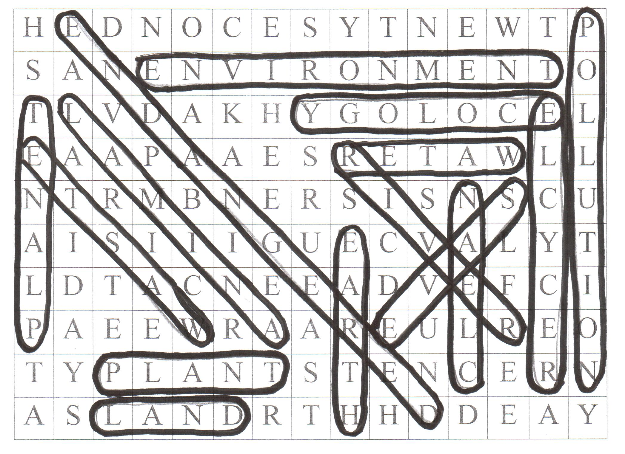
clean, earth, pollution, recycle, river, water, plant, animal, planet, land, ecology, environment, waste, save, endangered

Slide 8
4. THE CAPTAINS’ CONTEST
Guess the words:
The external surroundings in which a plant or animal lives, which tend to influence its development and behaviour.
The planet on which we live.
It is an organization that protects the environment.
All natural phenomena and plant and animal life, as distinct from man and his creations.

Slide 9
THE CAPTAINS’ CONTEST
Guess the words:
The external surroundings in which a plant or animal lives, which tend to influence its development and behaviour. (Environment)
The planet on which we live. (the Earth)
It is an organization that protects the environment. (The Greenpeace)
All natural phenomena and plant and animal life, as distinct from man and his creations. (Nature)

Slide 10
5. Match the parts of the ecological slogans
  1. Protect the environment …
  2. Keep the land, …
  3. Keep …
  4. All woods are … . So … .
  5. Help … . Protect … .
  6. The Earth is … . Don’t … .
  7. When you hike, …
  8. Plant a tree to create home …
  a) from industrial pollution.
  b) leave the place clean.
  c) for birds, squirrels and other small animals.
d) behave as guests.
e) our environment clean.
f) home for animals.
g) nature.
h) it.
i) our home.
j) pollute it.
k) air and water clean.

Slide 11
Match the parts of the ecological slogans
  1. Protect the environment a) from industrial pollution.
  2. Keep the land, k) air and water clean.
  3. Keep e) our environment clean.
  4. All woods are f) home for animals. So d) behave as guests.
  5. Help g) nature. Protect h) it.
  6. The Earth is i) our home. Don’t j) pollute it.
  7. When you hike, b) leave the place clean.
  8. Plant a tree to create home c) for birds, squirrels and other small animals.

Slide 12
Protect the environment from industrial pollution.
Охраняйте окружающую среду от промышленного загрязнения.
Keep the land, air and water clean.
Содержи землю, воздух и воду в чистоте.
Keep our environment clean.
Содержи окружающую среду в чистоте.
All woods are home for animals. So behave as guests.
Все леса – дом для животных. Ведите себя как гости.
Help nature. Protect it.
Помогай природе. Защищай ее.
The Earth is our home. Don’t pollute it.
Земля - наш дом. Не загрязняй его.
When you hike, leave the place clean.
На прогулке оставляй после себя место чистым.
Plant a tree to create home for birds, squirrels and other small animals.
Посади дерево, чтобы сделать дом для птиц, белок и других маленьких животных.

Slide 13
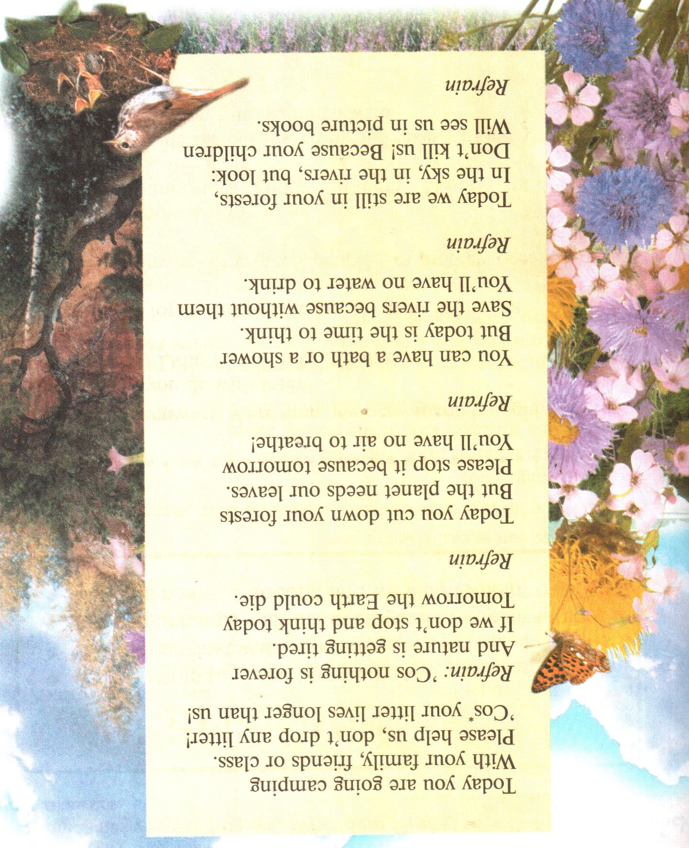


Slide 14
Our promise
The Earth is our home.
We promise to keep it healthy and beautiful.
We’ll love the land, the air, the water and all living creatures.
We’ll be the defenders of our planet, united with all people of good will.
We’ll save the Earth!

