Slide 2
m
m
m
How old are you?
What have you got in your school bag?
What’s your favourite sport?
What can you do?
What food do you like?
What’s your favourite colour?
m
m
m

Slide 3
At a hospital
He is a farmer. Where does he work?
She is a doctor. Where does she work?
At a shop
He is a police officer. Where does he work?
At a fire station
At a police
station
She is a postman. Where does she work?
He is a teacher. Where does he work?
He is a fire-
fighter. Where does he work?
At a restaurant
At school
He is a waiter. Where does he work?
On a farm
She is a cashier. Where does she work?
At a hospital
At a post office

Slide 4
TV
newspapers
magazine
the Internet
radio
Types of media

Slide 6
We will …

Slide 8
Wednesday, the 7th of April.
Classwork

Slide 9
director

Slide 10
reporter

Slide 11
newsreader

Slide 12
editor

Slide 13
presenter

Slide 14
sound engineer

Slide 15
Those were today’s headlines. And now it’s over to Jenny for the weather forecast.
newsreader
Hold the front page!
editor
This is Larry Forester, live from Glasgow.
reporter
The sound quality is not very good.
sound engineer
And now everybody get ready to welcome Britney Spears! Hello there, Britney!
presenter

Slide 16
Ex 5 p 112
sit
forecast
report
news
com
weather

Slide 17
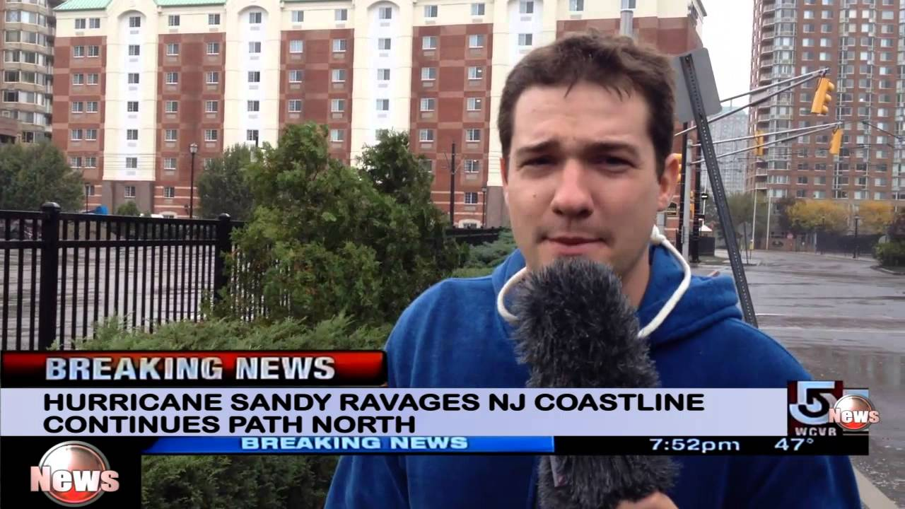
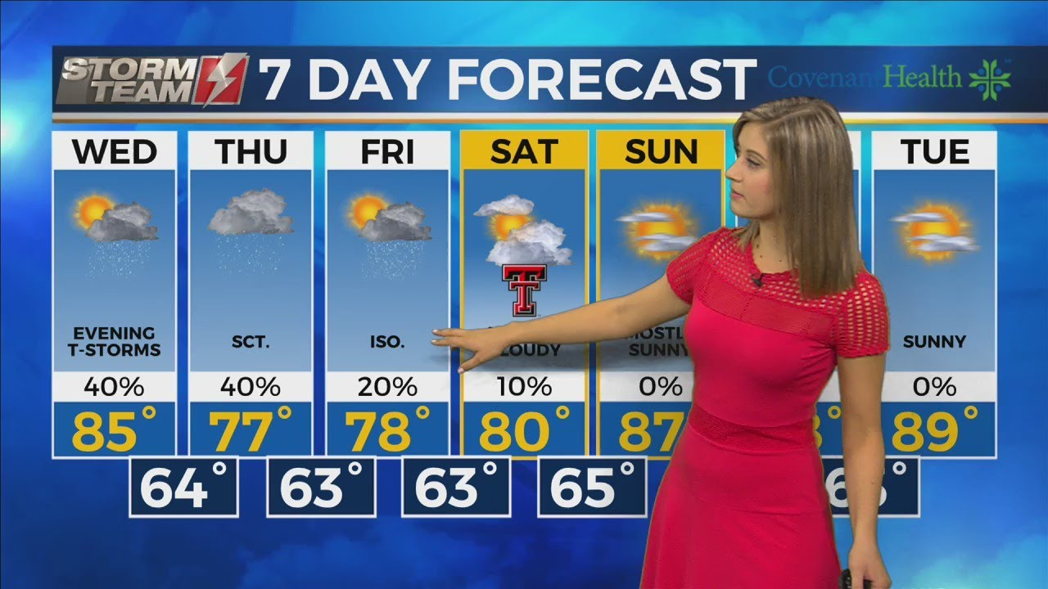
a sitcom
a news report
C
B
weather forecast
A

Slide 19
to calm her down
they were released into the wild again
С) it was just going to be a routine call
D) to help the mother koala
E) they go straight for it
F) on their own for very long
G) the stress hadn’t done any harm
успокоить ее
они были снова выпущены на свободу
это был просто очередной рутинный звонок
помочь маме коале
они идут по прямо к нему
самостоятельно (в течение долгого времени)
стресс не нанес какого-либо ущерба

Slide 20
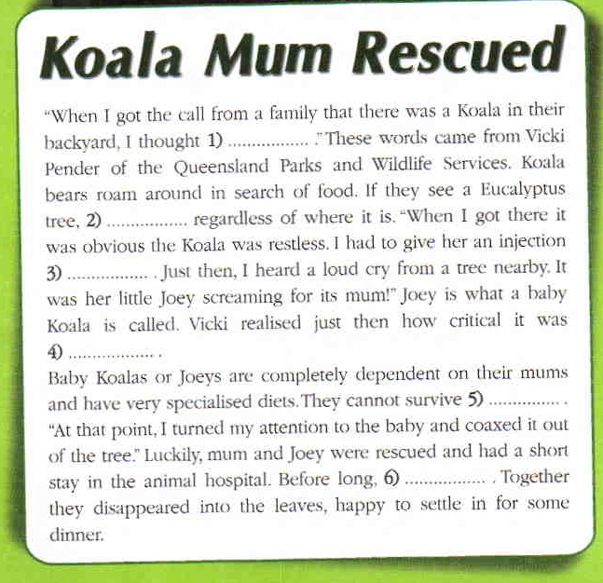
Ex 2 p 112
C
E
A
D
F
B

Slide 21
Speaking!
All types of media are important. I use … The most interesting profession for me is …

Slide 22
Homework
Group 1 – ex 1
Group 2 – ex 2

Slide 23
Thank you for the lesson! ☺

Slide 24
Game! Find a dollar!

Slide 25
