Slide 1
Homeless Animals. Animal Shelters
Saving an animal, we save a person in ourselves

Slide 2
REASONS why animals get to animal shelters

Slide 3
Rules for Customers at the Zoo Shop To have a Pet MEANS:

Slide 4
Work at the Animal Shelter

Slide 5
Animal Shelter ‘Eastern Crimea’

Slide 6
Animal Shelter ‘Eastern Crimea’ a veterinary

Slide 7
Animal Shelter ‘Eastern Crimea’ an animal resuscitator

Slide 8
Animal Shelter ‘Eastern Crimea’

Slide 9
Animal Shelter ‘Eastern Crimea’

Slide 10
Animal Shelter ‘Eastern Crimea’

Slide 11
Animal Shelter ‘Eastern Crimea’

Slide 12
Animal Shelter ‘Eastern Crimea’

Slide 13
Animal Shelter ‘Eastern Crimea’

Slide 14
Animal Shelter ‘Eastern Crimea’ alabai

Slide 15
Animal Shelter ‘Eastern Crimea’ Rhodesian Ridgeback or African Lion Hound

Slide 16
Animal Shelter ‘Eastern Crimea’ Rhodesian Ridgeback or African Lion Hound

Slide 17
Animal Shelter ‘Eastern Crimea’ cats

Slide 18
Animal Shelter ‘Eastern Crimea’ cats

Slide 19
Animal Shelter ‘Eastern Crimea’

Slide 20
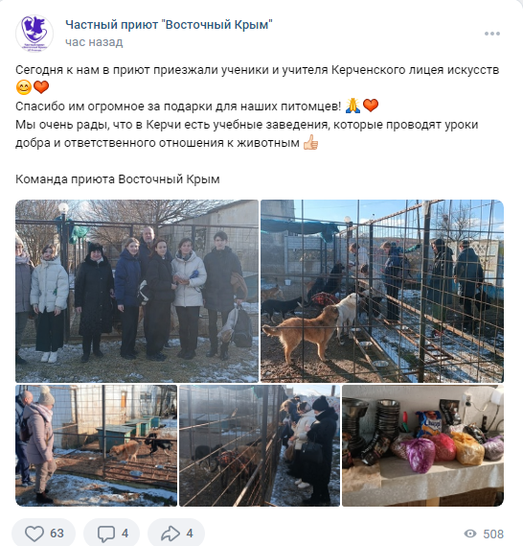

Slide 21
The Passive Voice (to be +V3) transform from Active into Passive
Sergey founded this animal shelter.
The vet operates injured animals.
The vet sterilizes stray and homeless animals.
The vet chips stray animals.
Staff members treat sick animals.
Staff members and volunteers remove neglected animals from bad owners.
The vet inoculates animals.
Cynologists train animals.

Slide 22
The Passive Voice (to be +V3) transform from Active into Passive
Staff members clean animals’ cages.
Volunteers explain people how to look after their pets properly.
Volunteers help people to choose a pet.
Volunteers raise money for charity.
Volunteers encourage people to donate money for charity.
Volunteers answer phone calls.
An administrator answers phone calls.
Volunteers assist vets in operations.

Slide 23
The Passive Voice (to be +V3) transform from Active into Pass
Many people visit animal shelters.
Bad owners neglect sick animals.
Bad owners abandon animals when they are tired of them.
All people should take care of their pets properly.
All pet-owners must take their pets to the vet on time.
Local authorities must fine owners for keeping their pets badly.
Dog handlers re-educate aggressive dogs.

Slide 24
Stray animal aggression

Slide 25
Conclusion

Slide 26
Conclusion
People make animals stray and homeless, therefore it is up to people to solve this problem.
There are no bad animals, there are bad masters.
We are responsible for those who we tamed.
Saving an animal, we save a person in ourselves.

