Slide 1
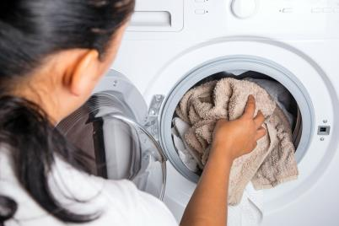
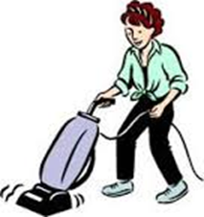
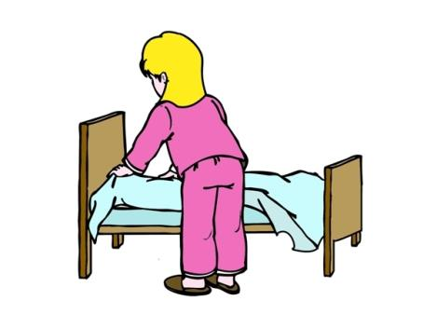
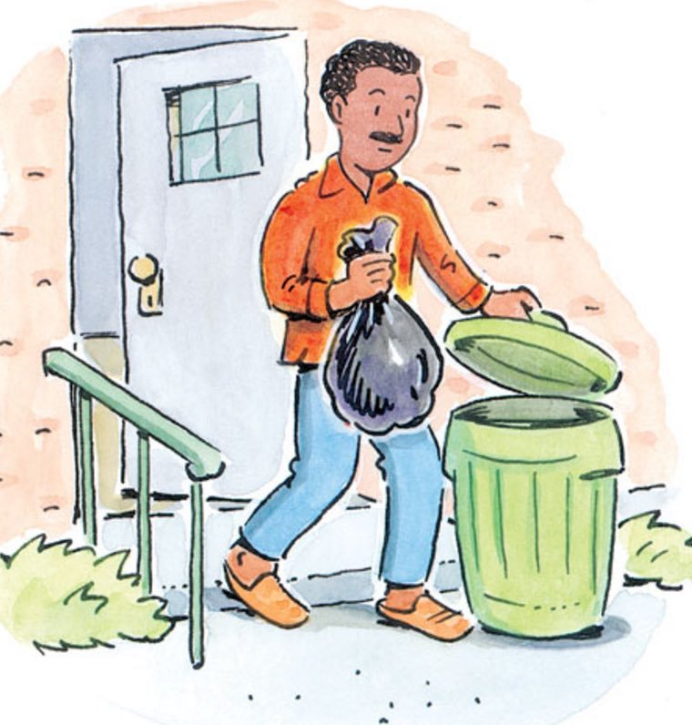
Guess! What are we going to talk about?
Topic: Household chores

Slide 2
Topic: Household chores.
Plan of the lesson
Цель урока (aim):
Speak about household chores (use the words in speech)
Задачи (tasks):
Learn new words;
Get the information about household chores from the text;
Discuss

Slide 3
Remember the words you know about the household chores.
Household chores

Slide 4
Learn new words
Household chores
Ex 1 p 102
Listen and repeat
Make up sentences using Present Continuous as in the example.

Slide 5
Translate from Russian into English
Каждое утро я заправляю кровать.
Every morning I make my bed
2. Мой брат выбрасывает мусор вечером.
My brother takes the rubbish out in the evening.
3. Я не люблю гладить бельё.
I don’t like doing the ironing.
4. Мама обычно готовит ужин, а я помогаю ей мыть посуду.
My mum usually makes the dinner and I help her to do the washing up.
5. Ты должен убирать свою комнату каждый день.
You should tidy your room every day.

Slide 6
6. Давай сходим за покупками.
Let us do the shopping.
7. Легче пропылесосить, чем мыть полы.
It’s easier to do the vacuuming than mop the floor.
8. Если ты разгрузишь посудомоечную машину, я помогу тебе сделать домашнее задание.
If you upload the dishwasher, I will help you do the homework.

Slide 7
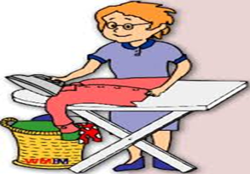
Worksheets Work in pairs.
Task 1 Match the definitions with words

Slide 8
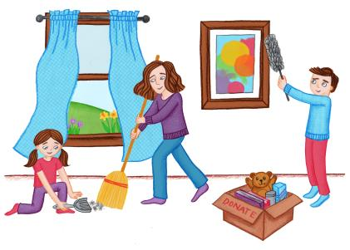
Check the answers.
Task 1
Correct answers:
1. f
2. c
3. a
4. d
5. b
6. g
7. h
8. e

Slide 9
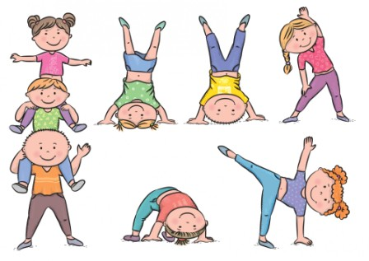
Физкультминутка
Загадай фразу из упр 1 стр 102 и изобрази её движением.

Slide 10
Work in pairs. Ask and answer about household chores.
What do you do to help your parents about the house?
How often do you do the washing up?
Who makes dinner in your house?
Who takes the rubbish out in your family?
Do you like doing the vacuuming?
Do you make your bed every day?

Slide 11
Get the information about household chores from the text
Read the text.
Work in pairs.
Are the statements true or false?
Correct answers:
False (All teenagers have different household duties.)
True
False (They are considered to be easy duties.)
False (The author doesn't like cooking every day.)
True
True

Slide 12
HOMEWORK
Сборник тестов: Ex 1 p 46
WB: ex 1,3,4 p 76

Slide 13
Рефлексия и оценивание
Заполните таблицу по итогам урока. Поставьте галочку
 | Утверждение | Согласен | Частично согласен | Не согласен
1 | Цель урока была достигнута
2 | Для достижения цели мы поэтапно реализовали поставленные задачи.
3 | Пути достижения поставленных задач были определены верно

Slide 14
Complete the table with “make”, “do”
make | do
the bed | the ironing
soup a cake | the shopping the washing up
breakfast/lunch/dinner | the vacuuming
mess tea/ coffee | the cleaning homework
the ironing, the bed, the shopping, the washing up, soup, the vacuuming, a cake,
the cleaning, breakfast/lunch/dinner, homework , mess, tea/ coffee
Notes:
Extra task

Slide 15
Word formation
Task Change the words to complete the sentence.
1. The _____(discuss) about climate change was very informative.
2. I had a _____(converse) with my friend about our favorite books.
3. _____(educate) is important for personal growth and development.
4. Making the _____(decide) to move to a new city was difficult but necessary.
5. My parents gave me _____(permit) to go on a road trip with my friends.
6. My grandmother has a _____(collect) of antique dolls from around the world.
Correct answers:
1. discussion
2. conversation
3. education
4. decision
5. permission
6. collection
Notes:
Extra task

