Slide 1
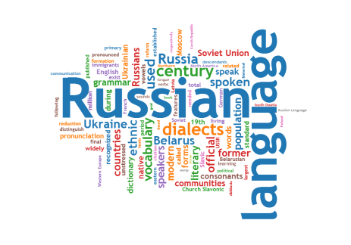
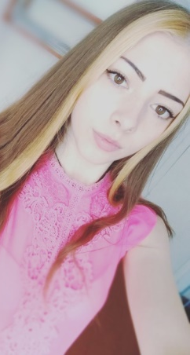
The Muromtsevo College of Agricultural Mechanization. I am a cook, I am a master, I am a magician.

Slide 2
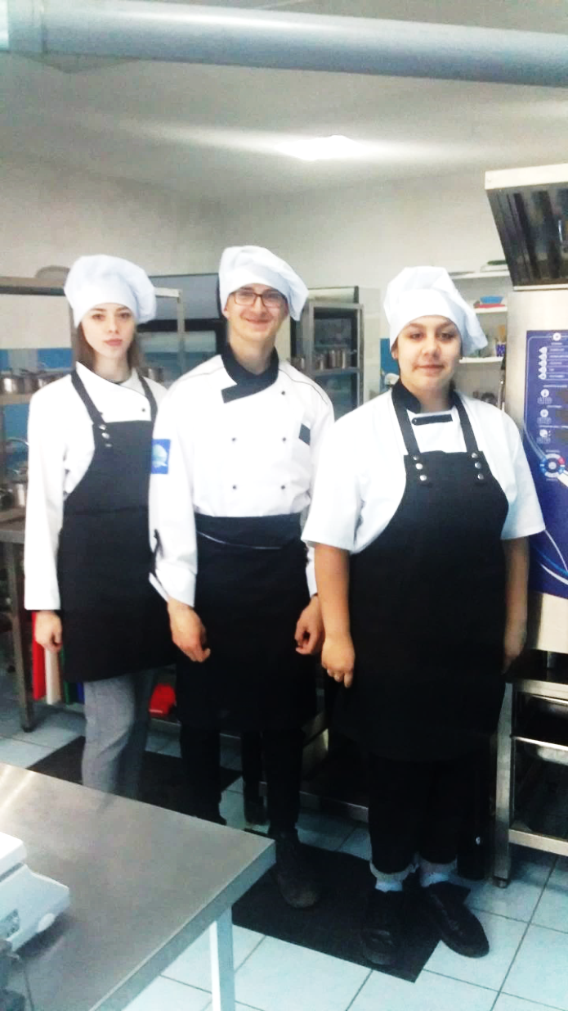
We are united—we are the best

Slide 3
My Future Profession Is a cook. The cook is one of the interesting job. I have liked cooking since childhood. When I was 7 years old I already could cook eggs, salad and make sandwiches. Sometimes I spend more time in the kitchen than my mother. I like being our family chef. My dream is to become a chef at the restaurant and then open my business .

Slide 4
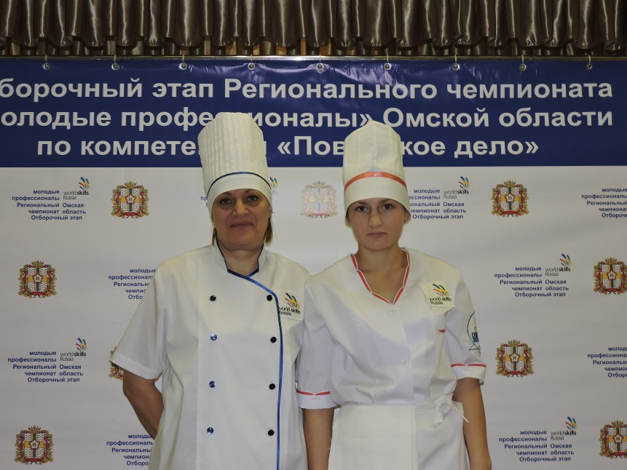
WorldSkills Russia In 2016, on the basis of the Omsk regional College, the qualifying stage of the regional closed championship "Young Professionals" (WorldSkills Russia) of the Omsk region on the competence of «Cooking». In 2018, the Оpen regional championship "Young Professionals" (WorldSkills Russia) was held Omsk region. Natalia Bogatyreva took the 6th place. In 2023, I dream of taking part in the Young Professionals Championship (World Skills Russia)

Slide 5
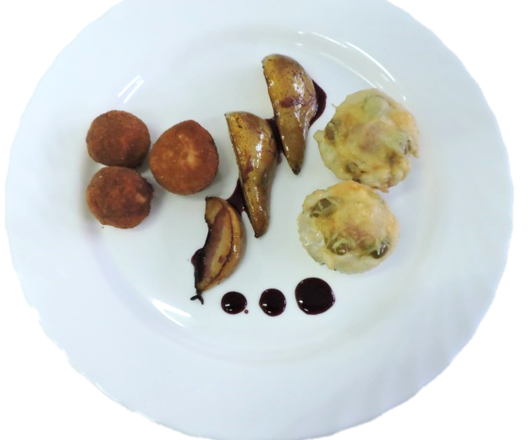
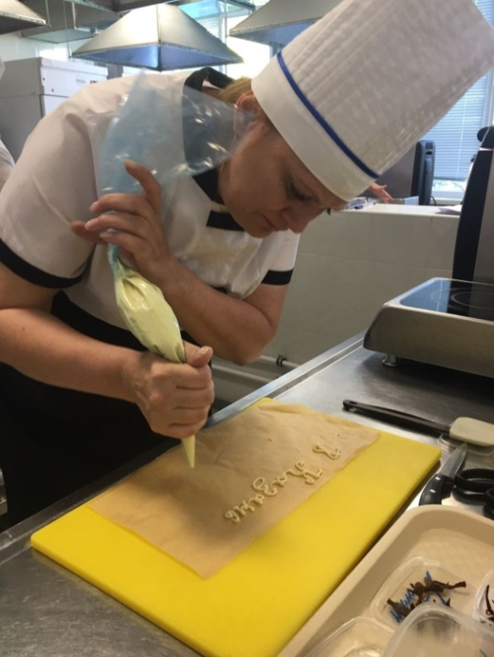

Slide 6
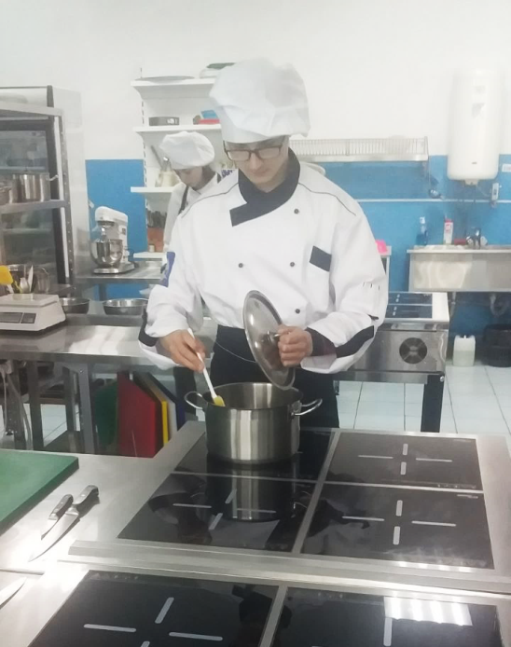
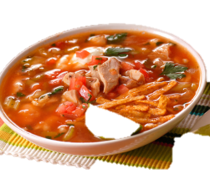
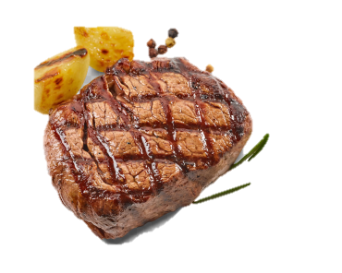
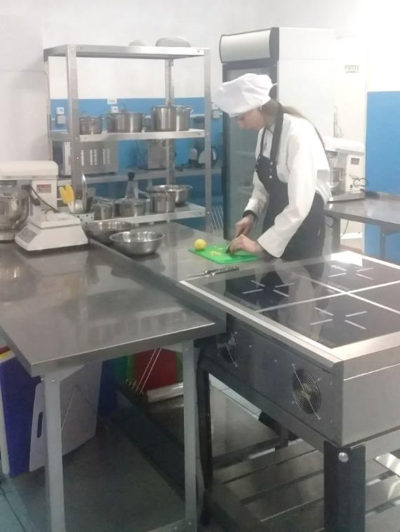
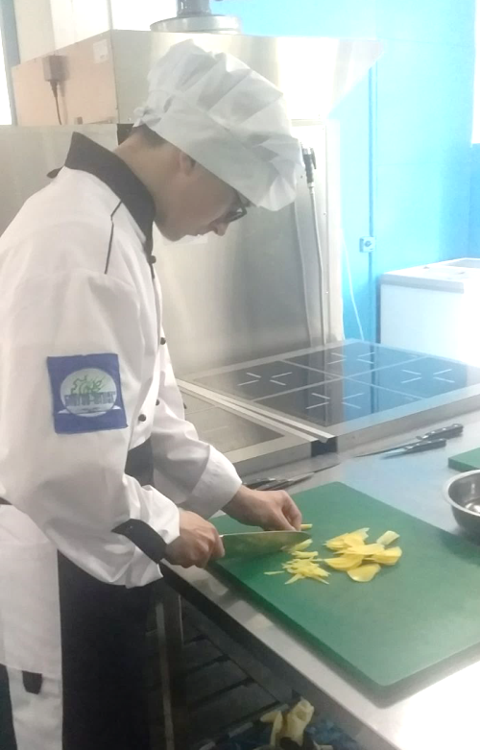
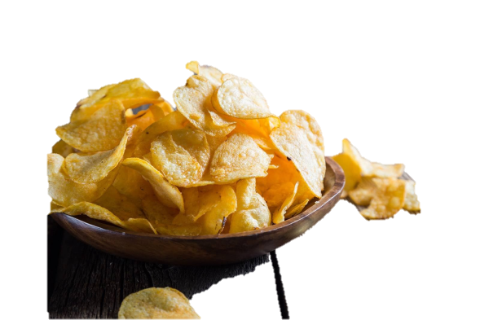
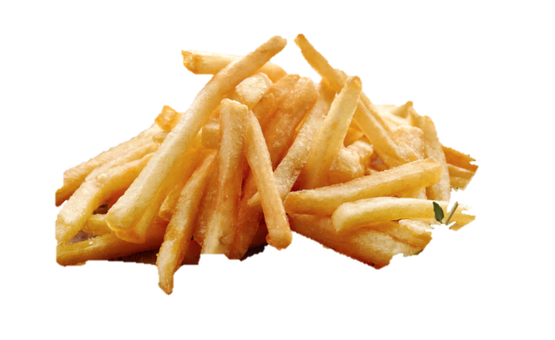
Steak/ medium rare
English soup – stu (СУП)
Chips
French fries

Slide 7
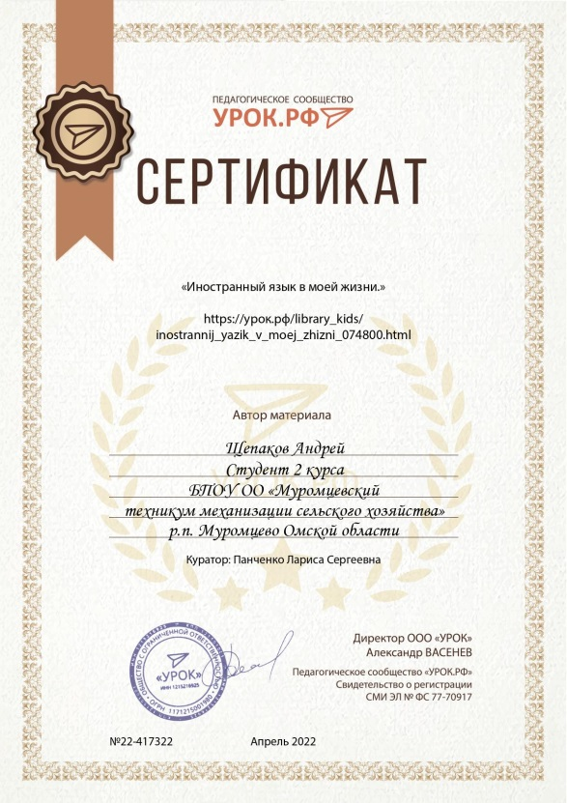
Роль иностранного языка в обществе. Taking a tour, shopping, dining at a restaurant, living in a hotel, we need the ability to speak English. When applying for a job, the director requires knowledge of a foreign language. And since English is the language of high technology, programming, the language is international. Speaking English today is a success.

