Slide 2
Appearance
Tall — высокий
Short — низкий
Long – длинный
Small – маленький
Big – большой
Strong – сильный
Slim – стройная
Short hair— короткие волосы long hair — длинные волосы straight hair— прямые волосы wavy hair— волнистые волосы curly hair — кудрявые волосы

Slide 3
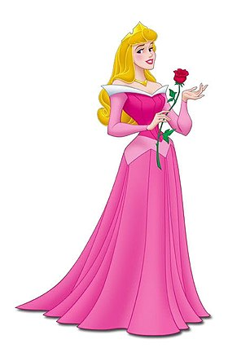
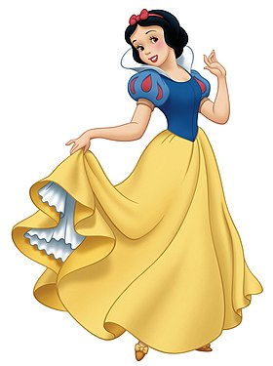
Who is it?
Snowhite
Sleeping beauty

Slide 4
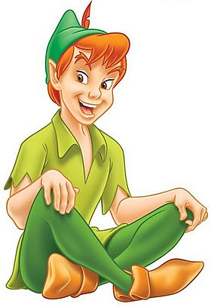
Who is it?
Peter Pen
Pirate Jack

Slide 5
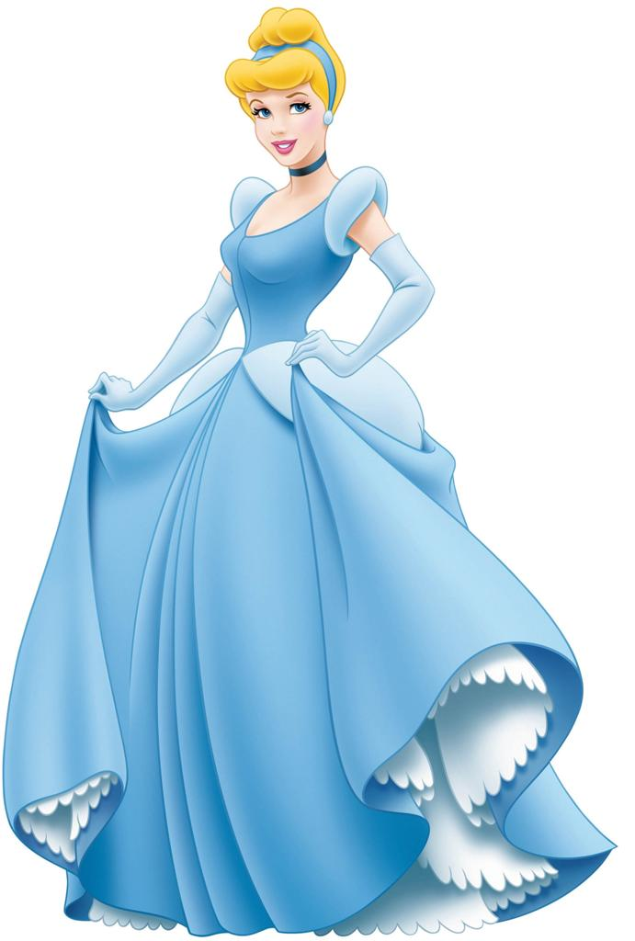
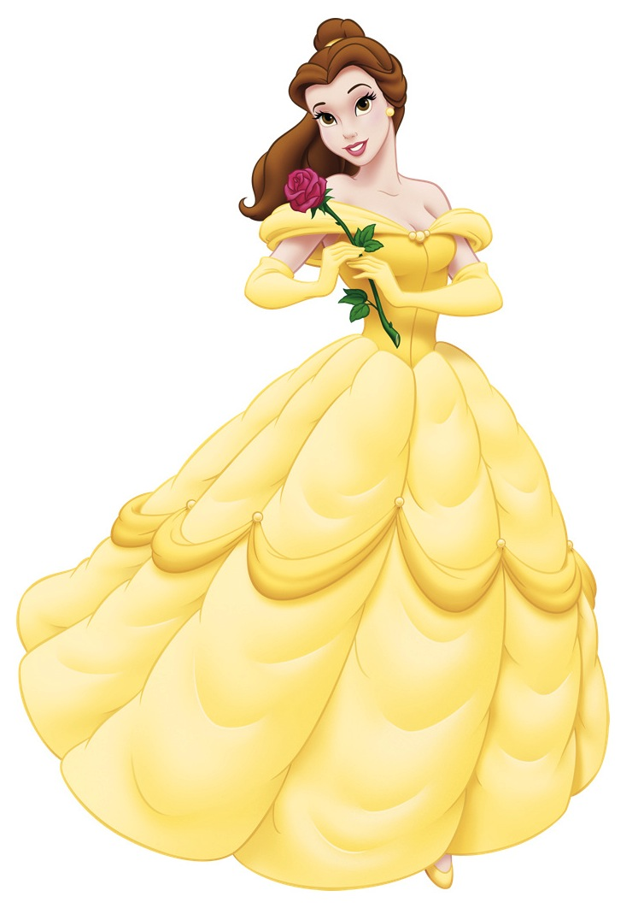
Who is it?
Cinderella
Belle

Slide 6
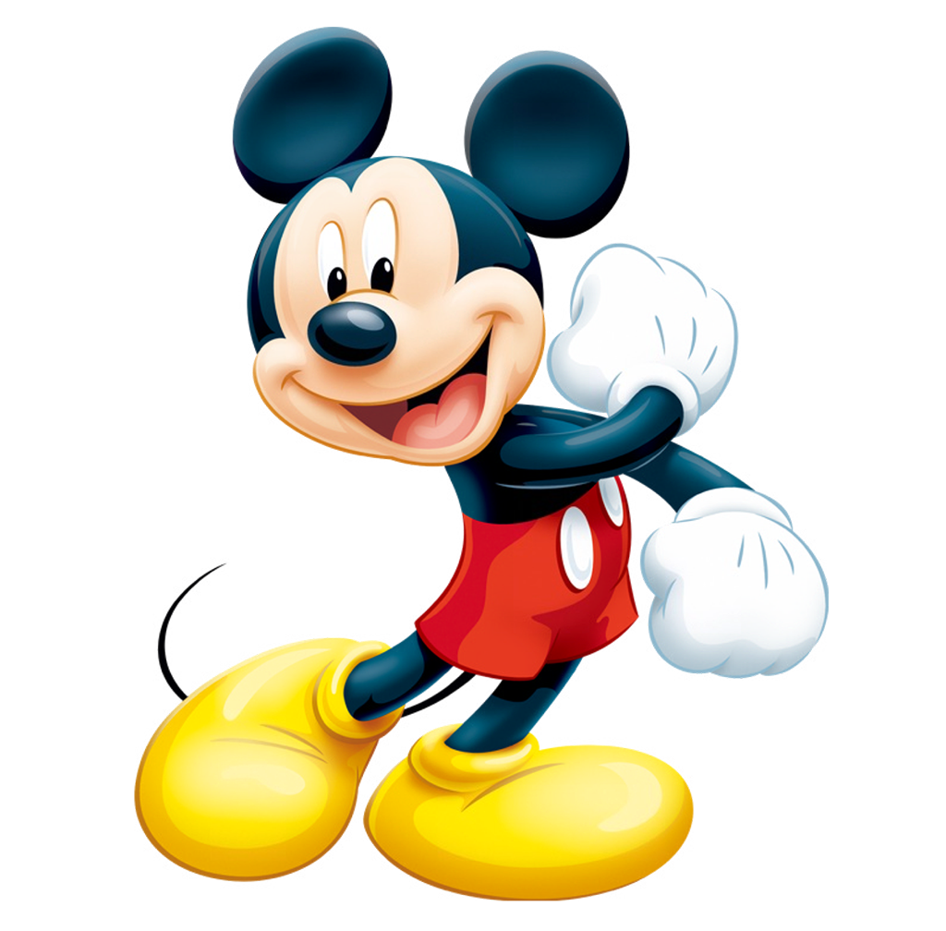
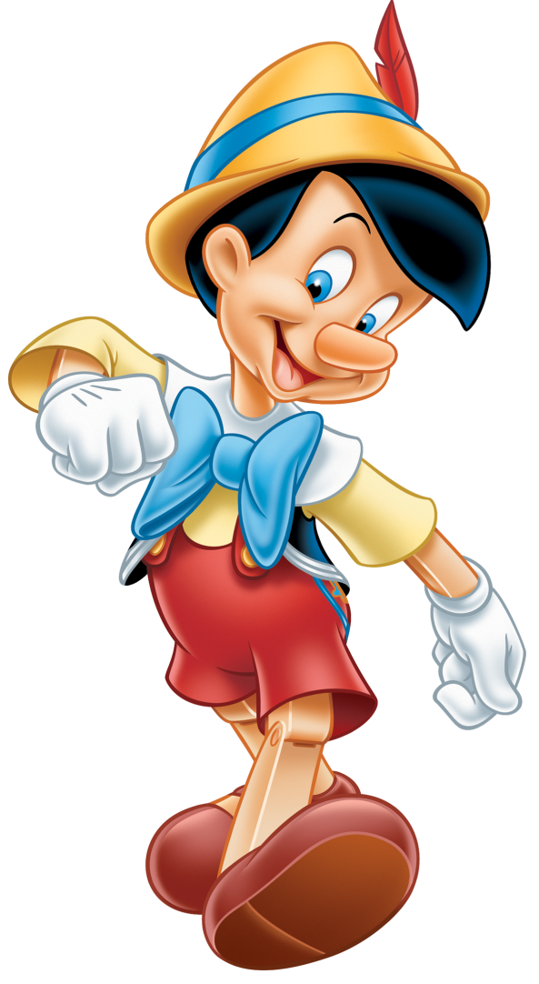
Who is it?
Mickey
Pinocchio

Slide 7
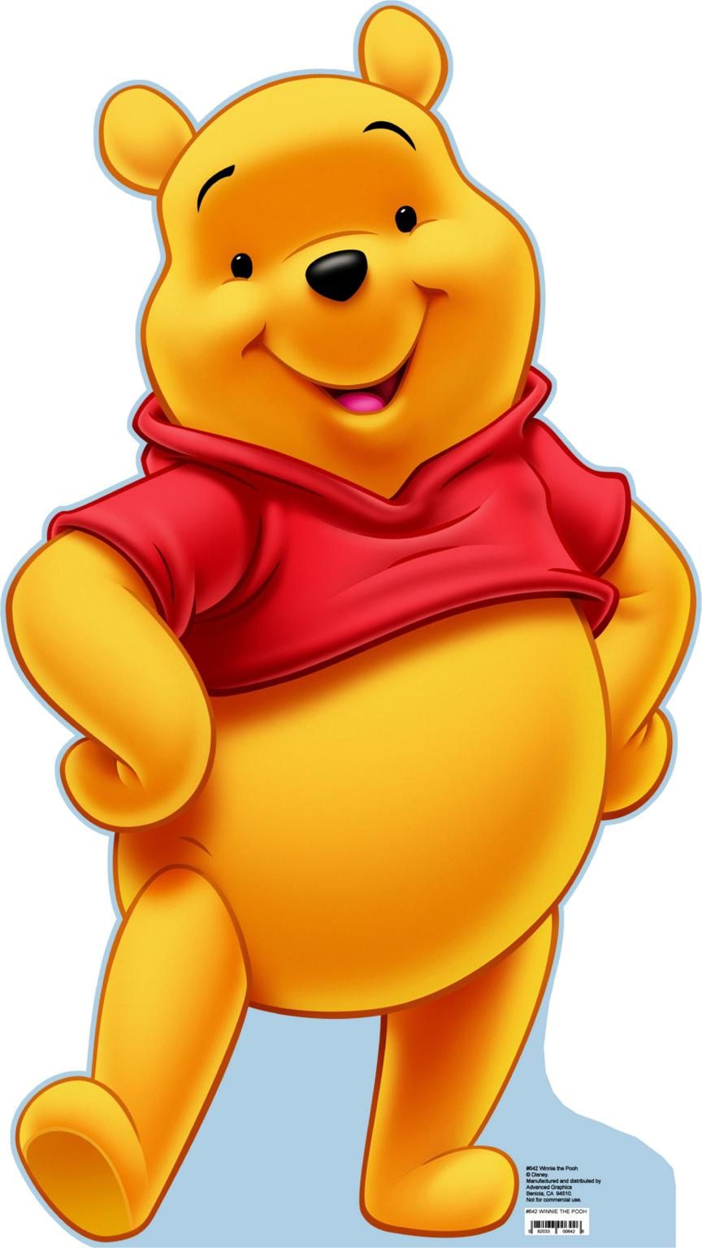
Who is it?
Whinei-the-Pooh
Pinocchio

Slide 8
Who is it?
Mary Poppins
Sleeping beauty

Slide 9
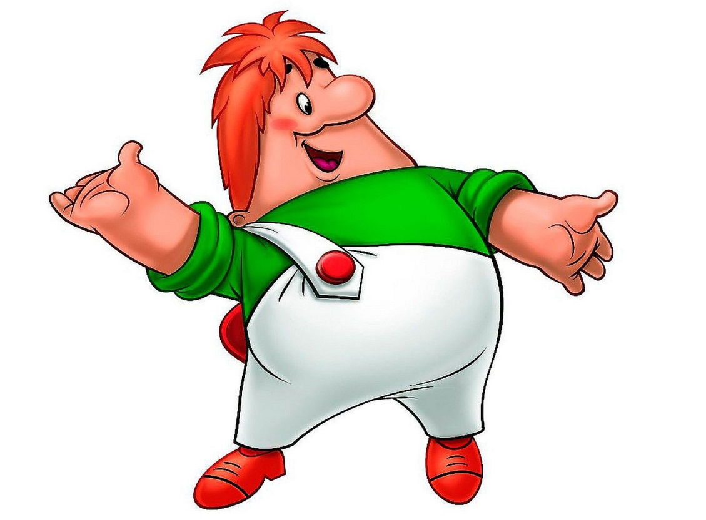
Who is it?
Whinei-the-Pooh
Karlsson

Slide 10
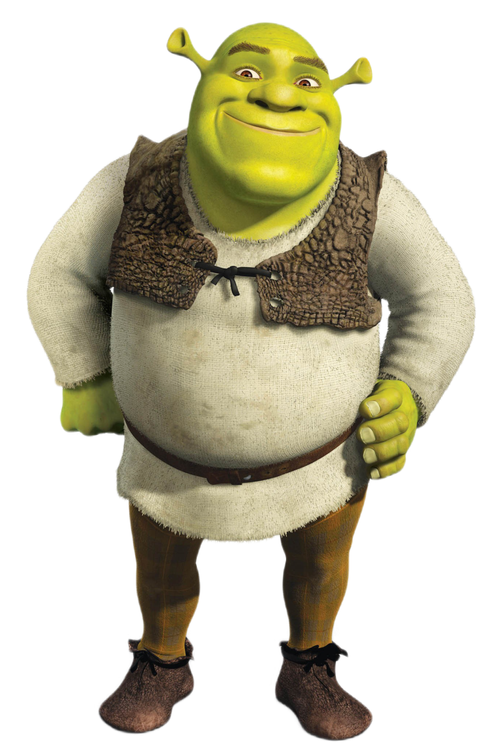
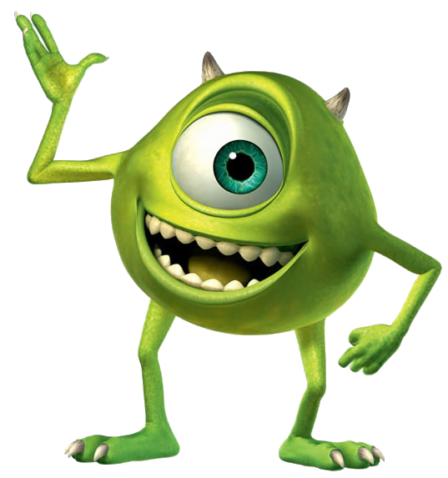
Who is it?
Shrek
Mike

Slide 11
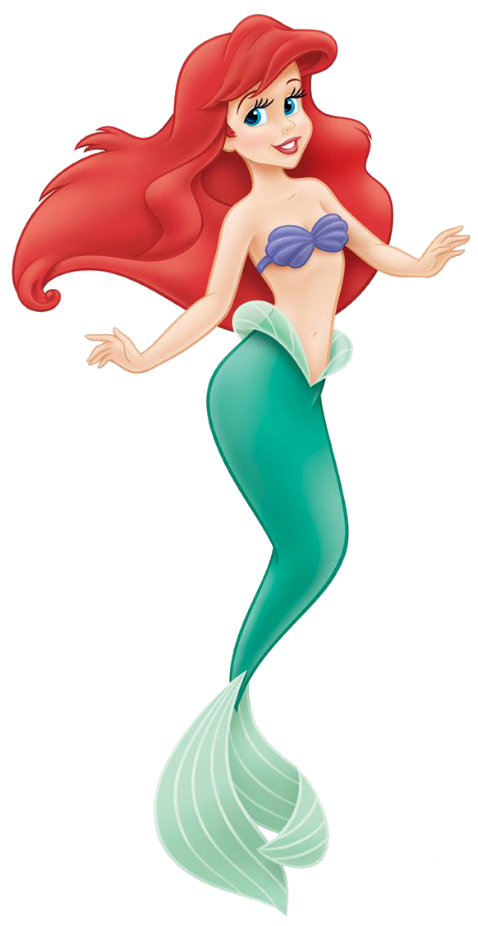
Who is it?
Ariel
Belle

