Slide 1
Greatest Galleries of the World
Учитель английского языка: Перминова Е.В.

Slide 2
National Gallery

Slide 3
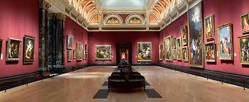
National Gallery was opened in 1824
The National Gallery is an art museum in Trafalgar Square in the City of Westminster, in Central London, England.

Slide 4
The Louvre

Slide 5
The Louvre or the Louvre Museum is a national art museum in Paris, France
The Louvre's painting collection is one of the richest in the world, representing all periods of European art up to the Revolutions of 1848.

Slide 6
The Hermitage

Slide 7
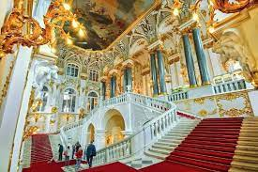
The State Hermitage Museum is a museum of art and culture in Saint Petersburg, Russia. It was founded in 1764 when Empress Catherine the Great acquired a collection of paintings from the Berlin merchant Johann Ernst Gotzkowsky.

Slide 8
The Uffizi Gallery

Slide 10
Tretyakov Gallery

Slide 11
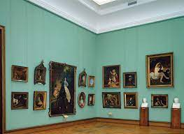
The State Tretyakov Gallery is an art gallery in Moscow, Russia, which is considered the foremost depository of Russian fine art in the world.

