Slide 1
Colours
Khmyrova I.A.

Slide 2
Let’s learn reading rules
sh=[ ʃ ]
ship
fish
dish
shop
ch= [ ʧ ] ph= [ f ]
chips phone
cheese dolphin
cherry photo
chocolate elephant

Slide 3
Read,translate and point to the colours
Black
Red
Yellow
Green
Blue
Pink
White
Purple
Brown
Grey

Slide 4
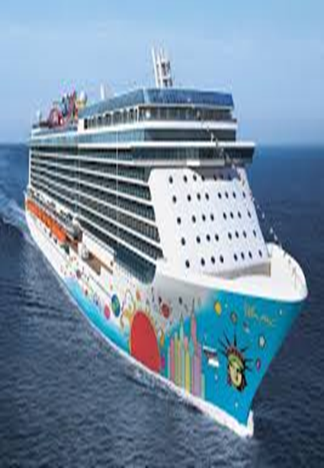
What colour is the ship?
The ship is …

Slide 5
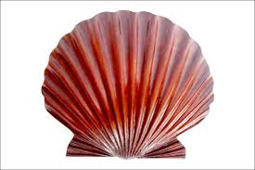
What colour is the shell?
The shell is …

Slide 6
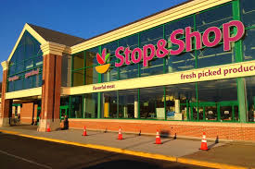
What colour is the shop?
The shop is…

Slide 7
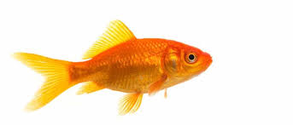
What colour is the fish?
The fish is…

Slide 8
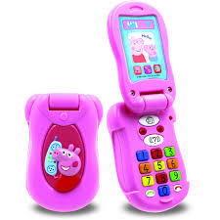
What colour is the phone?
The phone is…

Slide 9
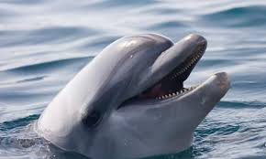
What colour is the dolphin?
The dolphin is…

Slide 10
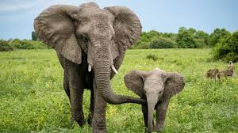
What colour is the elephant?
The elephant is…

Slide 11
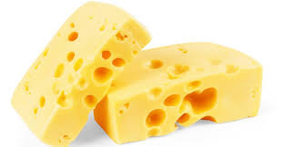
What colour is the cheese?
The cheese is …

Slide 12
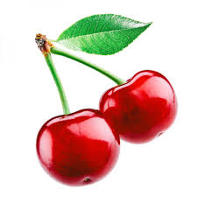
What colour is the cherry?
The cherry is…

Slide 13
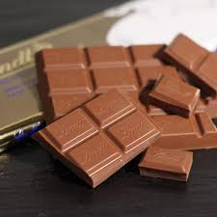
What colour is the chocolate?
The chocolate is …

Slide 14
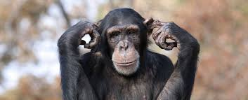
What colour is the chimp?
The chimp is …

