Slide 1
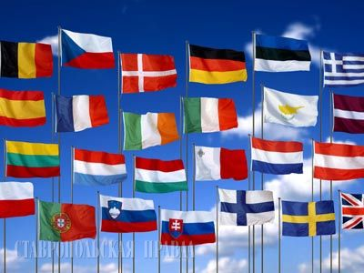
“Welcome to Europe!”

Slide 2
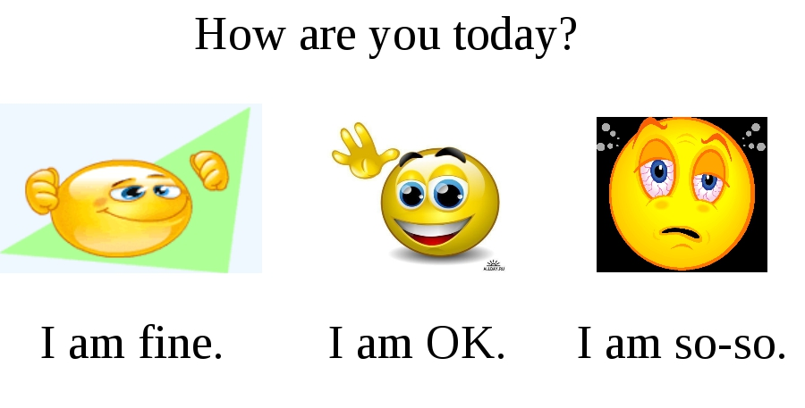

Slide 3
1.What European countries do you know? 2. What European cities do you know? 3. What languages do people speak in Europe?

Slide 4
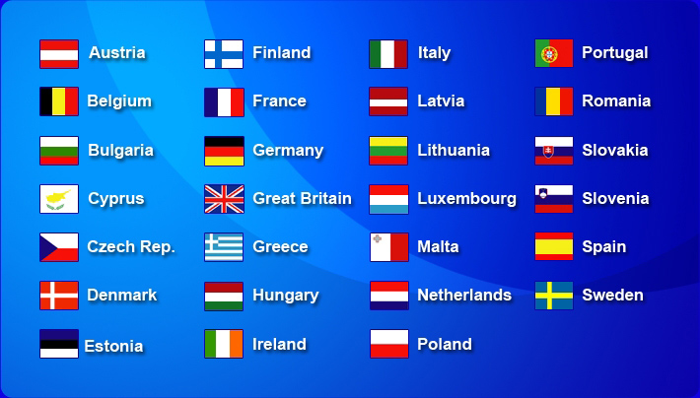
1.What European countries do you know?

Slide 5
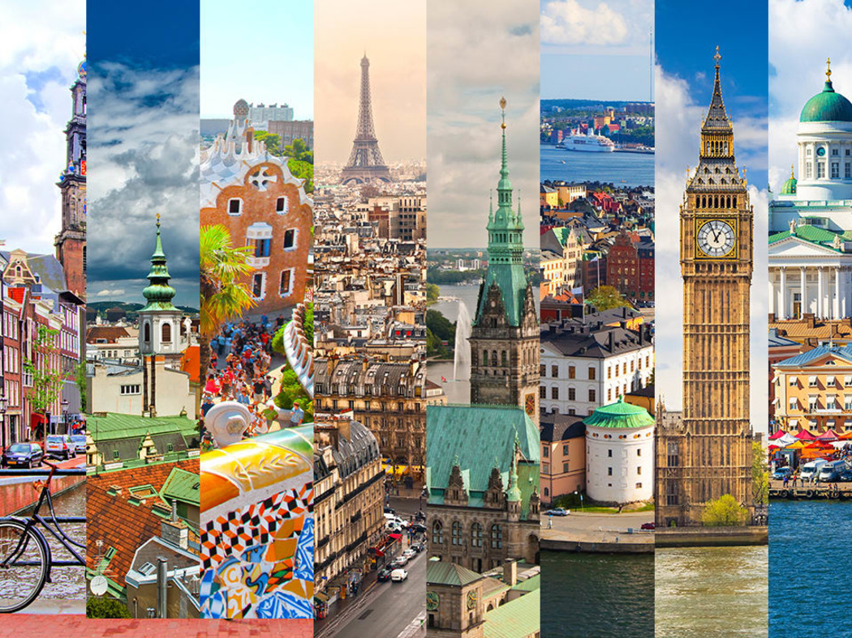
2. What European cities do you know?

Slide 6
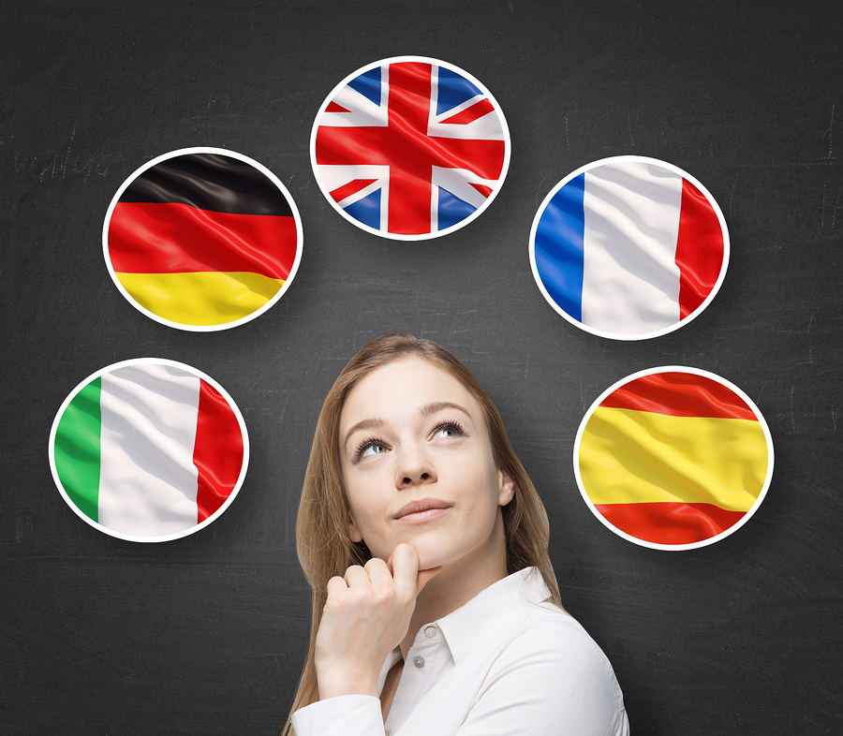
3. What languages do people speak in Europe?

Slide 7
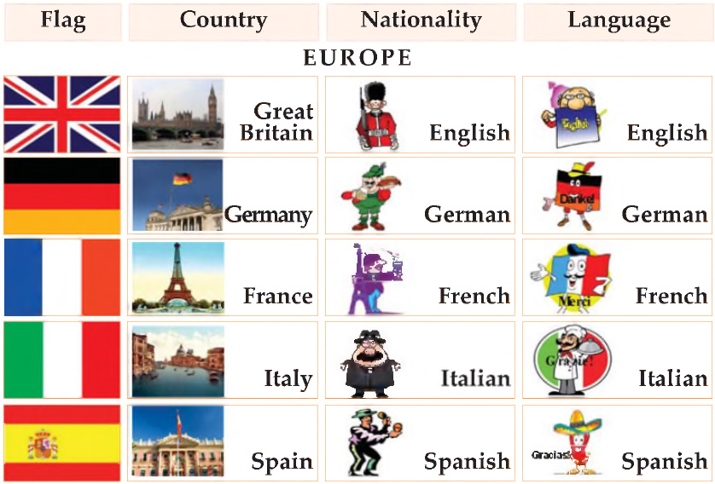
Phonetic drill

Slide 8
1. Would you like to show how well you know European countries and their cities? 2. Would you like to take part in the competition devoted to European countries?

Slide 9
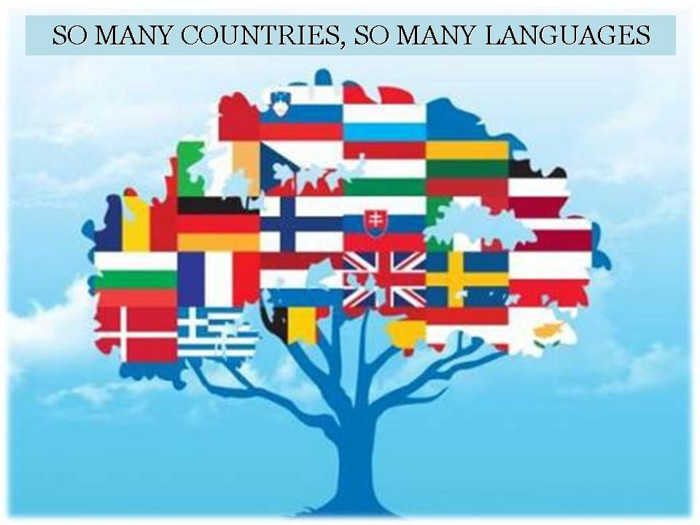

Slide 14
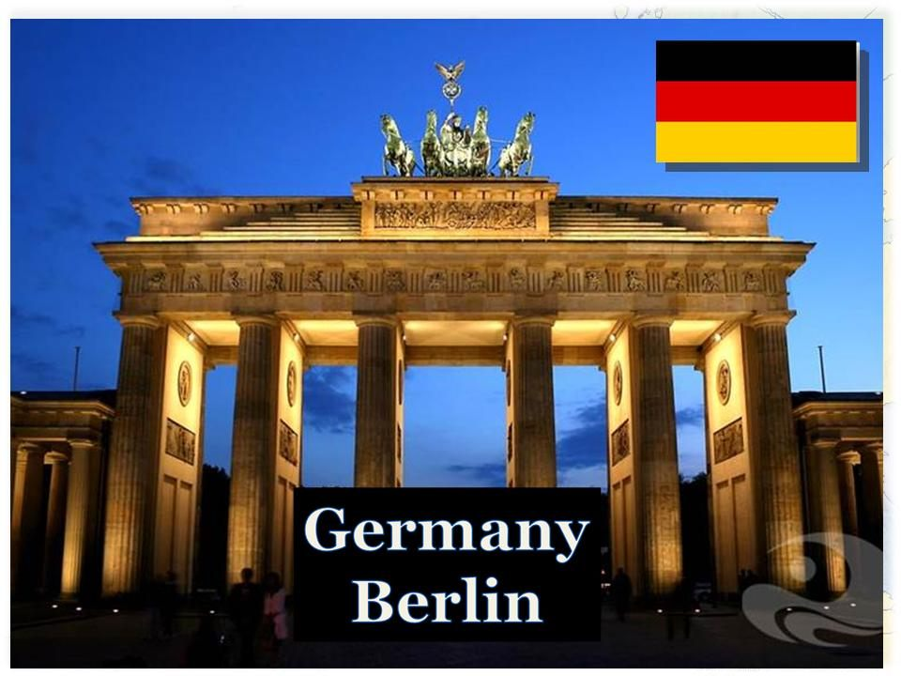

Slide 23
European Day of Languages
European Day of Languages

Slide 24
Thank you for your work!

Slide 27
Использованные материалы
Фон http://www.tvoyrebenok.ru/fony-dlya-prezentacij-globus.shtml
Рисунок http://kotofot.ru/gdefon/kotofots/full/447057-kotofotsfull
Карта Европыhttp://www.travelswithtwo.com/wp-content/uploads/2009/06/europe-map-1.jpg
Франция http://i070.radikal.ru/0907/be/0552be59e958.jpg
Италия http://100dorog.ru/upload/contents/432/italy_map.gif
Австрия http://austria-best.ru/images/maps/austria_regions.jpg
Рисунок http://img0.liveinternet.ru/images/attach/c/1/49/137/49137204_0a1313469.jpg
Флаги http://s0.tochka.net/cards/images/orig_22277de8d343e49273397f36703443c5.jpg
Привет на разных языкахhttp://www.kazved.ru/Thumbnail.aspx?w=670&img=/uploadimg/125112_61344_privet_na-_raznix_yazikax.jpg
Германия http://dop-obraz.ru/_nw/0/79606829.gif

