Slide 1
Подготовка
к олимпиаде по английскому языку
Автор: Хмырова И.А.
г. Корсаков Сахалинская область

Slide 2
Длительность олимпиады
Рекомендуемая общая продолжительность четырех письменных конкурсов:
для 7-8 классов – от 60 до 90 минут,
для 9-11 классов – от 90 до 120 минут.

Slide 3
Олимпиада по английскому языку состоит из 5 блоков, каждый из которых требует владения определённых навыков.
Listening(аудирование) проверяет способность учащихся воспринимать услышанный текст в объёме, достаточном для выполнения заданий.
Listening and Reading(аудирование и чтение) выявляет умение анализировать прослушанный и прочитанный тексты.
Reading(чтение) служит критерием умения находить в тексте нужную информацию, понимать структурно-смысловые связи.
Use of English(грамматика и лексика) оценивает понимание языковой системы через выполнение разнообразных заданий.
Linguistic and cultural competence
Writing(письмо) нацелен на проверку навыков выполнения различных видов письменных работ (эссе, доклад, статья, отчёт, письмо).

Slide 4
LISTENING
Time: 10 minutes
You will hear an interview with a conservationist who has built a cable car in the rainforest. For items 1-10, choose the best option (A, B or C). You will hear the text twice.
1. What feature of the cable car makes it particularly good for seeing wildlife in the rainforest?
A The speed at which it moves.
B The height at which it travels.
C The distance that it covers.
2. Donald worked as a …
A zoologist.
B biologist.
C psychologist.
3. What is the main aim of the cable car project?
A To educate local people.
B To persuade people to save the rainforest.
C To raise money for other conservation projects.
4. What is the advantage of the project for the local people?
A They can use the land if they want.
B They can sell forest products to the visitors.
C More work is available to them.
Примеры заданий

Slide 5
5. Why was the cable car redesigned?
A It was redesigned so that people could touch the trees.
B It was redesigned to avoid cutting down too much forest.
C It was redesigned because it had to be brought in by air.
6. How does Donald react to the suggestion that he has disturbed the wildlife?
A He explains what happened in the past.
B He criticizes what happens elsewhere.
C He denies that there’s been any disturbance.
7. Why is Donald sure his project is a success?
A This piece of forest has survived.
B Animals have returned to the area.
C Other projects have copied his ideas.
8. Donald thinks the future survival of the rainforest will depend on …
A the size of the world’s population.
B the attitude of people towards it.
C the size of the areas left as forest.
9. To get to difficult places they used …
A trucks.
B planes.
C helicopters.
10. People will value the rainforest and want to protect it if …
A they learn to appreciate it.
B they cut it down.
C they plant trees.
Transfer your answers to the answer sheet.
Заголовок слайда

Slide 6
Примеры заданий
READING
Task 1. Read an article in which four people comment on a book they have read recently. For questions 1-10, choose from the people A-D. The people may be chosen more than once.
Which person read a book which...
1. was set in an Oriental country.
2. finished in an unrealistic way.
3. had characters that the reader could sympathise with.
4. is well-known and was written a long time ago.
5. contained two stories.
6. was not set in the past.
7. was historically accurate.
8. made the reader cry.
9. contained insignificant details.
10. has a well-known scene.

Slide 7
Примеры заданий
A
Sundance by Teresa Wilson
Kerry:
I really don't know why this book is so popular. I mean, I suppose it is going to appeal to young girls who want danger and romance, but I found this book really tedious. For a start, the characters were really unconvincing. The author went out of her way to add lots of details about the characters, but I found these details really pointless. I thought that some of the facts she presented about the main characters would become significant in some way later in the novel, but they didn't. They were just worthless bits of information. I also was disappointed that, although this book is meant to be about kids at high school, the writer seems to have no recollection at all about what it's like to be 17. The main character thought and acted like a 32-year old. It just wasn't believable. I'm not saying Teresa Wilson is a bad writer. She can obviously string words together and come up with a story that is appealing to a large number of people, but she lacks anything original. There is no flair. It just uses the same sort of language as you can see in many other mediocre novels.

Slide 8
Task 2
For items 11-15, read the text and choose the best answer for the questions below.
She knew the street backwards, of course. How many times had she been dragged up it as a child by the wrist, whining and snivelling, always wishing she were somewhere else? Now she had no desire to be anywhere but here. This bustling traffic, these fuming buses, these chipped paving stones and boarded-up shop fronts, they were hers. Here, she would grow from defiant teenager to independent woman. When she was an old woman, she would gaze out over the lawns and say “Ah, Knox Road, that’s where I really came into my own”.
Number 126 was only a short walk from the bus stop, and she heaved her multiple bags onto her shoulders and trudged off, trying to maintain the elation as the straps dug into the flesh of her neck and fingers. Number 126 was set back slightly from the main road, with a concrete path and weed-patch at the front. The window frames were rotten and the paint chipped. Holly tried not to mind. It was what was inside that counted, after all. The coming-together of six individuals from diverse backgrounds. discussing politics, culture and art late into the night, sharing ideas, recipes, milk, shower gel and lovers – that would be what she’d look back on of course, not the paintwork. In the absence of either a bell or knocker, she rapped firmly on the door.
There was no reply. Holly peered through gap in curtains in the downstairs window, but there was nothing but gloom within. She could hear a faint thudding of a bass beat, but was not sure which house it belonged to. She rapped more firmly, and was searching for a pebble to throw to the upstairs window when the door opened. A shirtless, overweight twenty-something, with bleary eyes and greasy hair stood in the doorway wearing boxer shorts and mismatched socks.
“I’ve come for the upstairs room, I’m the new tenant,” said Holly brightly.
The man grunted slightly and moved aside. He gestured up the dim, uncarpeted stairway and began to shuffle along the dark hallway to the rear of the house. “Top floor, is that right? I guess I just follow my nose!” Holly gave a high laugh, and received another grunt in reply. Then the man was gone. Not to worry, he must be the quiet moody type, thought Holly, too caught up in his own profound thoughts for inane chit-chat. One day she would penetrate his hard outer shell and release the free spirit inside. Anyway, now for the stairs.
The four flights of stairs would be worth it, she’d decided when she picked out the flat, even if it did mean her going downstairs to get to the bathroom, because the room faced the front, and she could watch the world scurry by as she sipped her morning coffee. Kicking one bag in front and dragging the others behind, she finally made it up the four flights and flung open the door to her new room, her new haven, her new adult life.
Peeling beige wallpaper, a lumpy mattress on a chipboard bedframe, a bare light bulb, a flat-pack wardrobe inexpertly put together. All this, Holly could just about put up with, but when she saw the view from her window – a dull patch of grey sky, invariable whatever the angle, she finally had to admit to herself that her adult life was not getting off to a great start.
Примеры заданий

Slide 9
11. What can be inferred from the text?
A. This is Holly’s first time living away from home.
B. Holly visited the house before deciding to move in.
C. Holly is new to this part of the town.
D. Holly already knows someone who lives in this house.
12. Where is Knox Road?
A. In a town centre.
B. In a suburb.
C. In a village.
D. On a housing estate.
13. What can be inferred about the character of Holly?
A. She is a daydreamer.
B. She is ambitious.
C. She is prejudiced.
D. She is reckless.
14. What can be inferred about the man who opened the door?
A. He owns the property.
B. He had not expected Holly.
C. He lives in the front, ground floor room.
D. He had been asleep.
15. Which one is NOT true of Holly’s room?
A. It is on the fourth floor.
B. It is furnished.
C. It has an en suite bathroom.
D. It is at the front of the house.

Slide 10
Примеры заданий
USE OF ENGLISH
Time: 20 minutes
Task 1. For items 1-8, read the text below and think of the word which best fits each gap. Use only one word in each gap.
The Goulburn Valley
The Goulburn Valley is situated in the south-east corner of the Australian continent, in the state of Victoria. Because (1)… the introduction of irrigation over a century ago, primary industry flourished, resulting (2)… a multitude of orchards and market gardens. After World War II, migrants flocked to the area in search of work on the farms, and in many cases, establishing a property of their own. Unfortunately, the region has (3) … a turn for the worse over the past decade. The irrigation water that was (4)… plentiful has now been rationed, and many farmers have been forced (5) …the land. The main source of water is from the Goulburn River, with several reservoirs located along its stretch to the mighty Murray River. Dam capacities have fallen to dangerous levels, resulting in some farmers having (6)… inadequate supply of irrigation water. Despite the recent hardships, some farmers (7)… continued to eke an existence out of the land. Many have become (8)…ingenious, devising new ways to utilize water plus finding special niches to service the ever-changing urban needs. Perhaps the Goulburn Valley can return to its prosperous times again.

Slide 11
For Nigel Portman, a love of travelling began with what’s called a ‘gap year’. In common with many other British teenagers, he chose to take a year out before (9) ….. to study for his degree. After doing various jobs to (10) ….. some money, he left home to gain some experience of life in different cultures, visiting America and Asia. The more adventurous the young person, the (11) ….. the challenge they are likely to (12) ….. themselves for the gap year, and for some, like Nigel, it can (13) ….. in a thirst for adventure.
Now that his university course has (14) ….. to an end, Nigel is just about to leave on a three-year trip that will take him (15) ….. around the world. What’s more, he plans to make the whole journey using only means of transport which are (16) ….. by natural energy. In other words, he’ll be (17) ….. mostly on bicycles and his own legs; and when there’s an ocean to cross, he won’t be 22
taking a (18) ….. cut by climbing aboard a plane, he’ll be joining the crew of a sailing ship (19) ….. .
As well as doing some mountain climbing and other outdoor pursuits along the way, Nigel hopes to (20) ….. on to the people he meets the environmental message that lies behind the whole idea.
9. A settling down B getting up C taking over D holding back
10. A achieve B raise C advance D win
11. A stronger B wider C greater D deeper
12. A put B set C aim D place
13. A result B lead C cause D create
14. A come B turned C reached D brought
15. A just B complete C whole D right
16. A pulled B charged C forced D powered
17. A relying B using C attempting D trying
18. A quick B short C brief D swift
19. A anyway B alike C instead D otherwise
20. A leave B keep C pass D give
Примеры заданий
Task 2. For items 9-20, read the text below and decide which option (A, B, C or D) best fits each gap.
A Love of Travelling

Slide 12
Примеры заданий
WRITING
Time: 30 minutes
You recently saw this notice in an English-language magazine called Theatre World. Reviews needed!
Have you seen any plays by William Shakespeare in the theatre recently? If so, could you write us a review of the play you saw? Include information on the characters, costumes and story and say whether you would recommend the play to other people.
The best reviews will be published next month.
Write your review. Use 100-140 words.
Transfer your review to the answer sheet.

Slide 13
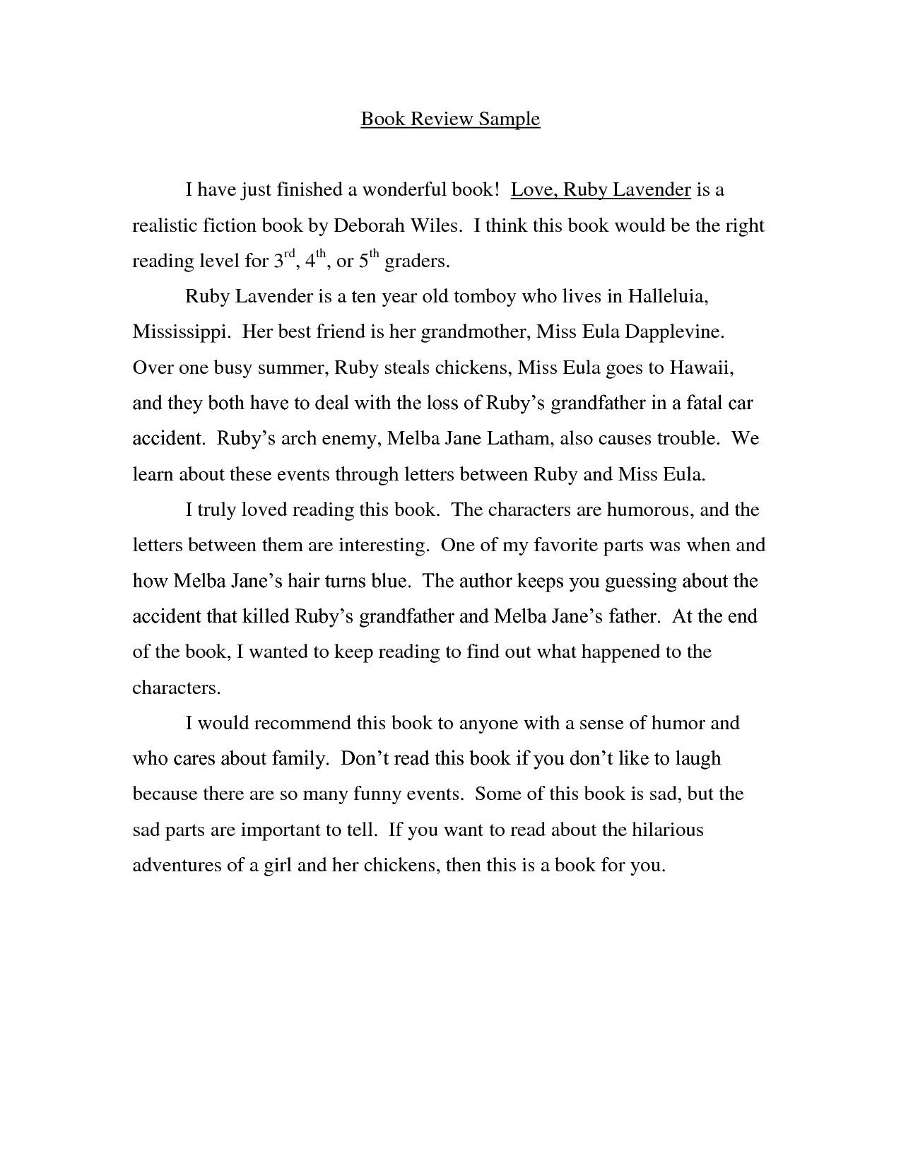
Примеры заданий
Book review

Slide 14
Примеры заданий
Book review

Slide 15
Примеры заданий
Story
Рассказ — это малая литературная форма, имеющая сюжет (фабулу). Текст в этом жанре должен соответствовать следующим требованиям:
Оригинальный динамичный сюжет.
Естественный тон повествования.
Использование таких приемов как описание, повествование, рассуждение.
Наличие индивидуально-авторской оценки событий и факторов, выражение чувств и эмоций автора и его героев.
Наличие элементов диалогической речи.
Четкая композиция (зачин, основная часть с кульминацией, развязка).
Наличие заголовка.
Разнообразие языковых средств.

Slide 16
Примеры заданий
Story
-Прежде чем приступить к написанию рассказа, продумайте сюжетную линию, характеристику героев, составьте план и набросайте ключевые слова к пунктам плана.
-Учтите, что динамика событий в рассказе очень важна, ее можно подчеркнуть, используя слова at first, before, until, while, during, after, finally, when, etc., а также глаголы happen, realize, start, run, appear, disappear, occur, exclaim, sigh, mutter, say, wonder, etc.
-Используйте прилагательные и наречия, чтобы описать чувства и действия героев. При этом вместо приевшихся слов: big, small, good, bad, very употребляйте их синонимы и эквиваленты: enormous, tiny, terrific, horrible, extremely, etc.
-Будьте внимательны с использованием грамматических времен. Например, Past Continuous подходит для описания погоды в момент действия, Past Simple — для основных действий, Past Perfect — для событий, предшествующих истории. ---- -!Примите во внимание, что в рассказе часто описываются герои, места, предметы, события.
!Помните, что в рассказе очень важны начало и конец.

Slide 17
Примеры заданий
Story
Пример
Write a short story. Choose any subject but use in your story the following words at least once ( underline the word from the list when using it for the first time): Fluffy, Ignorant, Board, Cord, Traffic. Title your story using a word from the list. Include description of feelings and emotions. Include direct and indirect speech. Make an unexpected ending. Write 200-250 words.

Slide 18
Рассказ, получивший наибольшее количество баллов:
A fluffy tail
Once upon a time, I was sitting in my office and observing my ignorant colleagues. I glanced at the watch and discovered that it was time to go home. So, I unplugged all the cords from my laptop, put a note on the board and left my workplace. Bob told me: «Have a nice day!» I told him to have a nice day too. I left the office building, found my car in the car park and headed off to my home place. The way home usually takes an hour. It’s a boring trip, because while covering the distance I have to stay in an enormous traffic jam. Not to feel bored I switched on the radio and started waiting for the cars in front of me to move. Suddenly I saw something strange in front of my car. It looked like a roll of a newspaper. Then I understood that it was something fluffy and alive. I left the car and took the fluffy ball in my hands. It turned out to be a small cat with a fluffy tail. It looked miserable and was shivering with cold. I decided to take it home just to feed it, because my wife would never let it live with us. A year ago our cat left home and didn’t come back. After this incident Monica couldn’t see any other cats. Well, this time she was about throwing the poor kitten away, when she suddenly found a necklace on the cat with the cat’s owner’s address. The address was ours! It was our cat that we had lost. How happy we were!
Примеры заданий
Story

Slide 19
Отчет — развернутое информационное сообщение. Текст в этом жанре должен соответствовать следующим требованиям:
При необходимости наличие заголовка и подзаголовков перед абзацами.
Описание цели во введении.
Данные о том, как собиралась информация.
Анализ фактов, оценивание мнений, сравнение, сопоставление, выяснение причин в основной части.
Финальное оценивание и рекомендации в заключении. Соответствие формальному стилю (в отличие от эмоционального рассказа).
Использование выражений «The aim of this report is to assess...», «The majority said that they...», «while, whereas» (comparison), «The following conclusions can be drawn...», «As can be seen from the findings of this report, the only...».
Примеры заданий
Report

Slide 20
Пример
Даны графики с информацией о сдаче экзаменов по различным предметам в 2015/2016 гг.
Write a report to your school administration based on the chart below. Give recommendations what should be done to increase students’ interest and success in some subjects. Use the following words in your report: Affect, Fluctuate, Percent, Percentage, Trend. Underline the required words when used in your report. Time: 1 hour 15 minutes.
Remember to: make an introduction, summarize the information by selecting and reporting the main features (2 or more), make comparisons where relevant (2 or more), give recommendations (2 or more), make a conclusion, USE YOUR OWN WORDS AND EXPRESSIONS in your report. Write 300-350 words. Пояснение: От вас требуется написать с использованием определенных слов отчет для школьной администрации. Отчет по графикам: сравнить данные и представить рекомендации о том, как поднять интерес к менее популярным предметам.
Примеры заданий
Report

Slide 21
The aim of this report is to recommend what should be done in order to make students interested and successful in some school subjects. The chart was used to analyze the information. The biggest number of both boys and girls has passed state exams in computer science, mathematics and foreign languages. The percentage of them is higher than 40. The choice of chemistry, physics and geography appears to be a little bit lower — its data fluctuates from 30 to 40 percent. History is the least popular subject students have passed state exam in.
Computer science exam was the most popular one among girls. It is because of the fact that the IT development greatly affected the demand for programmers. However, in 2015-2016 academic year most boys passed mathematics exam, following the trend of being more interested in mathematical sciences than practical areas. Speaking about less popular subjects, it should be stressed that only 14 percent of girls succeeded in passing state exam in chemistry, whereas 20 percent of boys managed to pass geography exam.
Judging by our research, we can give the following recommendations. On the one hand, to raise students’ interest in unpopular subjects such as chemistry, history and geography teachers should use modern technology such as computers and eboards during the lesson. On the other hand, group work and school projects may make them more interested in the subject. In conclusion, we can make a point that both interests and success of students do not depend on what kind of science a particular subject refers to. It is all about the education progress which can be improved by the use of special equipment and another way of studying.
Примеры заданий
Report

Slide 23
Ссылка
vos.olimpiada.ru

