Slide 1
Month, date

Slide 2
famous
great
well-known
outstanding
glorious
popular
знаменитый
великий
известный
выдающийся
славный
популярный

Slide 3
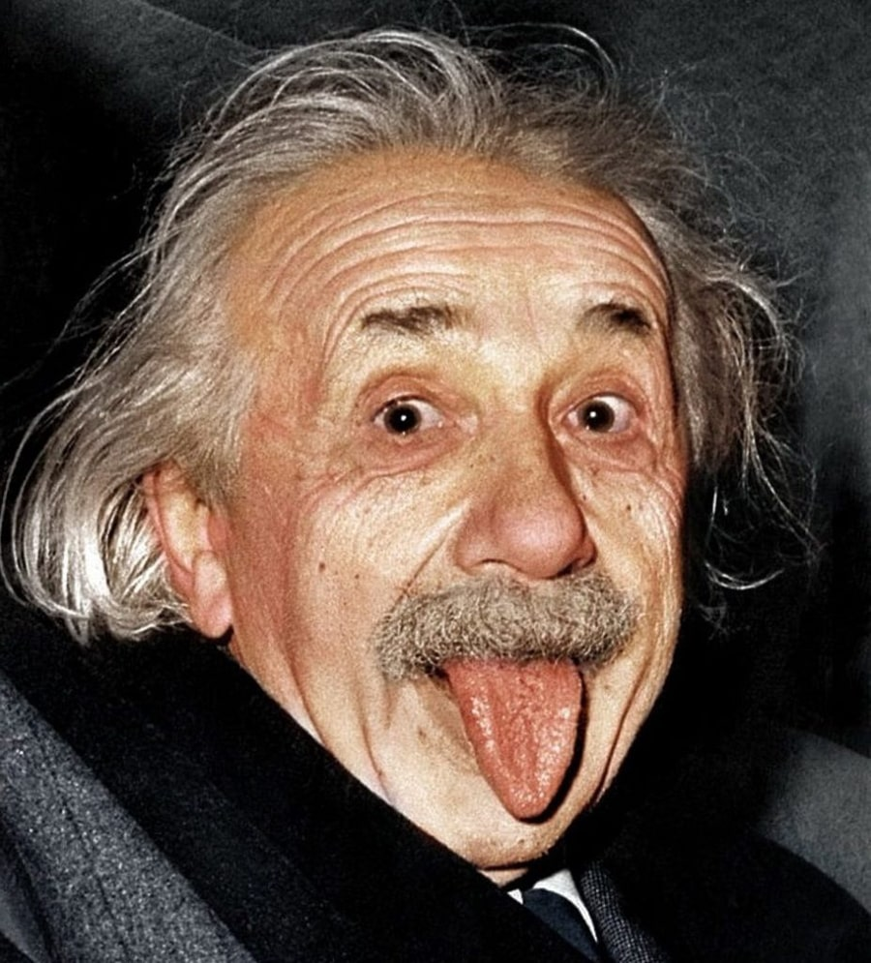
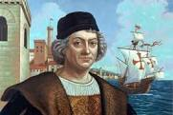
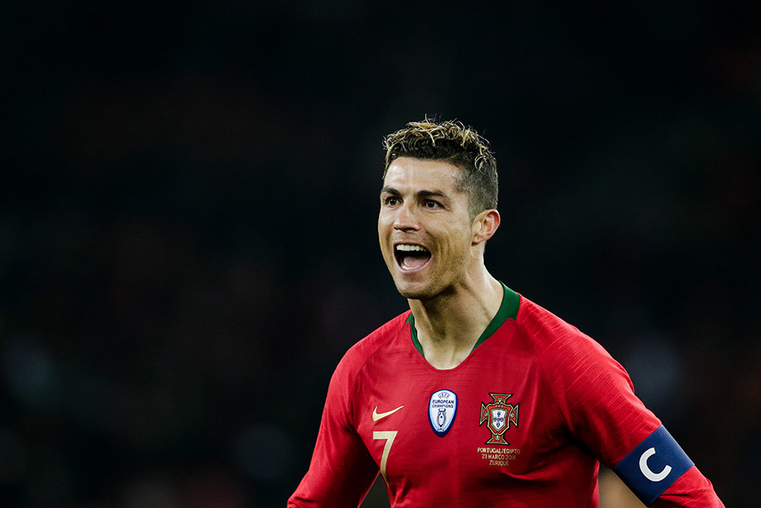
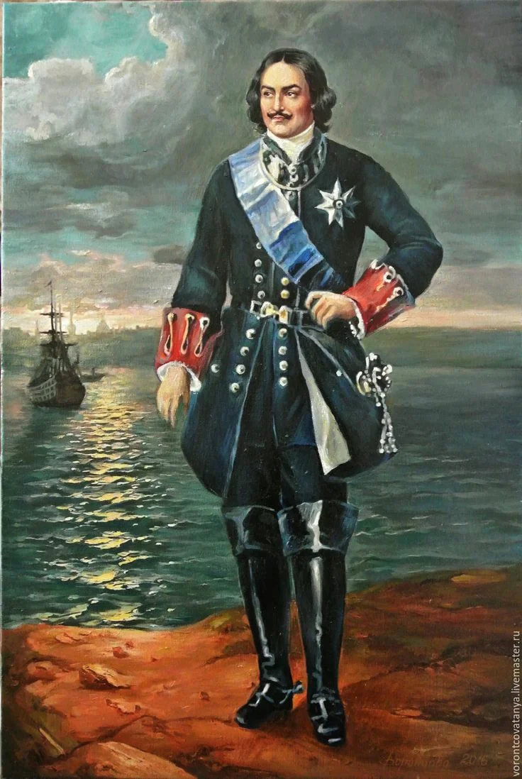
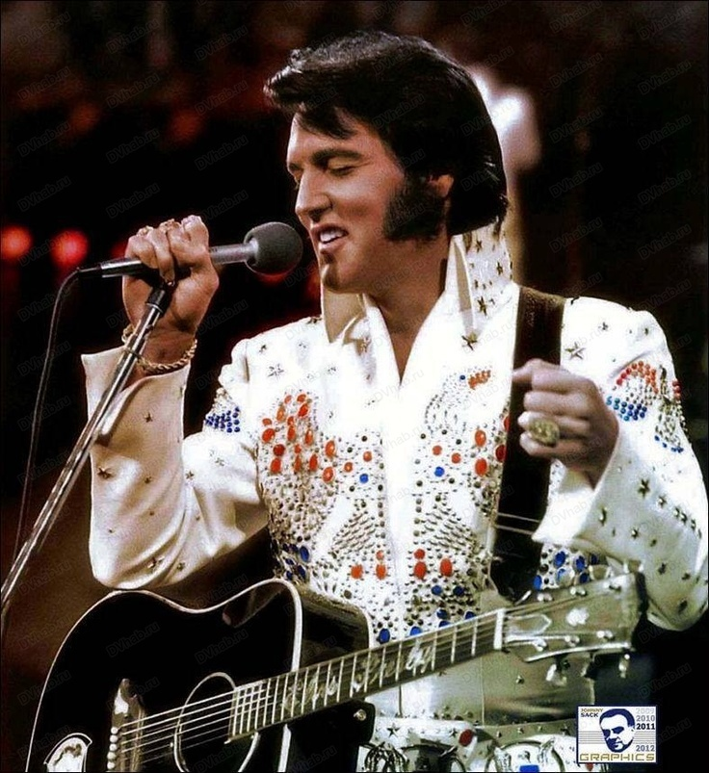
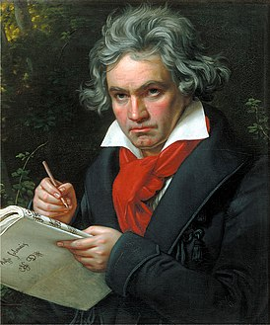
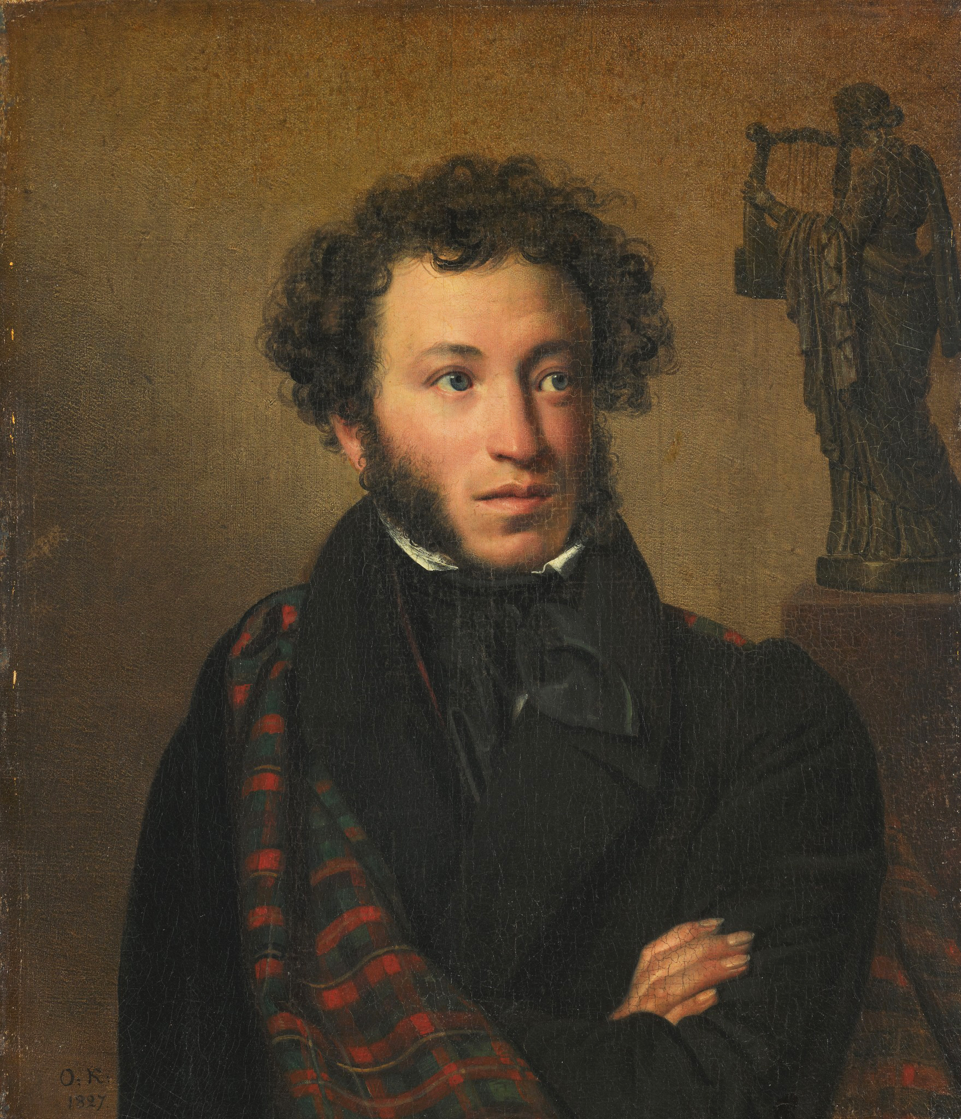
FAMOUS PEOPLE

Slide 4
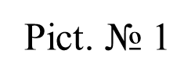
Columbus
Einstein
Pushkin
Ronaldo
Peter I
Presley
Beethoven

Slide 5
The aim of the lesson is…… By the land of the lesson I will be able…..
to know…..
to learn……
to tell….
to make….

Slide 6
To become famous a person should/may be…..

Slide 7
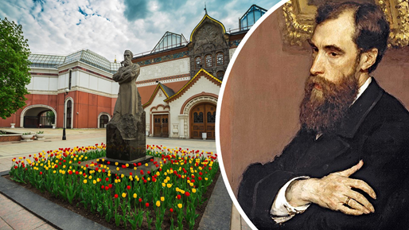
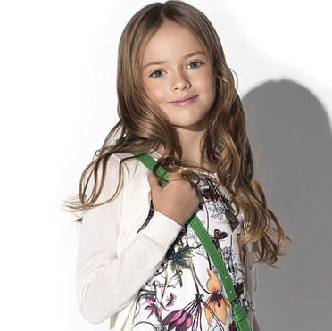
Pavel Tretyakov, patron of the arts
founded the Tretyakov Gallery in Moscow.
Kristina Pimenova became the most beautiful girl in the world when she was 5 years.

Slide 8
To become famous a person should/may be
talented
clever
kind
brave
strong
hard-working
ambitious
handsome/beautiful
creative
generous
rich
for example …….

Slide 9
p.91 №№ 4, 8
name
from
can
interesting facts

Slide 10
Fill the table with the information from the text
Jing Mao | nickname | Jing Mao
French | country | French
Alain | city | Alain
Robert | years | Robert
80 | nationality | 80
Chicago | name | Chicago
Westminster | highest skyscrapers | Westminster
Human Spider | surname | Human Spider
China | district of London | China
12 | the name of the tower | 12
95 | days spent in prison | 95
20-s | the height of the tower | 20-s
7 | age | 7
5 | fallings | 5

Slide 11
Open the door you like

Slide 12
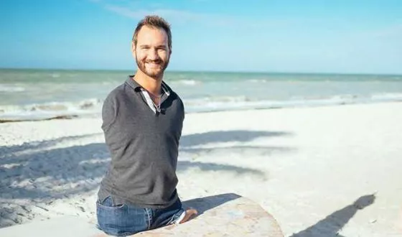
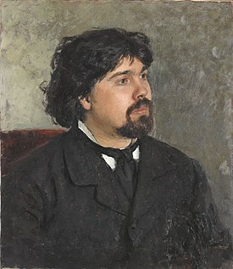
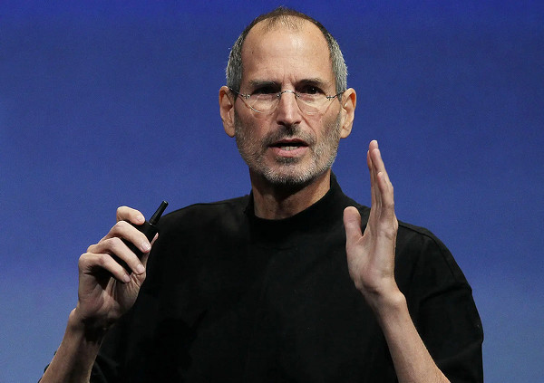
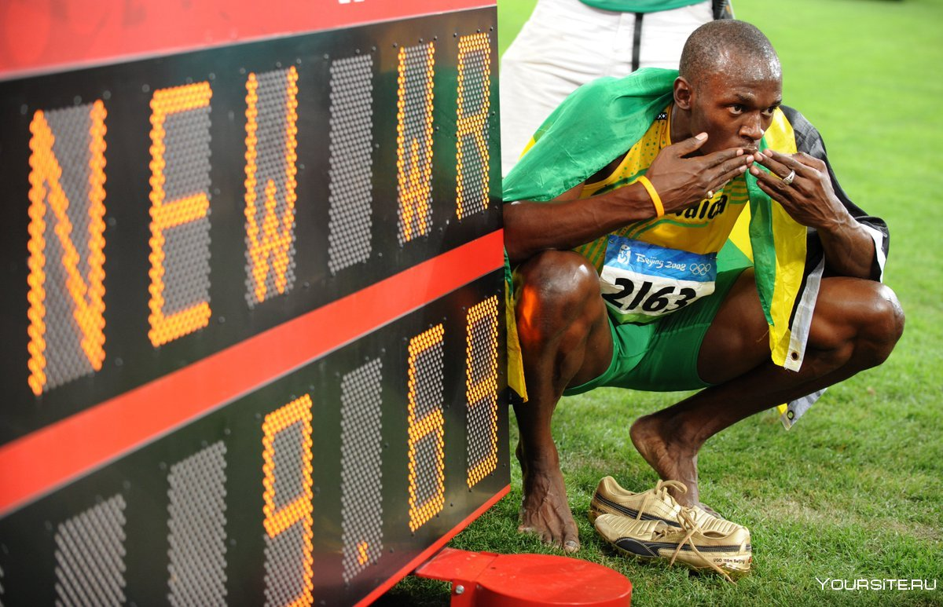
Steven Paul Jobs
Usain St. Leo Bolt
Nicholas James Vujicic
Vasily Ivanovich Surikov
Pict. 1
Pict. 2
Pict. 3
Pict. 4

Slide 13
During today’s lesson I have
known….
learnt...
remembered...
was touched….
I liked/didn’t like the lesson…..
I would like to know more….
It was/wasn’t interesting/new for me to know

Slide 14
Steve Jobs died on October 5, he was 56 years old. Here are his parting words:
"I have reached the top in business....My wealth is just a fact that I'm used to.....But here must be something more important in life: love, art, dreams from childhood.....God gave us feelings so that we could tell our loved ones about them. I can't take my wealth with me, the only thing I can take away is the memories of love.....Go to the heights you want to reach. Hurry to where your heart calls – everything is in your hands.....Our main treasure is the love for family, loved ones, and friends. Take care of yourself, take care of others."

