Slide 1
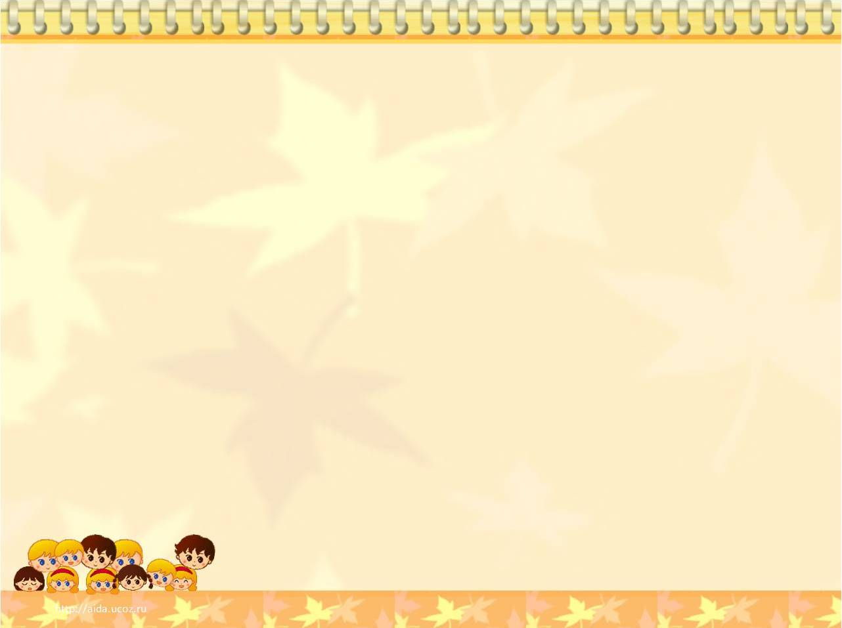
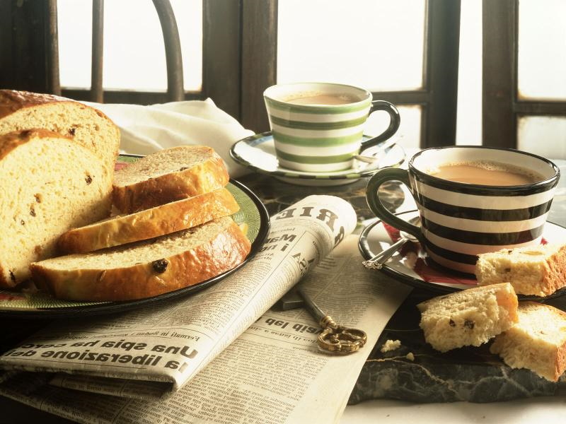
British FOOD

Slide 2
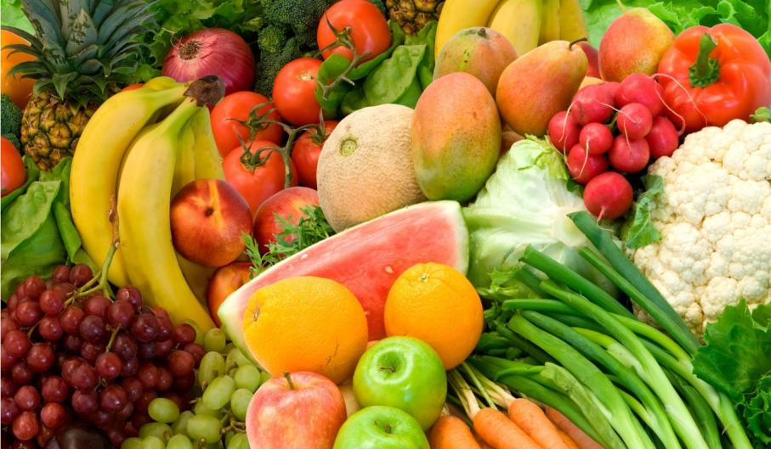
Questions to discuss:
DO YOU KNOW ANYTHING ABOUT BRITISH FOOD?
WHERE DO PEOPLE EAT IN BRITAIN?
WHAT KIND OF FOOD DO BRITISH STUDENTS LIKE AND DISLIKE?
HOW TO ORDER DISHES IN A RESTAURANT?
WHAT A DOCTOR(VEGETARIAN /SPORTSMAN) EATS?

Slide 9
LET’S WATCH A VIDEO

Slide 10
1.Write all food and drinks.

Slide 11
2.Make up shopping list.

Slide 12
3.Make up take away food.

Slide 13
4. Choose true/false.
1.Nick is 11.
2.Nick lives in Cambridge.
3. The family has their breakfast at 9 o’clock.
4.Molly likes lemon juice.
5.Children take a packed lunch at school.

Slide 14
6.Children eat at 13:30.
7.Molly has got vegetables curry and rice.
8.The father is making a shopping list.
9.The family is having Roast Beef and Yorkshire pudding.
10.The family cooked a Roast Beef on Friday.

Slide 15
English Tea-Proverbs and Idioms and Their Russian Equivalents
English tea-proverbs and idioms | Russian equivalents
Reading the tea-leaves | Гадание на кофейной гуще
Husband’s tea | Очень слабый чай, водичка
Not for all the tea in | Ни за какие коврижки
Easy as tea-drinking | Пустяковое дело
Storm in a tea cup | Буря в стакане воды

Slide 16
English Proverbs and Idioms and Their Russian Equivalents
A quiet cup of tea | Чашка чая, выпитая в тишине
One’s cup of tea | Увлечение
Make the cup run over | Переполнить чашу терпения
Kiss the cup | Пригубить чашку чая

Slide 17
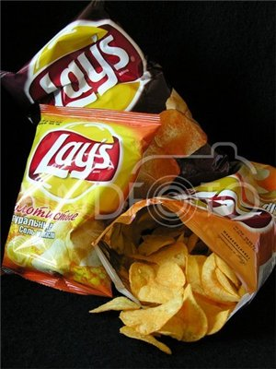
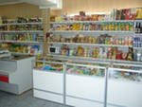
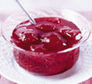
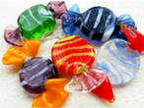
Do a crossword.
People buy food in this place.
It is made from fruit or berries.
A meal between breakfast and dinner.
Christmas food.
The British have a …tooth.
The British like this drink with tea.
This drink is made from fruit.
Children like them very much. They are made from potatoes.
 |  |  | 1
 |  | 2
 | 3
4
 |  | 5
 |  | 6
7
 |  | 8

Slide 18
Exchange your crosswords and check them up.
 |  |  | 1 | S | H | O | P
 |  | 2 | J | A | M
 | 3 | L | U | N | C | H
4 | P | U | D | D | I | N | G
 |  | 5 | S | W | E | E | T
 |  | 6 | M | I | L | K
7 | J | U | I | C | E
 |  | 8 | C | H | I | P | S
8 words – “5”
7 words – “4”
5-6 words – “3”
4 words and less – “2”
Your mark is ____

Slide 19
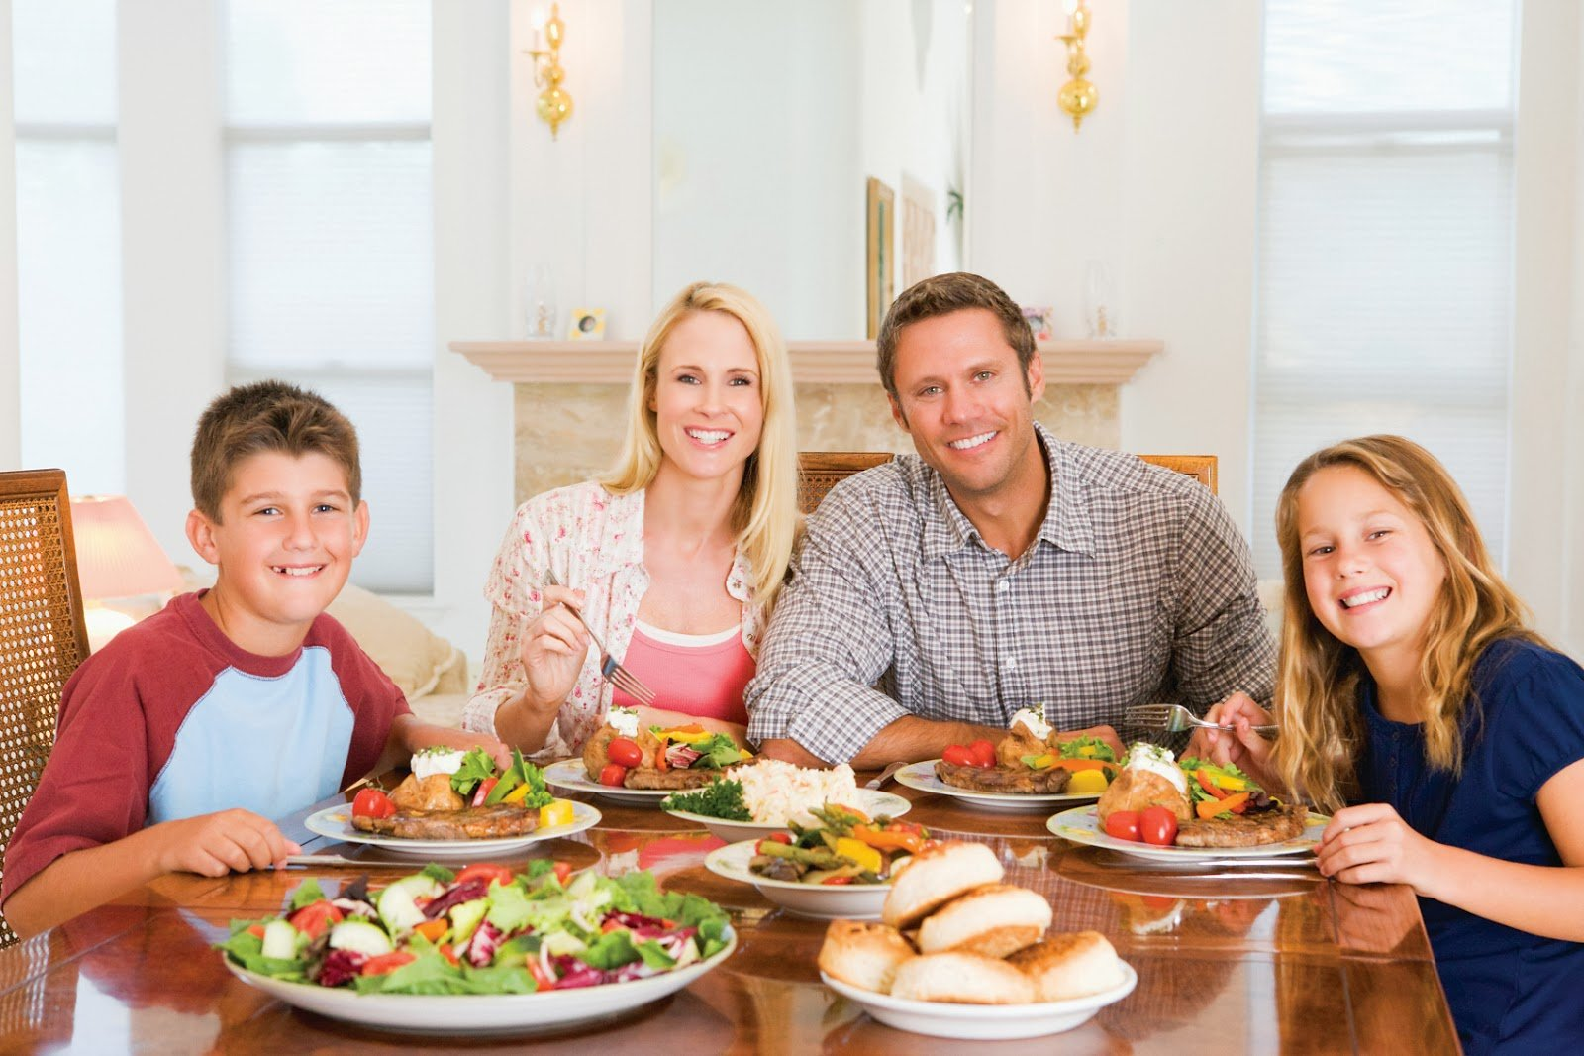

Slide 20
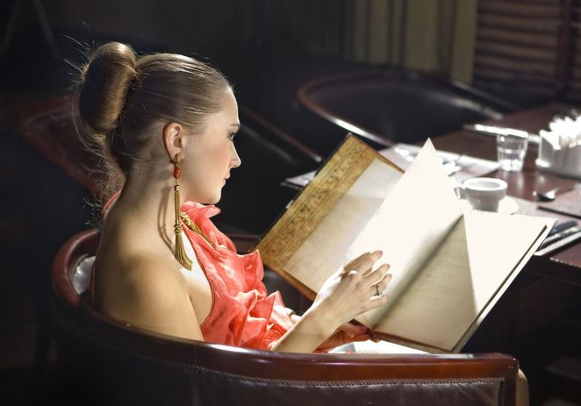

Slide 21
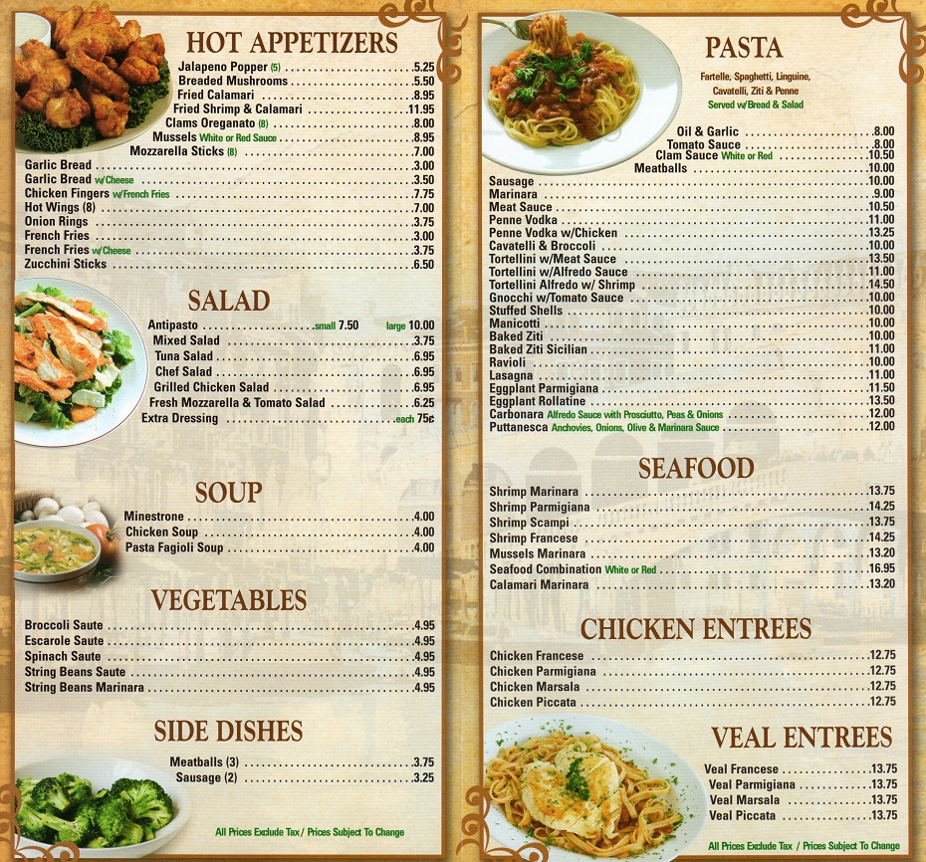

Slide 22
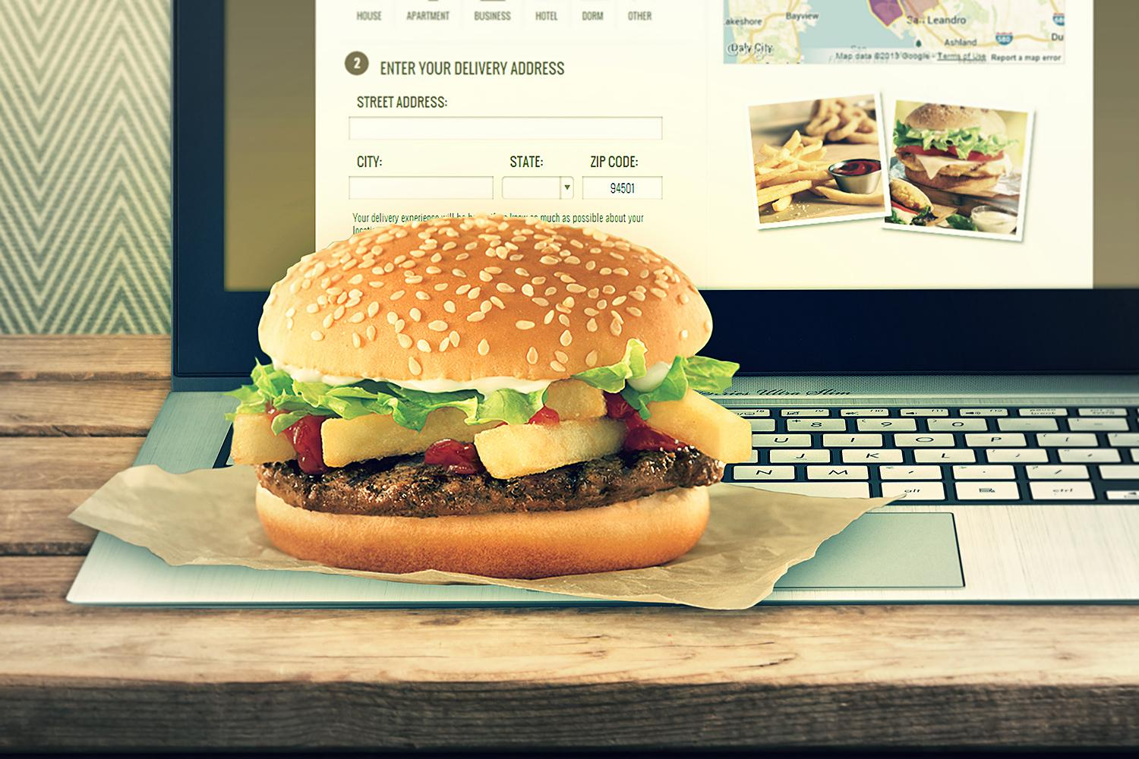

Slide 23
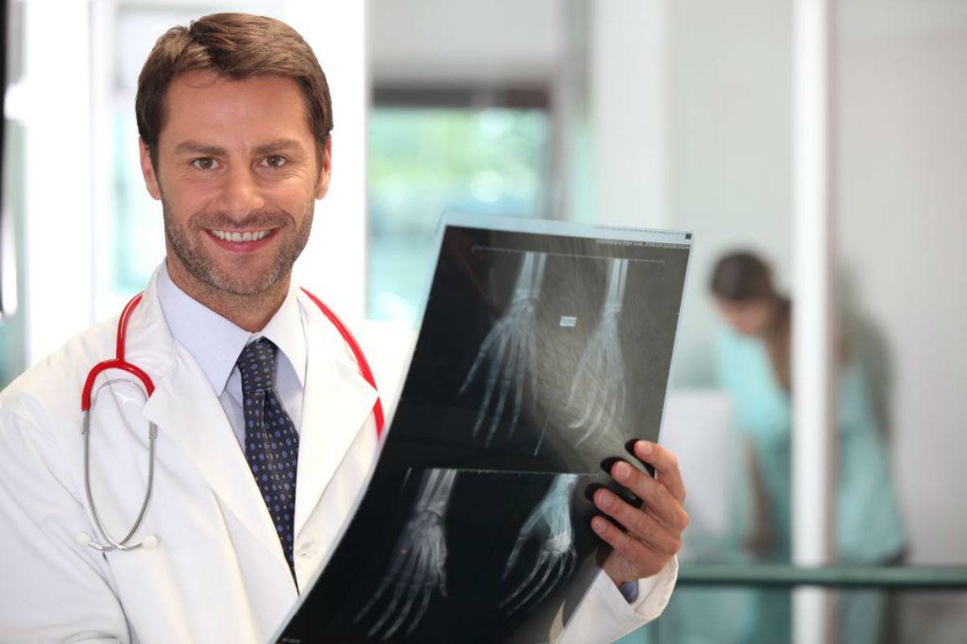

Slide 24
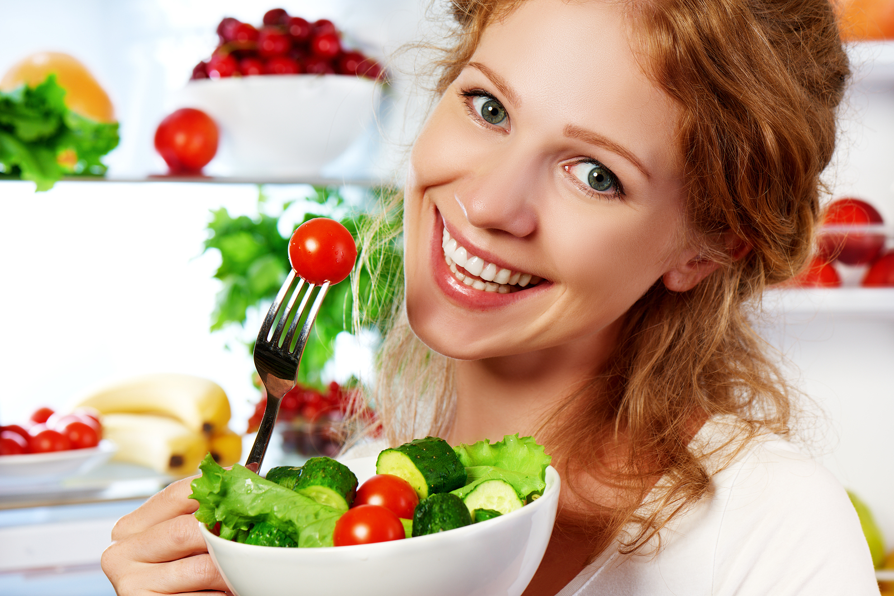
Vegetarian
[veʤɪˈtɛərɪən]

Slide 25
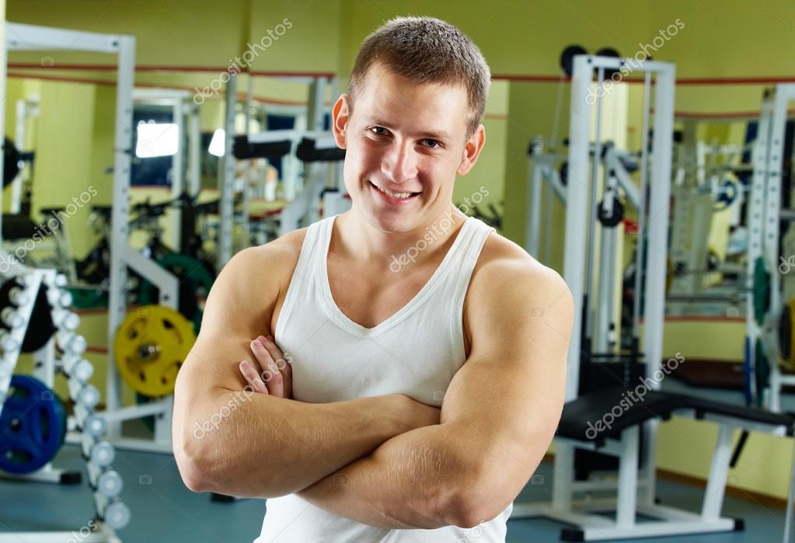

Slide 26
satisfaction
Positive emotions
Negative feelings
What emotions do you feel?
joy
success
unsatisfaction
irritation
boredom
happiness
I feel
proud
admiration
sadness
surprise
anxiety
Why?
fear
Because I…
…was (not) bored;
…worked hard;
…didn’t relax;
…answered properly;
…was active, emotional;
…fulfilled the task;
…received reward (a good mark).

Slide 27
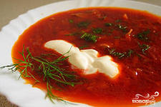
Homework
Write your foreign friend the recipe of borsch

