Slide 1
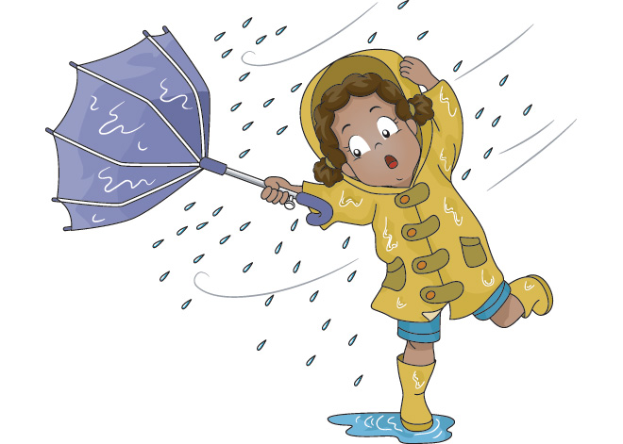
Warming up:
How are you?
What`s the weather like today?
What date is it today?
What day of the week is it today?

Slide 2
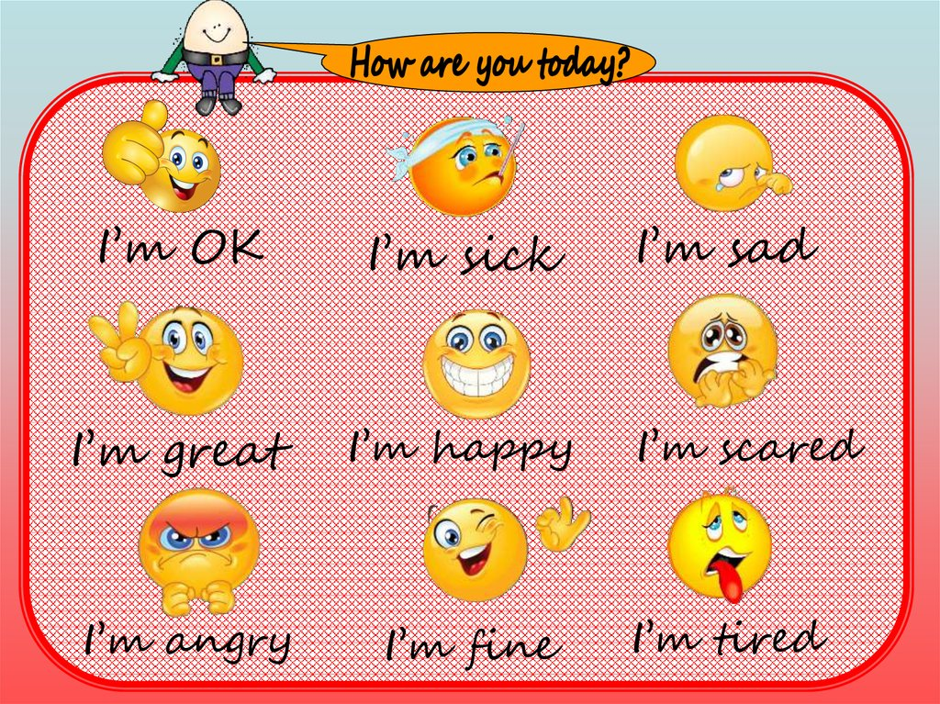

Slide 4
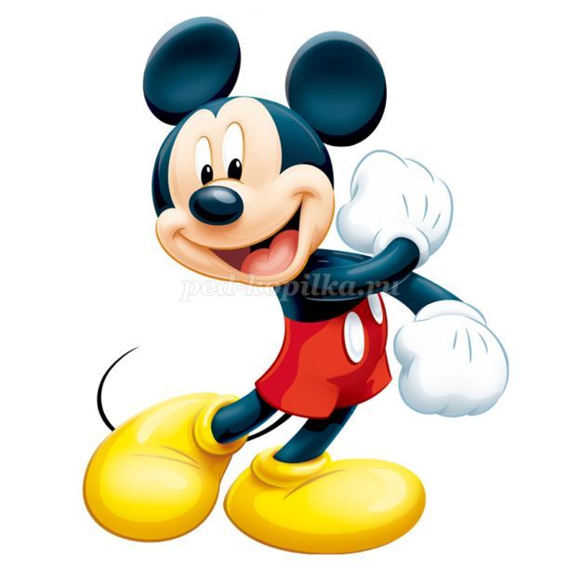
The 17 th of October
Tuesday
- be active be attentive
- be positive be quite

Slide 5
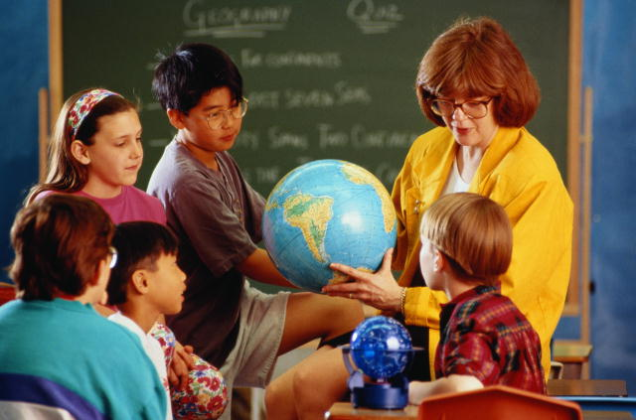
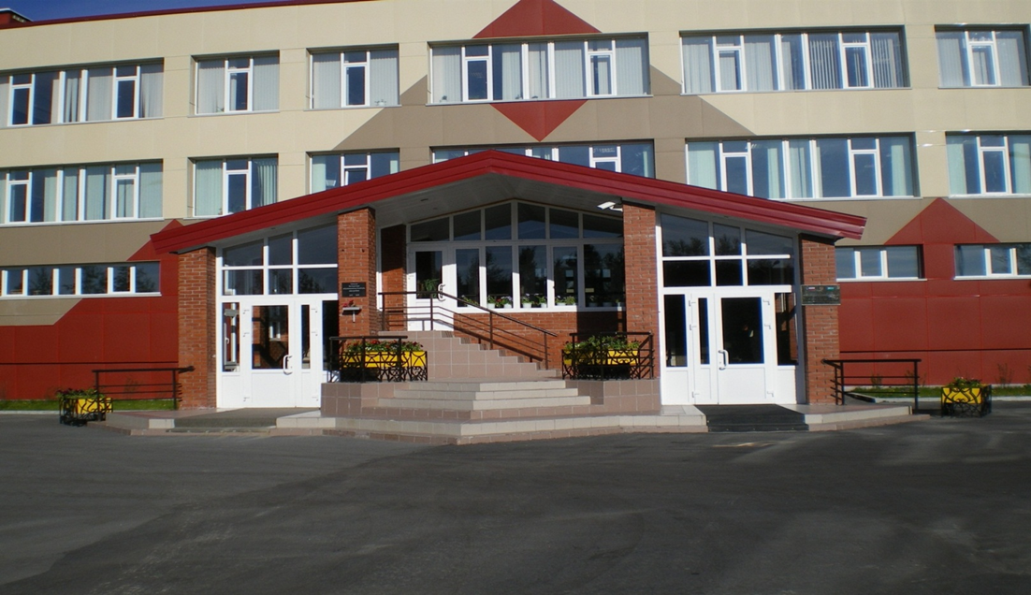
Look at this pictures and guess! What is our lesson about?

Slide 6
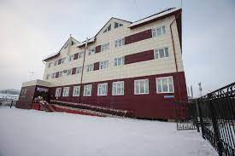
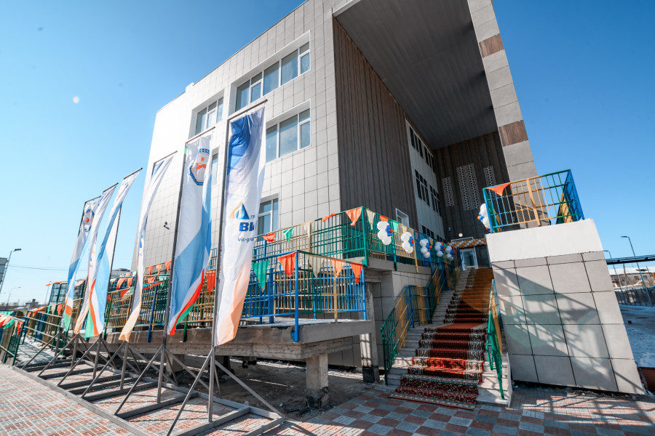
My school.
What do you associate your school with?
When I think of my school I imagine…

Slide 8
English sounds:
[ʃ] – English, information
[ʌ] – study, subject, discuss
[i:] – teacher, read
[i] – think, uniform
[ei] – favourite, name, break

Slide 9
Do you like to go to school or not? Why?
it’s fun.
I like to study.
I like to meet my friends.
I can learn good things.
it’s difficult for me to get up early.
we have got a lot of homework.
I like to go to school because/
I don’t like to go to school because

Slide 10
Guess some other riddles.
1. You need it for cleaning.
2. You need it for carrying things.
3. You need it for writing.
4. You need it for reading.
5. You need it for drawing.
6. You need it for measurement
7. You need it for storing pens and pencils

Slide 12
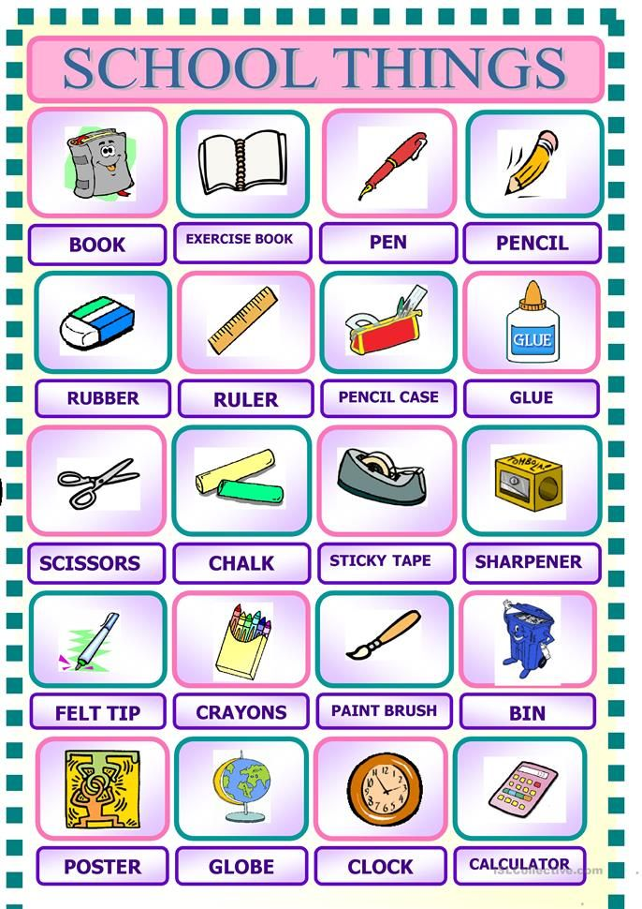
What have you got in your schoolbag today?
Today I have got a… and a…

Slide 14
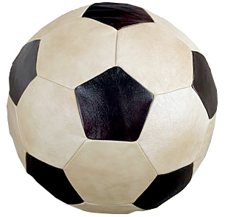
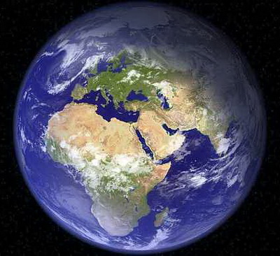
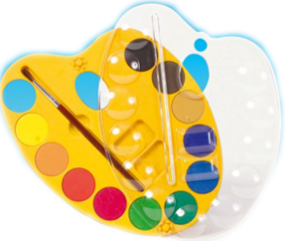
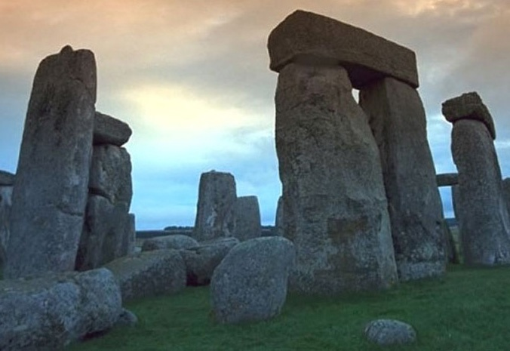
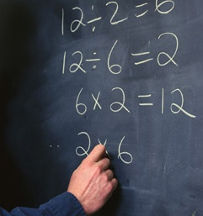
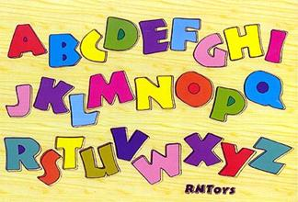
Which subjects do you have at school?
We have… .
We don’t have… .

Slide 15
What is your favourite subject? - My favourite subject is (are)….

Slide 16
Listen to descriptions of the subjects and say what subject is it?
1) At this subject you can run ,jump , play football or tennis (P.E.)
2) At this subject you can study , nature and do some experiements (science )
3) At this subject you can paint your favourite pictures. (art)
4) At this subject you can learn to speak to read , to write in foreign language (English)

Slide 18
Dear friend,
My name is John. I am 11 years old. I study in the 5th form. I like to go to school. My school is new and comfortable. We have got a lot of interesting school subjects : Russian, English, Literature, Maths, History, Art, P.E., Geography, Science and Music. My favourite subjects are PE and History. There is a large sportsground near my school. Also you can see a lot of classrooms , a dining-room, a gym and a school hall. I like my school very much because it is the best in my city.

Slide 19
And what about you? What kind of school do you have? Is your school big and modern? Do you like to go to school? What form are you in? How many subjects do you have this year? What is your favourite subject?
New words:
sportsground – спортивная площадка
classroom – учебный кабинет
a dining-room - столовая
a gym – спортивный зал
a school hall – школьный зал

