Slide 1
I wish you
Positive emotions
Fruitful work
Good luck
Happiness
Health
An excellent mark
Praise Not to be afraid
To shine
To be satisfied

Slide 2
SELF-CONTROL
Tick ✓ if you know the answer Name __________________________________
Questions
Quiz
Group 1
Group 2
Group 3 (Comments)
Film (Comments)
Questions

Slide 3
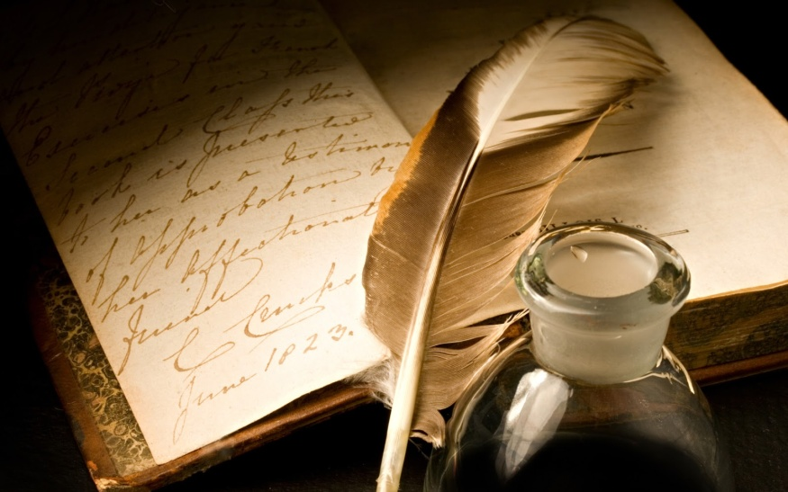
What writers do you know?

Slide 4
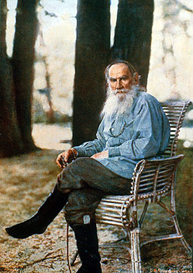
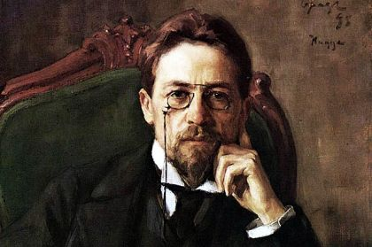

Slide 5
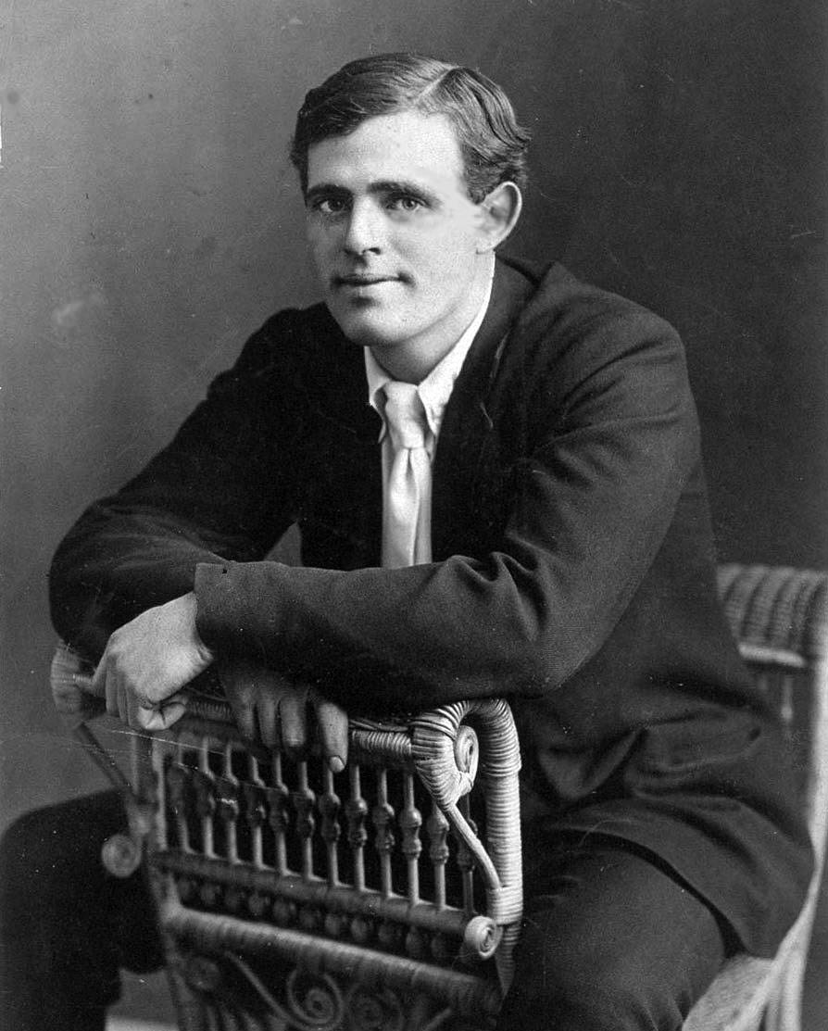
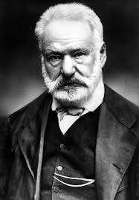
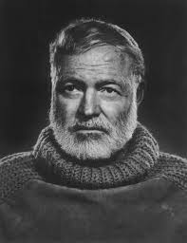

Slide 8
You are to remember
English
Literature
Geography
History

Slide 10
1. What is Mark Twain’s real name?
Tom Jackson
Samuel Langhorne Clemens
Daniel O’Connell
B

Slide 11
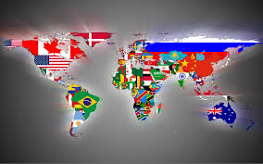

Slide 12
2. What country is Mark Twain from?
USA
UK
Canada
A

Slide 14
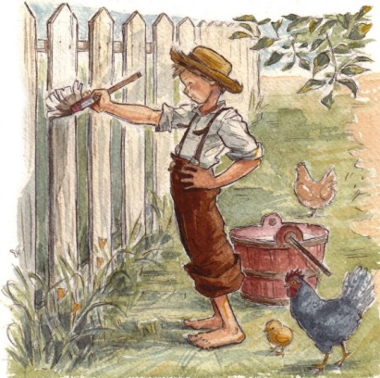
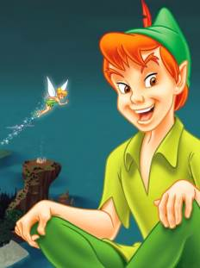
3. The most famous M. Twain’s hero is…
Mickey Mouse
Peter Pan
Tom Sawyer
C

Slide 15
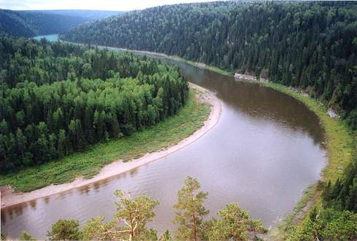

Slide 16
4. What river was M.Twain’s life connected with?
Colorado
Mississippi
Thames
B

Slide 18
5. Where did Tom Sawyer live?
in Saint Petersburg
in London
in New York
A

Slide 19
“The AdveNtures of Tom sawyer”

Slide 20
Make three groups

Slide 21
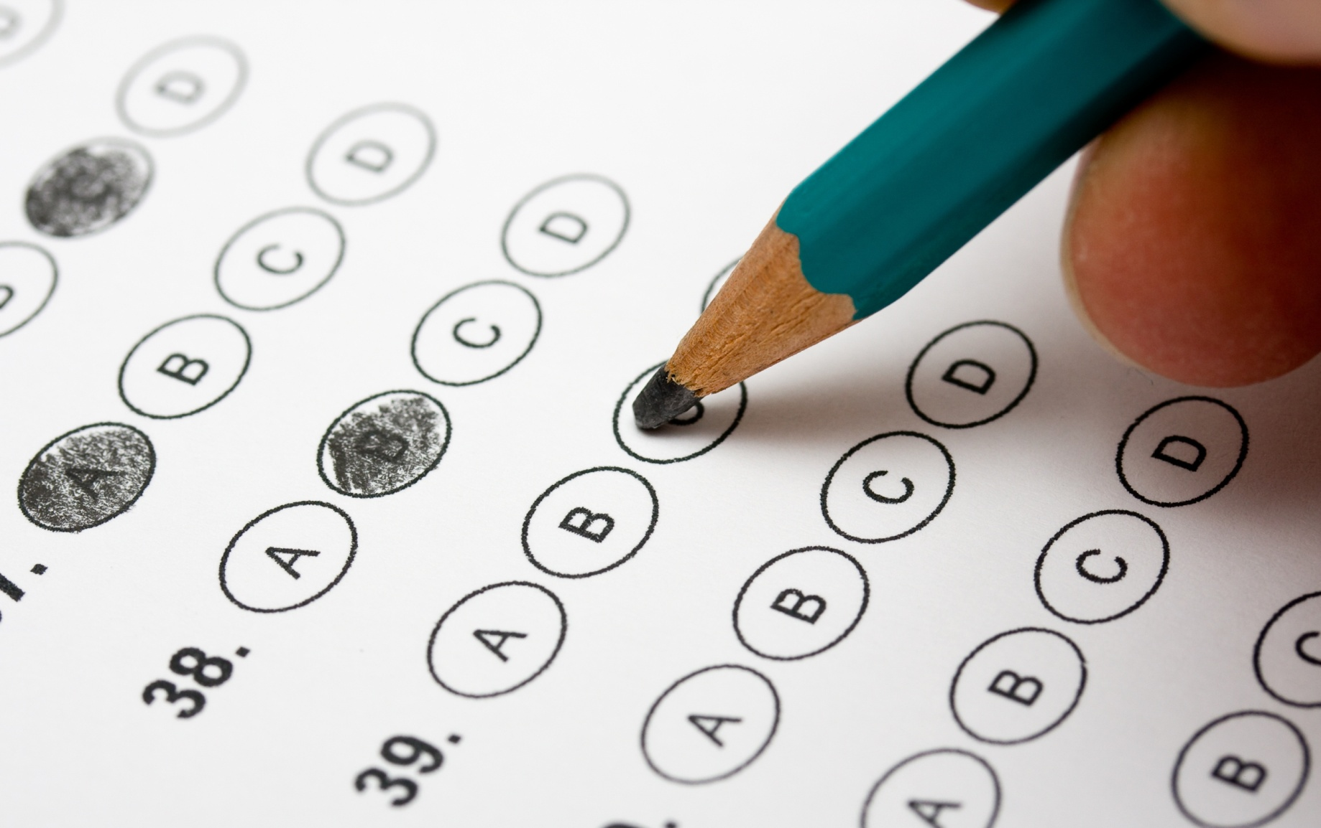
GROUP 1

Slide 22
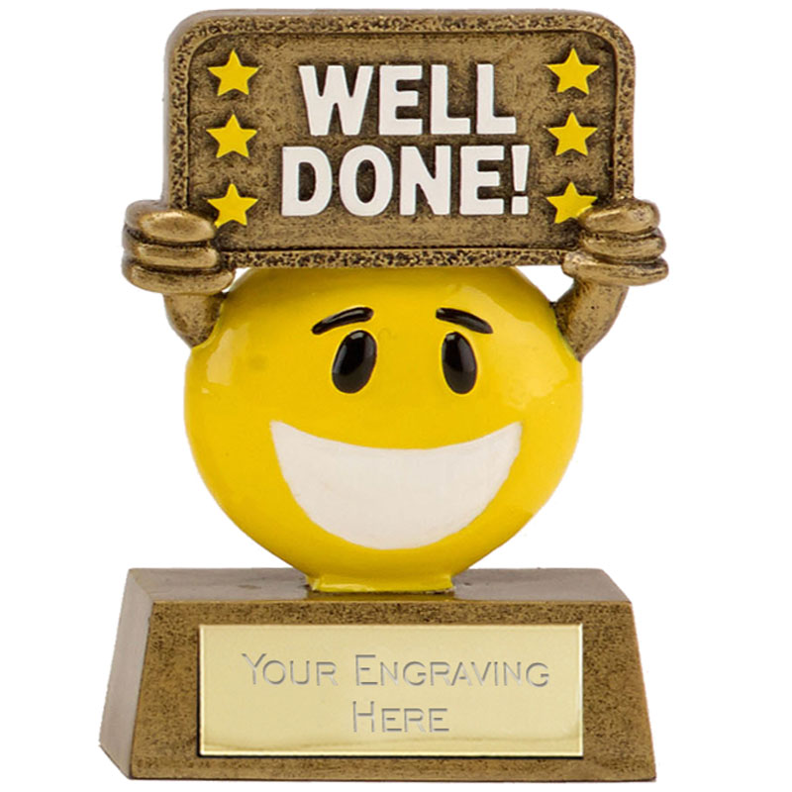

Slide 23
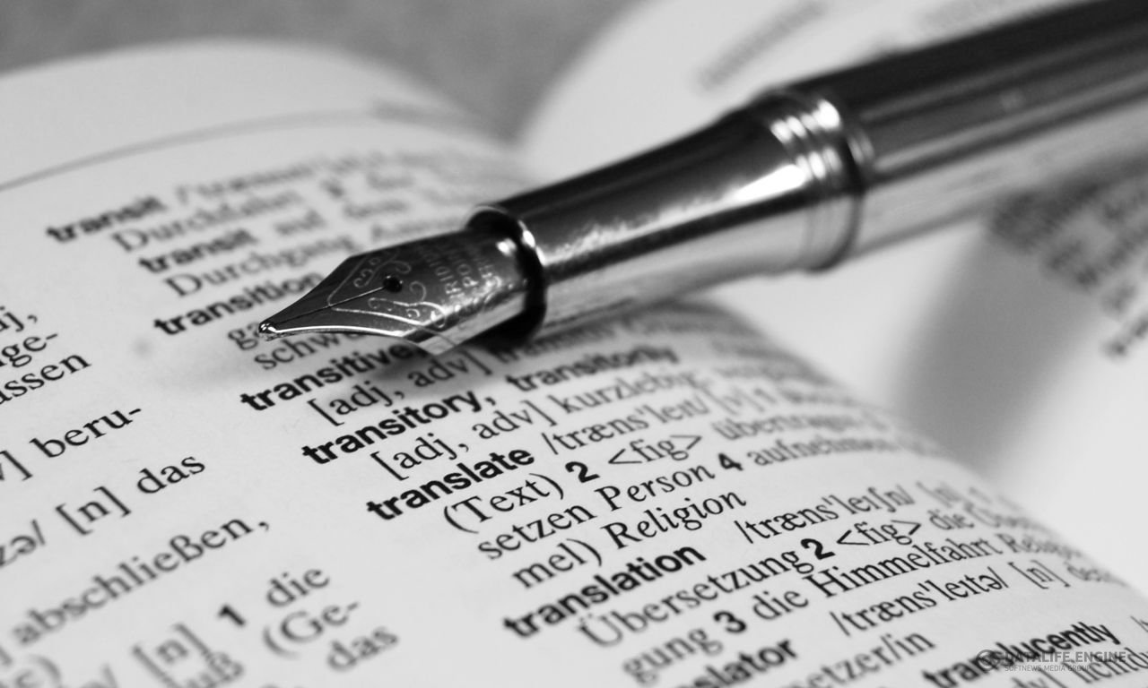
GROUP 2

Slide 24
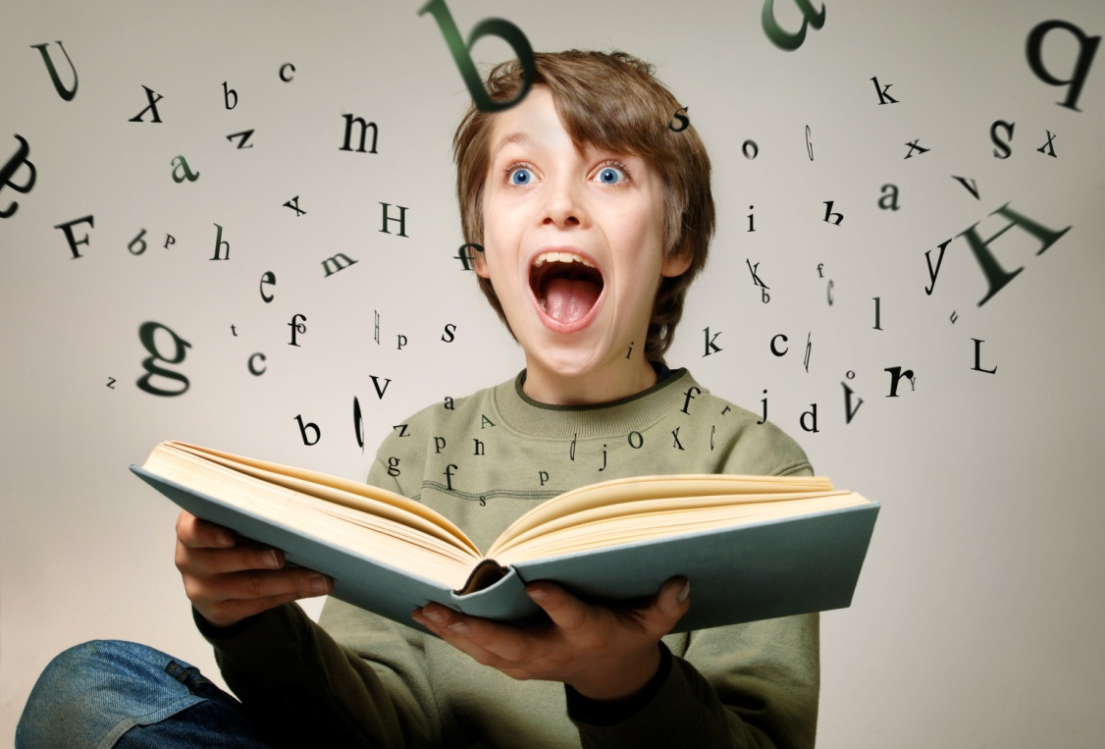

Slide 25
Have a rest

Slide 26
GROUP 3

Slide 27
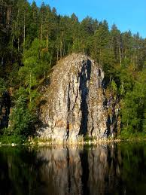
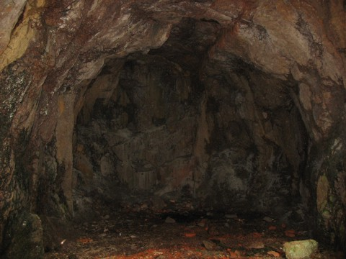

Slide 28
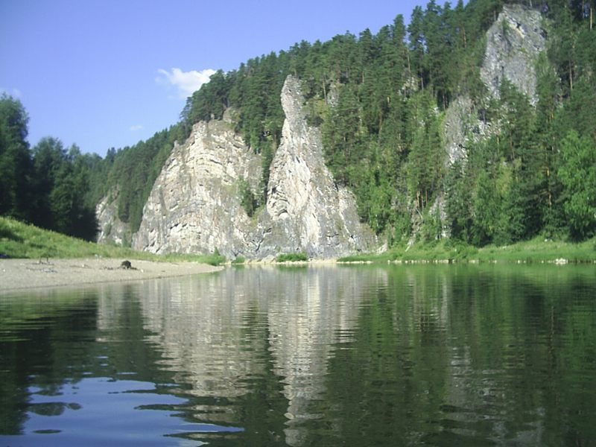

Slide 29
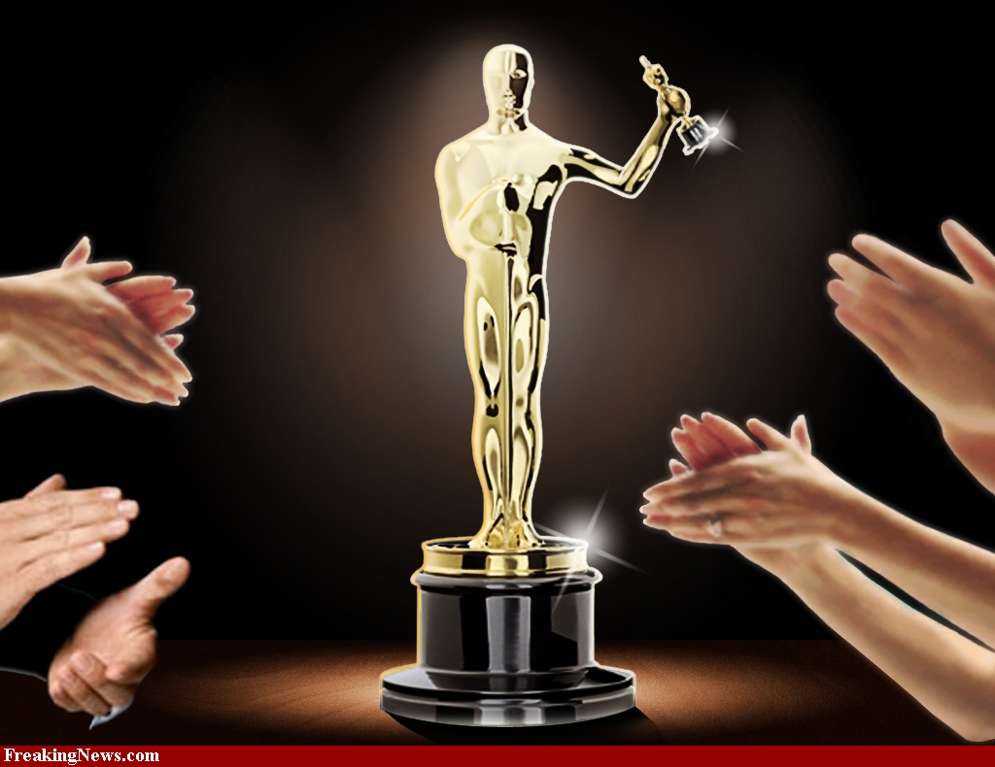

Slide 31
Answer the questions
What was the dialogue about?
Were the film and the dialogue the same?
What characters could you see in the dialogue?
What characters could you see in the film?
What forms of presentation of the story do you know?

Slide 32
What emotions did Tom feel?
What emotions did Becky feel?
Who is the smartest hero in this extract?
What did you like (film, dialogue, story)?
Think of another end of the story.

Slide 34
Write a composition “Tom Sawyer As I See Him”.
Make a plan.
Try and retell the text according to your plan.

