Slide 1
Plan
Listen, read and talk about …
-types of media
- news stories
Practice
-describing photos
-present continuous
-past simple
Learn about
-past continuous

Slide 2


Slide 3
Media means all the kinds of news including

Slide 4
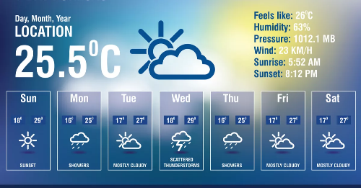
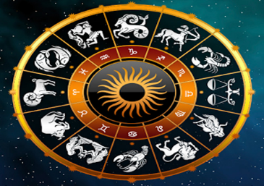


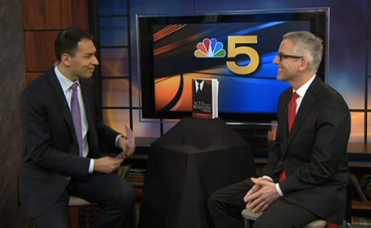
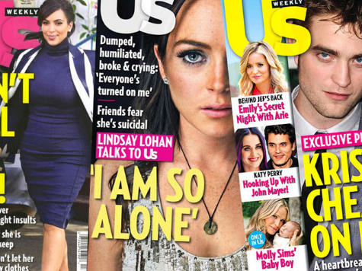
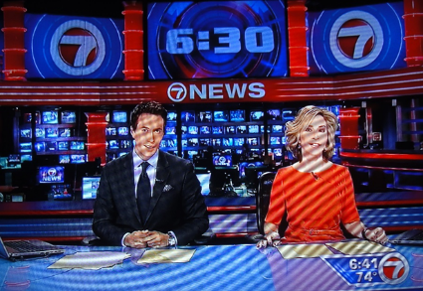

Weather reports
Daily horoscope
advertisements
interviews
celebrity gossip
beauty advice

Slide 5
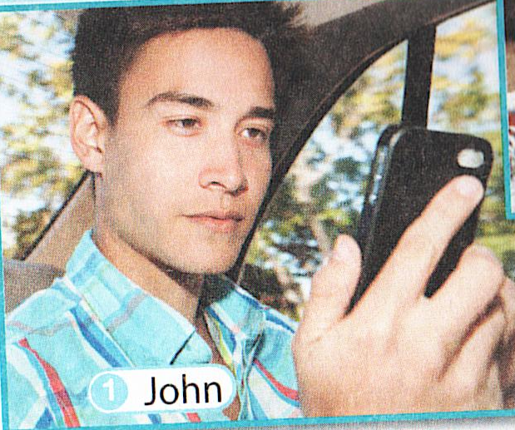

Slide 6
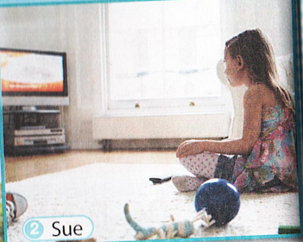

Slide 7
Past Continuous
We form the Past Continuous with a past form of the verb to be and V-ing
was +V-ing
were+V-ing

Slide 8
Past Continuous
We use the Past Continuous to describe:
a)an action in progress at a specific time in the past
She was watching TV yesterday afternoon at 3 o’clock.
b) an action in progress when another action interrupted it
I was reading when mother came home.

Slide 9
Put the verbs into the Past Continuous.
I (to surf) the Net at five o'clock yesterday.
He (to read) a daily horoscope from two till three yesterday.
We (to watch) documentaries the whole evening yesterday.
What Nick (to do) when you came to his place?
What you (to do) when I sent you a text message?
What he (to do) the whole evening yesterday? -He (to read) an interesting article.
I (to listen) to news stories at six o'clock yesterday.

Slide 10
