Slide 1
Кейс: ‘Let’s help the environment!’
Реальная история из социальной сети:
В г.Кинель четыре года назад во дворе одного дома собирались построить вышку сотовой связи.
Жители этого дома пишут в инстанции, переживают, что электромагнитное излучение отрицательно влияет на окружающую среду и на здоровье.
In Kinel four years ago a cell tower was going to be built in the courtyard of a block of flats.
Residents of this house write to the authorities, they worry that electromagnetic radiation affects negatively the environment and the health.

Slide 2
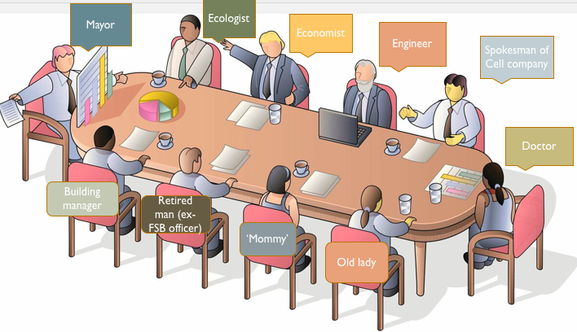
Ecological game. Script.
Kinel Town Hall. Сonference room.
Actors:
Mayor – kind person, doubter, doesn’t like conflicts, doesn’t
have his own opinion.
Economist – crazy about counting, counts and asks lots of questions.
For:
Spokesman of Cell company – smiles a lot, speaks a lot about future, progress and technology.
Engineer – wants to impress everybody, his cellular tower looks like the Eiffel Tower.
Building manager – interested in a real problem: the roof has a leak; will agree, if the roof is done. He’s a top floor resident), nervous and sometimes cries.
Against:
Ecologist – environmentalist, frightens by different facts, knows a lot of tragic incidents.
‘Mommy’– worried about her kids, it’s better to install the new playground.
Old lady– can’t stand the noise, hates construction, is afraid of change.
Doctor – tells how the cell phone’s microwaves affect.
Retired man – ex -FSB officer, paranoid, ‘Bill Gates is watching for you’ and claims that 5G technology is related to Covid-19.

Slide 3
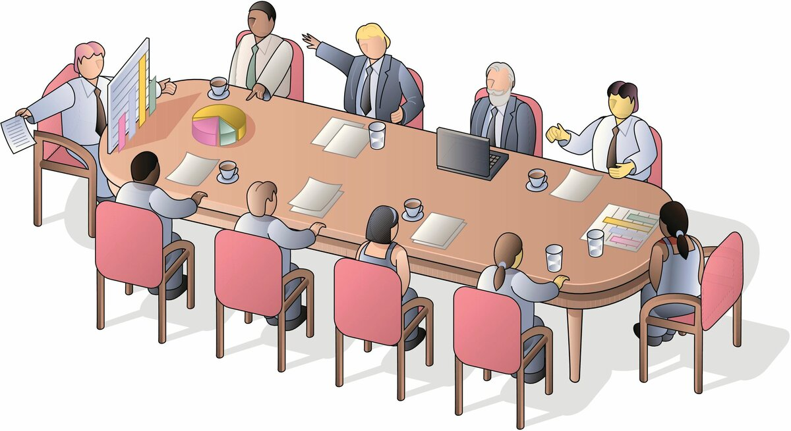
Mayor
Ecologist
Economist
Engineer
Spokesman of Cell company
Doctor
Building manager
Retired man (ex- FSB officer)
‘Mommy’
Old lady

