Slide 1
Who’s the author?
1
“To be, or not to be: that is the question: Whether ’tis nobler in the mind to suffer The slings and arrows of outrageous fortune, Or to take arms against a sea of troubles, And by opposing end them. To die: to sleep
No more;”

Slide 2
2
“All the world's a stage,
And all the men and women merely players:
They have their exits and their entrances;
And one man in his time plays many parts.
His acts being seven ages.”

Slide 3
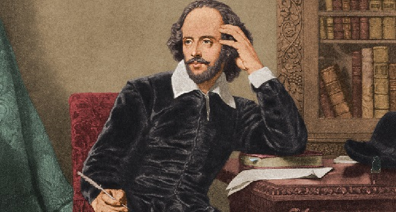
William Shakespeare (1564 - 1616)

Slide 4
The aims of our lesson
find out what Shakespeare used in his works (a grammar method)
learn how to transform his lines into simpler sentences
talk about the ideas in Shakespeare’s creation

Slide 5
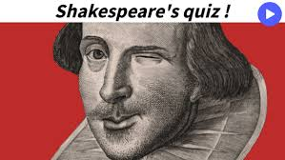

Slide 6
1. In what century was William Shakespeare active as a playwright?
A) 15th century
B) 16th century
C) 17th century
D) B and C

Slide 7
1. In what century was William Shakespeare active as a playwright?
A) 15th century
B) 16th century
C) 17th century
D) B and C
Shakespeare lived from 1564 to 1616.

Slide 8
2. In addition to writing plays, William Shakespeare was also:
A poet who wrote over 150 sonnets
B) An actor who performed for royalty
C) A successful businessman
D) A and B
E) A, B and C

Slide 9
2. In addition to writing plays, William Shakespeare was also:
A poet who wrote over 150 sonnets
B) An actor who performed for royalty
C) A successful businessman
D) A and B
E) A, B and C

Slide 10
3. Where did Shakespeare grow up?
London
B) Oxford
C) Stratford-upon-Avon

Slide 11
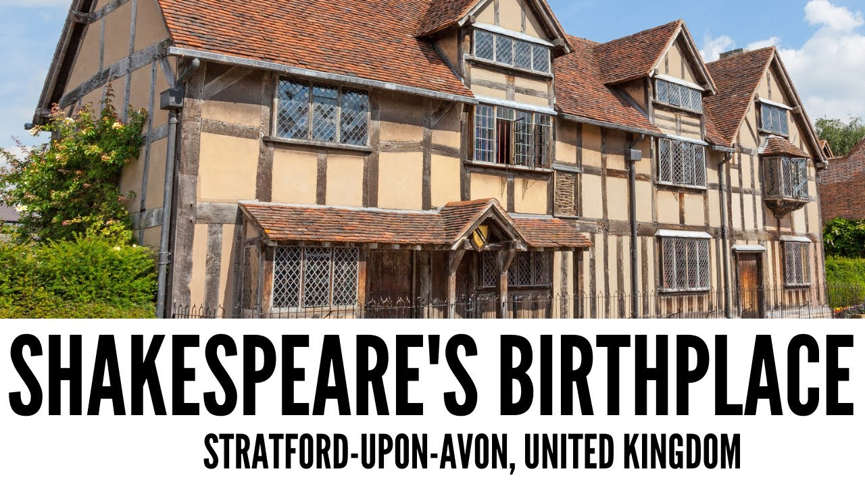
3. Where did Shakespeare grow up?
Stratford-upon-Avon
Oxford
C) London

Slide 12
4. Which country did Shakespeare set Twelfth Night, The Merchant of Venice and Romeo and Juliet in?
England
B) Italy
C) Spain

Slide 13
4. Which country did Shakespeare set Twelfth Night, The Merchant of Venice and Romeo and Juliet in?
England
B) Italy
C) Spain

Slide 14
5. What is Shakespeare's theatre's name?
The Rose
The Globe
The Swan
The Theatre

Slide 15
5. What is Shakespeare's theatre's name?
The Rose
The Globe
The Swan
The Theatre

Slide 16
6. Where did Shakespeare get the story of Romeo and Juliet from?
A) He made it up
B) It was a true story
C) He borrowed it from an Italian writer

Slide 17
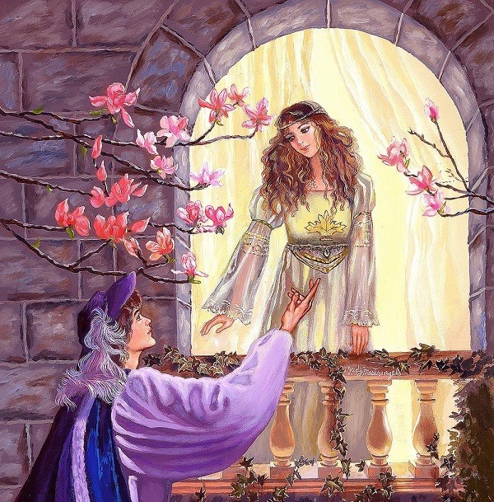
6. Where did Shakespeare get the story of Romeo and Juliet from?
A) He made it up
B) It was a true story
C) He borrowed it from an Italian writer

Slide 18
Inversion
1)The object is before the verb which is followed by the subject. O + V + S
2) The object is before the subject which is followed by the verb. O + S + V

Slide 19
1
Sometime too hot the eye of heaven shines, And often is his gold complexion dimmed, And every fair from fair sometime declines,
By chance, or nature’s changing course untrimmed:
So long as men can breathe, or eyes can see, So long lives this, and this gives life to thee

Slide 20
2
GLOUCESTER:
Now is the winter of our discontent Made glorious summer by this sun of York; And all the clouds that lour’d upon our house In the deep bosom of the ocean buried.

Slide 21
3
Of honourable reckoning are you both;
And pity ‘tis you lived at odds so long.
But now, my lord, what say you to my suit?

Slide 22
4
From fairest creatures we desire increase, That thereby beauty's rose might never die, But as the riper should by time decease, His tender heir might bear his memory..

Slide 23
5
MACBETH:
“If’t be so, For Banquo’s issue have I fil’d my mind,
For them the gracious Duncan have I murther’d, Put rancors in the vessel of my peace Only for them, and mine eternal jewel Given to the common enemy of man, To make them kings -the seed of Banquo kings!

Slide 24
Romeo and Juliet
What's in a name? That which we call a rose By any other name would smell as sweet; So Romeo would, were he not Romeo call'd, Retain that dear perfection which he owes Without that title. Romeo, doff thy name, And for that name which is no part of thee Take all myself.

Slide 25
As you like it
All the world's a stage, And all the men and women merely players: They have their exits and their entrances; And one man in his time plays many parts.
His acts being seven ages.

Slide 26
The Merchant of Venice
O hell! What have we here? A carrion Death, within whose empty eye There is a written scroll! I'll read the writing. All that glitters is not gold; Often have you heard that told: Many a man his life hath sold But my outside to behold

